Slide 1

Video - Deliverable #1

Slide 2

Video Requirements
Format:
MP4
Resolution:
1280x720
YouTube & Dropbox:
Post on due date

Slide 3
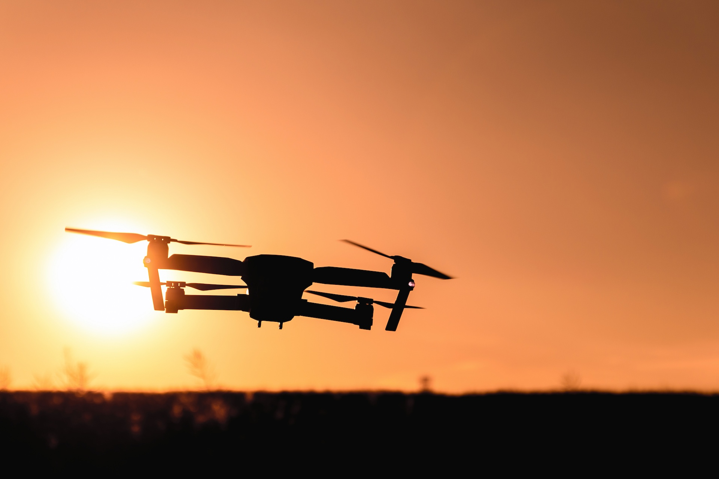
Cover Screen
Team name
Team members
Logo
Be creative
Background Image capturing idea

Slide 4
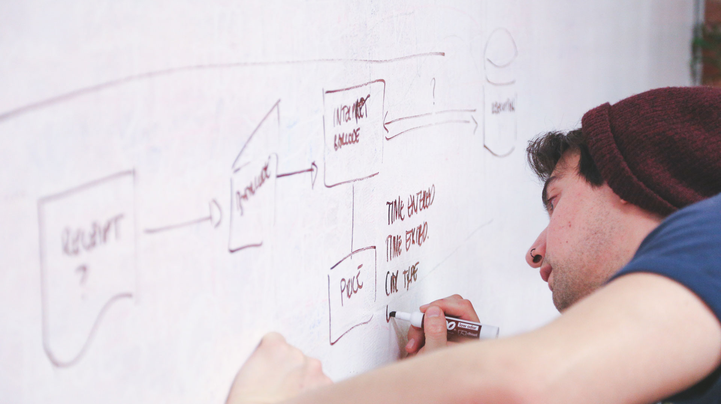
10 seconds – High Level Updates

Slide 5

10 seconds – Introduction Updates

Slide 6

30 seconds – Pitch Updates

Slide 7

30 seconds – Technology Updates

Slide 8

1 minute – Code Overview
Tell us about your code:
Architecture diagram (layered)
Major software artifacts
Organization
What you wrote and what you did not

Slide 9

1 minute – Early (Crude) Demo
Demonstrate the concept

Slide 10
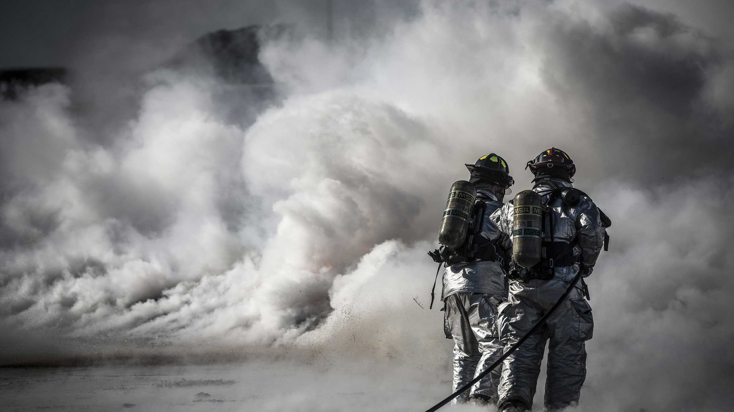
30 seconds – Risk Updates

Slide 11

30 seconds – Next steps

