Slide 1

Video - Deliverable #2

Slide 2

Video Requirements
Format:
  MP4
Resolution:
  1280x720
YouTube & Dropbox:
  Post on due date

Slide 3
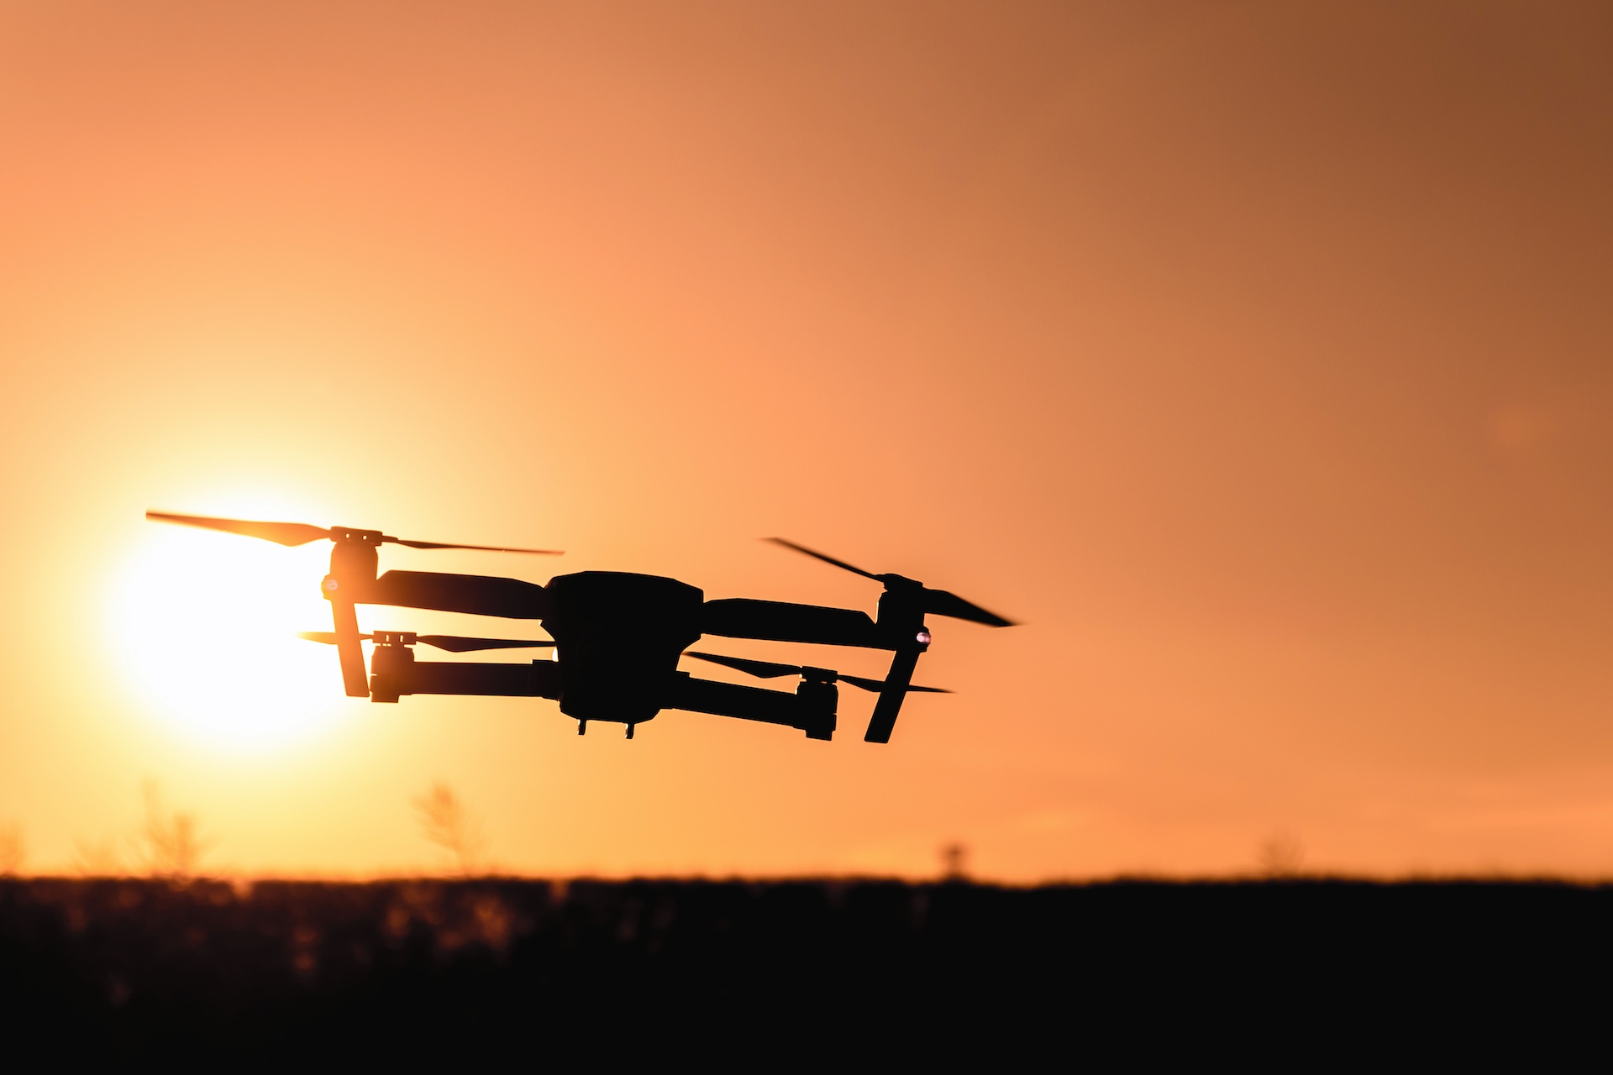
Cover Screen
Team name
Team members
Logo
Be creative
Background Image capturing idea

Slide 4
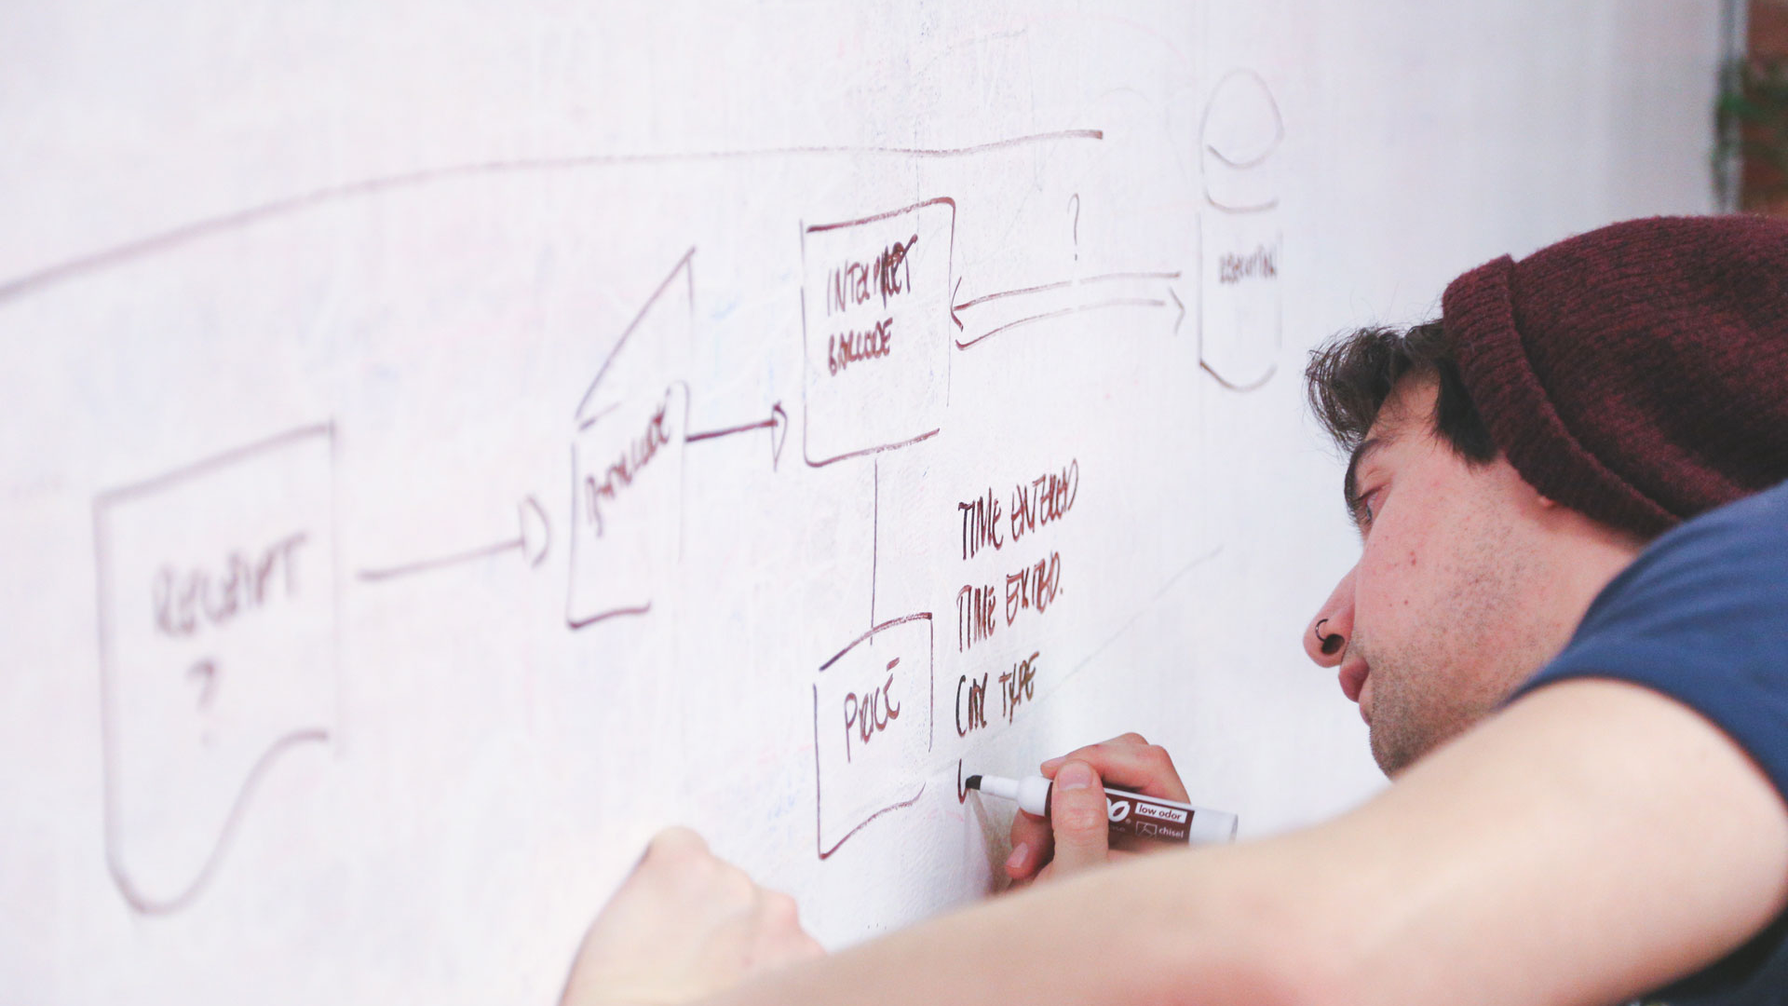
10 seconds – High Level Updates

Slide 5

10 seconds – Introduction Updates

Slide 6

30 seconds – Pitch Updates

Slide 7

30 seconds – Technology Updates

Slide 8

1 minute - Code Updates

Slide 9

1 minute – Demo
Demonstrate working prototype

Slide 10
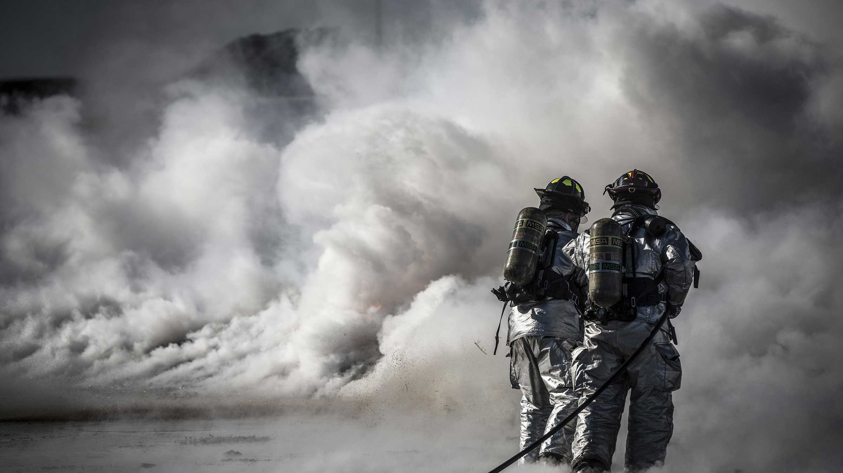
30 seconds – Risk Updates

Slide 11

30 seconds – Next steps

