Slide 1
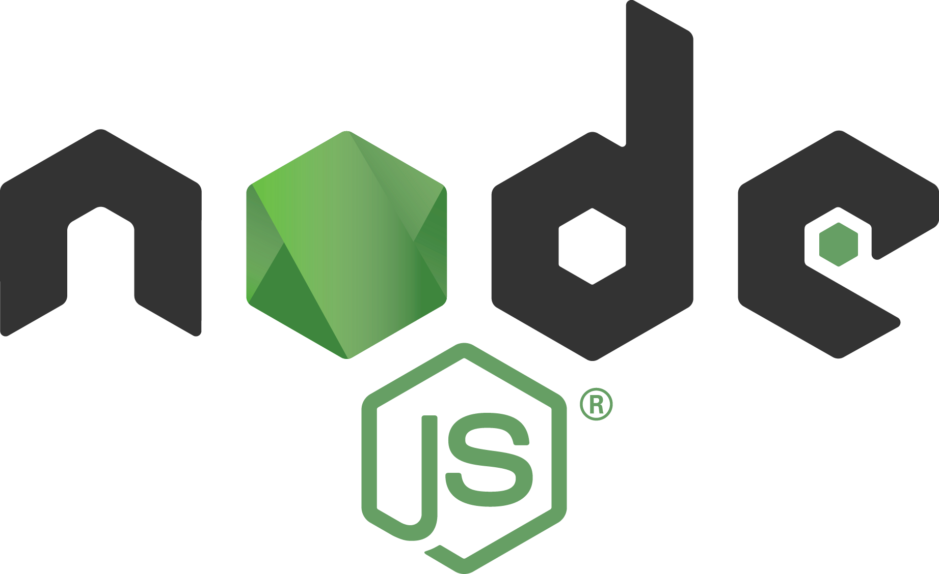

Slide 2
Node.JS
Node.js is an open source, cross-platform, JavaScript runtime built on Chrome's V8 JavaScript engine, for developing server and client side applications. Node.js uses an event-driven, non-blocking I/O model that makes it lightweight and efficient.

Slide 3

Node’s goal is to provide an easy way to build scalable network programs

Slide 4
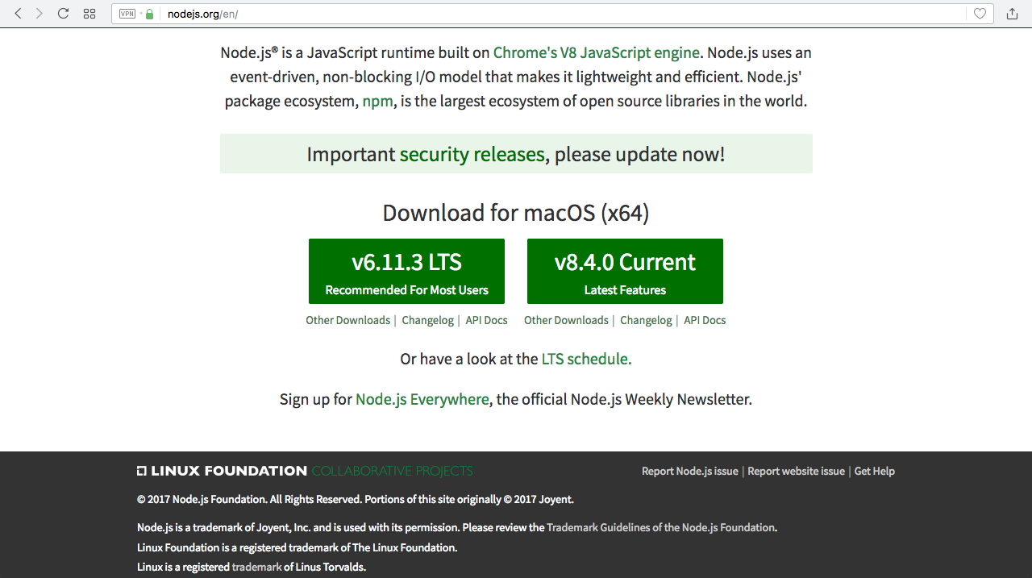
Install Node.js
From
http://nodejs.org

Slide 5
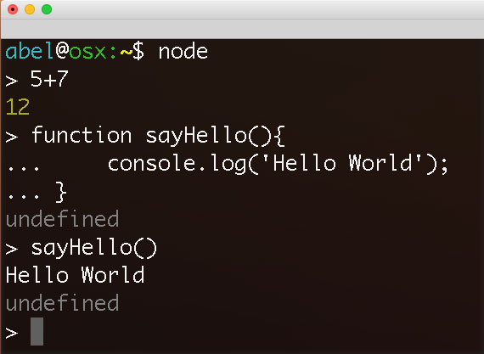
Console Use

Slide 6
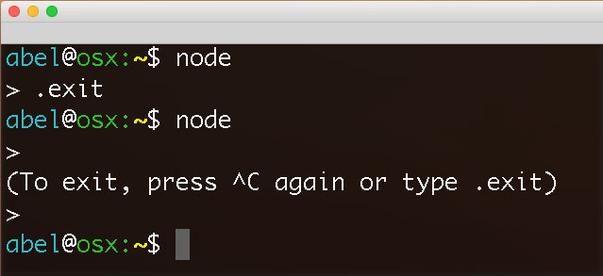
Exit Console

Slide 7
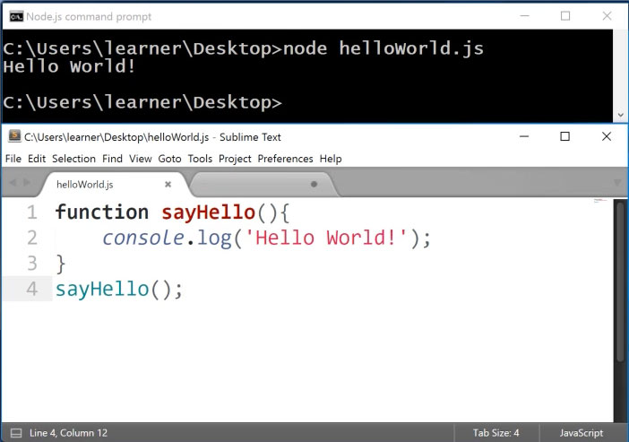
Run File

Slide 8
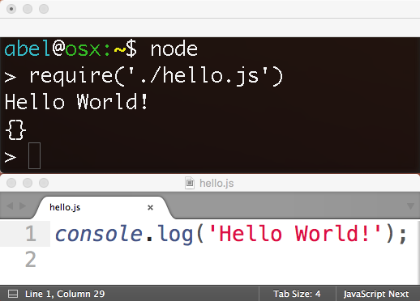
Load File

Slide 9
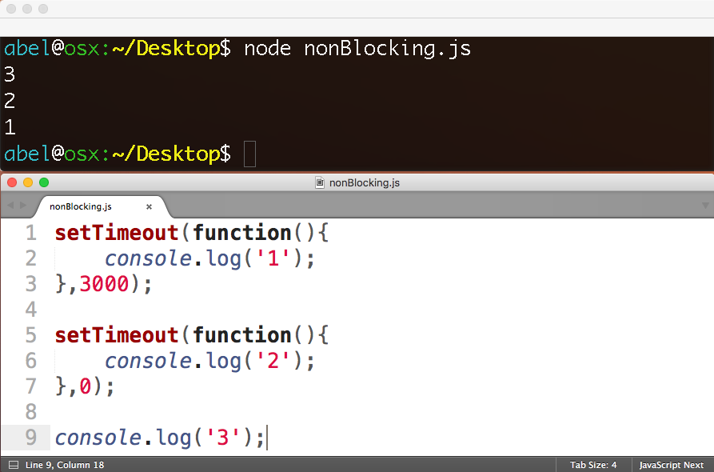
Non-Blocking

Slide 10


Slide 11
trigger callback
register callback
REQUESTS
EXPENSIVE
OPERATION
EVENT LOOP
(single thread)
operation complete
FILE SYSTEM
DATABASE
COMPUTATION

Slide 12
Architectural Shift
1.old) web server with application logic
1.new) app that can connect and collaborate
2.old) stateful
2.new) stateless

Slide 13
Architectural Shift
1.old) blocking
1.new) non-blocking
2.old) process per request
2.new) single process

Slide 14
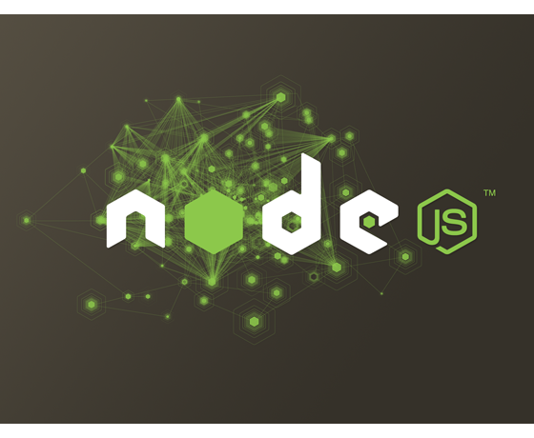
MODULES

Slide 15

What is npm?
https://www.npmjs.com
Package manager. Installs, publishes and manages node programs

Slide 16
What is npm? Largest Ecosystem
475K Modules 2.7 Billion/Week

Slide 17
Advantages
Small pieces, loosely joined
Leverage external packages
Leverage internal packages
Facilitate collaboration
Packages are discoverable in npm

Slide 18
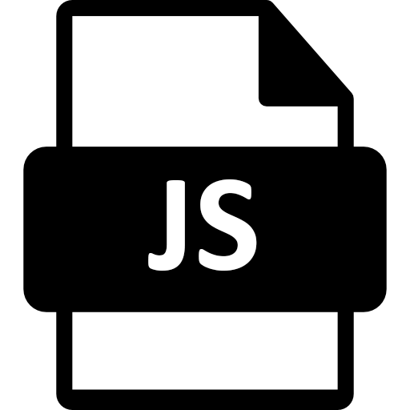

What is a Module?
A Module is some JavaScript paired with a package.json file
+

Slide 19
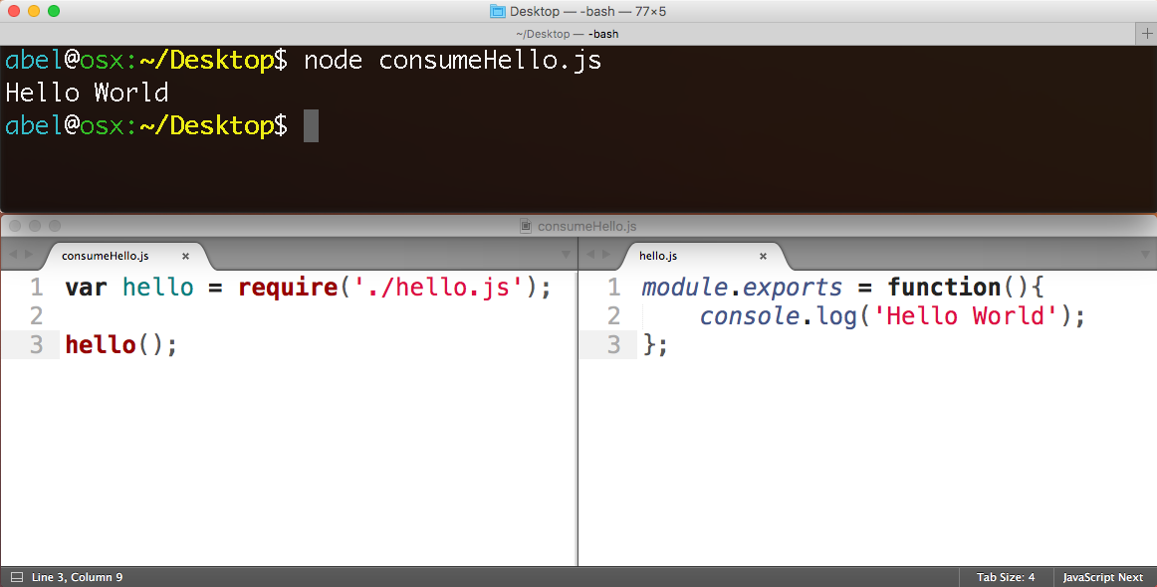
Use module with
“require”
Make module with “module.exports”

Slide 20
Creating node/npm apps

Slide 21
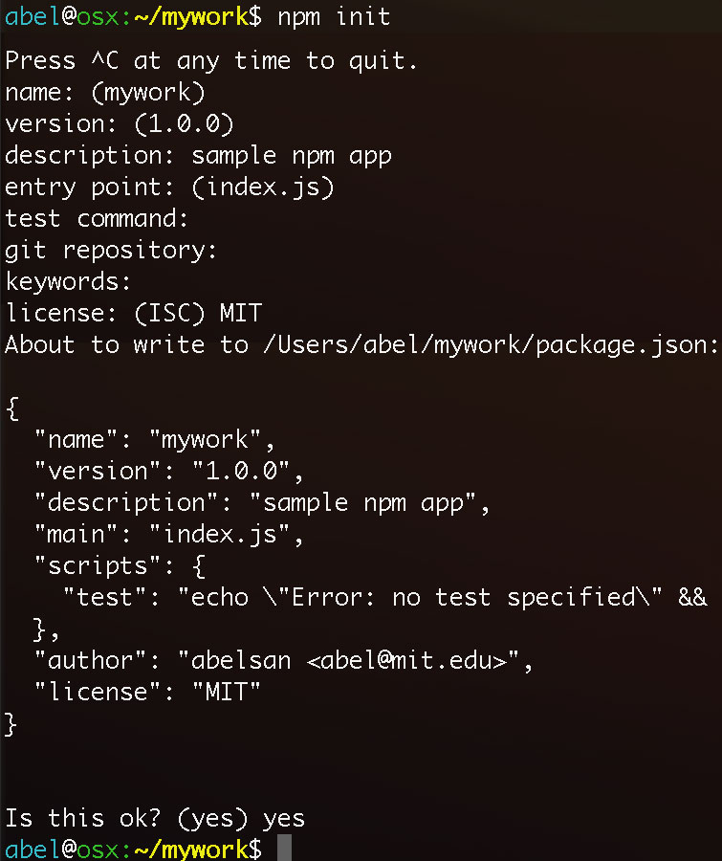
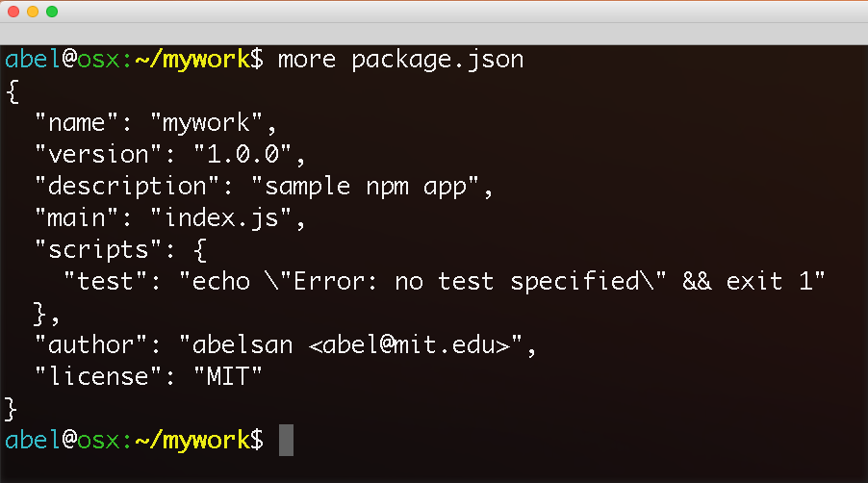
“npm init” generates the configuration file package.json

Slide 22
adding npm packages
to your application

Slide 23
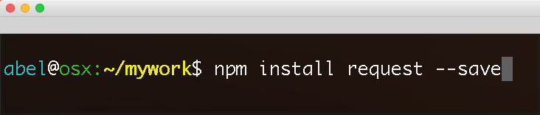
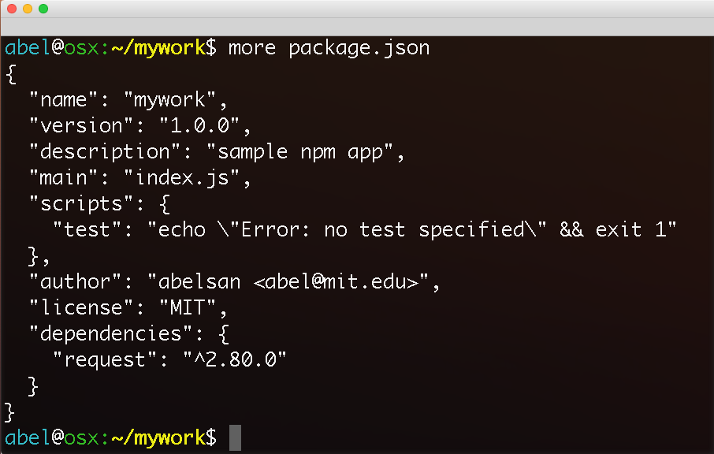
Local installation of request package. Dependency added to package.json

Slide 24
Active Learning
…

