Slide 1

大模型算法
Text to Text
ZOMI

Slide 2
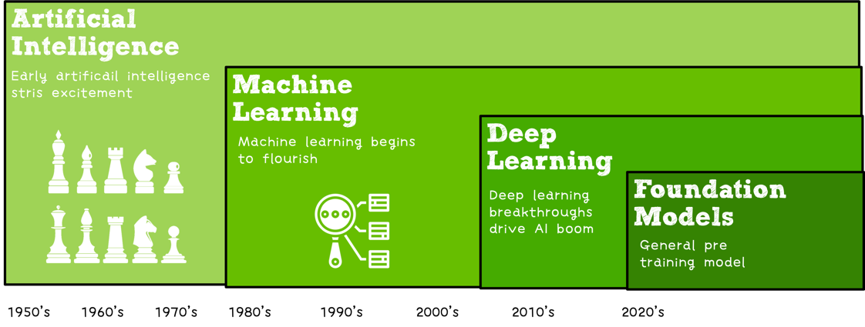

Slide 3
关于本内容
内容背景
大规模分布式训练系统：串行到并行 – 并行处理体系 – 深度学习并行训练
具体内容
大模型训练的挑战：内存墙 – 性能墙 – 效率墙 – 调优墙
分布式训练系统：并行处理硬件架构 – 业界分布式系统分析
分布式并行总体架构：参数服务器模式 – 集合通讯模式
通信原语与协调：通讯协调软硬件 - 通信实现方式 - 通信原语
大模型算法结构：大模型算法发展 – NLP大模型 - CV大模型 – 多模态大模型
分布式并行与同步策略：数据并行 – 模型并行 – 流水并行 – 混合并行
内存和计算优化：ZeRO内存优化 – 混合精度与计算优化

Slide 4
About LLM (Large Language Models)
What are LLM (Large Language Models)
BERT/RoBERTa (Encoder Models)
GPT-3 (Decoder Models)
T5/BART (Encoder Decoder Models)
How to use and Adapt LLM
Prompting for few-shot
Prompting as fine-tuning
In-context learning (Instruction learning)
Downstream Task and Data
NLP downstream Task
Data

Slide 5
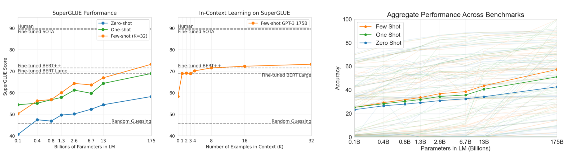
GPT3 with 175B Parameters
•General-purpose “English” knowledge.
https://jalammar.github.io/how-gpt3-works-visualizations-animations/

Slide 6
Inference
Transformer. Vaswani, Ashish, et al. "Attention is all you need." Advances in neural information processing systems 30 (2017).
BERT Devlin, Jacob, et al. "Bert: Pre-training of deep bidirectional transformers for language understanding." arXiv preprint arXiv:1810.04805 (2018).
GPT3. Brown, Tom, et al. "Language models are few-shot learners." Advances in neural information processing systems 33 (2020): 1877-1901.
T5. Raffel, Colin, et al. "Exploring the limits of transfer learning with a unified text-to-text transformer." J. Mach. Learn. Res. 21.140 (2020): 1-67.
FLAN. Wei, Jason, et al. "Finetuned language models are zero-shot learners." arXiv preprint arXiv:2109.01652 (2021).
COS 597G (Fall 2022): Understanding Large Language Models. https://www.cs.princeton.edu/courses/archive/fall22/cos597G/

Slide 7
Notes:
7

Slide 8
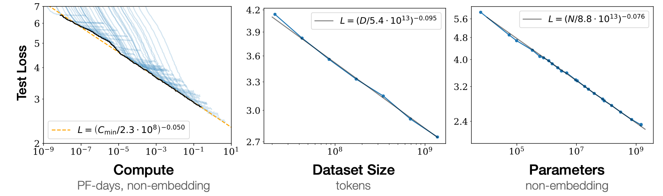
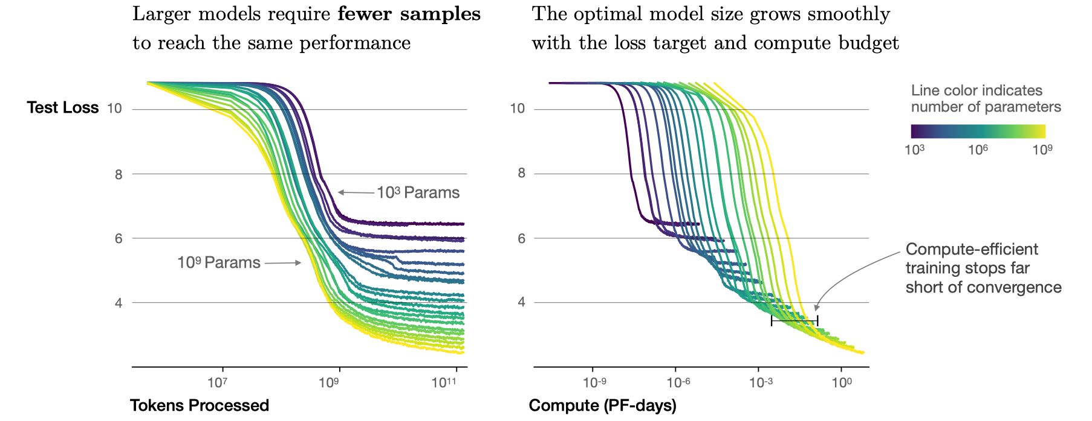
Scaling Up & Prompt
Model size bigger is better.
Optimal model size increases very quickly.

Slide 9
Limitations of Pre-training to Fine-tuning like BERT
Word vectors + task specific
Multi layer RNN
Transformer Pre-training + Fine-tuning
Prompt + Context Learning

