Slide 1
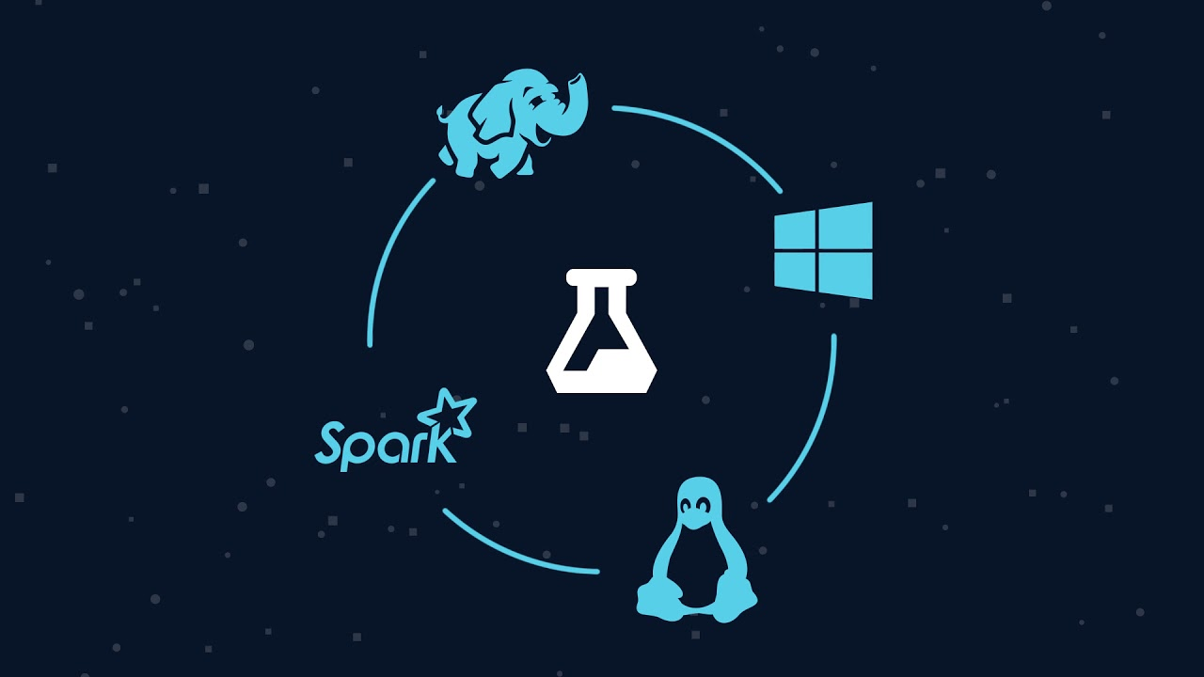
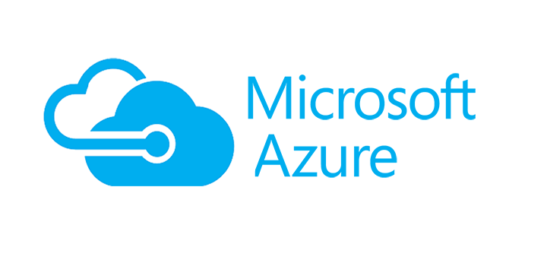

Azure Data Services Overview
Bryan Cafferky
Technical Solutions Professional

Slide 2


About Bryan Cafferky…
Data Solutions Enabler (TSP)
Decades of IT Experience in health care, insurance, banking, and ecommerce.
Microsoft MVP.
Author of Pro PowerShell for Database Developers.
Founded and lead PASS Chapter The RI Microsoft BI User Group and The Greater Boston Machine Learninf & AI Group.
Frequent presenter at technical conferences and user groups.
Bryan.Cafferky@Microsoft.com
https://github.com/bcafferky/shared
https://www.linkedin.com/in/bryancafferky
@BryanCafferky – follow me!
Subscribe to me on YouTube!

Slide 3

Digital Transformation – What Business Are You In?

Slide 4

Why So Many Options?

Slide 5

Why So Many Options?
https://www.quebechebdo.com/content/dam/tc/quebec-hebdo/images/2010/7/16/une-nouvelle-salle-d-operation-pour-cont-1075320.jpg

Slide 6

SQL Server Services – Everything is Covered
Machine Learning Services
Always On
Scale Out
Always Encrypted
Total Data Encryption
Dynamic Data Masking
Row Level Security
Database Engine
Reporting Services
Analysis Services
Integration Services

Slide 7

Data Science, ML, and AI Perspective

Slide 8
Opportunities
Member Mobile Apps Integrated with Devices
Patient Analytics Portal
Customer Service Chatbot
Biometric Steaming Analytics
Predictive Models
Readmission?
Infection?
What Members are not engaging?
How do members feel about you?
What Customers are likely to drop service?
What are people saying about us on social media?

Slide 9
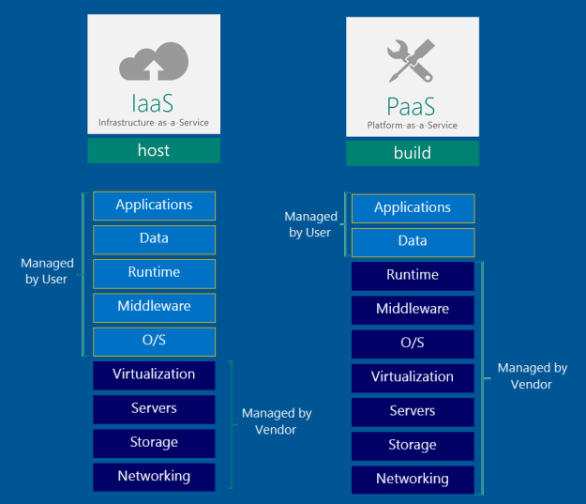
Azure Data Platform

Slide 10
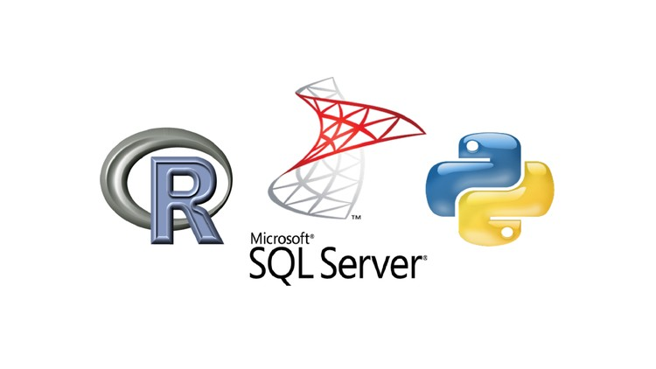
SQL Server/Machine Learning Integration

Slide 11
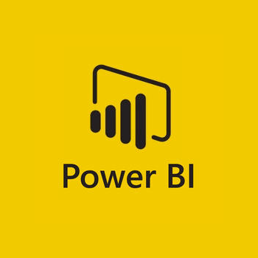
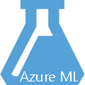
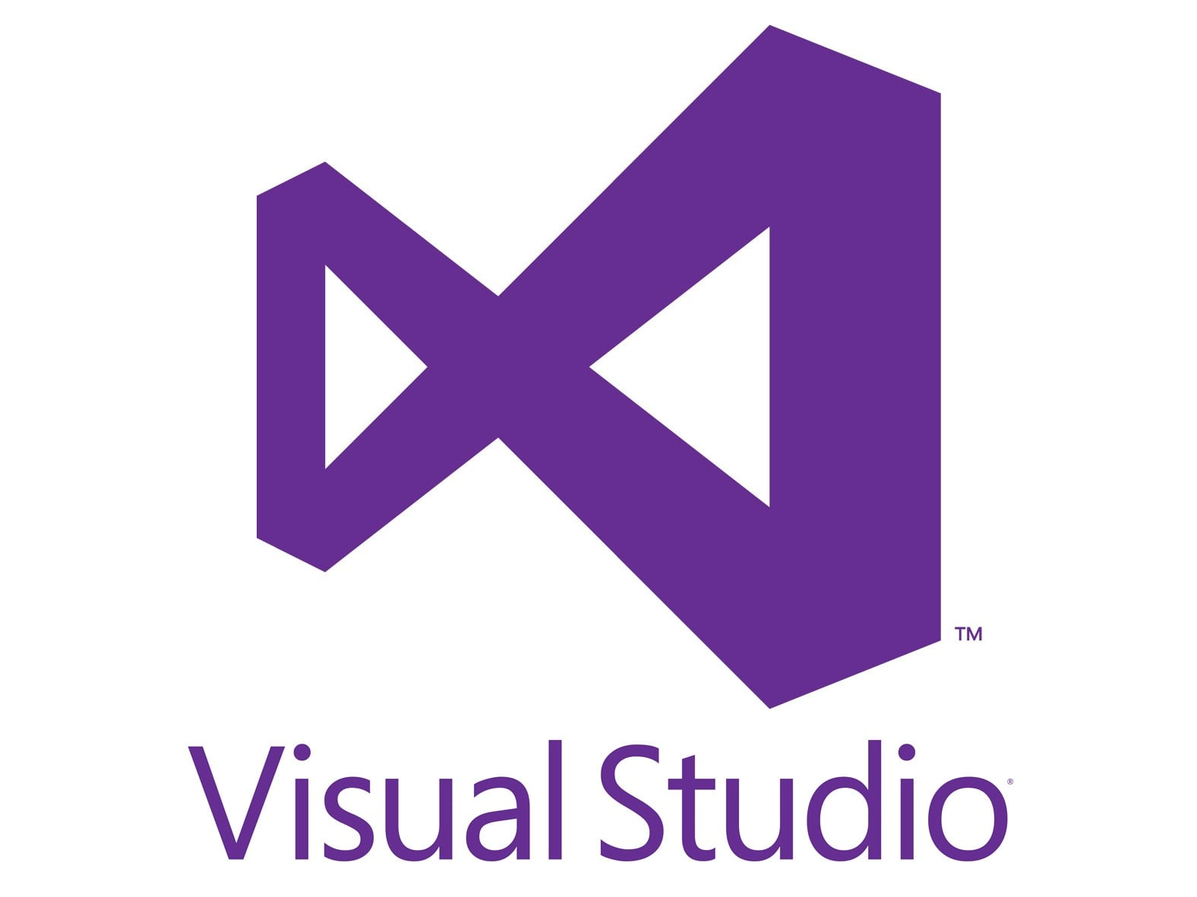






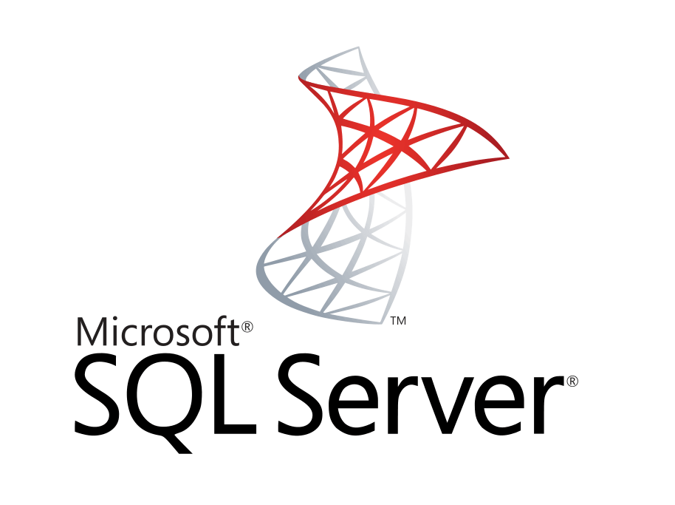

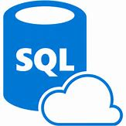
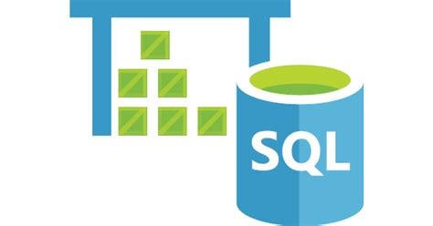



Data Analysis Platform
Client Tools
Streaming
Azure Data Factory
Data Ingestion
Azure Cognitive
Services
On-Prem
Analysis Services
Managed Instance/
SQL DB
SQL Data Warehouse
Cosmos DB
HDInsight
Databricks
Massively Parallel Processing
Cloudera via Marketplace
PostgreSQL and MySQL Offered as Azure Services (in preview).
Scale

Slide 12
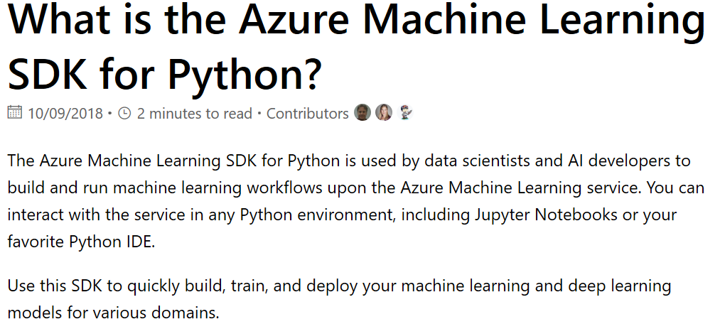
Using Python and Azure ML Services
https://docs.microsoft.com/en-us/python/api/overview/azure/ml/intro?view=azure-ml-py

Slide 13
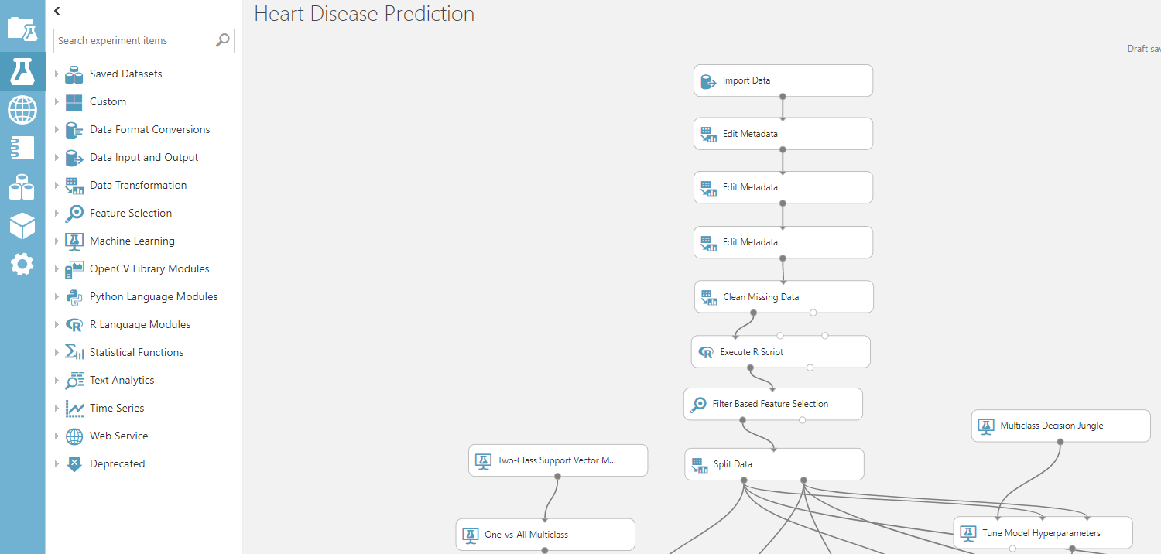
Azure ML Studio

Slide 14
SSIS -> ADFv2
On-Prem
SQL Server/ML Server
Maximizes Multiple CPUs
Multi-Threaded
Not limited to memory
No Data Movement
Azure Analysis Services
Fast Slicing and Dicing of Data
Cubes or Tabular Model
SQL Server MI / SQL DB
MI to Support More SQL Server Features
Can Scale Up
Azure Data Lake
Analytics
Unlimited Scale
No Set Up
Just Pay For Query
U-SQL/R/ Python
Azure DW
Scale Out
Big Data
HDInsight
Unlimited Scale
Streaming Support
R Server/
Spark
Interface
CosmosDB
Scale Out
Multi Model
Globally Distributed
* Planned
Scale

Slide 15
Azure ML Studio

Slide 16



Azure Databricks
Azure Databricks
Collaborative Workspace
IoT / streaming data
Machine learning models
DATA ENGINEER
DATA SCIENTIST
BUSINESS ANALYST
Deploy Production Jobs & Workflows
Cloud storage
BI tools
MULTI-STAGE PIPELINES
JOB SCHEDULER
NOTIFICATION & LOGS
Data warehouses
Optimized Databricks Runtime Engine
Data exports
Hadoop storage
DATABRICKS I/O
APACHE SPARK
SERVERLESS
Rest APIs
Data warehouses
Enhance Productivity
Build on secure & trusted cloud
Scale without limits
Notes:
Databricks, founded by the team that created Apache Spark – unified analytics platform that accelerates innovation by unifying data science, engineering & business.
75% of the code committed to Apache Spark comes from Databricks
Unified Runtime
Create clusters in seconds, dynamically scale them up and down.
They’ve made enhancements to Spark engine to make it 10x faster than open source Spark
Serverless- Auto-configured multi-user cluster, Reliable sharing with fault isolation
Unified Collaboration
Overall – a simple & collaborative environment that enables your entire team to use Spark & interact with your data simultaneously
DE – Improve ETL performance, zero management clusters. Execute production code from within notebooks
DS - For data scientists, easy data exploration in notebooks
Business SME – interactive dashboards empower teams to create dynamic reports
Enterprise Security
Encryption
Fine grained Role-based access control (files, clusters, code, application, dashboard)
Compliance
Rest APIs
DE – DBIO, SPARK, API’s , JOBS
DS – Spark and Serverless, Interactive Data Science
Data Products - Everything
Creators of Spark
Training People
Number of Customers
Ingest
Workflow
Schedule / Run / Monitor
Execute
Troubleshoot
Debug
Production Jobs
---------
Ingest, ETL, Scheduling, Monitoring

Slide 17
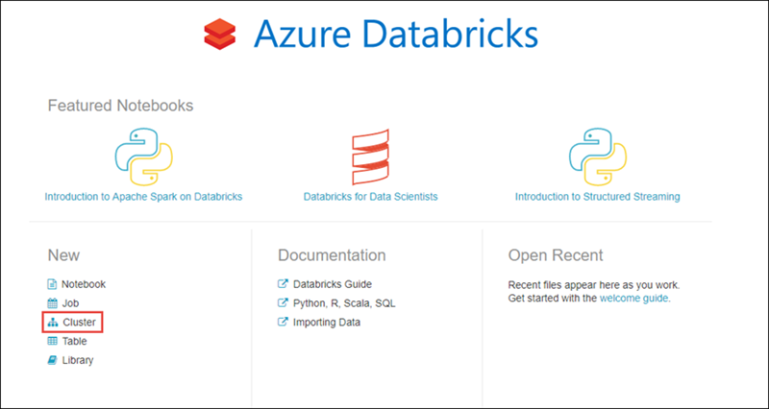
Azure Databricks

Slide 18
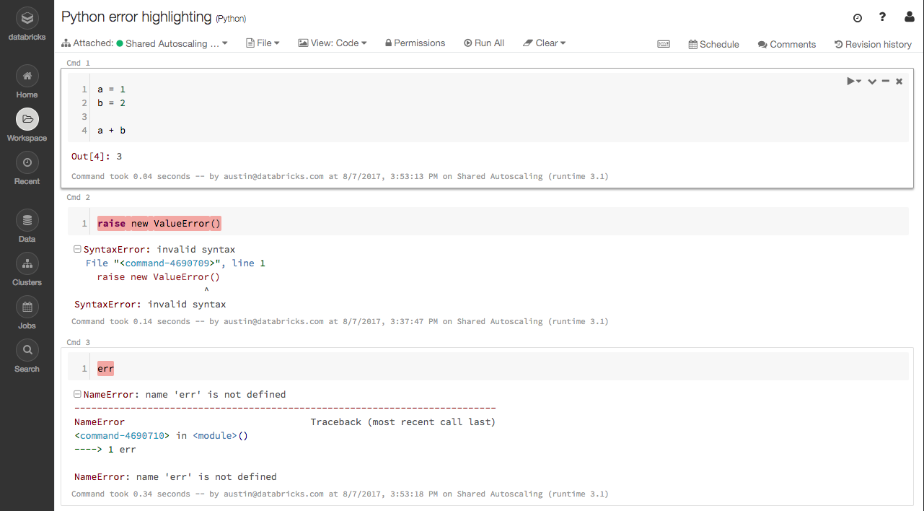
Azure Databricks
Create Workspace
Get Data
Create Cluster
Schedule Jobs

Slide 19
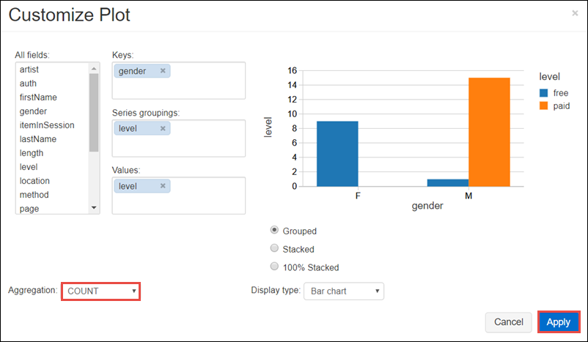
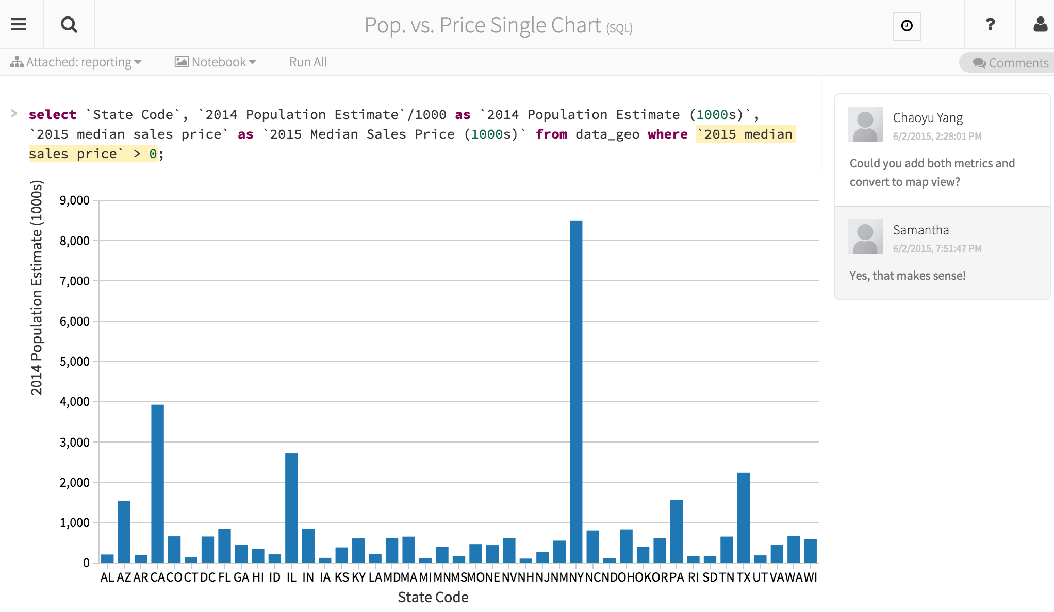
Azure Databricks

Slide 20

HDInsight

Slide 21
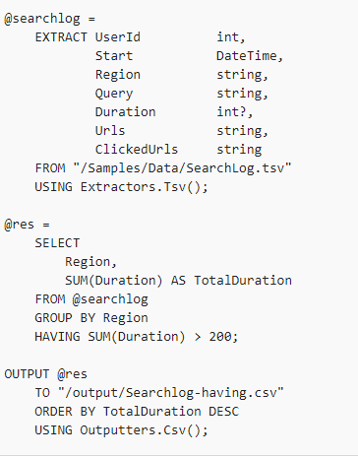
Data Lake Analytics – U-SQL
https://docs.microsoft.com/en-us/azure/data-lake-analytics/data-lake-analytics-u-sql-r-extensions

Slide 22


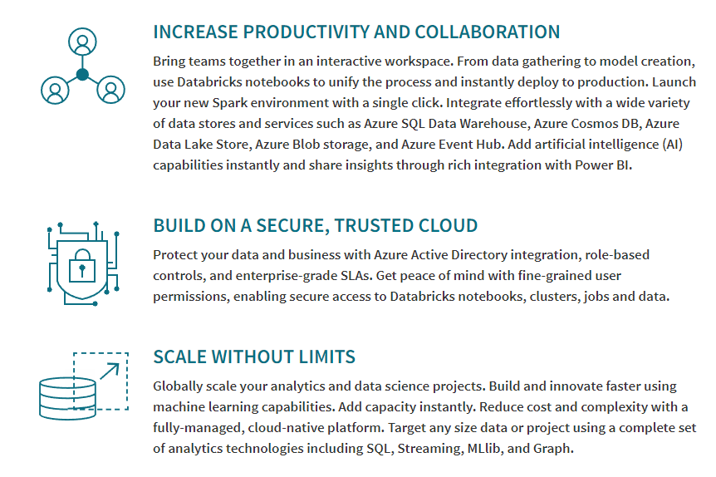

on Azure (Private Preview)
Azure Integration
Security/AD

Slide 23
on Azure (Private Preview)

Slide 24
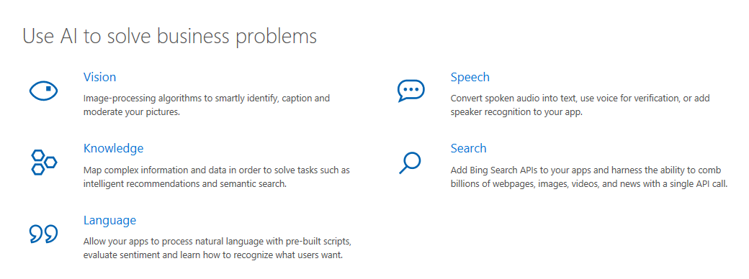
Cognitive Services

Slide 25
Why Azure?
Enablement and Ease of Use
Integration
Fluid Scaling
Enterprise Solutions
Secure
Support

Slide 26
Community
The RI SQL Server User Group
The RI Business Intelligence User Group
The Greater Boston Area Data Science, ML, and AI Group
https://www.meetup.com/Rhode-Island-SQL-Server-Users-Group/
https://www.meetup.com/The-RI-Microsoft-BIUG/
https://www.meetup.com/GreaterBoston-DataScienceGroup

Slide 27
Wrapping Up

