Slide 1


Azure on Steroids: Full Automation with PowerShell
Bryan Cafferky
Microsoft Data and AI Solutions Enabler
Demo Code at:
https://github.com/bcafferky/shared/FullAutomationWithPowerShell

Slide 2




About Bryan Cafferky…
Microsoft Data and AI Solutions Enabler for Healthcare Customers
Decades of IT Experience
Past Microsoft Data Platform MVP and Cloud and Data Center MVP
Author of Pro PowerShell for Database Developers
Experienced in health care, insurance, banking, and ecommerce
Founded and lead PASS Chapter The RI Microsoft BI User Group and The Boston Data Science Group
https://www.linkedin.com/in/bryancafferky
Subscribe to my YouTube Channel

Slide 3
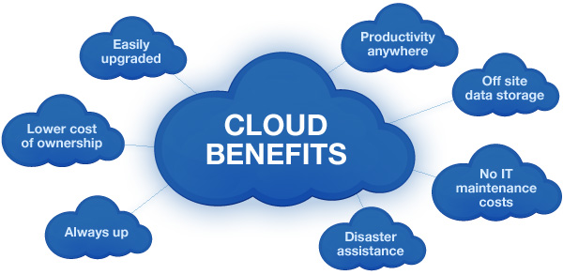

Slide 4
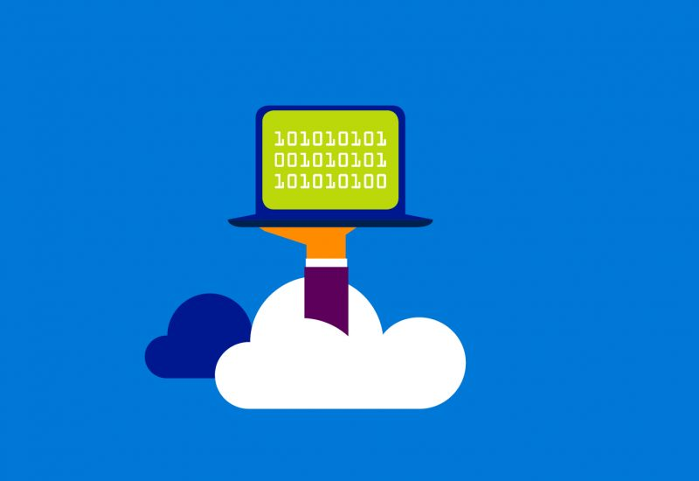
Welcome to Azure – Computing Power On Demand
Create a Powerful Virtual Machines in minutes
Multiple Cores
Any Amount of Memory and Storage
With SQL Server
Web Applications
Big Data Support

Slide 5
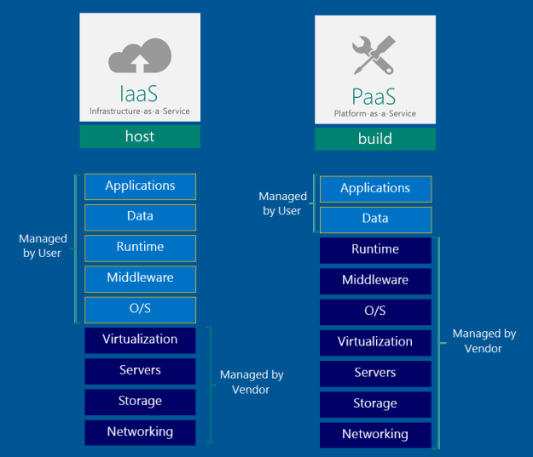
Azure Platform

Slide 6
What is PowerShell?

Slide 7

One Shell to Rule Them All

Slide 8
The Fellowship of the Shell
The Case for Automation
One Shell to Rule Them All
Client Side Automation
Azure Side Automation
Bringing the Client Side and Azure Side Together

Slide 9


Why PowerShell?
Without PowerShell
With PowerShell

Slide 10

Time to Find Your Inner Child!

Slide 11
Delivering on the Promise of IT
Enables Responsive Scaling
“Automation in its many incarnations will be a pivotal linchpin in the future data center.”
Reduces Costs
- Gartner, The Business Case for Automation
Improves Reliability
Security
Dev Ops
http://www.gartner.com/smarterwithgartner/automation-the-next-frontier-for-it-2/

Slide 12
The Promise
“If you learn PowerShell, we vow to make it one of the best investments you ever made and that we will work to extend PowerShell to reuse the skills you learned instead of creating brand new things with different syntax.”
- Jeffrey Snover, Microsoft, PowerShell Architect

Slide 13

The Ecosystem
Ease of Use
Administration
Explorability
Configuration
Extensibility
Remoting
Job System
Providers
Azure
Programming
Extensions
Advanced Functions
Object Orientation
Object Based Piping
Cloud Automation
Work Flows
Desired State Configuration

Slide 14

The Tools
PowerShell ISE
Azure RM Module
Azure Subscription
Azure Automation Account
Azure Add-On

Slide 15
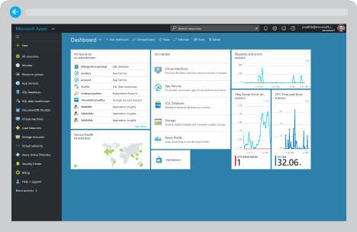
Demo (Portal)

Slide 16
Full Automation with PowerShell

Slide 17

Client Side Azure Automation

Slide 18
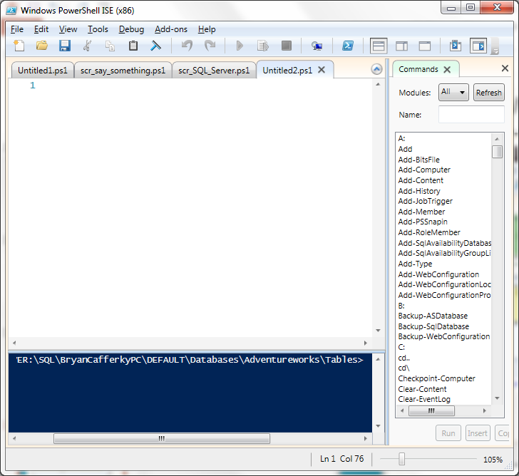
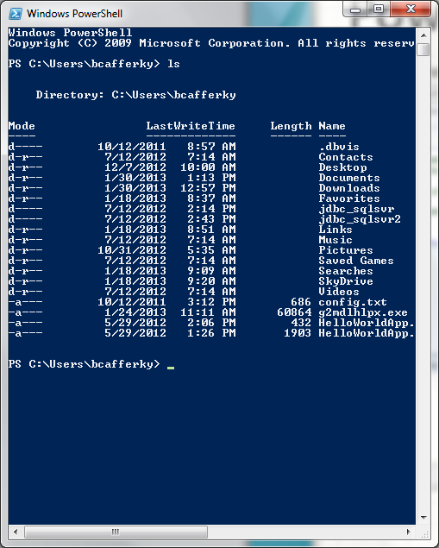
PowerShell Environments
The PowerShell ISE
The PowerShell CLI

Slide 19
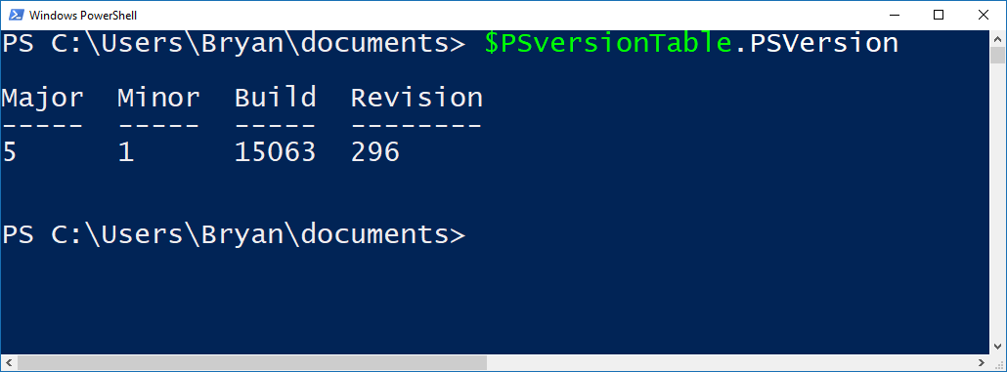
Checking Your PowerShell Version
Latest Version is 5 - Recommended

Slide 20

Azure Automation with PowerShell
Create Resources in Azure
Inquire about Azure Resources
Modify Azure Resources
Shut Down and/or Remove Resources
Application Specific Job Like Data Load

Slide 21
Installing the AzureRM Module
Start PowerShell with Elevated Privileges
Confirm PowerShellGet is Installed and the Correct Version
Get-Module PowerShellGet -list | Select-Object Name,Version,Path # 1.0.0.1 plus
Install the PowerShell AzureRM Module
Install-Module AzureRM
Import the AzureRM Module
Import-Module AzureRM -Force -Verbose # Will list cmdlets being imported
Verify the Azure Module Installation
Get-Module AzureRM # Will list module information
https://docs.microsoft.com/en-us/powershell/azure/install-azurerm-ps?view=azurermps-3.7.0

Slide 22
Demo
Demo Code at:
https://github.com/bcafferky/shared

Slide 23
Inquiring About Resources
Get-AzureRmVM – List Virtual Machines
Get-AzureRmResourceGroup – List resource groups
Get-AzureRmAvailabilitySet – List Availability Sets
Get-AzureRmVirtualNetworkSubnetConfig

Slide 24

Automation with Runbooks
Job Scheduling and More

Slide 25
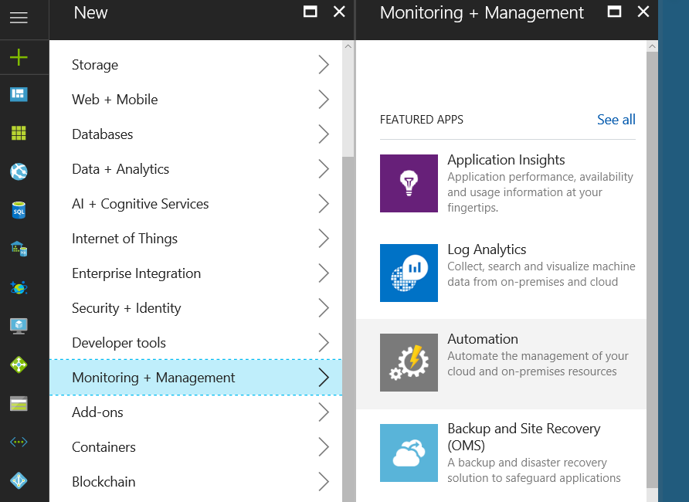
Adding Automation Method 1
Click to Add

Slide 26
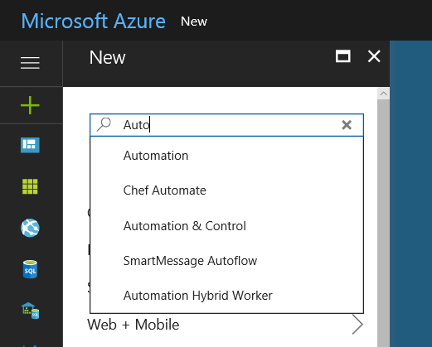
Adding Automation Method 2
Click to Select

Slide 27
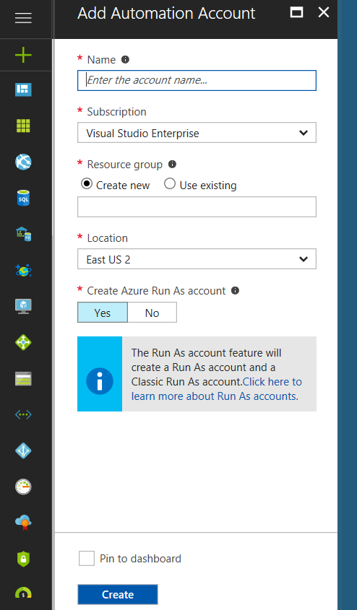
Adding Automation Account
Click to Add Account to Run Our Scripts
Check so Automation is in your Dashboard

Slide 28
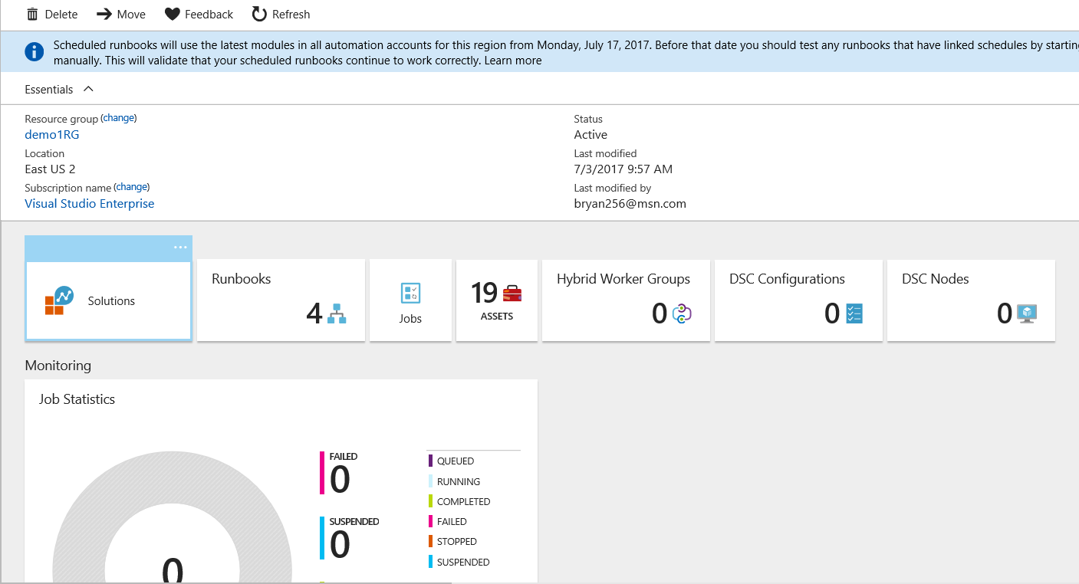
Automation Account Dashboard

Slide 29
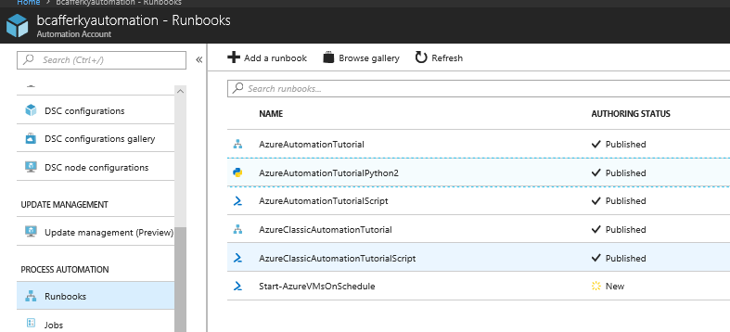
Runbook Types
Not Shown
Workflow Runbook
Graphical Runbook
Python Runbook
PowerShell Script Runbook

Slide 30
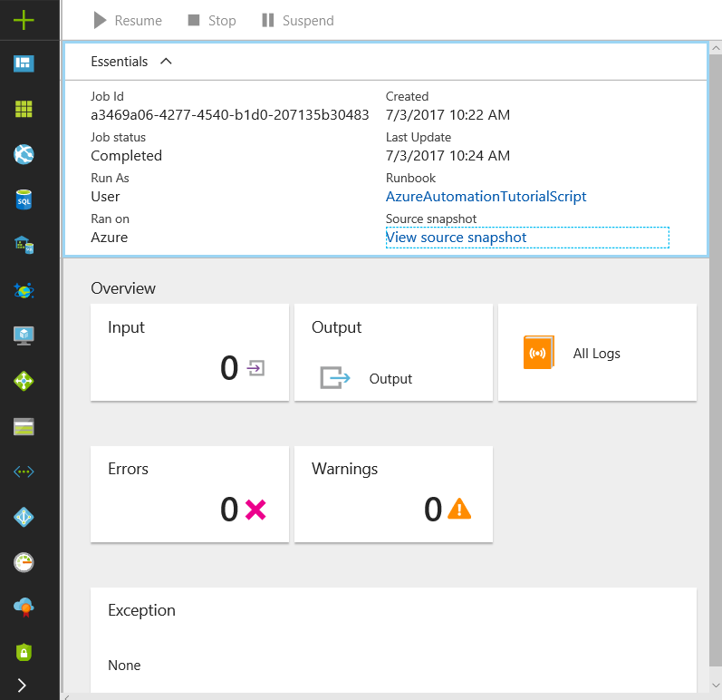
Runbook Job Status

Slide 31
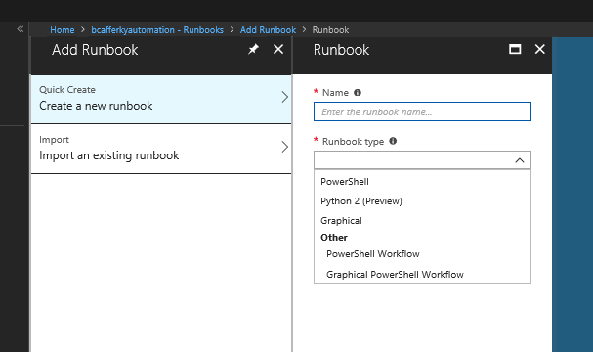
Creating a Runbook
Standard PowerShell Language
Python 2 Language
Standard PowerShell using GUI Designer
PowerShell using Workflow Engine
PowerShell Workflow using GUI Designer

Slide 32
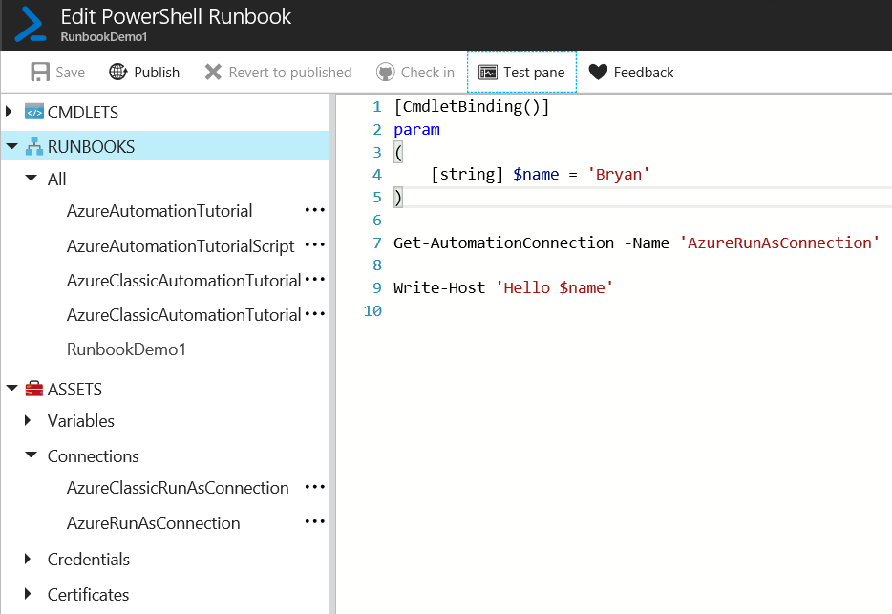
Editing a Runbook
Parameters
Connect with Connection Asset

Slide 33
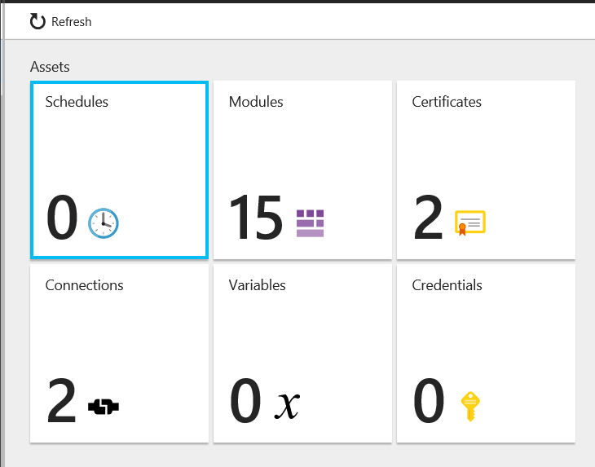
Editing a Runbook
Job Schedules
Built-In or Import Your Own
Authentication
Reusable Azure Connections
Automation Account Scoped Variables

Slide 34
Runbook Demo

Slide 35

There’s No Place Like Home: Staying within Azure
https://www.pdclipart.org/

Slide 36
How Do We Integrate Client Side Development
with
Azure Automation?

Slide 37
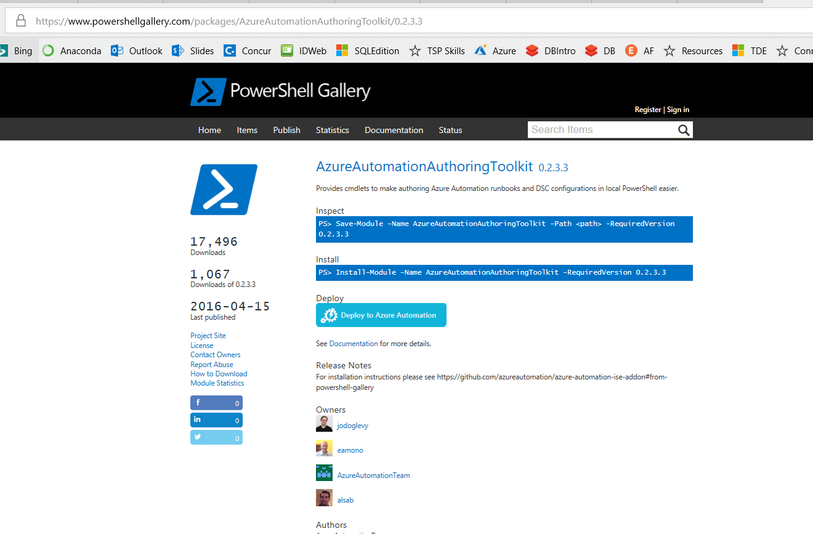
Azure Automation Authoring Toolkit
https://www.powershellgallery.com/packages/AzureAutomationAuthoringToolkit/0.2.3.3

Slide 38
Demo Azure Authoring
Demo Code at:
https://github.com/bcafferky/shared

Slide 39
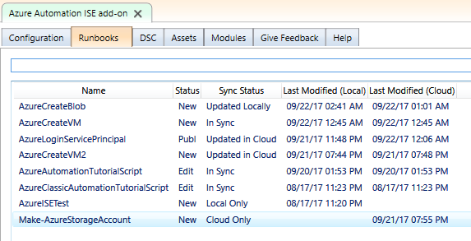
Automation Authoring Toolkit - Runbooks

Slide 40
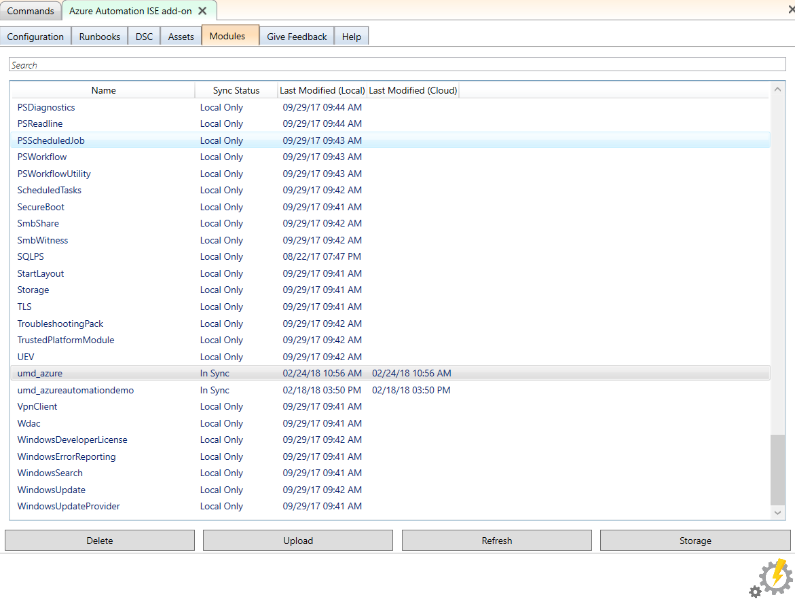
Automation Authoring Toolkit - Storage
No Zipping Required. Can upload directly from you WindowsPowerShell\Modules folder!
Must Create Azure Storage to Hold the Module

Slide 41
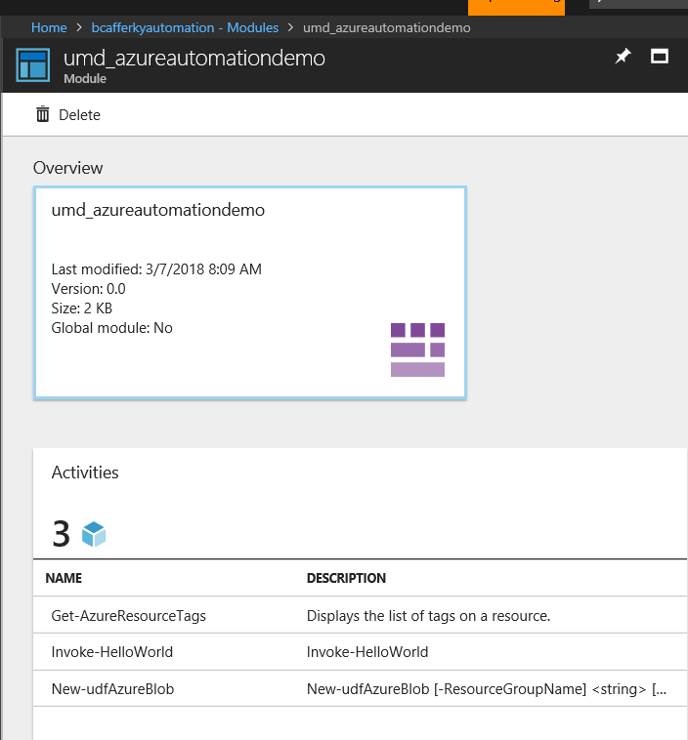
Uploaded Custom Modules
Module Functions Available

Slide 42
Wrapping Up
The Case for Automation
Why PowerShell?
Client Side Automation
Azure Side Automation
Client Side and Azure Side: Azure Automation Authoring Toolkit

Slide 43
Closing: Q & A

