Slide 1



Full Azure Automation with PowerShell Part 2: Automation from the Client Side
Bryan Cafferky
Microsoft Data Solutions Enabler
https://github.com/bcafferky/shared/PowerShellAutomation

Slide 2
What is PowerShell?

Slide 3

One Shell to Rule Them All

Slide 4
The Fellowship of the Shell
The Case for Automation
Installing and Using AzureRM – the PowerShell Azure Module
Use Cases:
Inquiring About Resources
Creating Resources
Modifying Resources
Deleting Resources
Starting and Stopping Services
Using Modules to Make Life Easier

Slide 5
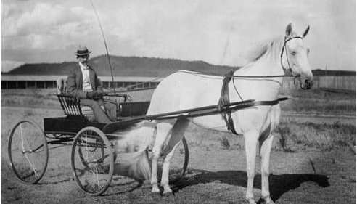

Slide 6
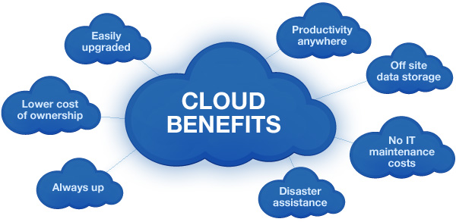

Slide 7
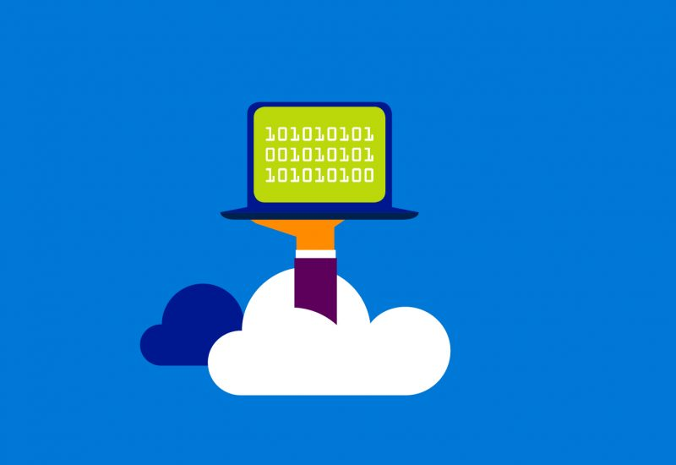
Welcome to Azure – Computing Power On Demand
Create a Powerful Virtual Machines in minutes
Multiple Cores
Any Amount of Memory and Storage
With SQL Server
Web Applications
Big Data Support
Program Complete.
Enter when ready.

Slide 8


Why PowerShell?
Without PowerShell
With PowerShell

Slide 9
The Promise
“If you learn PowerShell, we vow to make it one of the best investments you ever made and that we will work to extend PowerShell to reuse the skills you learned instead of creating brand new things with different syntax.”
- Jeffrey Snover, Microsoft, PowerShell Architect

Slide 10
Delivering on the Promise of IT
Enables Responsive Scaling
“Automation in its many incarnations will be a pivotal linchpin in the future data center.”
Reduces Costs
- Gartner, The Business Case for Automation
Improves Reliability
Security
Dev Ops
http://www.gartner.com/smarterwithgartner/automation-the-next-frontier-for-it-2/

Slide 11
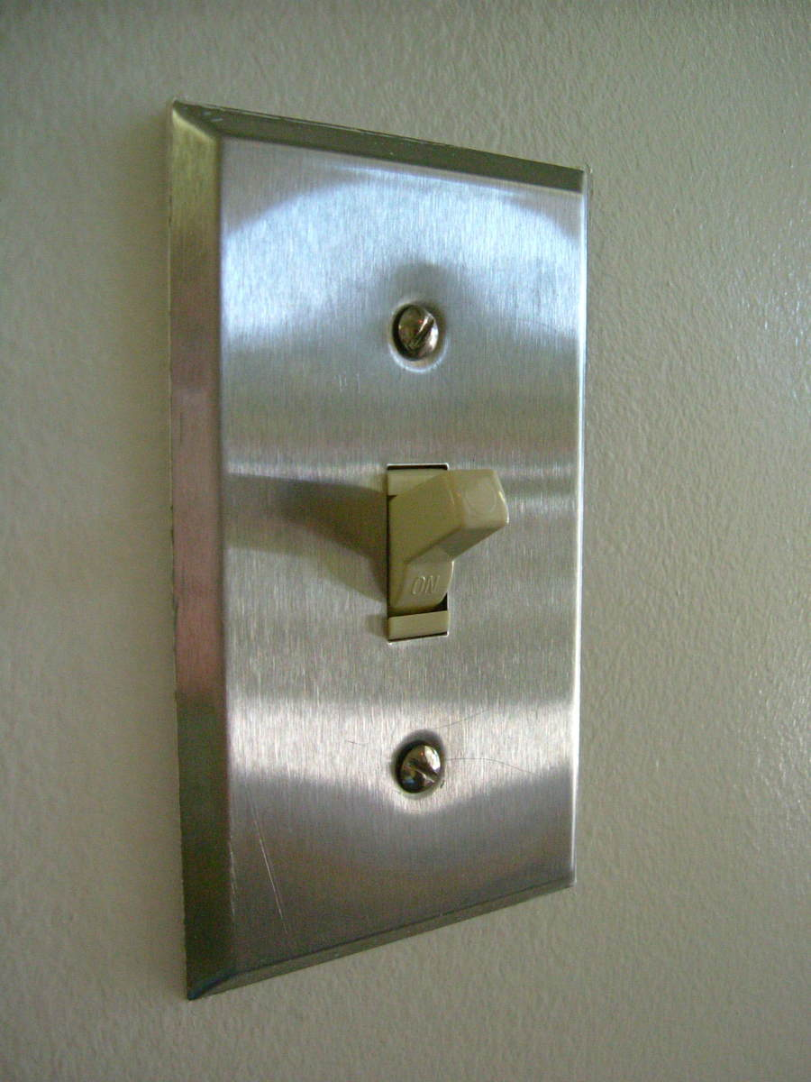
Turn Off The Lights!!!

Slide 12

The Ecosystem
Ease of Use
Administration
Explorability
Configuration
Extensibility
Remoting
Job System
Providers
Azure
Programming
Extensions
Advanced Functions
Object Orientation
Object Based Piping
Cloud Automation
Work Flows
Desired State Configuration

Slide 13

The Tools
PowerShell ISE
Azure RM Module
Azure Subscription
Azure Automation Account
Azure Add-On

Slide 14
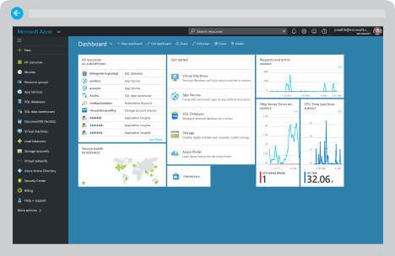
Demo (Portal)

Slide 15

Client Side Azure Automation

Slide 16
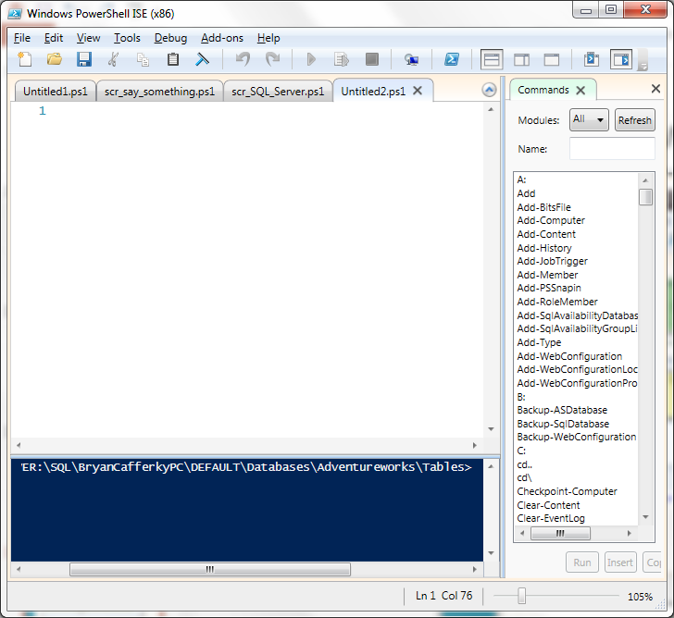
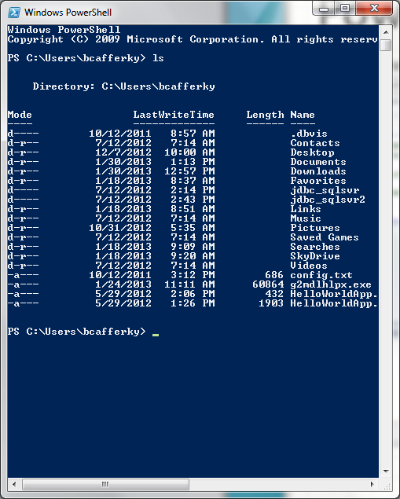
PowerShell Environments
The PowerShell ISE
The PowerShell CLI

Slide 17
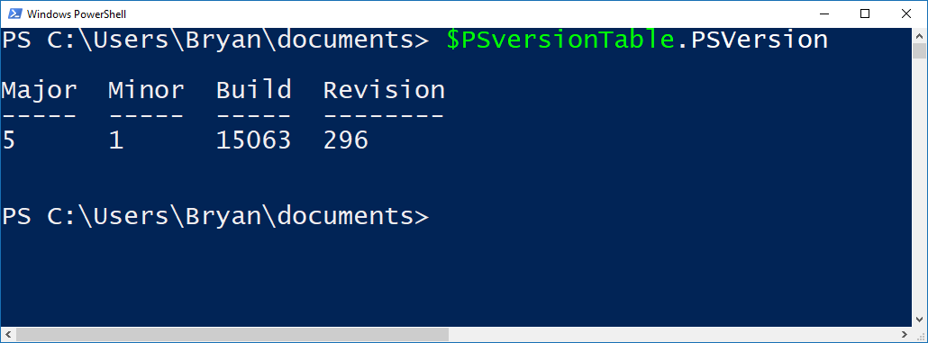
Checking Your PowerShell Version
Latest Version is 5 - Recommended

Slide 18

Azure Automation with PowerShell
Create Resources in Azure
Inquire about Azure Resources
Modify Azure Resources
Shut Down and/or Remove Resources
Application Specific Job Like Data Load

Slide 19
Installing the AzureRM Module
Start PowerShell with Elevated Privileges
Confirm PowerShellGet is Installed and the Correct Version
Get-Module PowerShellGet -list | Select-Object Name,Version,Path # 1.0.0.1 plus
Install the PowerShell AzureRM Module
Install-Module AzureRM
Import the AzureRM Module
Import-Module AzureRM -Force -Verbose # Will list cmdlets being imported
Verify the Azure Module Installation
Get-Module AzureRM # Will list module information
https://docs.microsoft.com/en-us/powershell/azure/install-azurerm-ps?view=azurermps-3.7.0

Slide 20
Demo
Demo Code at:
https://github.com/bcafferky/shared

Slide 21
Inquiring About Resources
Get-AzureRmVM – List Virtual Machines
Get-AzureRmResourceGroup – List resource groups
Get-AzureRmAvailabilitySet – List Availability Sets
Get-AzureRmVirtualNetworkSubnetConfig

Slide 22
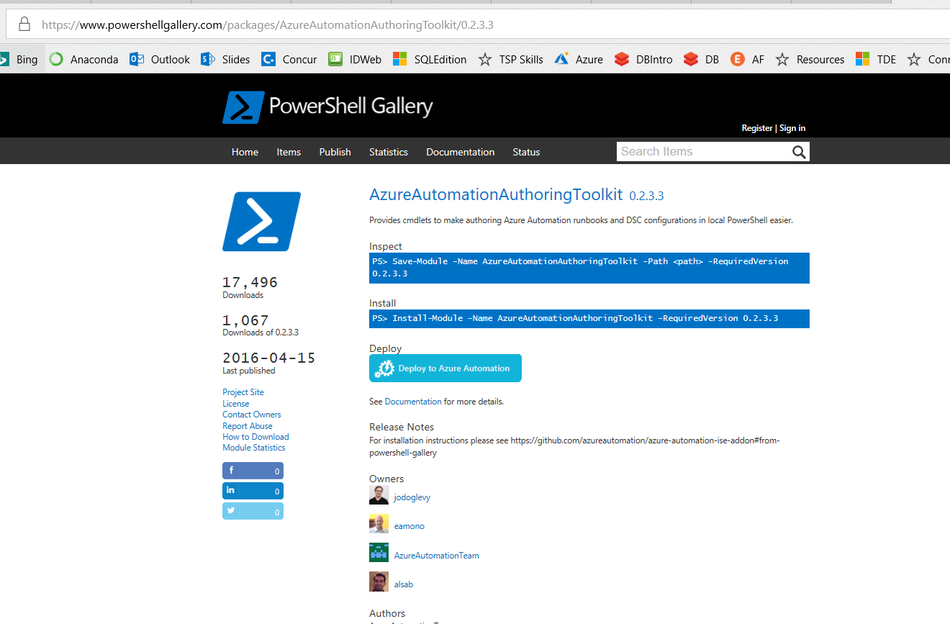
Azure Automation Authoring Toolkit
https://www.powershellgallery.com/packages/AzureAutomationAuthoringToolkit/0.2.3.3

Slide 23
Wrapping Up
The Case for Automation
Why PowerShell?
Client Side Automation
Azure Side Automation
Client Side and Azure Side: Azure Automation Authoring Toolkit

Slide 24
Wrapping Up
Azure
The Case for Automation
Installing and Using AzureRM – the PowerShell Azure Module
Use Cases:
Inquiring About Resources
Creating Resources
Modifying Resources
Deleting Resources
Starting and Stopping Services
Using Modules to Make Life Easier

