Slide 1



Full Azure Automation with PowerShell Part 3: Bringing It All Together
Bryan Cafferky
Microsoft Data Solutions Enabler
https://github.com/bcafferky/shared/PowerShellAutomation

Slide 2

What is PowerShell?
One Shell to Rule Them All

Slide 3
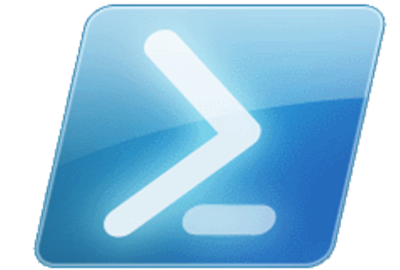
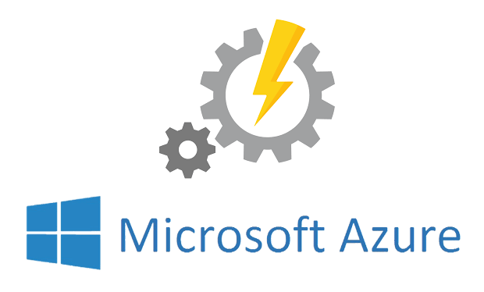
The two towers
Client PowerShell
Azure Automation

Slide 4
Where is our Journey Going?
The Tools: What Do We Need?
The Client Side
The Azure Automation Account
Using the Azure Automation Authoring Toolkit
Setting Up Scripts to Run Unattended

Slide 5


The Tools
Azure Subscription
PowerShell ISE
Azure Automation Account
Azure RM Module
Azure Automation Authoring Toolkit
Azure Add-On

Slide 6

Client Side: The PowerShell ISE

Slide 7
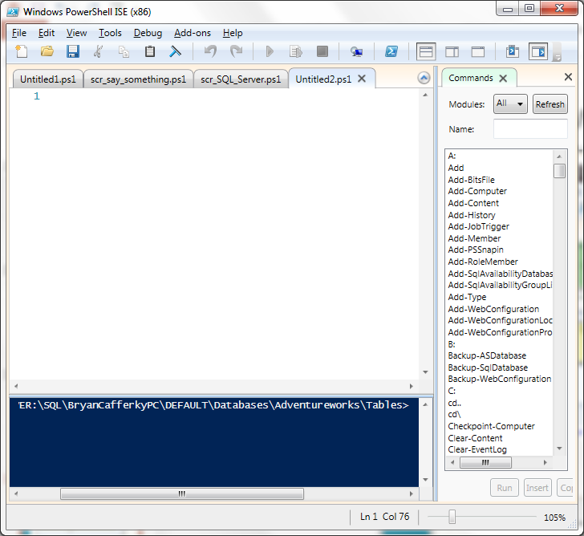
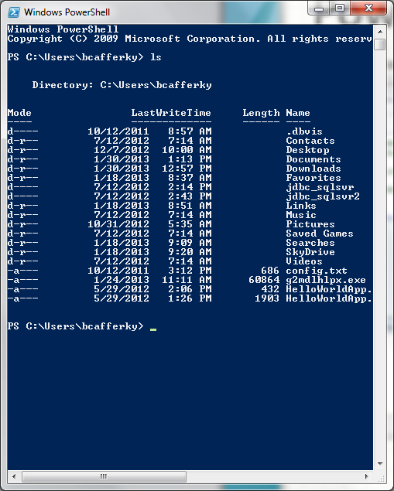
PowerShell Environments
The PowerShell ISE
The PowerShell CLI

Slide 8
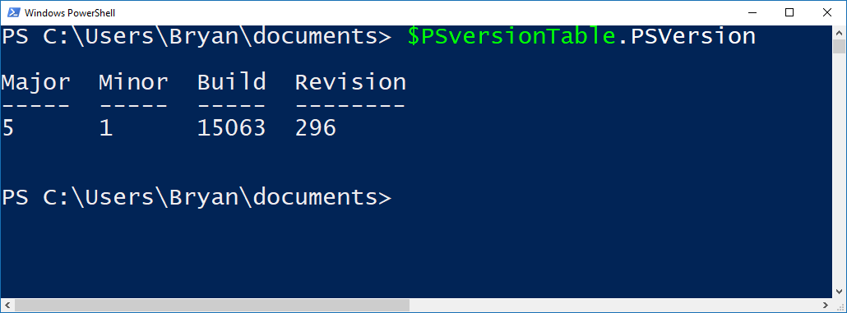
Checking Your PowerShell Version
Latest Version is 5 - Recommended

Slide 9

Azure Automation with PowerShell
Create Resources in Azure
Inquire about Azure Resources
Modify Azure Resources
Shut Down and/or Remove Resources
Application Specific Job Like Data Load

Slide 10
Installing the AzureRM Module
Start PowerShell with Elevated Privileges
Confirm PowerShellGet is Installed and the Correct Version
Get-Module PowerShellGet -list | Select-Object Name,Version,Path # 1.0.0.1 plus
Install the PowerShell AzureRM Module
Install-Module AzureRM
Import the AzureRM Module
Import-Module AzureRM -Force -Verbose # Will list cmdlets being imported
Verify the Azure Module Installation
Get-Module AzureRM # Will list module information
https://docs.microsoft.com/en-us/powershell/azure/install-azurerm-ps?view=azurermps-3.7.0

Slide 11
Demo: PowerShell
Demo Code at:
https://github.com/bcafferky/shared

Slide 12
Problems with Client Side Automation
Unattended Execution – How does the job log into Azure?
Safely Storing Credentials?
Creating a Server Environment?
Robust Job Scheduler?
Administration?

Slide 13


There’s No Place Like Home: Staying within Azure
https://www.pdclipart.org/

Slide 14
Automation with Runbooks

Slide 15
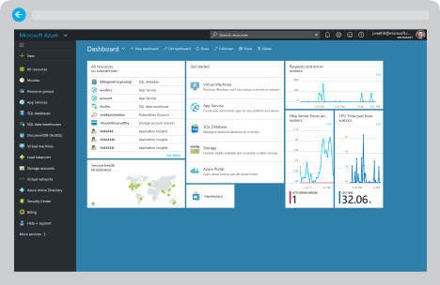
Creating the Azure Automation Account

Slide 16
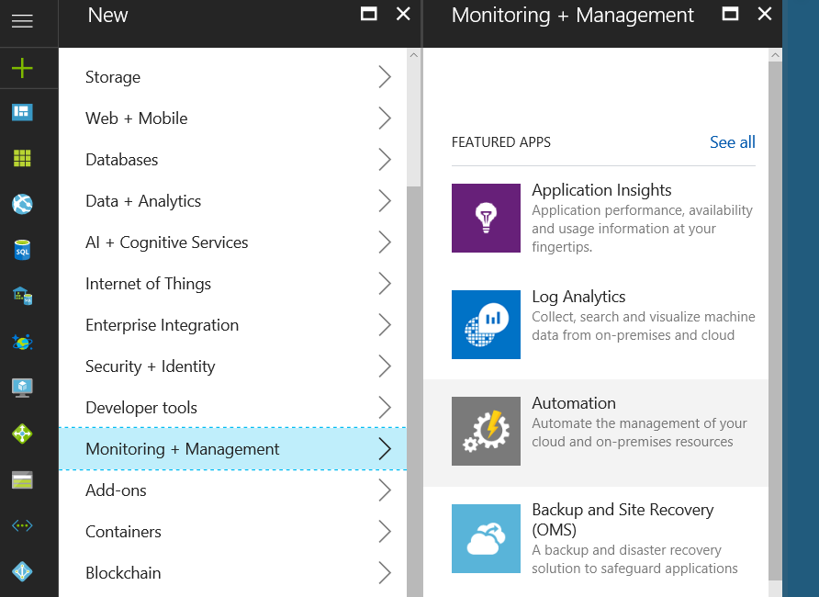
Adding Automation
Click to Add

Slide 17
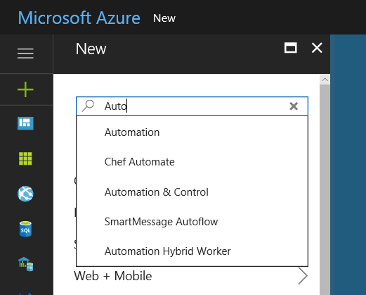
Adding Automation Method 2
Click to Select

Slide 18
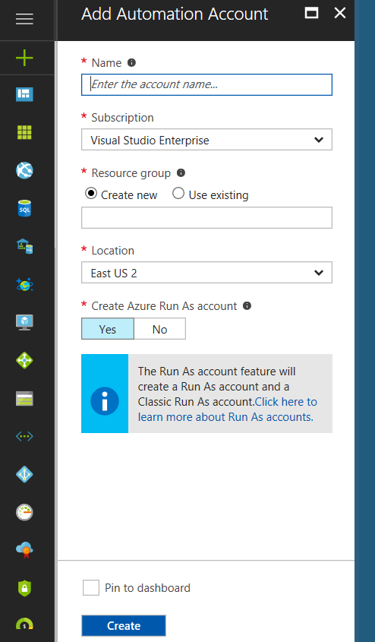
Adding Automation Account
Click to Add Account to Run Our Scripts
Check so Automation is in your Dashboard

Slide 19
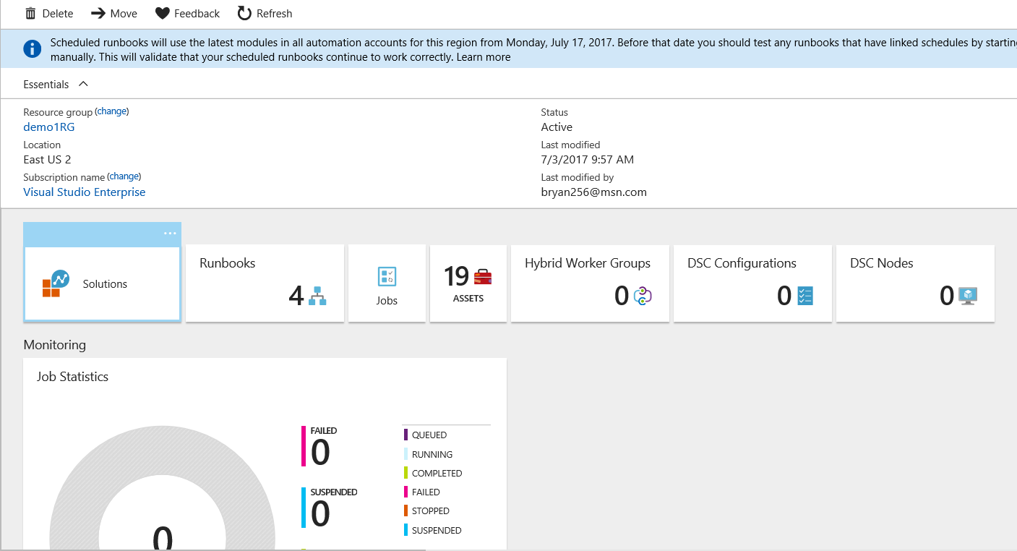
Automation Account Dashboard

Slide 20
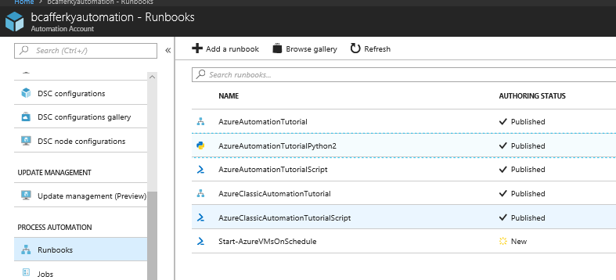
Runbook Types
Not Shown
Workflow Runbook
Graphical Runbook
Python Runbook
PowerShell Script Runbook

Slide 21
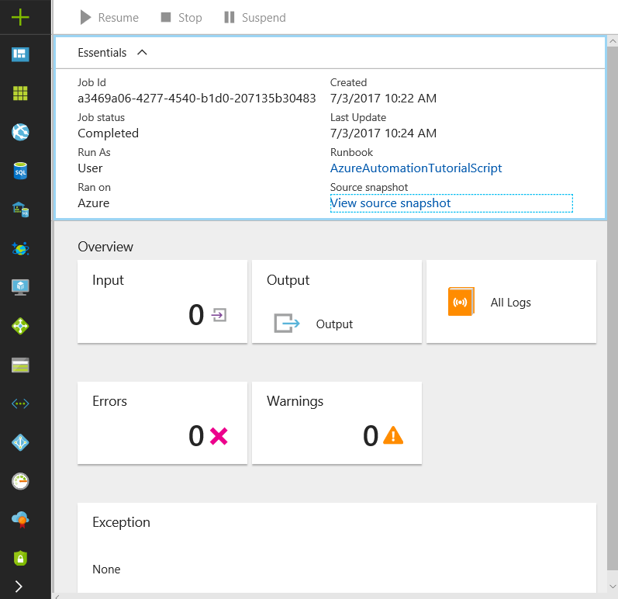
Runbook Job Status

Slide 22
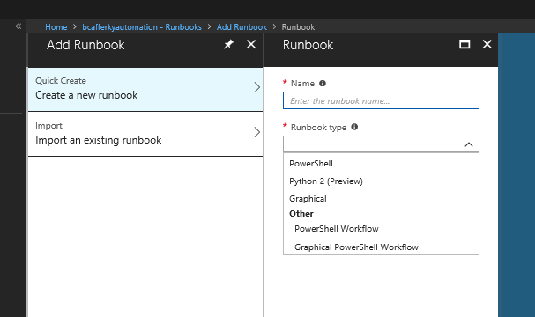
Creating a Runbook
Standard PowerShell Language
Python 2 Language
Standard PowerShell using GUI Designer
PowerShell using Workflow Engine
PowerShell Workflow using GUI Designer

Slide 23
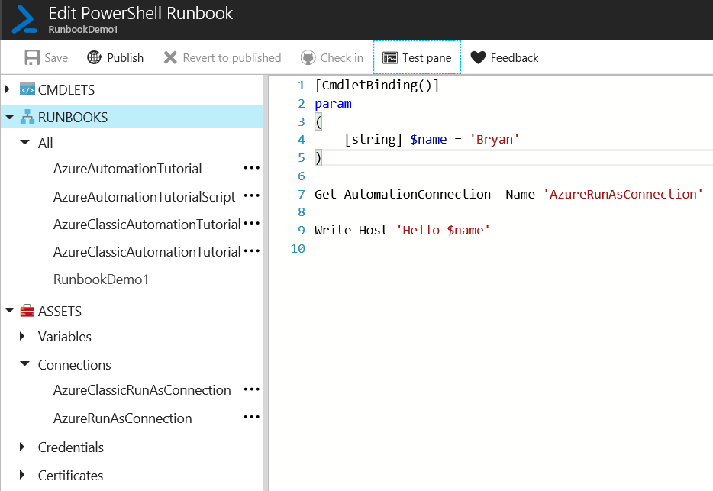
Editing a Runbook
Parameters
Connect with Connection Asset

Slide 24
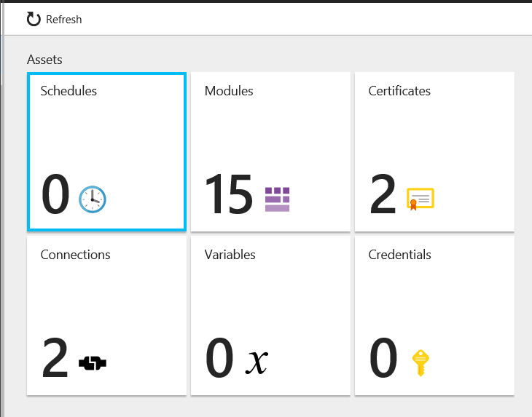
Editing a Runbook
Job Schedules
Built-In or Import Your Own
Authentication
Reusable Azure Connections
Automation Account Scoped Variables

Slide 25
Runbook Demo

Slide 26
How Do We Integrate Client Side Development
with
Azure Automation?

Slide 27
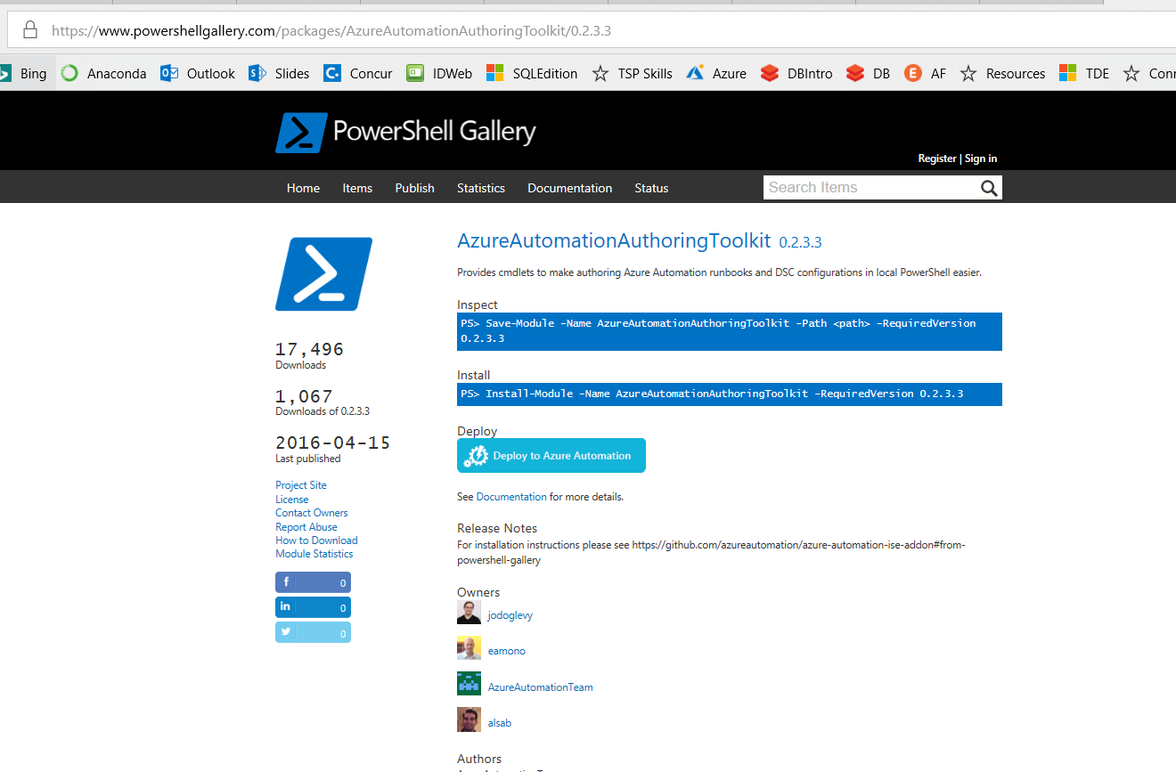
Azure Automation Authoring Toolkit
https://www.powershellgallery.com/packages/AzureAutomationAuthoringToolkit/0.2.3.3

Slide 28
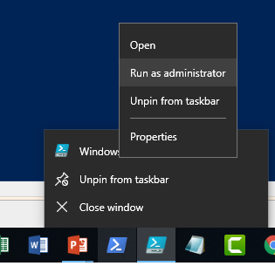
Azure Automation Authoring Toolkit
Must run as administrator to
Install the toolkit!!
https://www.powershellgallery.com/packages/AzureAutomationAuthoringToolkit/0.2.3.3

Slide 29
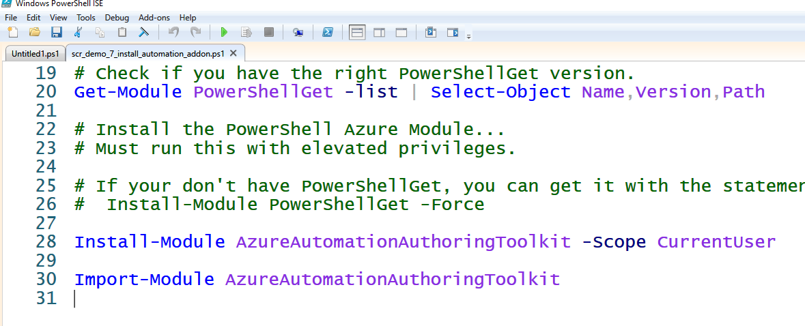
Azure Automation Authoring Toolkit
You Need PowerShellGet
You Need PowerShellGet
Installing
Loading the Toolkit
https://www.powershellgallery.com/packages/AzureAutomationAuthoringToolkit/0.2.3.3

Slide 30
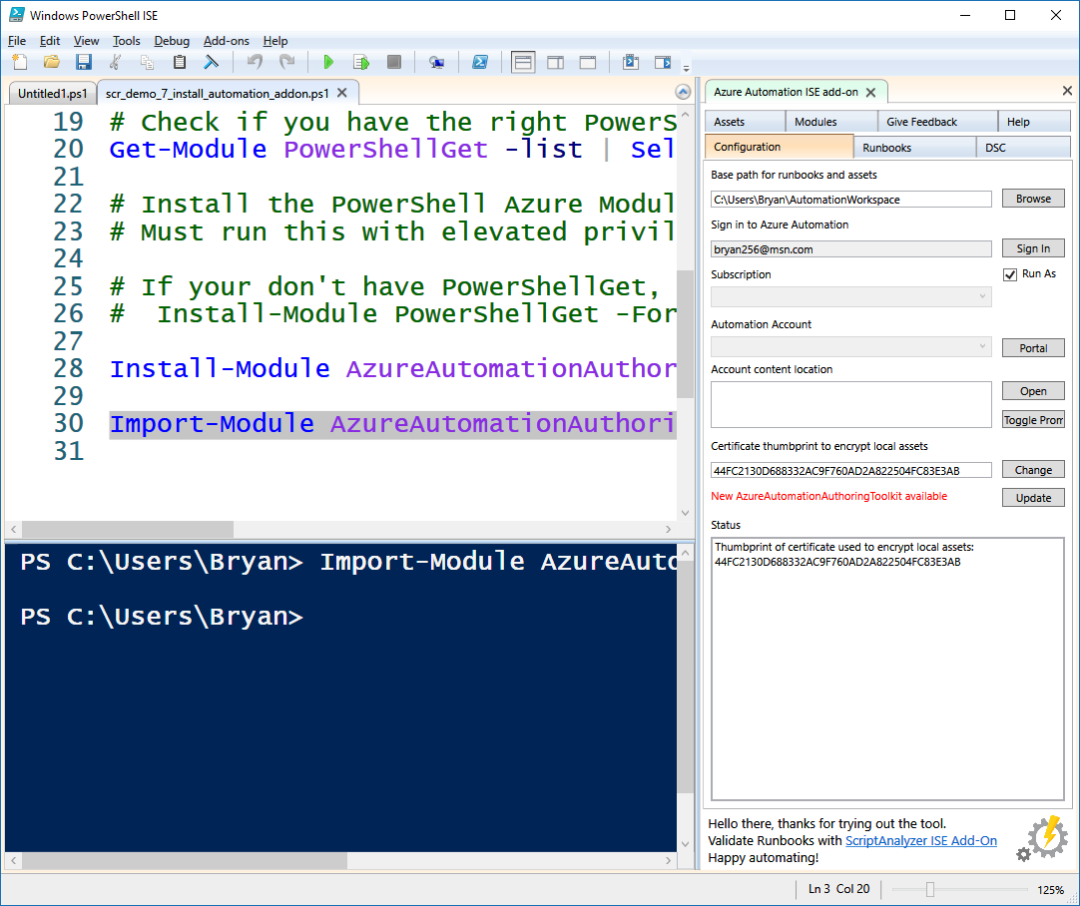
Azure Automation Authoring Toolkit
Automation Integration
Control Panel

Slide 31
Demo Azure Authoring
Demo Code at:
https://github.com/bcafferky/shared

Slide 32
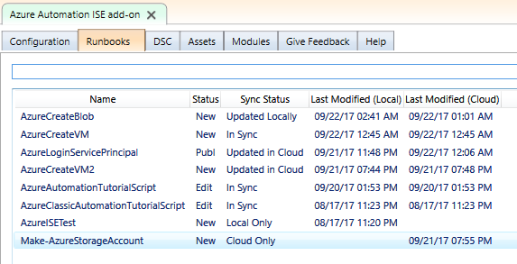
Automation Authoring Toolkit - Runbooks

Slide 33
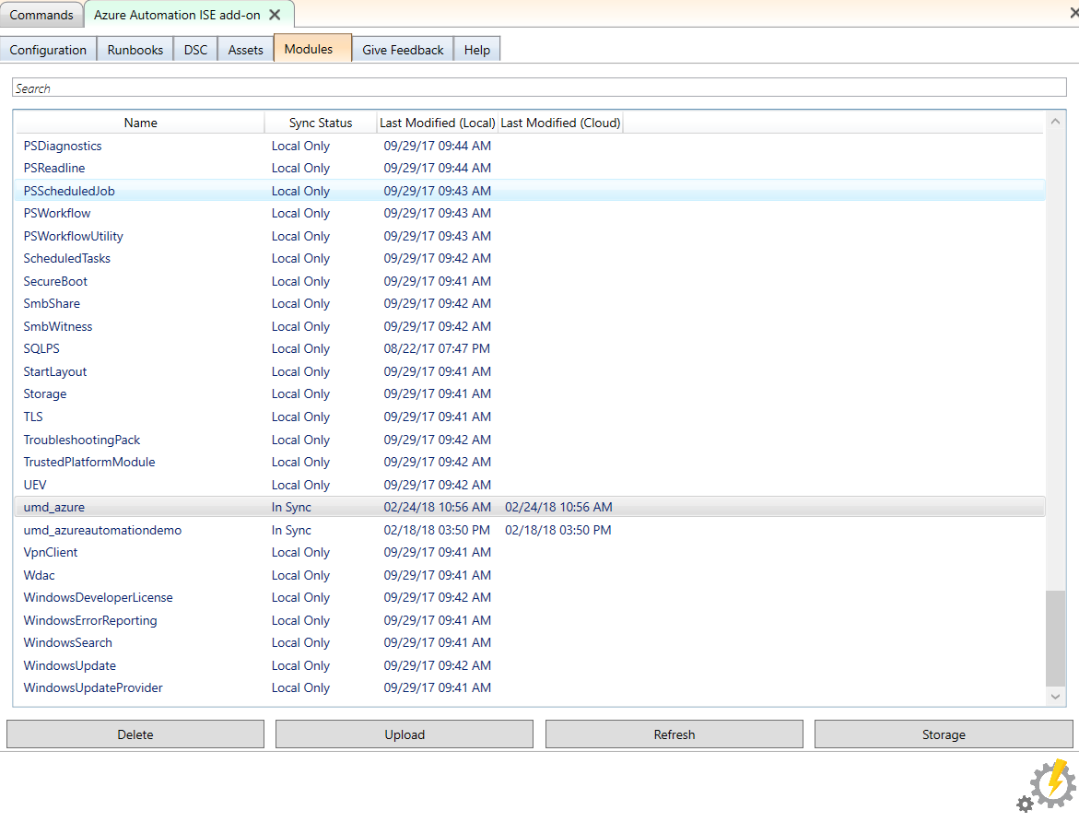
Automation Authoring Toolkit - Storage
No Zipping Required. Can upload directly from your WindowsPowerShell\Modules folder!
Must Create Azure Storage to Hold the Module

Slide 34
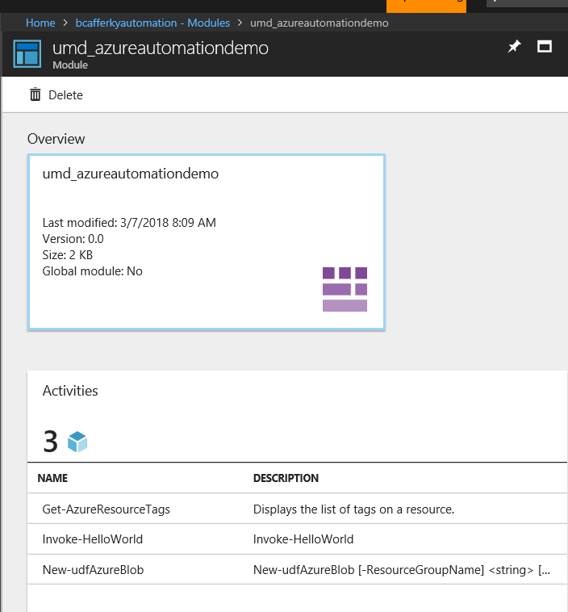
Uploaded Custom Modules
Module Functions Available

Slide 35
Demo Setting Up Unattended Execution
Demo Code at:
https://github.com/bcafferky/shared

Slide 36
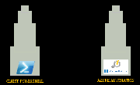
Wrapping Up: The End of the Fellowship
The Tools: What Do We Need?
The Client Side
The Azure Automation Account
Using the Azure Automation Authoring Toolkit
Setting Up Scripts to Run Unattended

Slide 37
Full Azure Automation with PowerShell Part 2: Automation from the Client Side
Bryan Cafferky
Microsoft Data Solutions Enabler
https://github.com/bcafferky/shared/PowerShellAutomation

