Slide 1
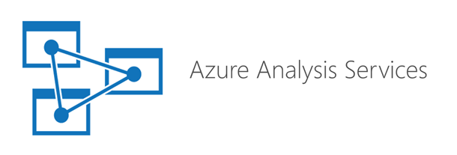


Analysis Services What’s the Difference Between the Tabular and Multidimensional Models?
Bryan Cafferky
Microsoft Data Solutions Enabler
https://github.com/bcafferky/shared

Slide 2
What is Analysis Services?
Power BI Incorporates a local version of the Analysis Services Tabular Model

Slide 3
Why Do We Need Analysis Services?
Self Service BI Reporting Means the Need for Speed
First Solution was the OLAP Multidimensional Model
Then Came the Tabular Model
Scaling Up and Out with Azure Analysis Services
Which Should You Choose?

Slide 4
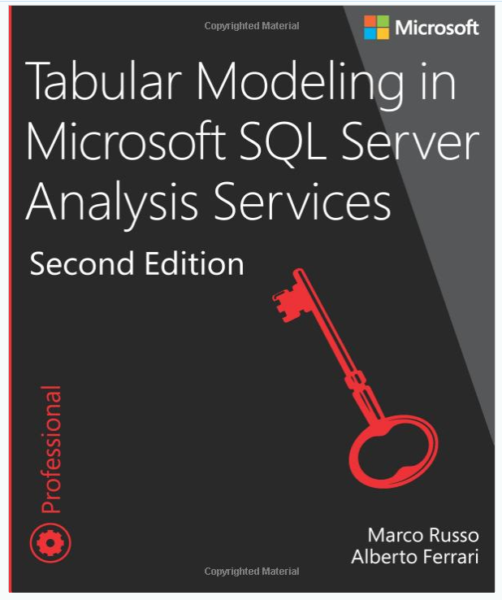
The Multidimensional Model
https://www.microsoft.com/en-us/p/tabular-modeling-in-microsoft-sql-server-analysis-services/fgqpf3gzm3gh

Slide 5
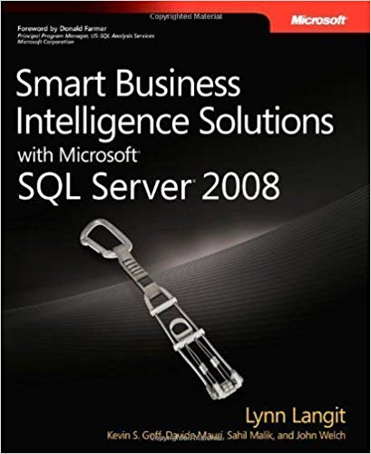
The Multidimensional Model
Not Intuitive to SQL Database Developers!!!

Slide 6

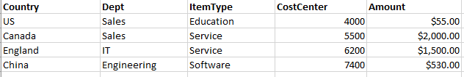
Using the Way Back Machine
Accounting Charges
Could we just run the queries to summarize the amount using every possible combination once and save the results?
When a user asks for a summary, just give them the one they need.
SELECT SUM(AMOUNT) GROUP BY COUNTRY
Need to quickly see summaries by:
Country
Country and Dept
Item Type
By any combination of the descriptive columns
SELECT SUM(AMOUNT) GROUP BY COUNTRY, DEPT
SELECT SUM(AMOUNT) GROUP BY ITEMTYPE
SELECT SUM(AMOUNT)
GROUP BY COUNTRY,
DEPT,
ITEMTYPE,
COSTCENTER
Hmmmm….
Once closed, data does not change.
Limited number of combinations.

Slide 7
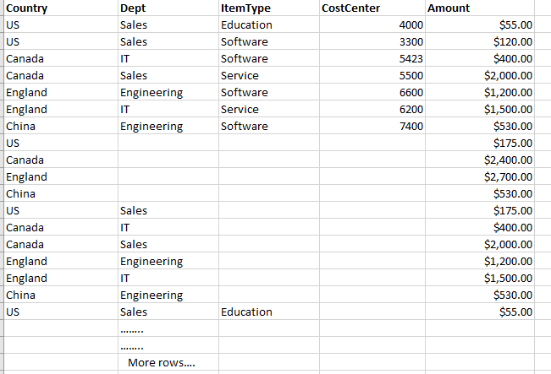
The Multidimensional Model

Slide 8

The Multidimensional Model
Country
Dept
Item Type

Slide 9
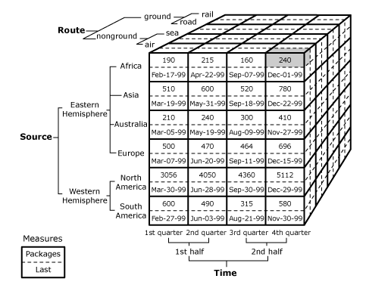
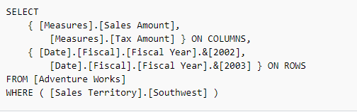
The Multidimensional Model
https://docs.microsoft.com/en-us/sql/analysis-services/multidimensional-models-olap-logical-cube-objects/cube-cells-analysis-services-multidimensional-data?view=sql-server-2017

Slide 10
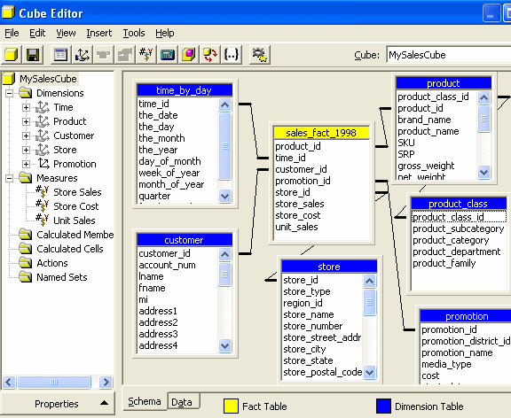
The Multidimensional Model

Slide 11
The Multidimensional Model
Very closely related to Star Schema (Dimensional Modeling)
Heavy Processing to Build the Cube -> Writes to Disk
Reads from Disk to Answer Queries
Takes More Storage Space
Is More Mature
More Complex to Create and Maintain
Is NOT Limited by Computer Memory
Not Available in Azure Analysis Services

Slide 12
The Multidimensional Model
MOLAP – Multidimensional Online Analytical Processing
ROLAP – Relational Online Analytical Processing
HOLAP – Hybrid Online Analytical Processing

Slide 13
The Tabular Model
An In Memory Table
Hyper Compressed
No Preaggregations – Slice and Dice in Real Time
Generally Easier to Create and Maintain
Power BI Uses The Tabular Model Natively
Memory is the Limitation

Slide 14

How Fast Does it Need to Be?
The Tabular Model Was Not Possible Until Recent Technology

Slide 15
Which Model Should You Choose?
If Your Model Can Fit into Available Memory, May Be Better to Start with Tabular
If Not or If You Need Features Only Available in the Multidimensional Model, Go With That
Azure Analysis Services Only Supports Tabular
Azure Analysis Services Significantly Helps Scale the Tabular Model
There Is Not Automated Migration From One Model Type to the Other

Slide 16
Scaling with Azure Analysis Services
Much Larger Models Supported
Scale Out with Query Replicas

Slide 17
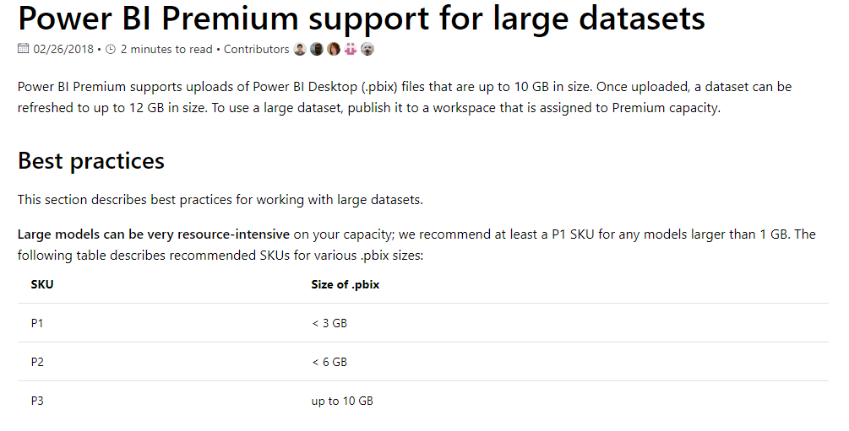
Power BI Premium Dataset Size Limits

Slide 18
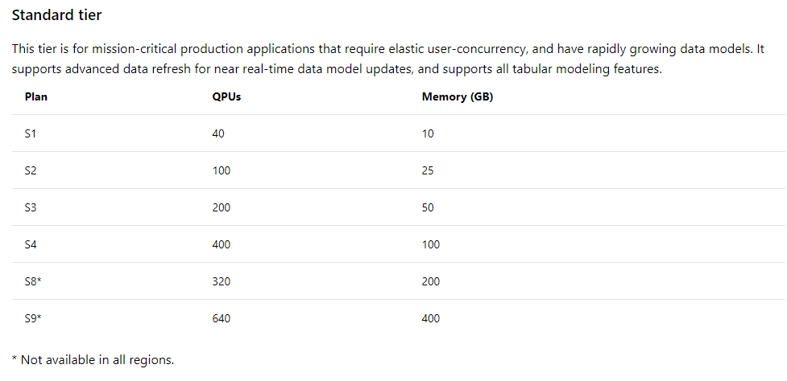
Scaling with Azure Analysis Services
https://docs.microsoft.com/en-us/azure/analysis-services/analysis-services-overview

Slide 19
Scale out – Query Replicas
Azure AS Cluster
asazure://aspaaseastus2.asazure.windows.net/someserver
asazure://aspaaseastus2.asazure.windows.net/someserver
asazure://aspaaseastus2.asazure.windows.net/someserver
Frontend node
From Josh Caplan @ Microsoft
https://www.youtube.com/watch?v=qO2pmfgbG1w
Backend node

Slide 20
Scale out
Azure AS Cluster
asazure://aspaaseastus2.asazure.windows.net/someserver
asazure://aspaaseastus2.asazure.windows.net/someserver
asazure://aspaaseastus2.asazure.windows.net/someserver
Frontend node
Backend node

Slide 21
Scale out
Azure AS Cluster
asazure://aspaaseastus2.asazure.windows.net/someserver
asazure://aspaaseastus2.asazure.windows.net/someserver
asazure://aspaaseastus2.asazure.windows.net/someserver
Frontend node
Backend node

Slide 22
Scale out
Number of query replicas: 0
Azure AS Cluster
asazure://aspaaseastus2.asazure.windows.net/someserver
asazure://aspaaseastus2.asazure.windows.net/someserver
asazure://aspaaseastus2.asazure.windows.net/someserver
Frontend node
Backend node

Slide 23
Scale out
Number of query replicas: 3
Azure AS Cluster
asazure://aspaaseastus2.asazure.windows.net/someserver
asazure://aspaaseastus2.asazure.windows.net/someserver
asazure://aspaaseastus2.asazure.windows.net/someserver
Frontend node
Backend node

Slide 24
Scale out
Number of query replicas: 0
Azure AS Cluster
asazure://aspaaseastus2.asazure.windows.net/someserver
asazure://aspaaseastus2.asazure.windows.net/someserver
asazure://aspaaseastus2.asazure.windows.net/someserver
Frontend node
Backend node
Notes:
https://www.youtube.com/watch?v=qO2pmfgbG1w

Slide 25
Wrapping Up
Self Service BI Reporting Means the Need for Speed
First Solution was the OLAP Multidimensional Model
Then Came the Tabular Model
Scaling Up and Out with Azure Analysis Services
Which Should You Choose?

Slide 26

Analysis Services Tabular vs. Multidimensional Models
Bryan Cafferky
Microsoft Data Solutions Enabler
https://github.com/bcafferky/shared

