Slide 1




Slide 2


Azure Databricks Calling the Cognitive Services Vision API
Bryan Cafferky
Microsoft Data Solutions Enabler
https://github.com/bcafferky/shared

Slide 3
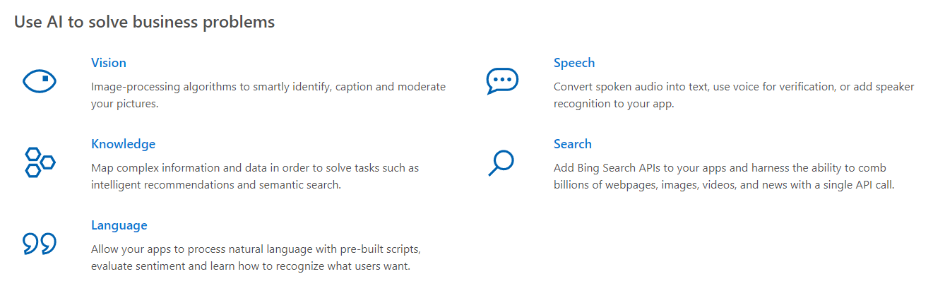
What is Azure Cognitive Services?
Pretrained Machine Learning Models
https://azure.microsoft.com/en-us/services/cognitive-services/directory/know/

Slide 4
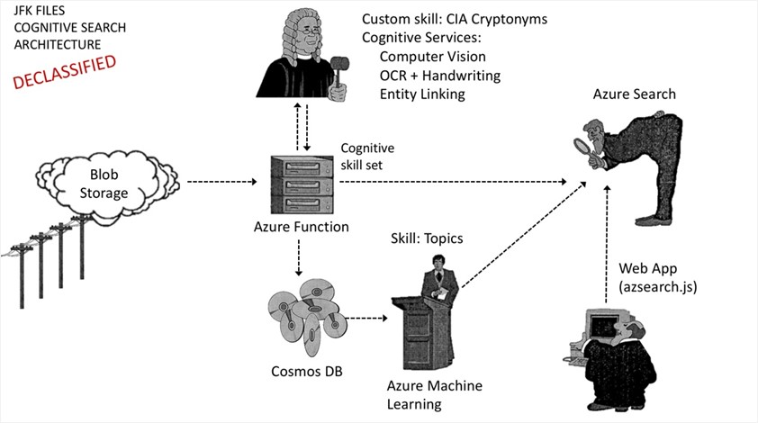
Intelligent Searching of the JFK Files
https://channel9.msdn.com/Shows/AI-Show/JFK-Files--Cognitive-services
https://blogs.technet.microsoft.com/machinelearning/2017/11/15/gain-insights-into-the-jfk-files-with-azure-search-and-cognitive-services/

Slide 5
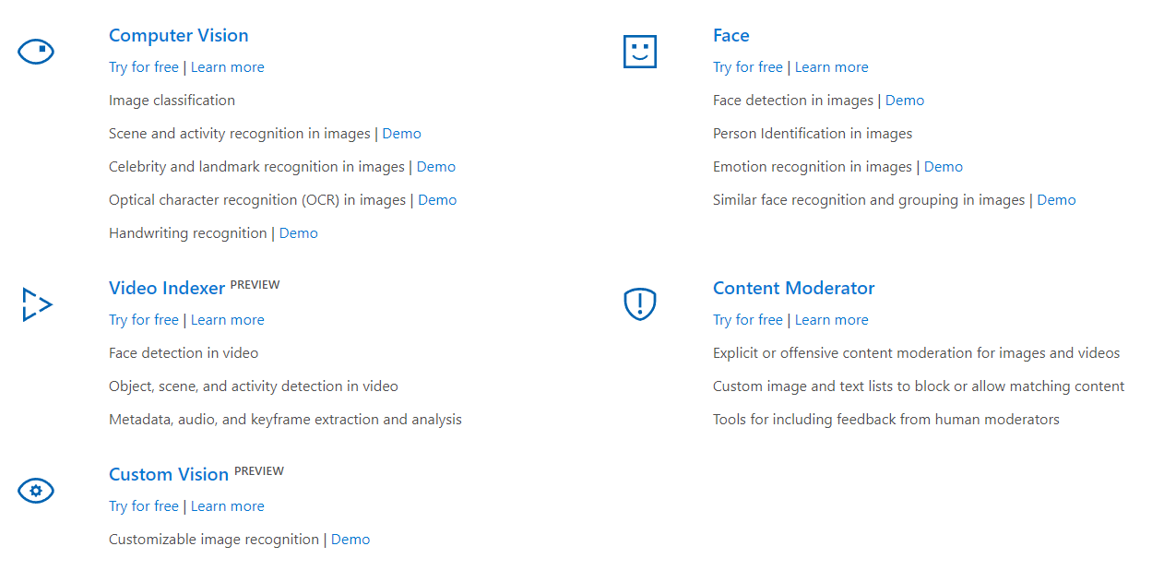
What is Azure Cognitive Services
The Vision API
From Azure Databricks Notebook

Slide 6
Create the Cognitive Services Service in Your Subscription

Slide 7
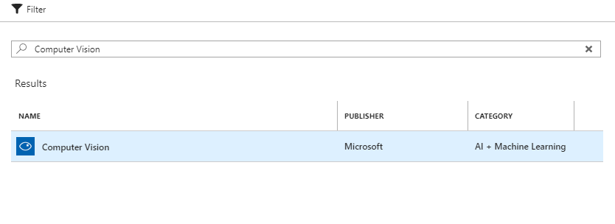
Create the Cognitive Services Service in Your Subscription

Slide 8
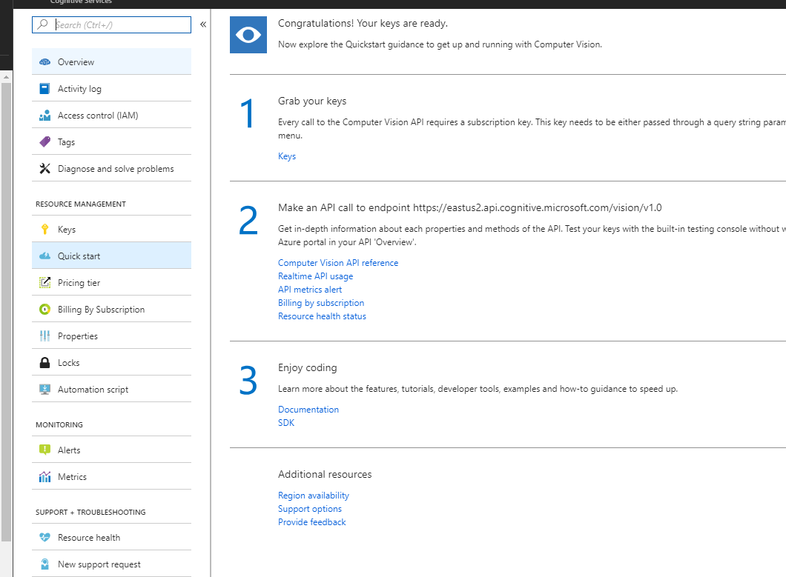
Create the Cognitive Services Service in Your Subscription
Get the key
Documentation

Slide 9
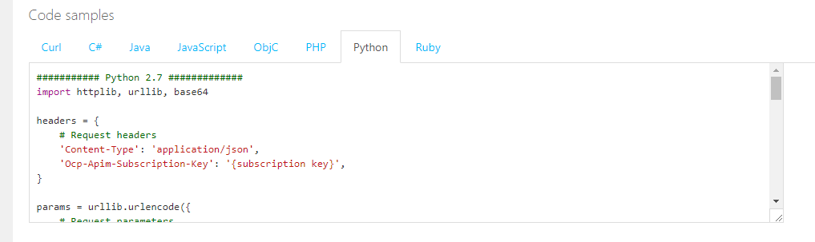
Sample Code for Multiple Languages

Slide 10
Demo
Online Demos
https://azure.microsoft.com/en-us/services/cognitive-services/computer-vision/#text
Sample API Code
https://westus.dev.cognitive.microsoft.com/docs/services/5adf991815e1060e6355ad44/operations/56f91f2e778daf14a499e1fa

Slide 11
Wrapping Up
The Easiest Way To Jump into Machine Learning
Many Different Useful Models
Online Demonstrations
Sample API Code

