Slide 1

How Do We Integrate Client Side Development
with
Azure Automation?

Slide 2
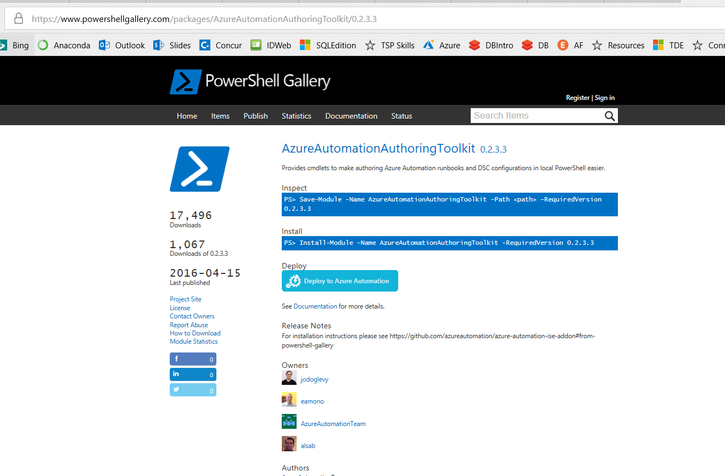
Azure Automation Authoring Toolkit
https://www.powershellgallery.com/packages/AzureAutomationAuthoringToolkit/0.2.3.3

Slide 3
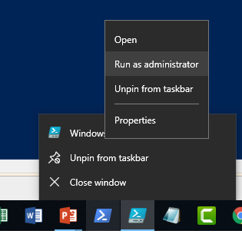
Azure Automation Authoring Toolkit
Must run as administrator to
Install the toolkit!!
https://www.powershellgallery.com/packages/AzureAutomationAuthoringToolkit/0.2.3.3

Slide 4
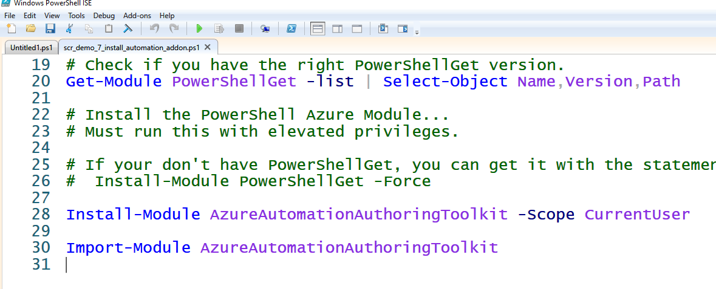
Azure Automation Authoring Toolkit
You Need PowerShellGet
Installing
Loading the Toolkit

Slide 5
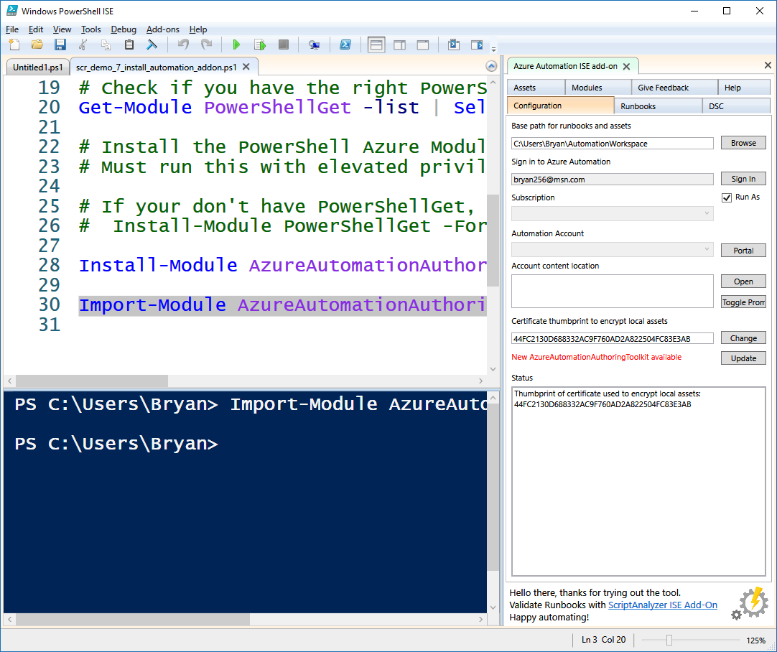
Azure Automation Authoring Toolkit
Automation Integration
Control Panel

Slide 6
Demo Azure Authoring
Demo Code at:
https://github.com/bcafferky/shared

Slide 7
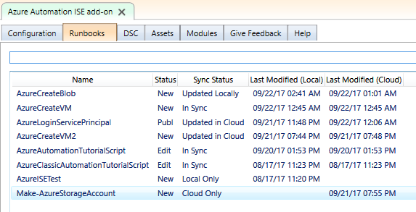
Automation Authoring Toolkit - Runbooks

Slide 8
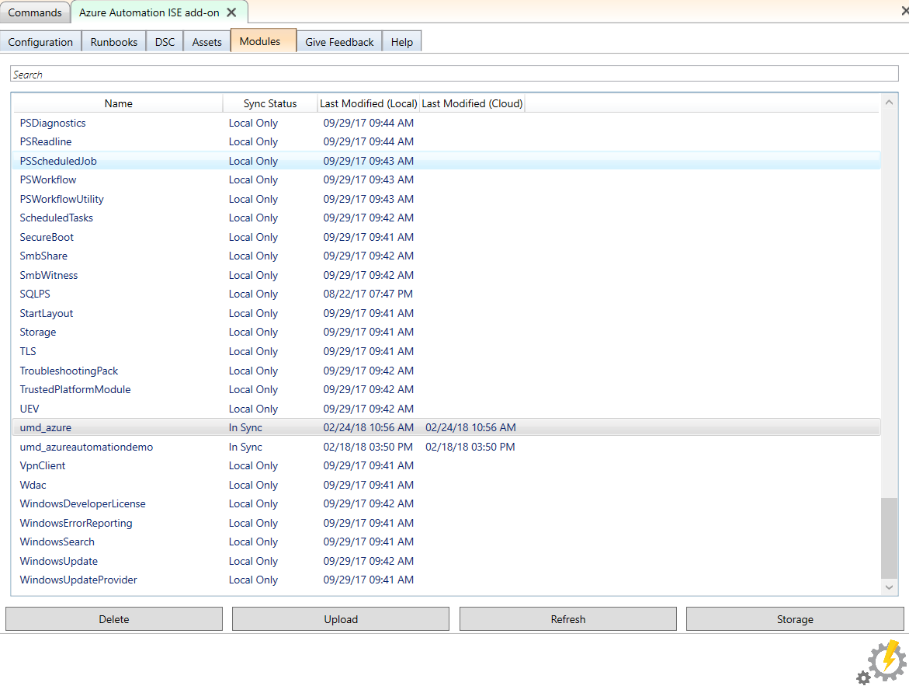
Automation Authoring Toolkit - Storage
No Zipping Required. Can upload directly from your WindowsPowerShell\Modules folder!
Must Create Azure Storage to Hold the Module

Slide 9
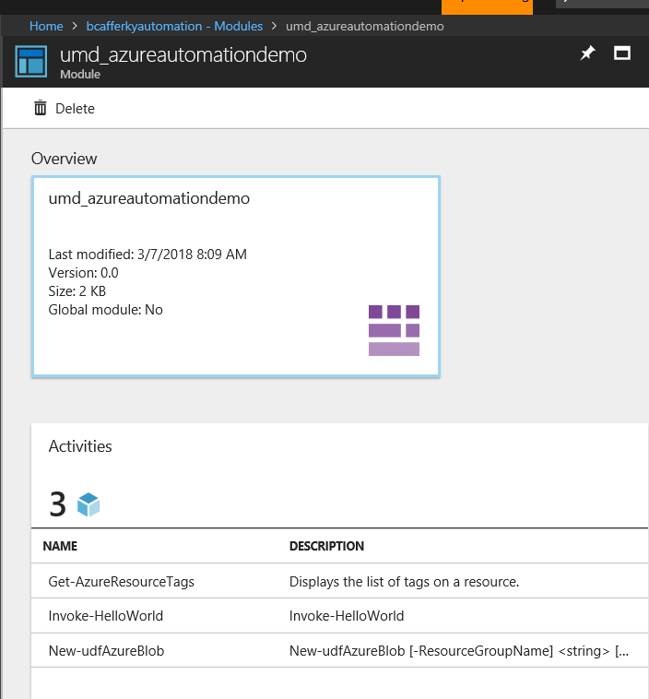
Uploaded Custom Modules
Module Functions Available

Slide 10

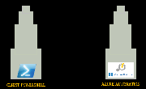

Wrapping Up: The End of the Fellowship
The Tools: What Do We Need?
The Client Side
The Azure Automation Account
Using the Azure Automation Authoring Toolkit
Setting Up Scripts to Run Unattended

