Slide 1
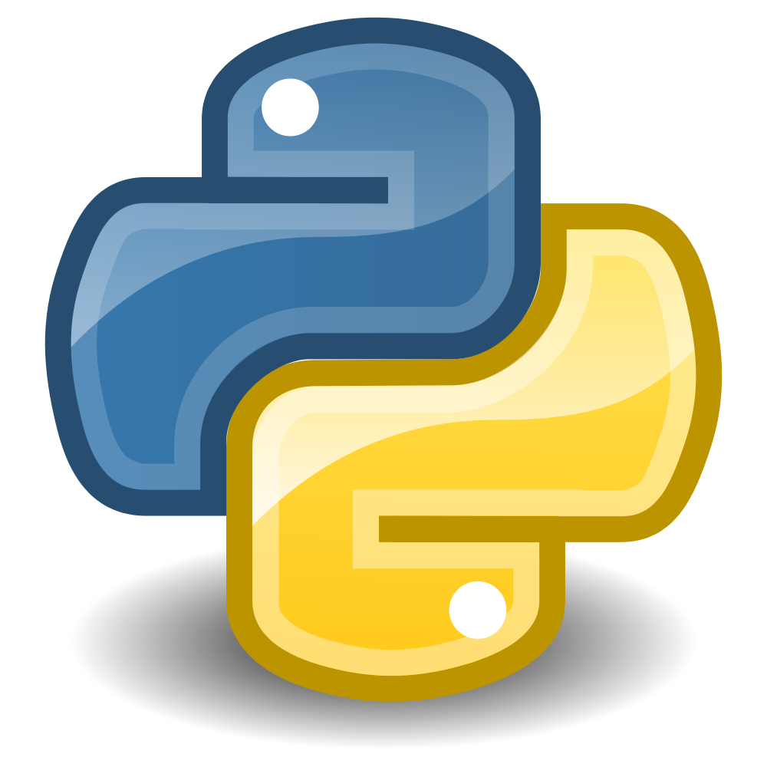


Data Science with Python and the Shiny Toys of Anaconda
Bryan Cafferky

Slide 2
Data Science with Python and the Shiny Toys of Anaconda
Bryan Cafferky

Slide 3

Getting Started with Anaconda
And now for something completely different!
https://github.com/bcafferky/shared/tree/master/PythonAnaconda

Slide 4
Anaconda Libraries
Matplotlib - Visualizations
NumPy – Arrays and Number Crunching
Scikit-learn – Data Science
Pandas – Data Wrangling
Seaborn – Visualizations
SQLAlchemy – SQL Support and Database Access
https://docs.anaconda.com/anaconda/packages/py3.6_win-64

Slide 5

Installing Anaconda
Anaconda Distribution
https://www.anaconda.com/download/

Slide 6
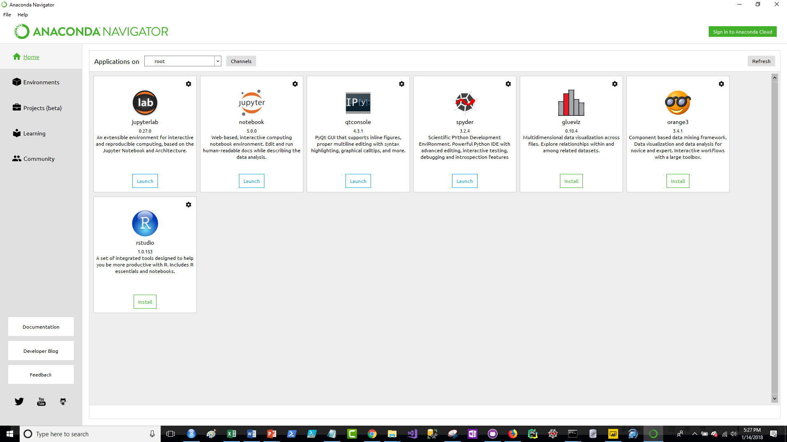
Anaconda Goodies

Slide 7
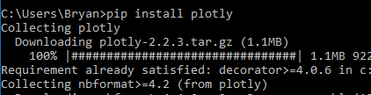
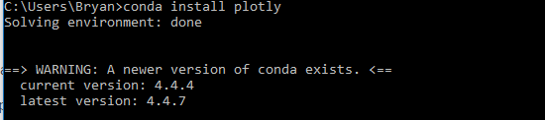
Package Management
pip
conda
Pip Installs Packages

Slide 8
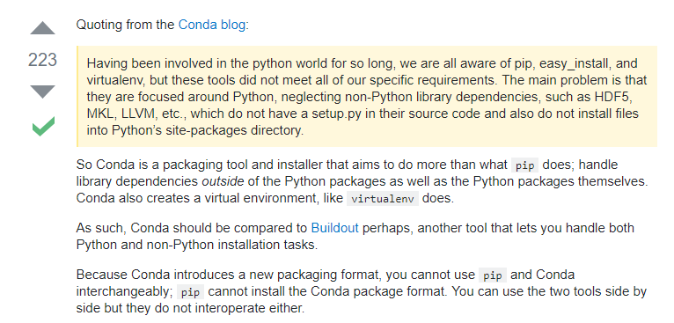
Pip vs. Conda

Slide 9
Wrapping Up

