Slide 1

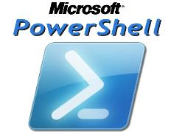

A long time ago in a galaxy far, far, away…
Restoring the balance of the force with PowerShell Remoting.
https://github.com/bcafferky/shared

Slide 2
Automation, scale, and peace would reign in the galaxy once again…..
But the force was to be brought into balance with a new generation of PowerShell Masters.
Chaos reigned and everything was done manually.
A long time ago in a galaxy far, far, away…

Slide 3


About Bryan Cafferky…
Technical Solutions Enabler
Decades of IT Experience in health care, insurance, banking, and ecommerce.
Microsoft MVP.
Author of Pro PowerShell for Database Developers.
Founded and lead PASS Chapter The RI Microsoft BI User Group.
Greater Boston Area Data Science, ML, and AI Group.
Frequent presenter at technical conferences and user groups.
https://www.linkedin.com/in/bryancafferky
@BryanCafferky – follow me!
Subscribe to me on YouTube!

Slide 4
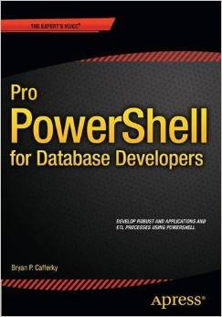
Author of…
Available on Amazon

Slide 5
Goals of this Presentation
What is PowerShell Remoting and why you need it?
Security Concerns
How to Set it Up
How to Use PowerShell Remoting

Slide 6


Why PowerShell?
Without PowerShell
With PowerShell

Slide 7
What is PowerShell Remoting?
Ability to connect from a client machine to other machines and submit PowerShell commands or scripts to those machines.
Can run synchronously or asynchronously.
Can run in batch mode or interactive mode.
Massive feature for scaling automation.

Slide 8
What is PowerShell Remoting?
“Interconnected are all things.
PowerShell is the force that binds everything together.”

Slide 9
Connecting it All
SQL Server
Windows Server
File System
PowerShell
SharePoint
Exchange Server
Active Directory
IIS
Azure

Slide 10
Remote Execution
Enable-PSRemoting -Force
Dev Server 1
Mary Smith’s Computer
DNS Server
Invoke-Command
Get-EventLog
Restart-Computer
PowerShell
Dev Server 2
Prod Server 1
Set-Service
Restart-Service
Show-EventLog
Test-Connection
Enable-PSRemoting -Force
Dev Server 3
John Doe’s Computer
Prod Server 2

Slide 11
Security Concerns with PowerShell Remoting?
Requires the remote machine to allow other machines to connect and run commands.
Port must be open.
Review setting this up with you organizations IT security to confirm you meet company policies and are secure.
For experimenting, choose non production machines with no production data like an Azure VM on a MSDN license subscription.

Slide 12
Security Concerns with PowerShell Remoting?
Some links:
https://docs.microsoft.com/en-us/powershell/scripting/setup/winrmsecurity?view=powershell-6
PowerShell Remoting Security Considerations
https://docs.microsoft.com/en-us/powershell/scripting/core-powershell/running-remote-commands?view=powershell-6
PowerShell Remoting Discussion by Expert Jason Helmick
http://www.jasonhelmick.com/2011/07/27/enabling-powershell-remoting-in-your-environment/

Slide 13
Enabling PS Remoting on Azure VM
DEMO
Creating you machines. Azure Data Science VMs work well.
See Script: scr_remote_vm_setup_remote_ps.ps1

Slide 14
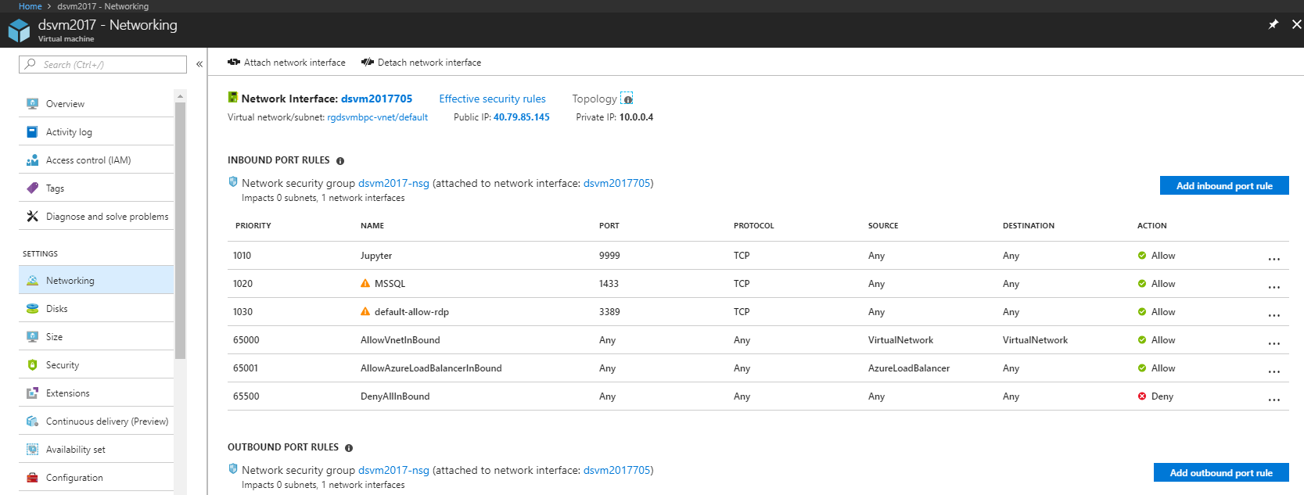
Enabling PS Remoting on Azure VM
Add Inbound Rule for 5986

Slide 15
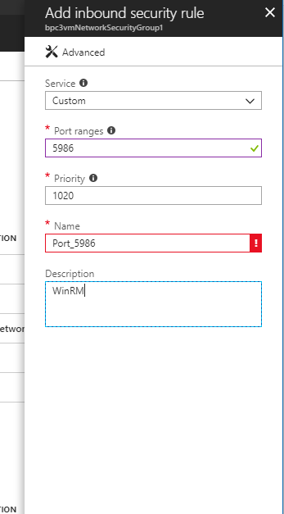
Enabling PS Remoting on Azure VM
Add Inbound Rule for 5986

Slide 16
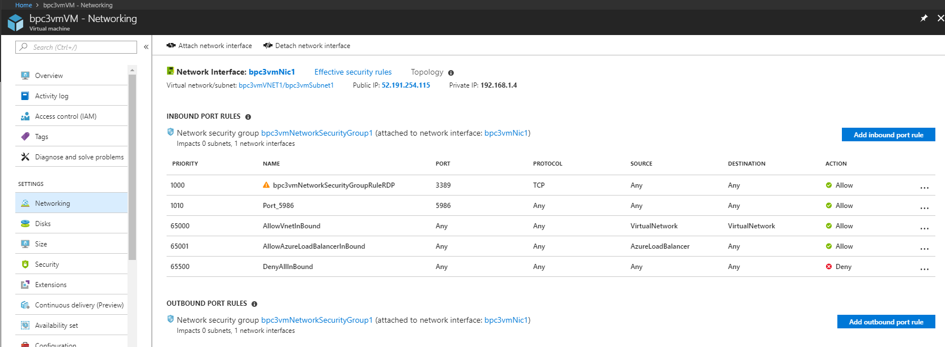
Enabling PS Remoting on Azure VM
Add Inbound Rule for 5986

Slide 17
Enabling PS Remoting on an Azure VM
Add Inbound Rule for 5986

Slide 18
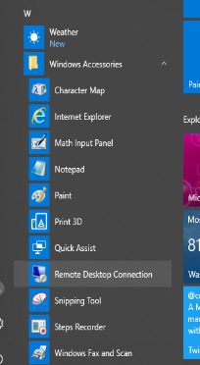
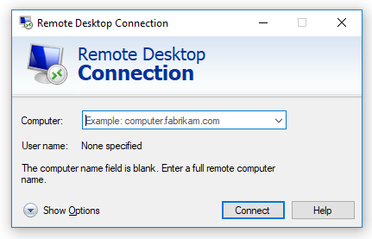
Connecting to Your VM
Paste the VM IP Address and click Connect.
Start Remote Desktop.

Slide 19
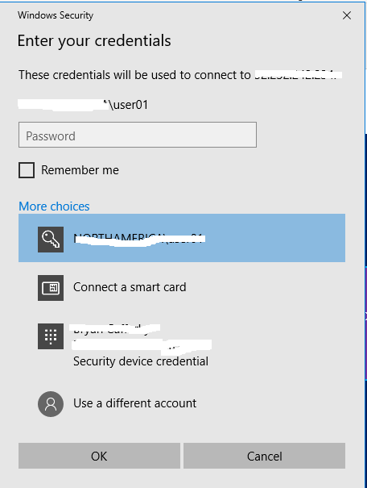
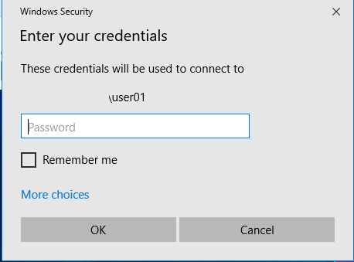
Connecting to Your VM
You may need to click on More choices.
Use a different account.

Slide 20
Connecting to Your VM
Enter the admin user account and password you set for the VM and click Ok.

Slide 21
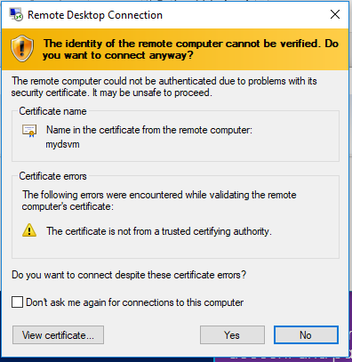
Connecting to Your VM
If you see this popup, just check the Don’t Ask me again check box and click Yes.

Slide 22
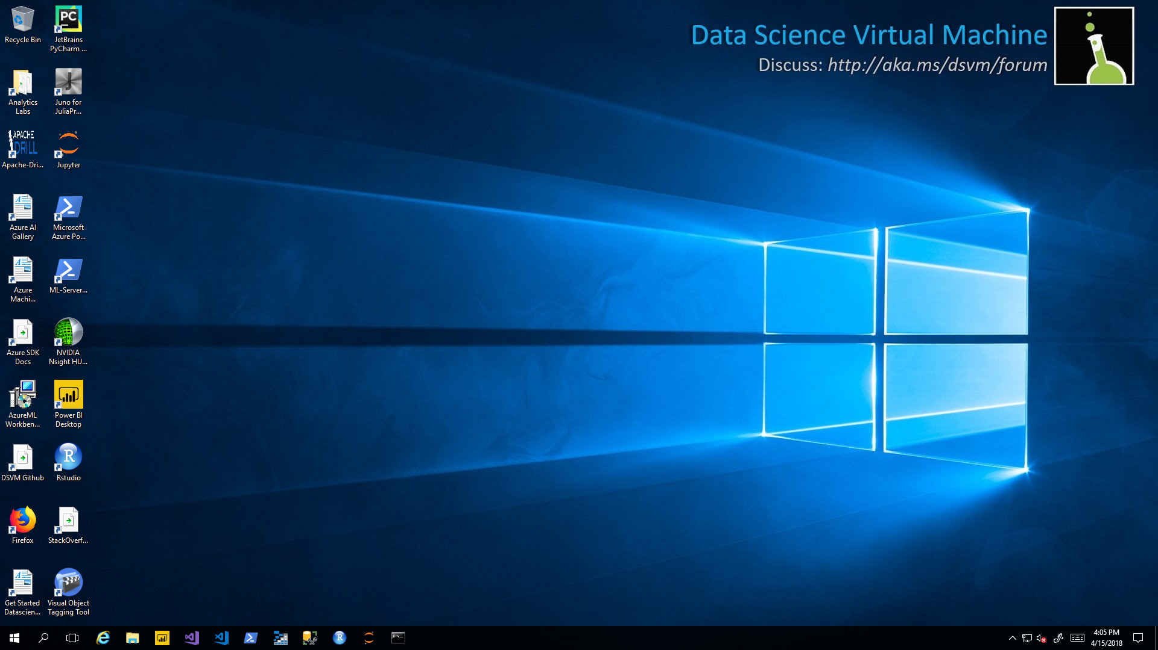
Connecting to Your VM
Wait until the VM is set up and Initialized. This can take a few minutes. Be patient.

Slide 23
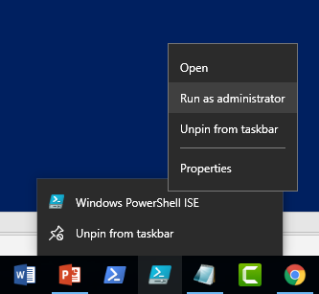
Enabling PS Remoting on Azure VM
Start the PowerShell ISE as Administrator
Right Mouse Click on PowerShell ISE Icon, Right Mouse Click on it again, select ‘Run as Administrator’.

Slide 24
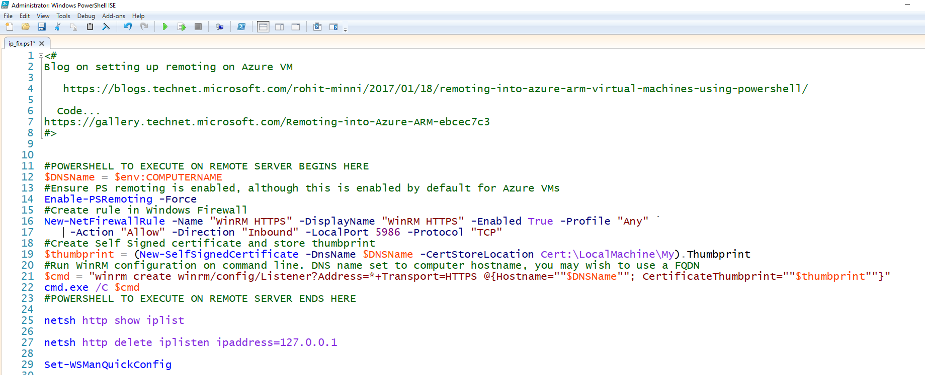
Enabling PS Remoting on Azure VM
See Script: scr_remote_vm_setup_remote_ps.ps1

Slide 25
Using PowerShell Remoting
DEMO
Blog by Timothy Warner
https://4sysops.com/archives/enable-powershell-remoting/

Slide 26
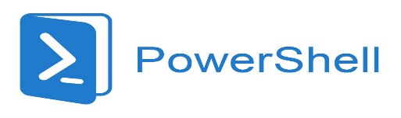

Wrapping Up: The Real Power of PowerShell

