Slide 1

SSIS 2012: The Quiet Revolution
Presented by Bryan Cafferky
Business Intelligence Consultant
BPC Global Solutions LLC
bryan256@msn.com
www.sql-fy.com
www.linkedin.com/in/bryancafferky
The RI Business Microsoft Intelligence User Group
http://www.meetup.com/The-RI-Microsoft-BIUG/

Slide 2
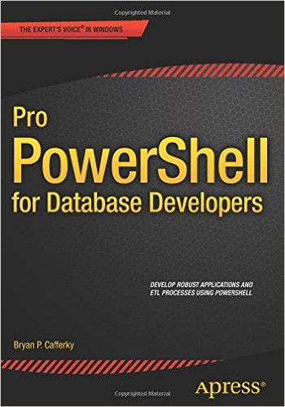
Author: Pro PowerShell for Database Developers

Slide 3
SSIS 2012
What is the Quiet Revolution?
New Architecture Addresses Many SSIS Limitations!
New SSIS Catalog in SQL Server managed via SSMS.
Built-in SSRS Reports on package executions.
Project Deployment Model: All the packages in the project are deployed together.
Configurable Project and Package parameters.
Environments – containers of configurations settings.
True database service execution.

Slide 4
SSIS 2012
Configuration Improvements
Project Deployment Model
All the packages in the project are deployed together.
Packages in the project can share Parameters and Connection Managers.
Parameter and Configuration Values can easily be configured in SSMS.
The Legacy Package Deployment Model is available but does not support the above features.

Slide 5
SSIS 2012
A Simple project example

Slide 6
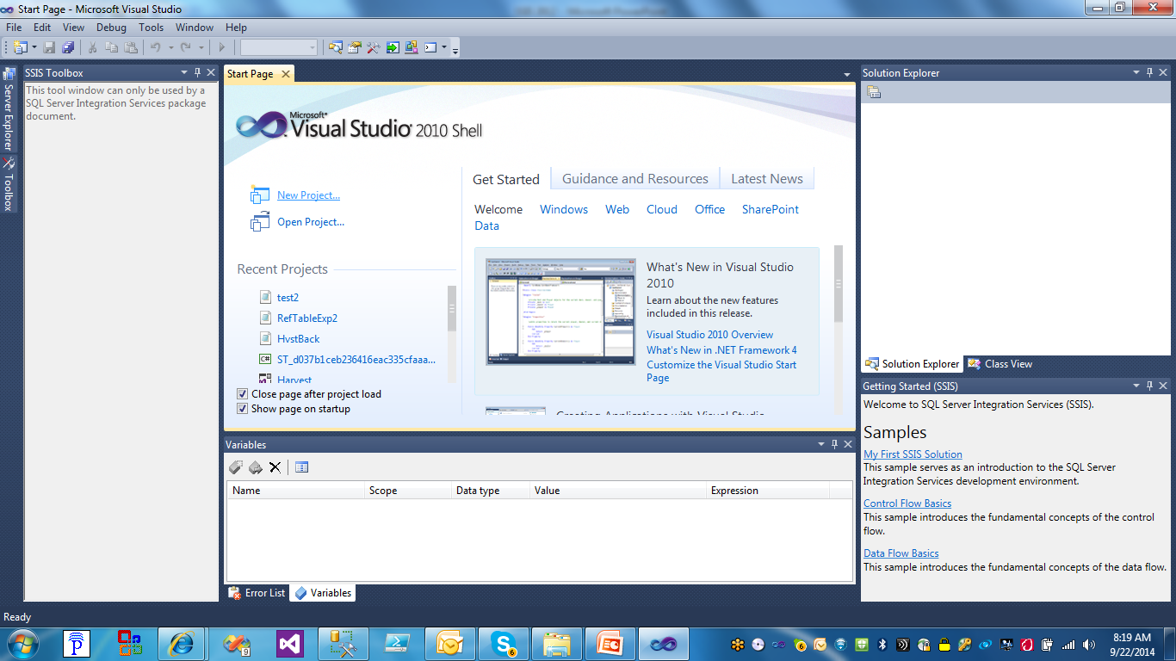
SSIS 2012
Creating a Project
Click on New Project

Slide 7
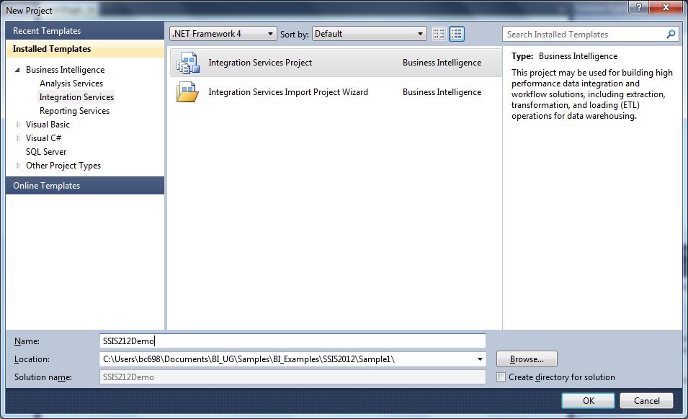
SSIS 2012
Creating a Project
Click on Integration Services Project

Slide 8
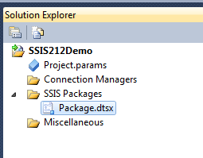
SSIS 2012
Creating a Project – Project Level Configuration
New in 2012 – Project Parameters
And
Project Level Connection Managers

Slide 9
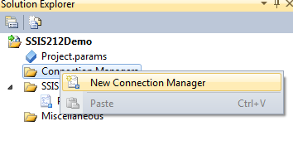
SSIS 2012
Creating a Project – Project Level Configuration
Right Mouse Click and Select New Connection Manager to create a Project Level Connection Manager

Slide 10
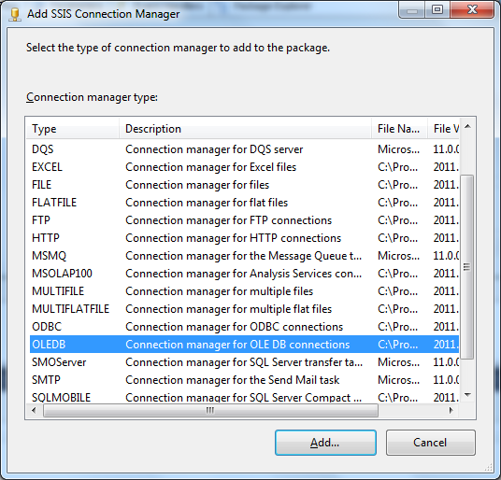
SSIS 2012
Creating a Project – Project Level Configuration
Select the Connection Type. OLEDB is the most common, i.e. SQL Server.

Slide 11
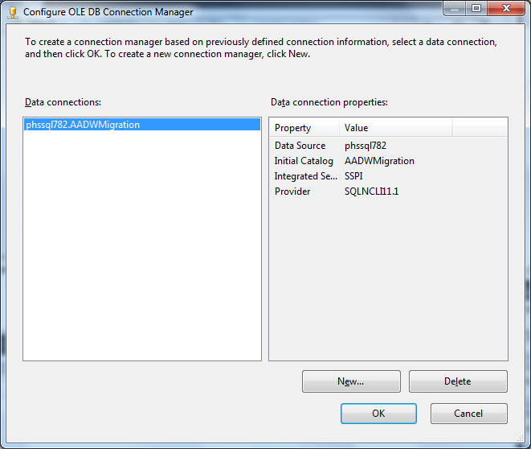
SSIS 2012
Creating a Project – Project Connection Manager
Enter the Connection Properties.

Slide 12
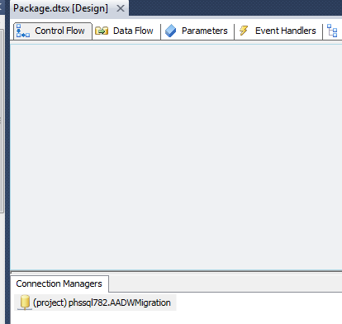
SSIS 2012
Creating a Project – Project Connection Manager
Note: (project) indicates this is a Project Level Connection Manager.

Slide 13
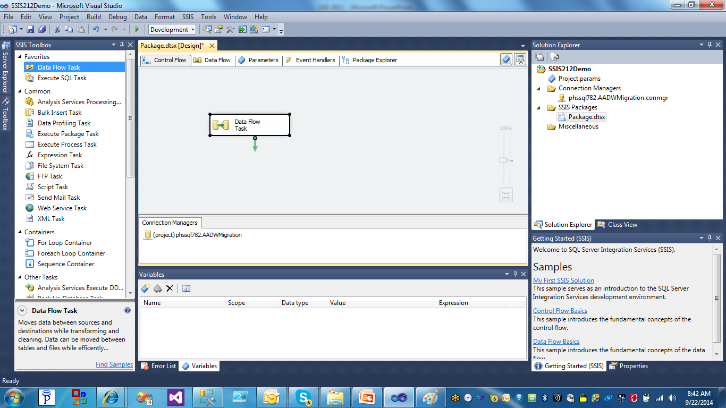
SSIS 2012
Add a Data Flow.
Creating a Project – Project Connection Manager

Slide 14
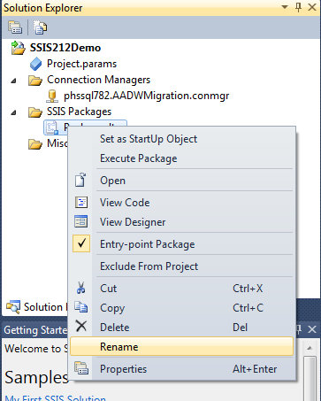
SSIS 2012
Creating a Project – Project Connection Manager
Right Mouse Click on the Package Name in Solution Explorer and select Rename to rename the package. Do not change the dtsx extension.

Slide 15
SSIS 2012
Parameters:
Variables that can be configured externally.
Can be scoped to the package or project.
Variables can get their value from a parameter.

Slide 16
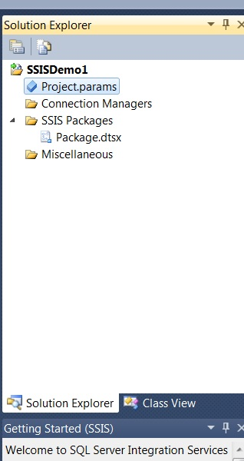
SSIS 2012
Creating a Project – Project Parameter
Double Click on the Project.parameters to create Project Parameters.
Project Parameters are just Project Level scoped variables but they are exposed
To the Configuration Editor in SSMS and SQL Agent.

Slide 17
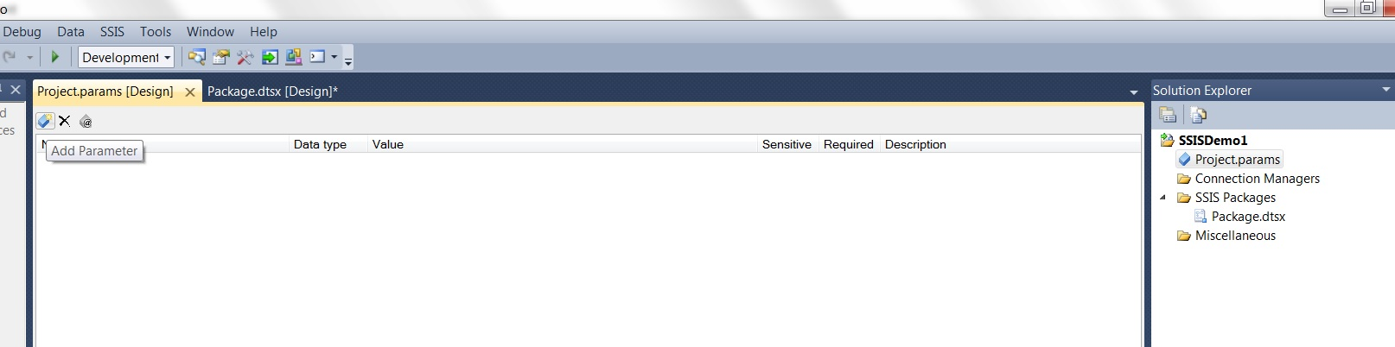
SSIS 2012
Creating a Project – Project Parameter
Click on the Add Parameter Icon

Slide 18
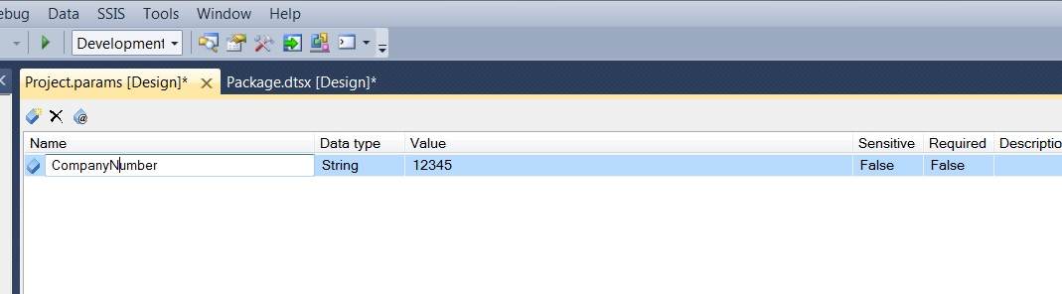
SSIS 2012
Creating a Project – Project Parameter
Enter Parameter Details

Slide 19
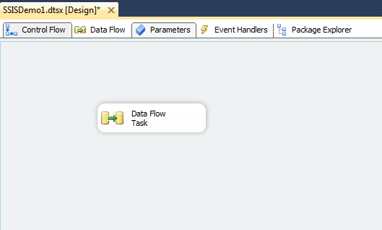
SSIS 2012
Creating a Project – package Parameter
With a package open, click on the Parameters tab so we can create Project Parameters.

Slide 20
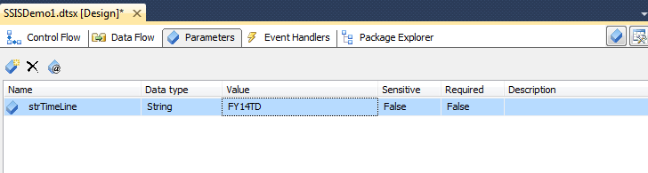
SSIS 2012
Creating a Project – PACKAGE Parameter
Create a new Parameter. You can make it required.

Slide 21
SSIS 2012
Deploying a project overview
Loads the entire project, i.e. all packages with current settings to the SSISDB in the Integration Services Catalogs.
Can be exported from the catalog as needed and restored to a Data Tools project.
Packages can be configured in the catalog and executed from the catalog.
SSISDB is a central repository for SSIS packages on a given SQL Server instance.

Slide 22
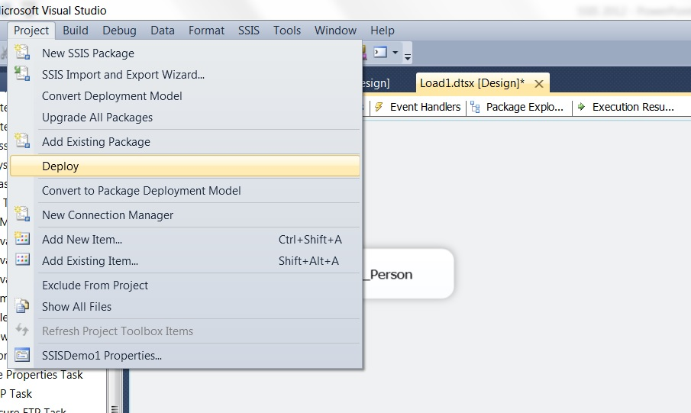
SSIS 2012
Deploying a project – Step 1
Click on Project and then Deploy.

Slide 23
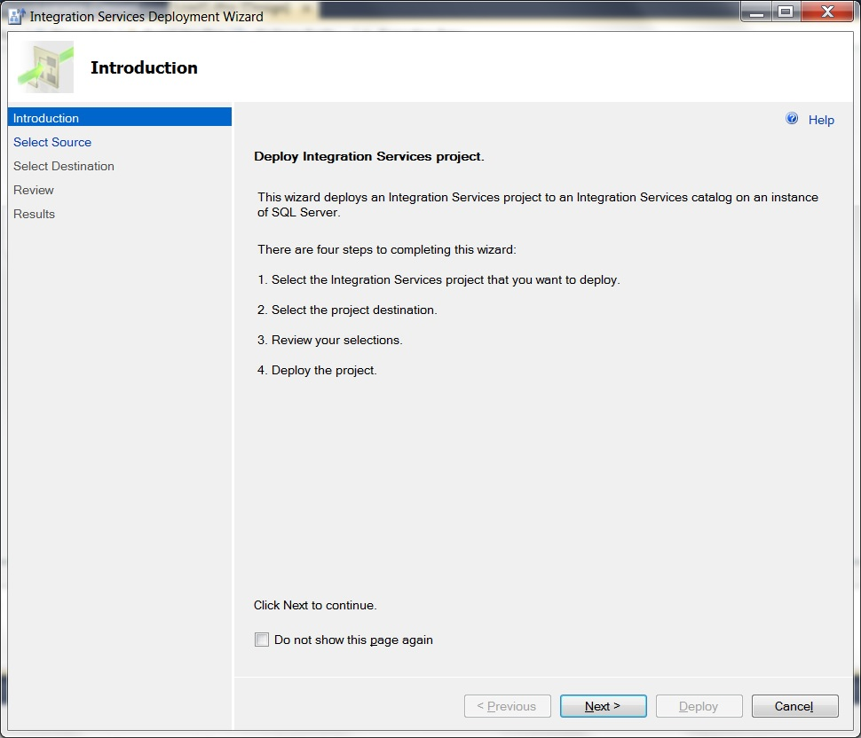
SSIS 2012
Deploying a project – step 2
The Deployment Steps screen. Click Next.

Slide 24
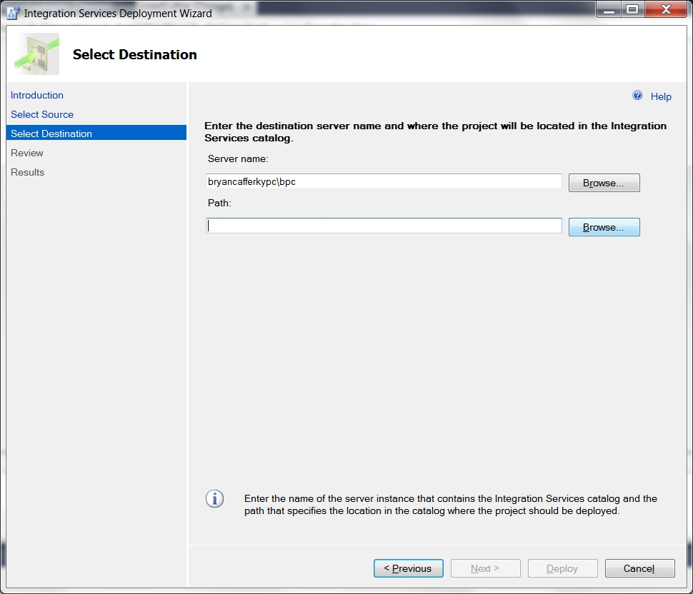
SSIS 2012
Deploying a project – step 3
Enter the SQL Server Instance where the project should be deployed. Click Browse to locate the folder.

Slide 25
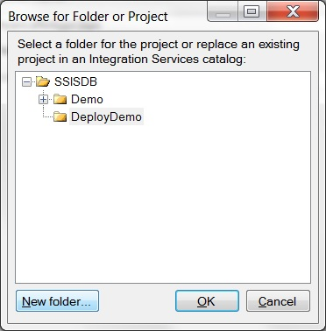
SSIS 2012
Deploying a project – step 4
Select the folder or click on New Folder to create a one.

Slide 26
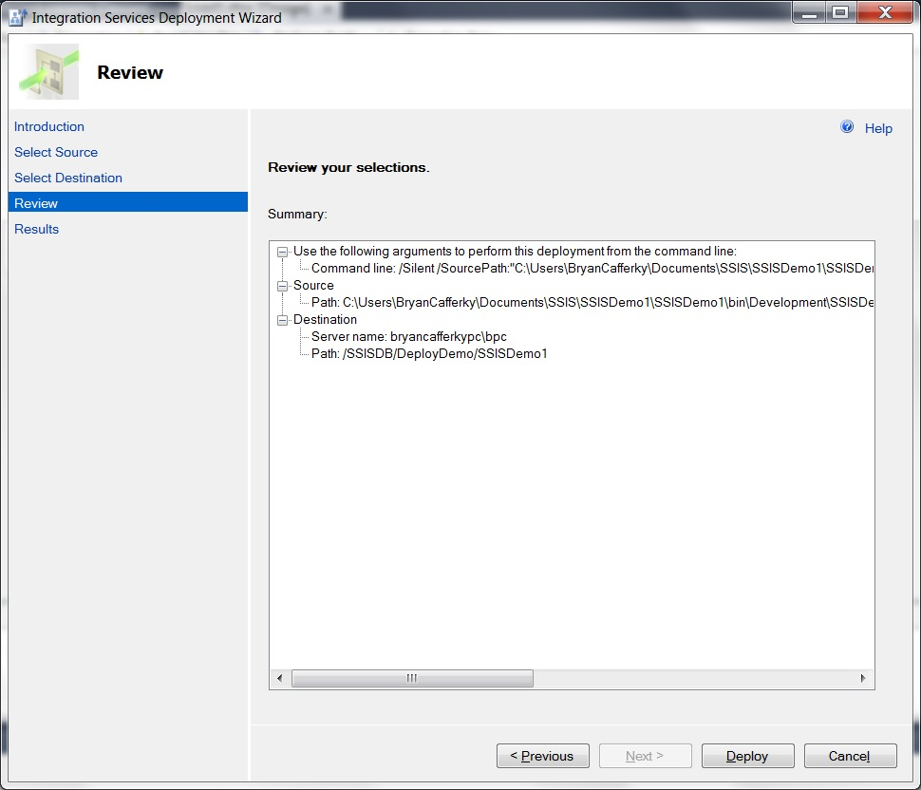
SSIS 2012
Deploying a project – step 5
Verify the settings and click Deploy.

Slide 27
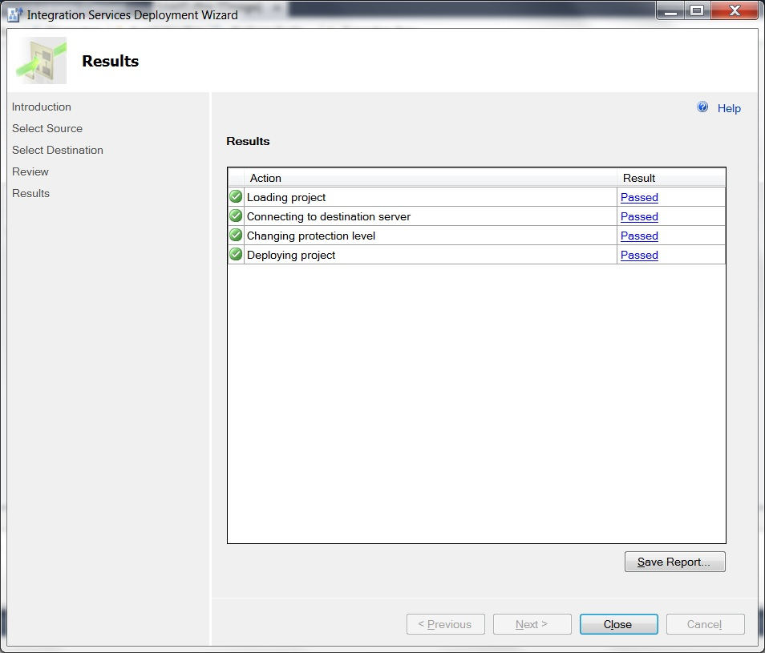
SSIS 2012
Deploying a project – step 6
The deployment confirmation screen shows all tasks Passed. Click Close when ready.

Slide 28
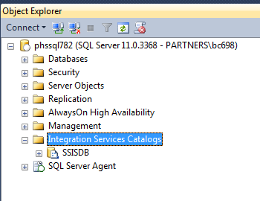
SSIS 2012
New in 2012 – The Integration Services Catalog
Exposes Projects, Packages and Configurationns.

Slide 29
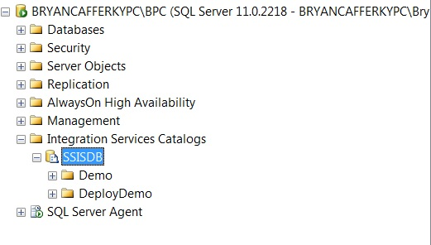
SSIS 2012
New in 2012 – The Integration Services Catalog
Folders hold Projects and Environments.

Slide 30
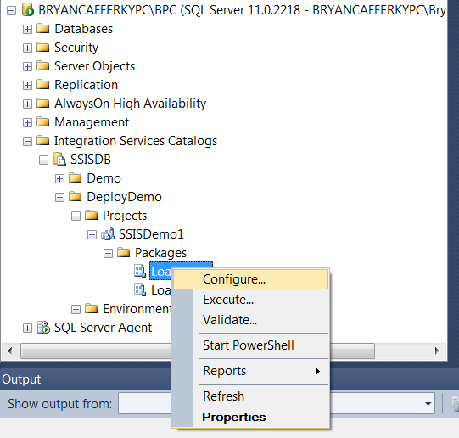
SSIS 2012
New in 2012 – The Integration Services Catalog
Right Mouse Click on a Package or Project to get a Context Sensitive Menu. Select Configure.

Slide 31
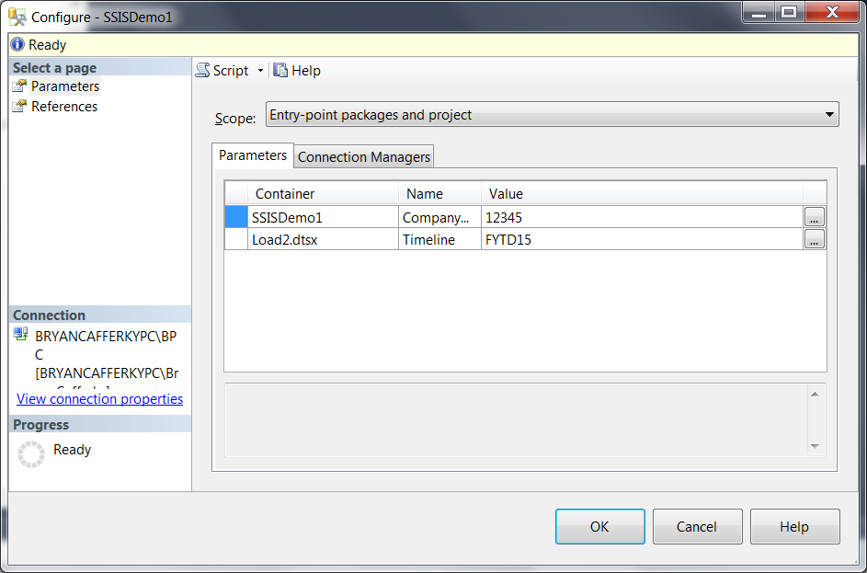
SSIS 2012
New in 2012 – The Integration Services Catalog - Configuration
Enter values for Project Parameters and Connection Managers.

Slide 32
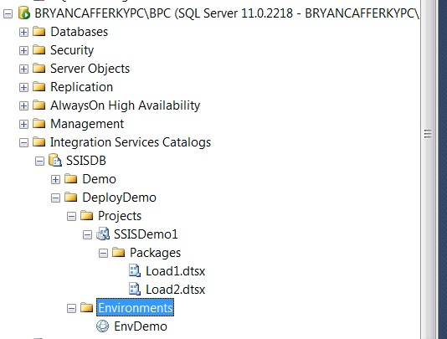
SSIS 2012
New in 2012 – The Integration Services Catalog - Environments
SSIS Environment.
An Environment is just a set of Project Configuration Values stored
as an object in the catalog. The idea is that for each environment, Dev,
Integration, QA and Production, the configuration values will need to be
Different. SSIS Environments make this easier to manage.

Slide 33
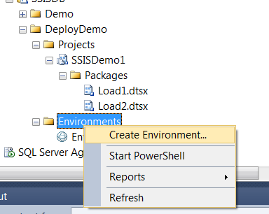
SSIS 2012
New in 2012 – The Integration Services Catalog - Environments

Slide 34
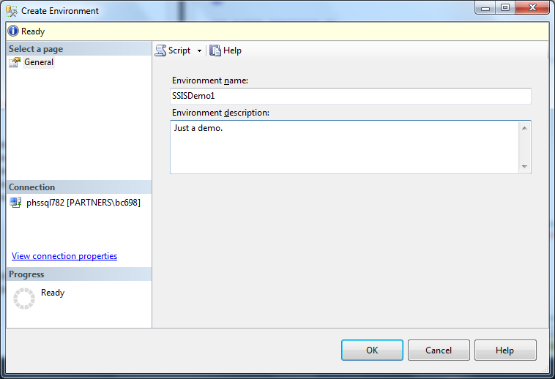
SSIS 2012
New in 2012 – The Integration Services Catalog - Environments
Enter a named and description and click Ok.

Slide 35
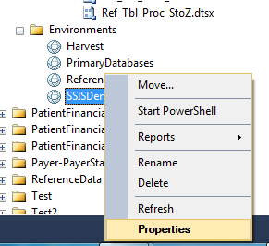
SSIS 2012
New in 2012 – The Integration Services Catalog - Environments
Right Mouse Click and select Properties to edit.

Slide 36
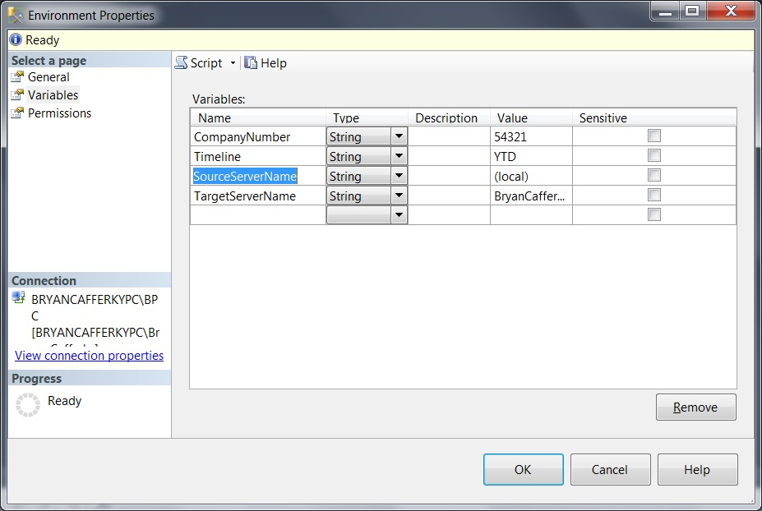
SSIS 2012
New in 2012 – The Integration Services Catalog - Environments
Enter variable names and values. These will be assigned to configuration properties.

Slide 37
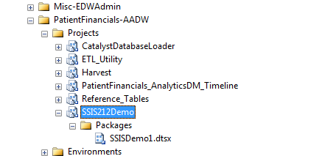
SSIS 2012
New in 2012 – Deploying
You can see the project in the catalog.

Slide 38
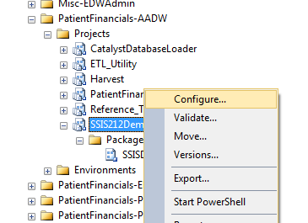
SSIS 2012
New in 2012 – Configuration
Right mouse click on the Project and select Configure.

Slide 39
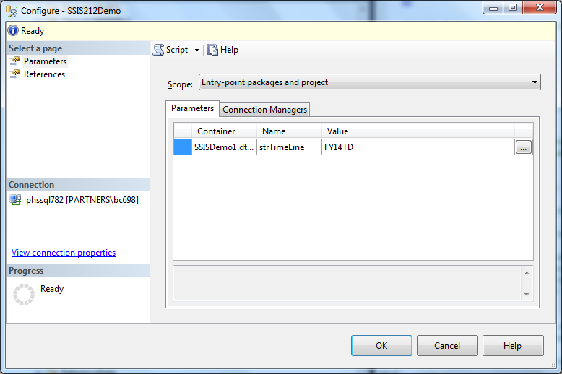
SSIS 2012
New in 2012 – Configuration
Click on the refrences to configure.

Slide 40
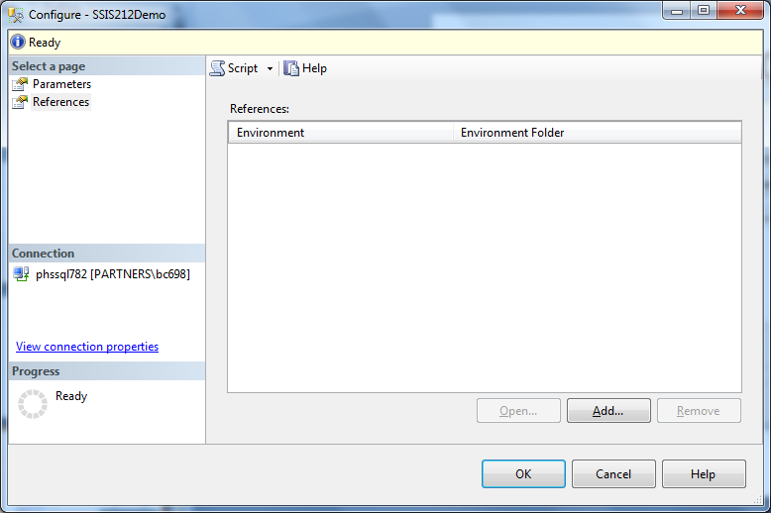
SSIS 2012
New in 2012 – Configuration
Click on Add to add a reference to an Environment.

Slide 41
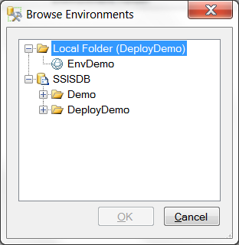
SSIS 2012
New in 2012 – Configuration
Click on the environment and Ok.

Slide 42
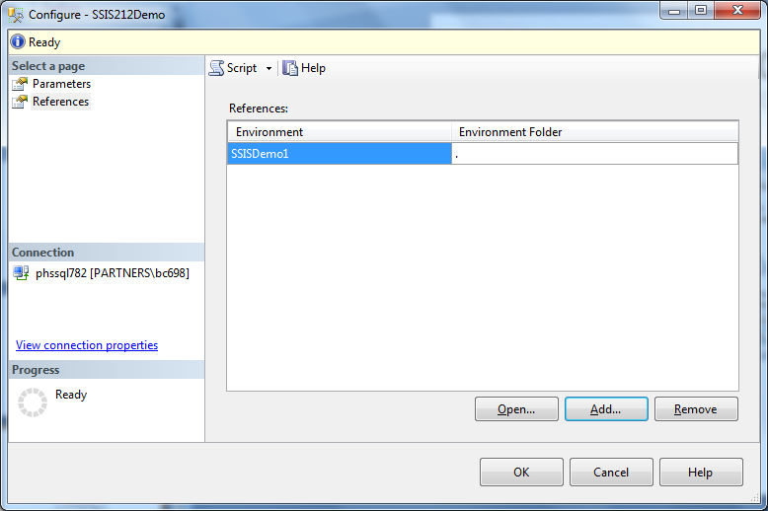
SSIS 2012
New in 2012 – Configuration
You can see the reference was added..

Slide 43
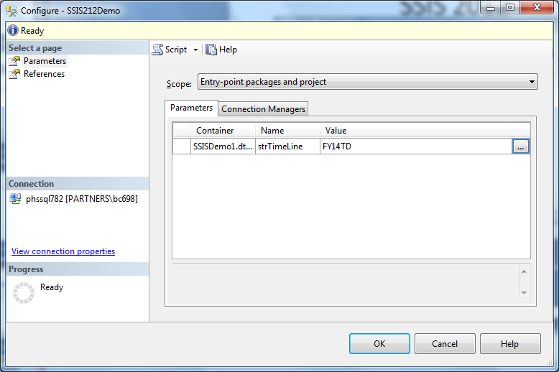
SSIS 2012
New in 2012 – Configuration
Click on Parameters and then the ellipsis.

Slide 44
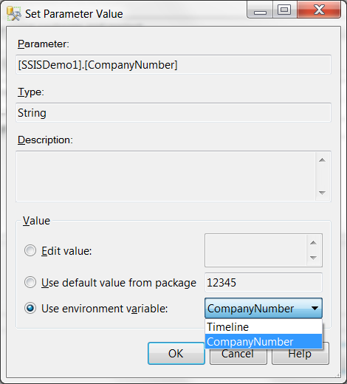
SSIS 2012
New in 2012 – Configuration
Check Use Environment variable and select a variable.

Slide 45
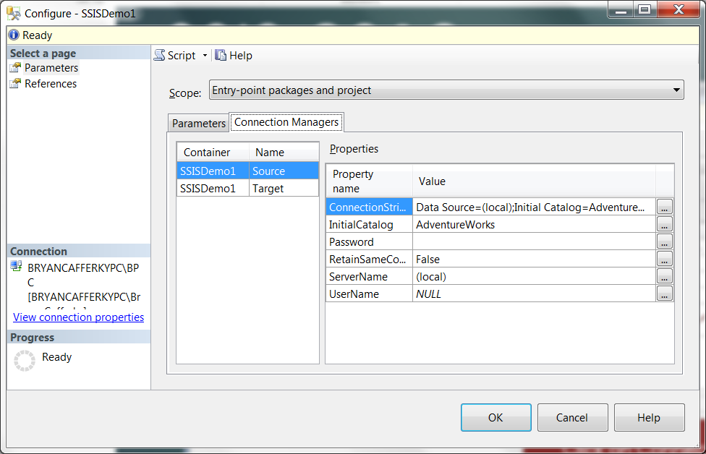
SSIS 2012
New in 2012 – Configuration
Click on Connection Managers and the ellipsis next to ServerName.

Slide 46
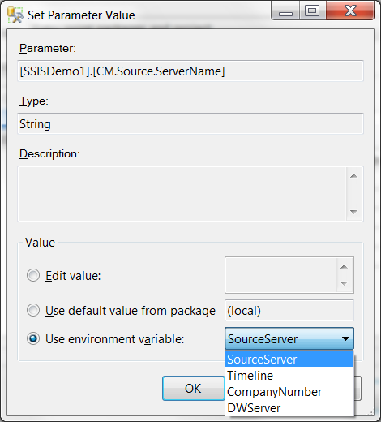
SSIS 2012
New in 2012 – Configuration
Check ‘Use environment variable’ and select the variable from the drop down..

Slide 47
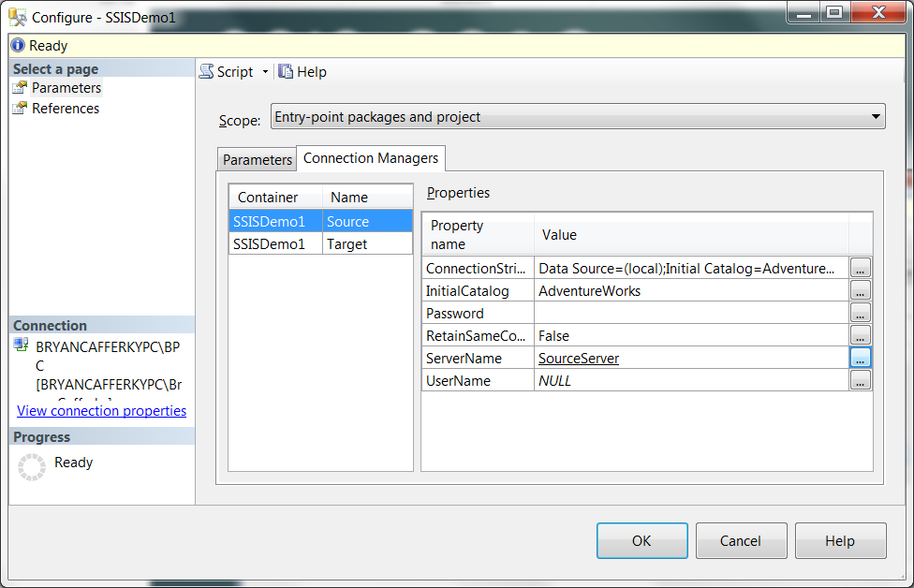
SSIS 2012
New in 2012 – Configuration
Notice ServerName is now set to the environment variable name.

Slide 48
SSIS 2012
Using SSIS with SQL Agent

Slide 49
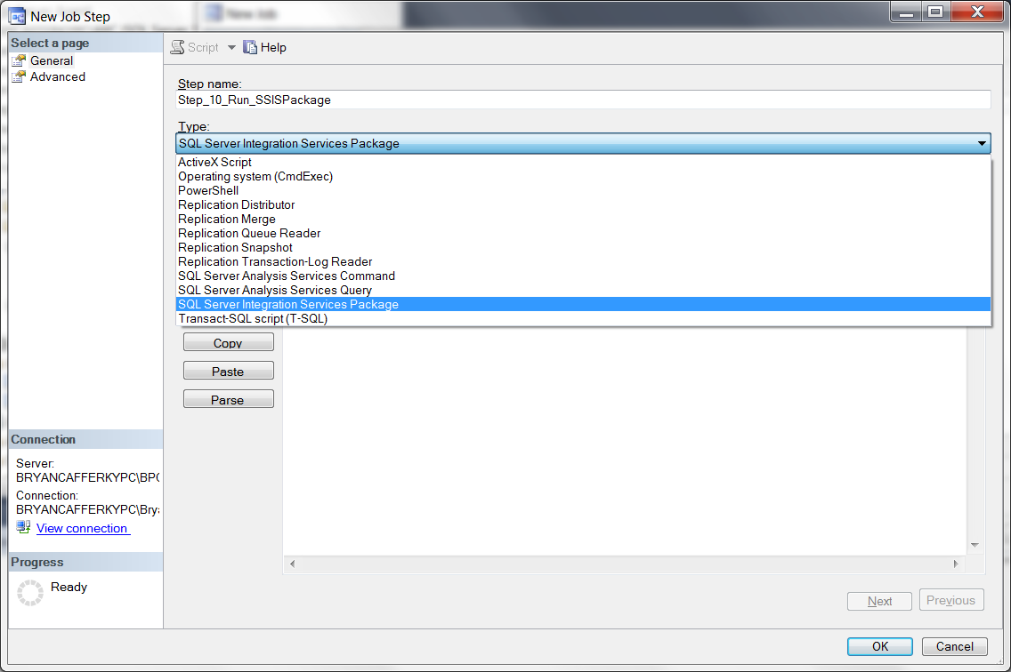
SSIS 2012
Using SSIS with SQL Agent

Slide 50
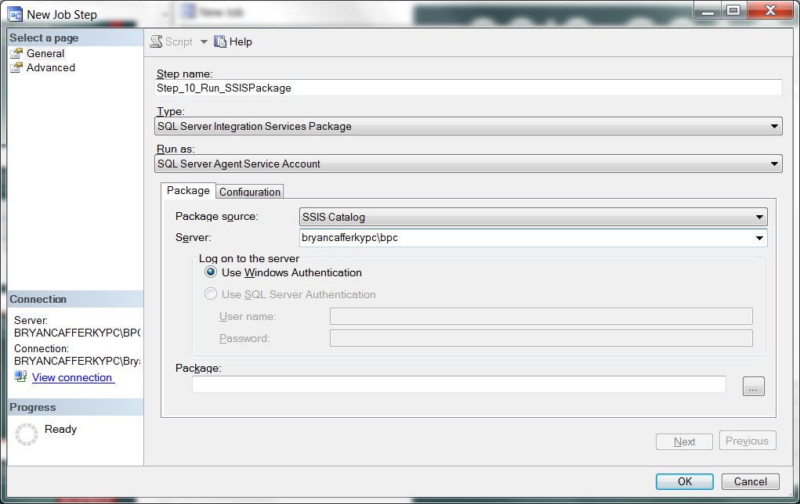
SSIS 2012
Using SSIS with SQL Agent
After entering the server name, click the ellipsis next to the Package text box.

Slide 51
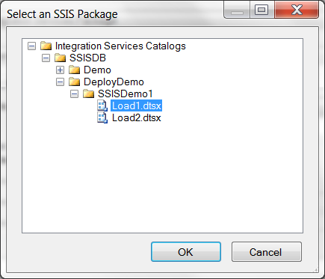
SSIS 2012
Using SSIS with SQL Agent

Slide 52
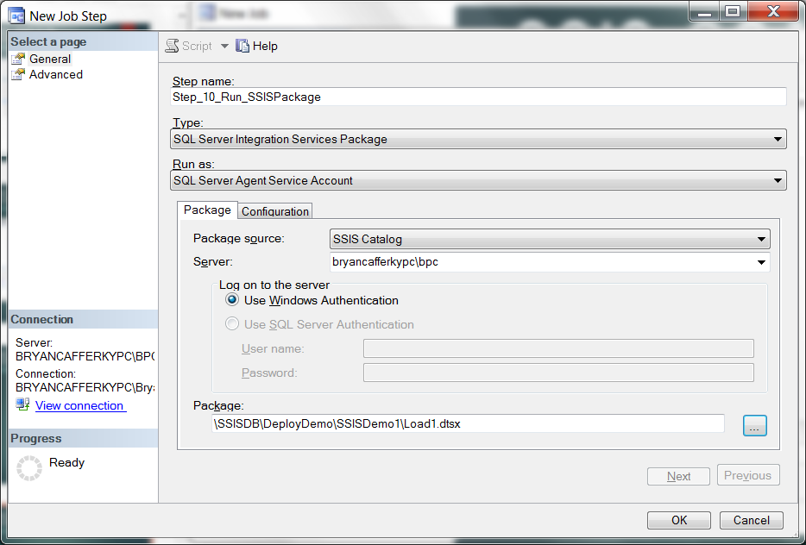
SSIS 2012
Using SSIS with SQL Agent

Slide 53
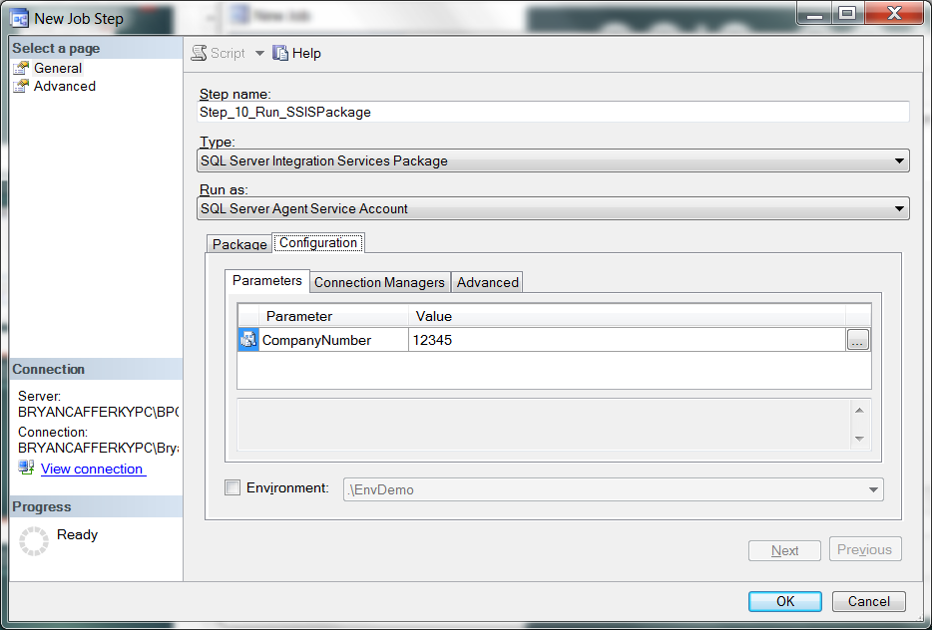
SSIS 2012
Using SSIS with SQL Agent

Slide 54
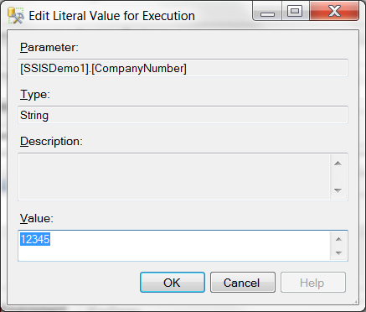
SSIS 2012
Using SSIS with SQL Agent

Slide 55
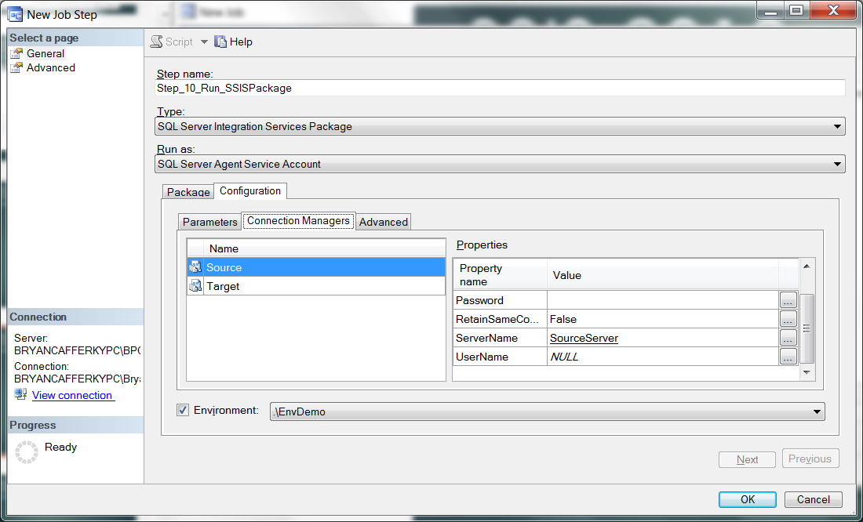
SSIS 2012
Using SSIS with SQL Agent

Slide 56
SSIS 2012
Using SSIS with SQL Agent
Can use package/project defaults.
Can use Environment variables.
Can be overridden with hard coded values.

Slide 57
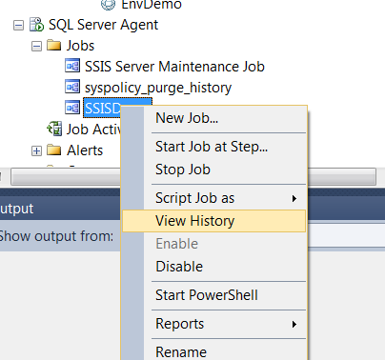
SSIS 2012
Using SSIS with SQL Agent

Slide 58
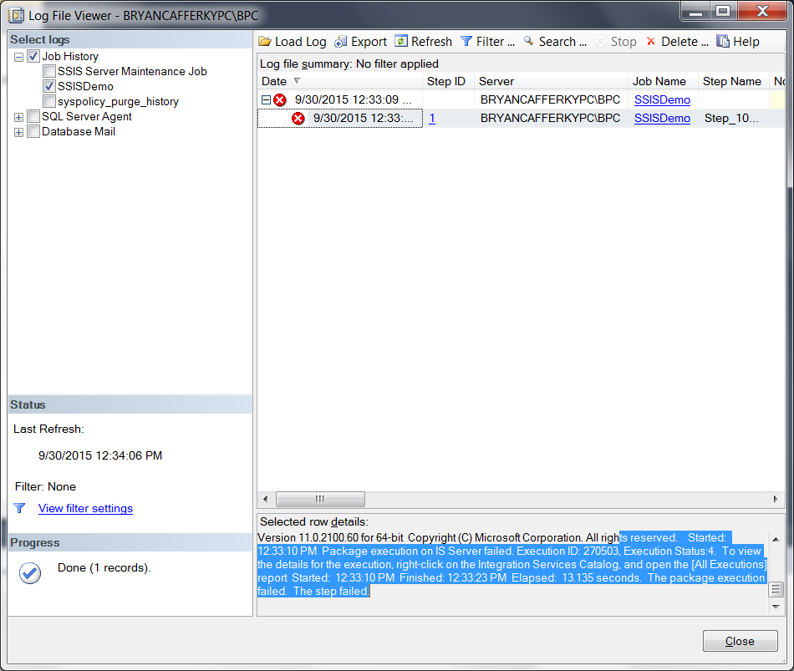
SSIS 2012
Using SSIS with SQL Agent

Slide 59
SSIS 2012
Using SSIS with SQL Agent

Slide 60

SSIS 2012
New in 2012 – Configuration
When a package fails, you need to view Reports from the catalog to get details.

Slide 61

SSIS 2012
New in 2012 – Configuration
Click on All Messages for error details.

Slide 62
SSIS 2012
New in 2012 – Configuration
QA
Development
Production
SSIS Catalog
SSISDemo Folder
SSISProject1
SSISEnv1
Server=devserver
SSIS Catalog
SSISDemo Folder
SSISProject1
SSISEnv1
Server=qaserver
SSIS Catalog
SSISDemo Folder
SSISProject1
SSISEnv1
Server=prodserver
You can deploy the project to each server and it automatically picks up the
configuration settings for that server. Note: We are using relative references.

Slide 63
SSIS 2012
What is the Quiet Revolution?
New Architecture Addresses Many SSIS Limitations!
New SSIS Catalog in SQL Server managed via SSMS.
Built-in SSRS Reports on package executions.
Project Deployment Model: All the packages in the project are deployed together.
Configurable Project and Package parameters.
Environments – containers of configurations settings.
True database service execution.

