Slide 1
Lighting Talks
Jupyter Notebooks – One IDE to Rule Them All
Image Recognition with Pre Trained Deep Neural Networks
Databricks – A Spark Based Data Science Team Collaboration Platform
Using SQL with R and Python
https://github.com/bcafferky/shared/

Slide 2



An Introduction to Jupyter Notebooks
by Bryan Cafferky
https://github.com/bcafferky/shared/

Slide 3


About Bryan Cafferky…
Microsoft Technical Solutions Professional
Decades of IT Experience
Author of Pro PowerShell for Database Developers
Experienced in health care, insurance, banking, and ecommerce
Founded and lead PASS Chapter The RI Microsoft BI User Group
Founded and Lead the Greater Boston Data Science, Machine Learning, and AI Group
Subscribe to my channel!
https://www.youtube.com/user/Bryancutube256123
https://www.linkedin.com/in/bryancafferky
@BryanCafferky – follow me!

Slide 4
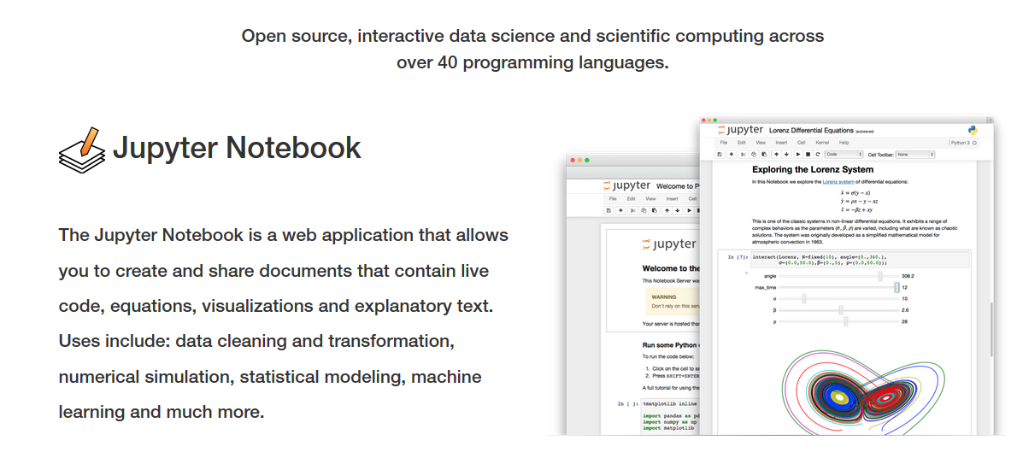
What is Jupyter Notebook?

Slide 5




When to Use Notebooks?
Teaching
Collaboration
Research
Exploration

Slide 6


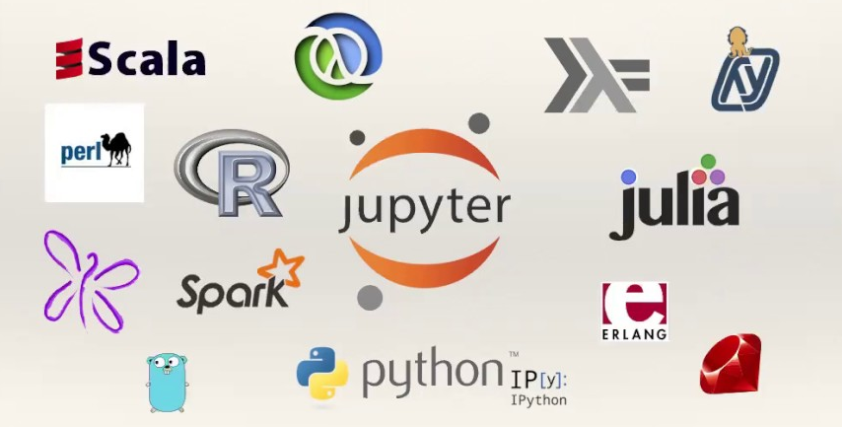

Why Use Notebooks?
75+ Languages Supported
Sharing

Slide 7
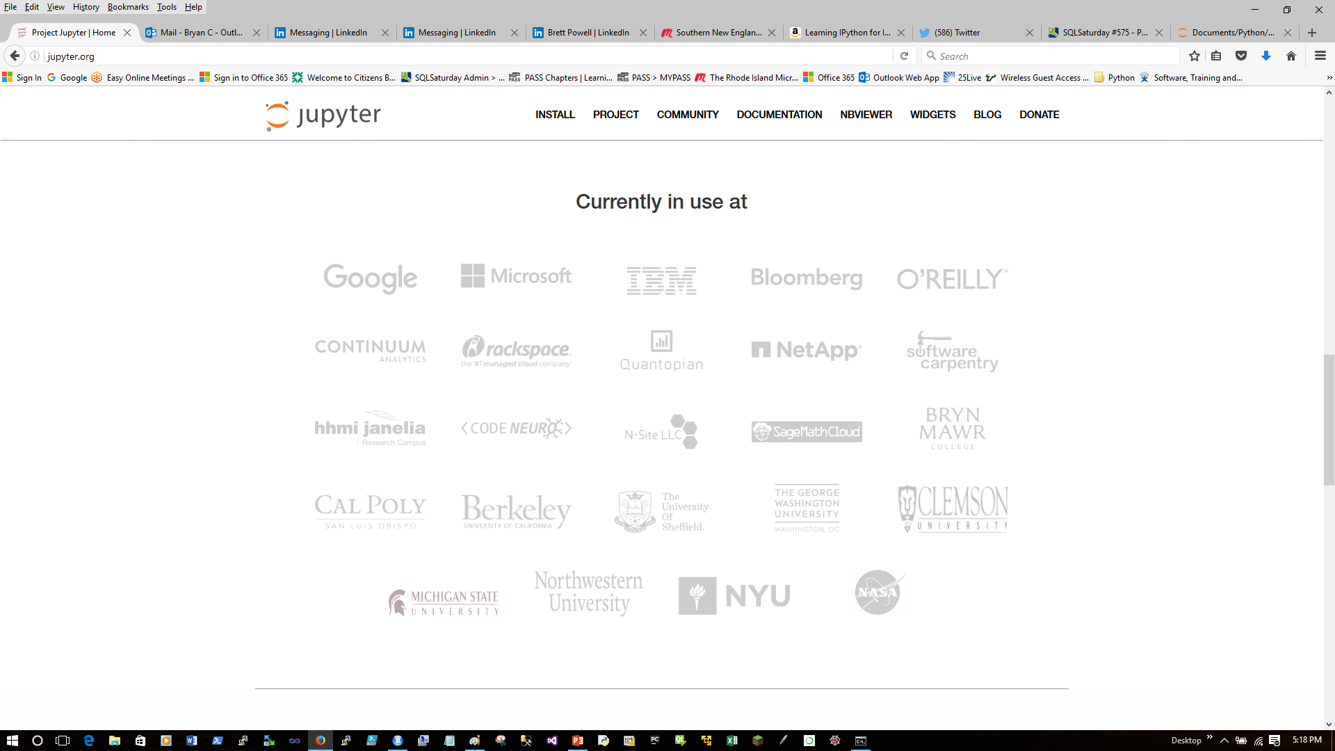
Who uses Jupyter Notebooks?

Slide 8
What’s in a name?
Emphasizes multi-language support.
Jupyter
R
Julia
Python

Slide 9
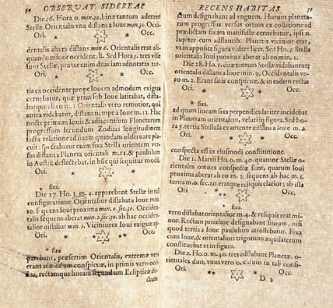
Why Notebook?
From Galileo’s Notebook –
Drawing’s of Jupiter’s satellites.

Slide 10
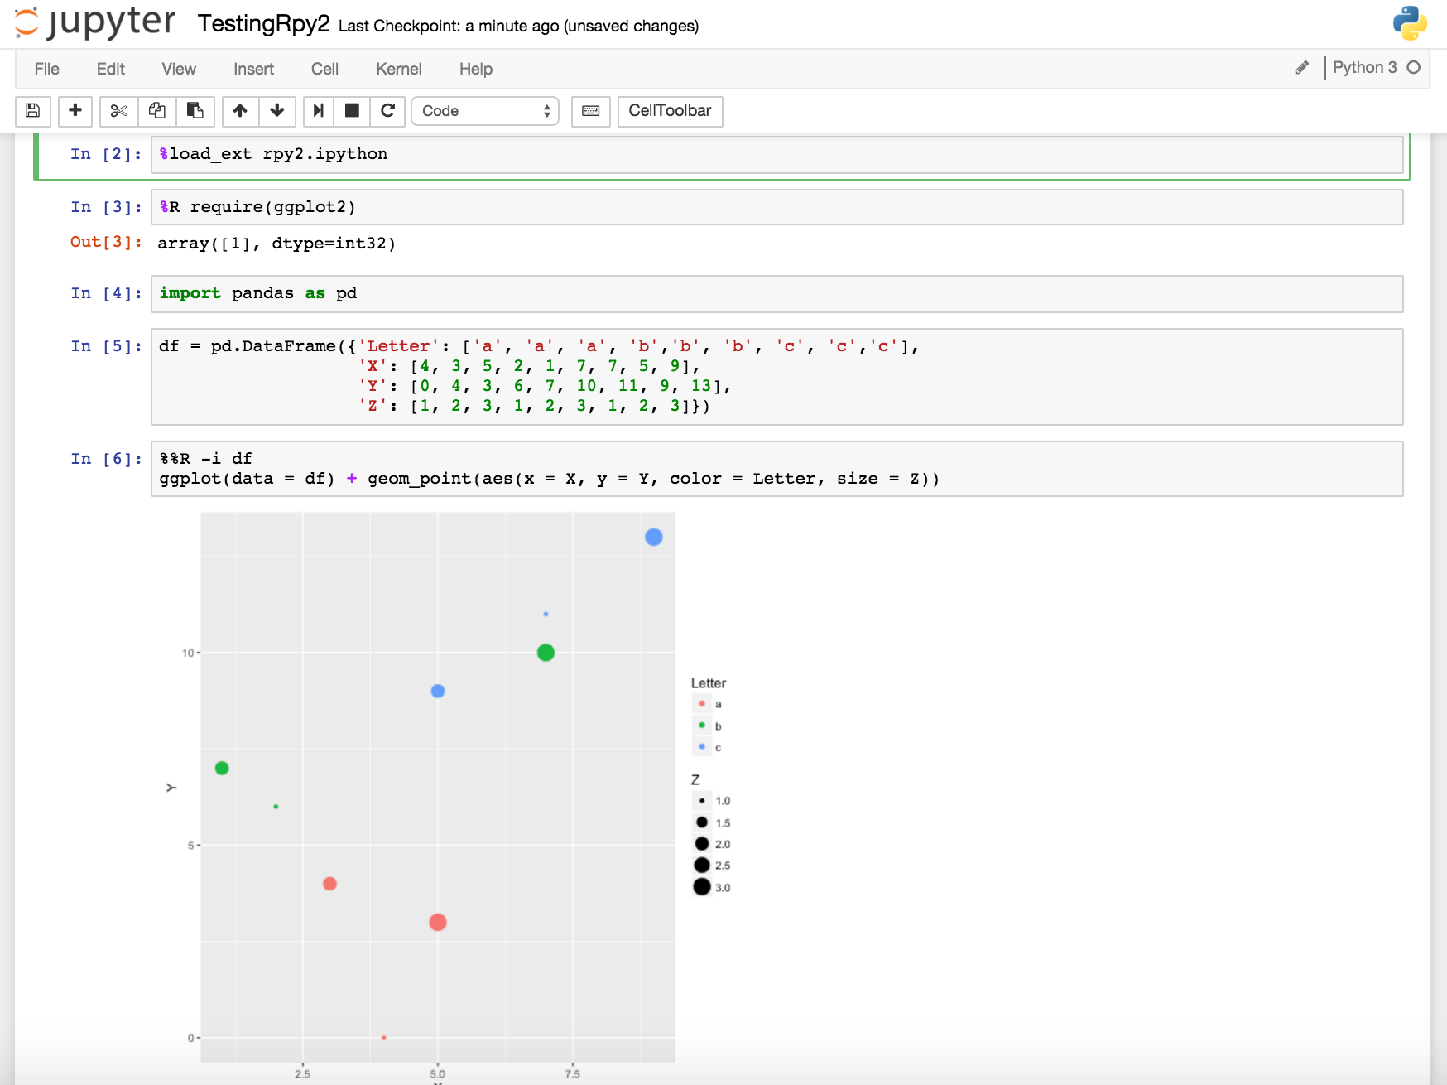
What is Jupyter Notebook?
Execute the cell
Command Prompt called a cell
Code executes in real time.
Can go back, edit and re-run cells.
Like a cross between a command line and Excel spreadsheet.
Rich visualizations rendered inline.

Slide 11
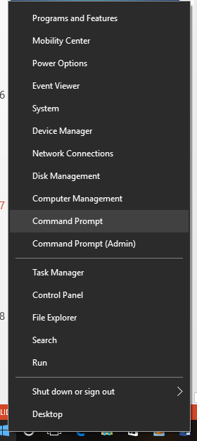
Starting Jupyter Notebook
Start the command shell.
Included with the Python Anaconda Distribution
https://www.anaconda.com/download/

Slide 12
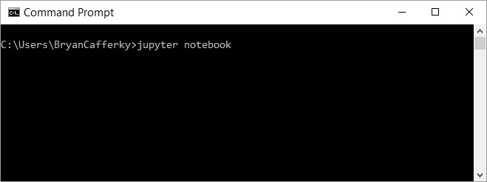
Installing Jupyter Notebook
Start the Jupyter Notebook
Windows Command Prompt
Note: The notebook starts pointing to the folder from where the notebook was started.

Slide 13
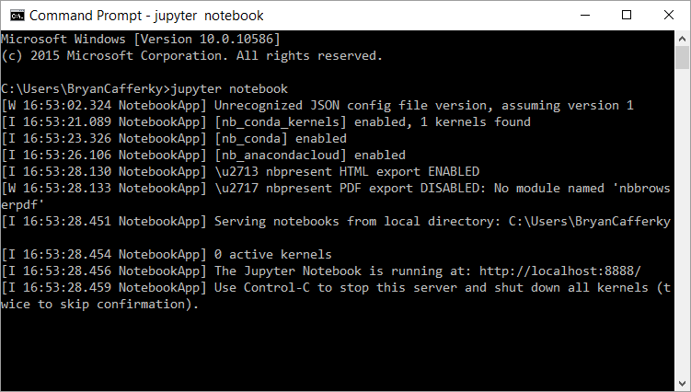
The Jupyter Server Running

Slide 14
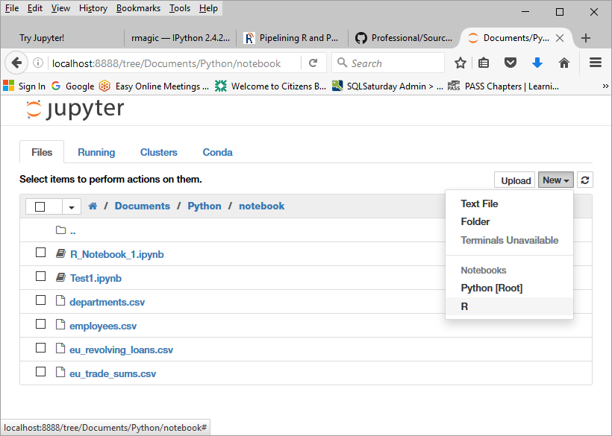
A First Look at a Notebook
Select New and the kernel, i.e. R

Slide 15
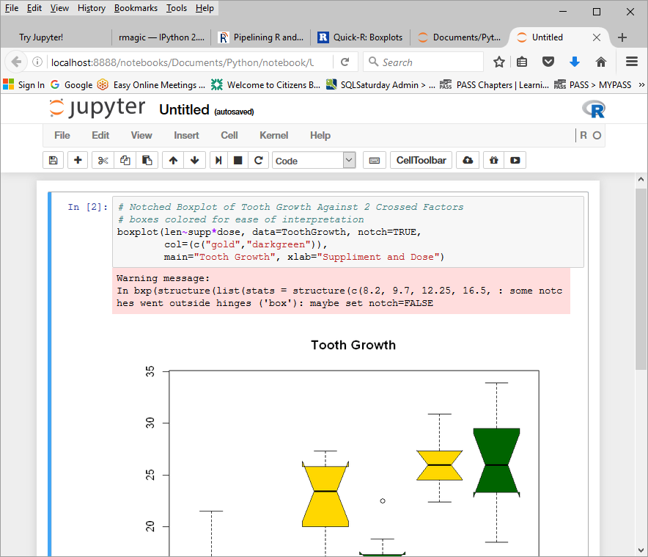
A First Look at a Notebook
Kernel Running
Enter R code and press Shift + Enter
Or
Click on

Slide 16
The Cell Toolbar
Save Notebook
Cut Cell
Copy Cell
Move Cell Down 1
Stop Cell Execution
Insert Cell
Paste Cells Below
Move Cell(s) Up 1
Run Code in Selected Cell(s)
Restart the Kernel
Set Cell Content Type

Slide 17

Exploring Jupyter…
New notebook
Sample notebooks
Python
R
Cell Magic
Widgets

Slide 18
http://jupyter.org/
Documentation
Free notebook play area

Slide 19
Use R and Python Together…
Loads R Python Extension
%R to run R code in the cell
Default language is Python 3
R ggplot call passing data frame, df, from Python
%%R defines data to be passed between R and Python:
-i = Python to R
-o = R to Python

Slide 20
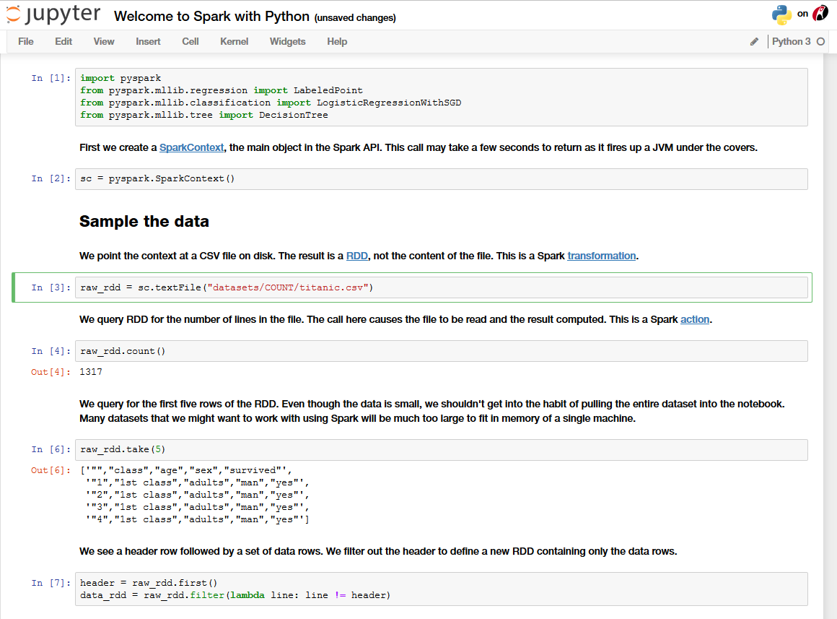
Accessing Spark with pyspark…
Import pyspark module
Set the Spark context
Resilient Distributed Dataset
Point context to HDFS file
Reads the data in Spark
Sample the data

Slide 21
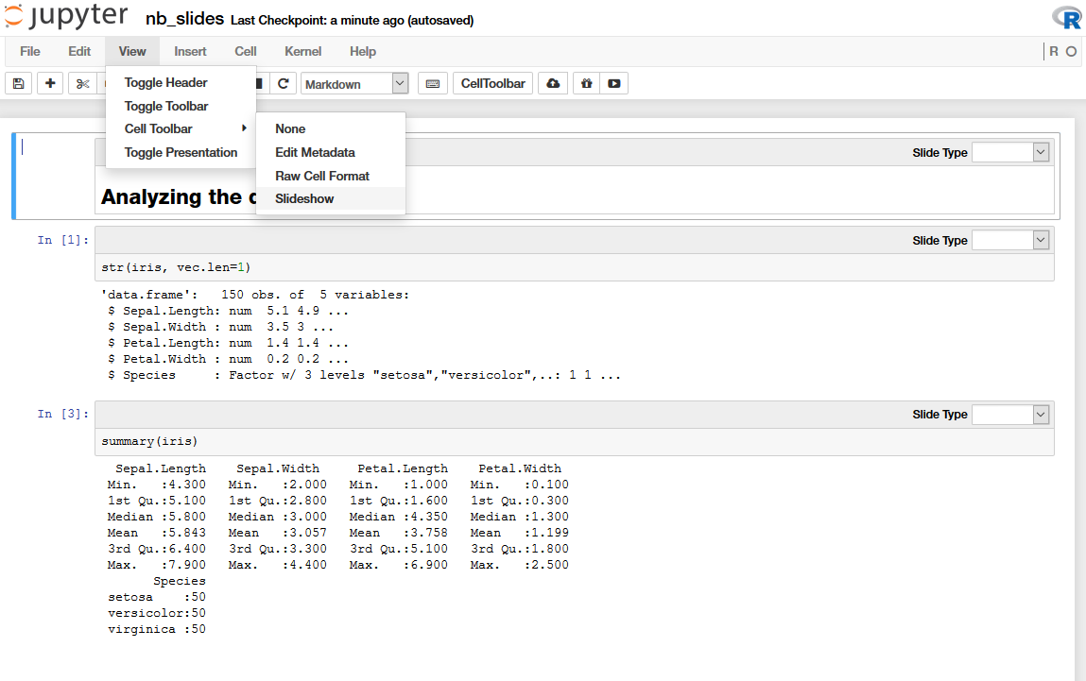
Presentations from Jupyter…
Switch to Slideshow Mode
Organize Slides

Slide 22
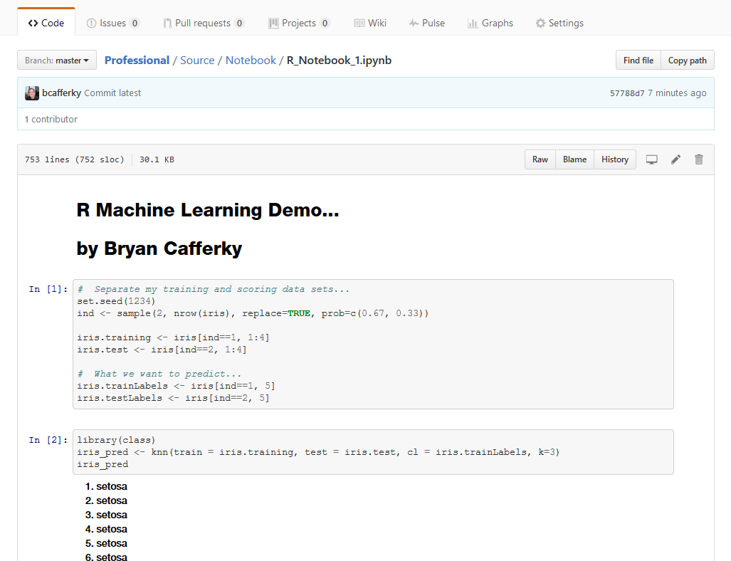
Github Renders Notebooks Automatically…

Slide 23
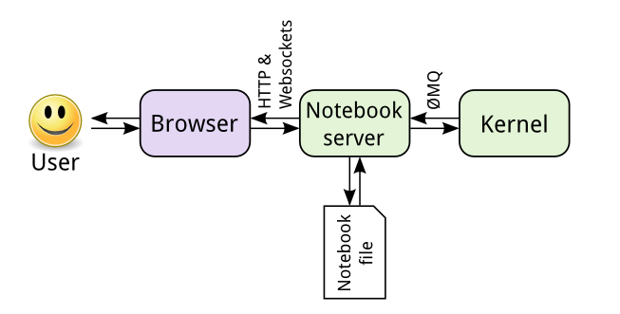
Kernel Architecture
JSON format
Can be many kernels:
Python
R
Julia
Ruby
Perl
PowerShell
http://jupyter.readthedocs.io/en/latest/architecture/how_jupyter_ipython_work.html

Slide 24
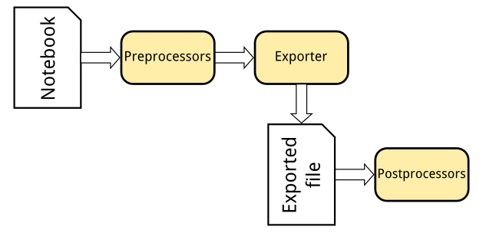
Flexible Notebook Conversions
nbconvert
Formats include:
HTML Slides
PDF
Markdown
Script
http://jupyter.readthedocs.io/en/latest/architecture/how_jupyter_ipython_work.html

Slide 25
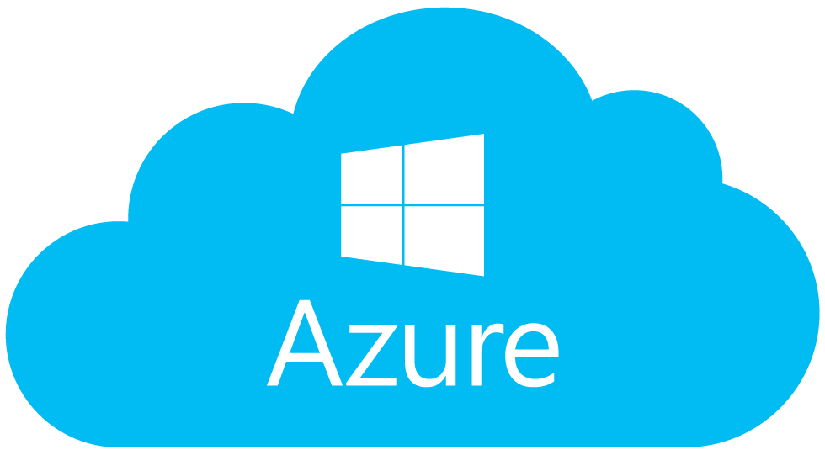
Azure Notebooks
Maximize Notebook Value
https://notebooks.azure.com/

Slide 26
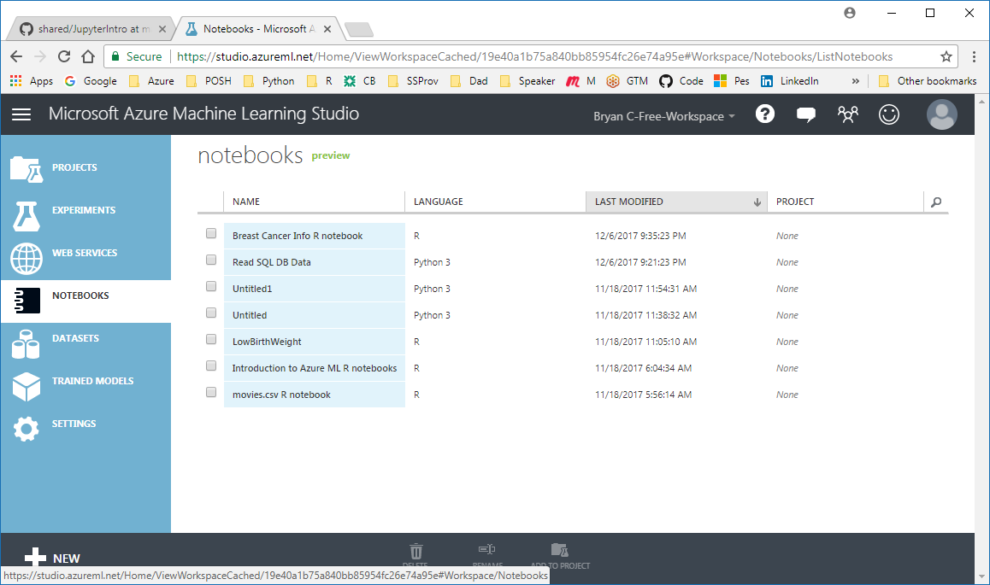
Azure Notebooks in ML Studio
https://studio.azureml.net/

Slide 27
Wrapping Up
Teaching
Collaboration
Research
Exploration

