Slide 1
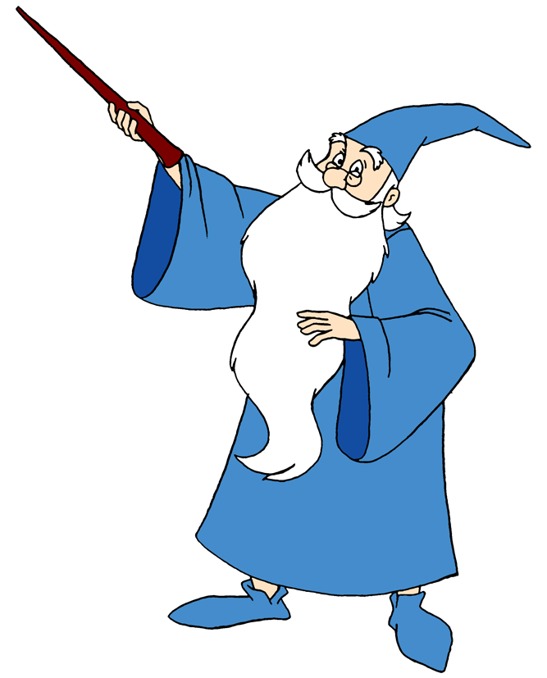

The Technical Skills You Need Now!!!
How to Create a
Virtual Machine in Azure
Part 1: The Easy Way
Bryan Cafferky
https://github.com/bcafferky/shared
https://www.cleanpng.com/png-bookkeeping-accountant-accounting-microsoft-excel-202974/download-png.html

Slide 2

The Technical Skills You Need Now!!!
How to Create a
Virtual Machine in Azure
Part 1: The Easy Way
Bryan Cafferky
https://github.com/bcafferky/shared
https://www.cleanpng.com/png-bookkeeping-accountant-accounting-microsoft-excel-202974/download-png.html

Slide 3
Where Are We Going?
What is a Virtual Machine?
The Easy Way to Create a VM
The Harder Way to Create a VM (Video Part 2)
Connecting to Your VM

Slide 4
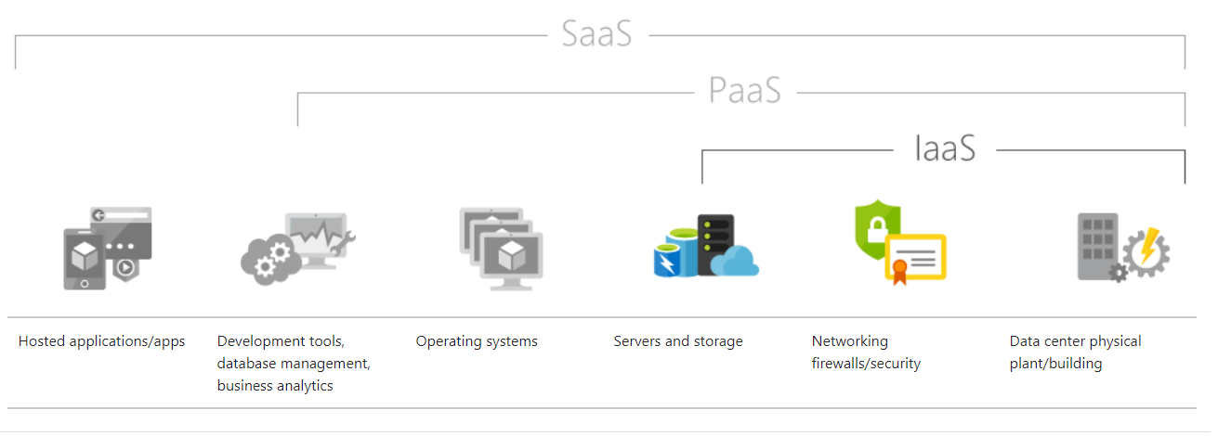
IaaS and VMs
Infrastructure as a Service

Slide 5
The Easy Way
Choose one from the Azure Marketplace
Start with a Dev/Test VM
Create a VM
Connect to the VM
Pause/Start the VM

Slide 6
The Harder Way
Roll Your Own
Start with a Dev/Test VM

Slide 7
Where Are We Going?
What is a Virtual Machine
The Easy Way to Create a VM
The Harder Way to Create a VM (Video Part 2)
Connecting to You VM

