Slide 1



Machine Learning with R
Bryan Cafferky
Microsoft Technical Solutions Professional

Slide 2

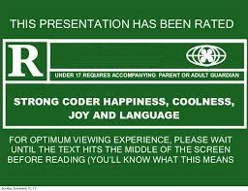
For Language and graphics

Slide 3
Goals
Data Science
Machine Learning with R
SQL Server/Machine Learning Server

Slide 4
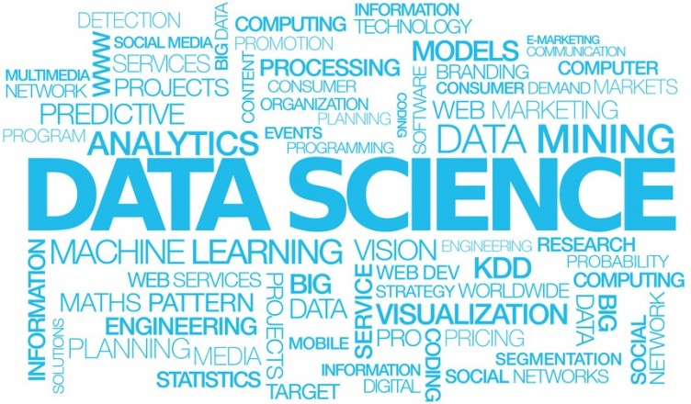
What is Data Science?
Machine Learning

Slide 5
Data Science: Revolution or Evolution
Data Science is Not New! (S and SAS languages started in 1976)
Focus on and Explosion of Volume of Data – Requires Statistics
Faster Computers & Scaling Technologies / Cloud
New Hype = New Terms

Slide 6


Statistics & Data Science Roles
Data Scientist
Advanced Degree in Statistics
Research/Discovery Orientated
Conceptualize/Develop Models
Analyst
Has deep domain knowledge
Blends Operational Reporting & Analytics
Some Knowledge of Statistics
Less Complex Models/Solutions
Data Engineer
Focuses on Scaling Up/Out and Automation
May Modify Solution/Model to Scale It
Basic Understanding of Statistics and Models

Slide 7

What is Data Science?
Data science, also known as data-driven science, is an interdisciplinary field about scientific methods, processes, and systems to extract knowledge or insights from data in various forms, either structured or unstructured
How Can We Use the Inundation of Data to Learn New things.
https://en.wikipedia.org/wiki/Data_science

Slide 8
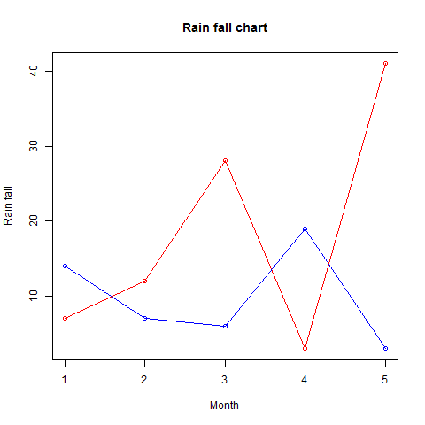
Relationships Between Variables
Age to Disease
Population to Crime
Drug to Recovery
Age, Education to Income

Slide 9

What is Machine Learning?
Branch of Artificial Intelligence that Allows Programs to Learn without Being Explicitly Programmed by Using Algorithms and Statistical Models.
Make Sense of the Many Various Forms and Volumes of Data.
Turn Data into Actionable Insights.

Slide 10

Unsupervised Learning
The Input Data is not Labeled, i.e. we don’t know what the data is.
The Goal is to Look for Patterns in the Data Such as Grouping, aka Clustering.
Example: Fraud Detection.

Slide 11

Predictive Modeling, Supervised Learning
Input Data is Fed into the Program
The Program is to Determine the Relationship Between the Input Columns and a Result Output Column
Based on Analysis of Inputs to Result, a Model is Created to Predict the Result Based on a Given Set of Inputs
History is used to predict the future.

Slide 12

Data Mining
Goal is to Find Patterns in the Data.
Can be Supervised or Unsupervised.
Result May Be Used to Create a Predictive Model.
Example: Market Basket Analysis.

Slide 13
Research/Population Comparison
Is a Pharmaceutical Effective?
Is the Lifestyle in One Population Leading to Better Health?
Are Environmental Factors Affecting the Survival Rate of Possum?
Are Pesticides Negatively Impacting Consumers?

Slide 14
Review
What is Data Science?
Machine Learning - Supervised and Unsupervised Learning
Predictive Modeling
Data Mining
Research/Population Comparison

Slide 15
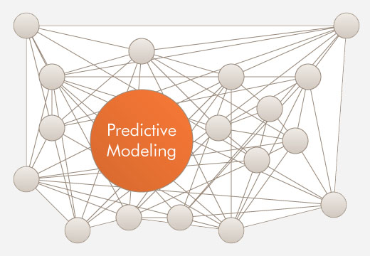

Slide 16
Creating a Predictive Model
What is a Predictive Model?
Identifying the Input Variables
Steps to Creating a Predictive Model
Evaluating the Model

Slide 17
What is Predictive Modeling?
Predictive Modeling attempts to determine an unknown variable based on known variables using probabilities.
Use the past to predict the future (Historical Data).
Use the Correlation between the Input Variables and the Variable to be predicted.

Slide 18
Applications of Predictive ModelingModeling
Classify something such as is an is an email spam or ham?
What group does something belong to such as what species of plant?
Will a person contract a certain illness?
Will the patient be readmitted?
Is the person a high health risk?

Slide 19
Steps to Creating a Predictive Model
Analyze/Clean the Data
Determine the Columns that Predict the Answer
Select a Model to Use
Train the Model
Evaluate the Model’s Effectiveness
Use the Model

Slide 20
The Birth Weight (BirthWt) Data Set
Risk Factors Associated with Low Infant Birth Weight
Column | Meaning
age | mother's age in years.
lwt | mother's weight in pounds at last menstrual period.
race | mother's race (1 = white, 2 = black, 3 = other).
smoke | smoking status during pregnancy.
ptl | number of previous premature labors.
ht | history of hypertension.
ui | presence of uterine irritability.
ftv | number of physician visits during the first trimester.
bwt | birth weight in grams.
low | indicator of birth weight less than 2.5 kg.

Slide 21
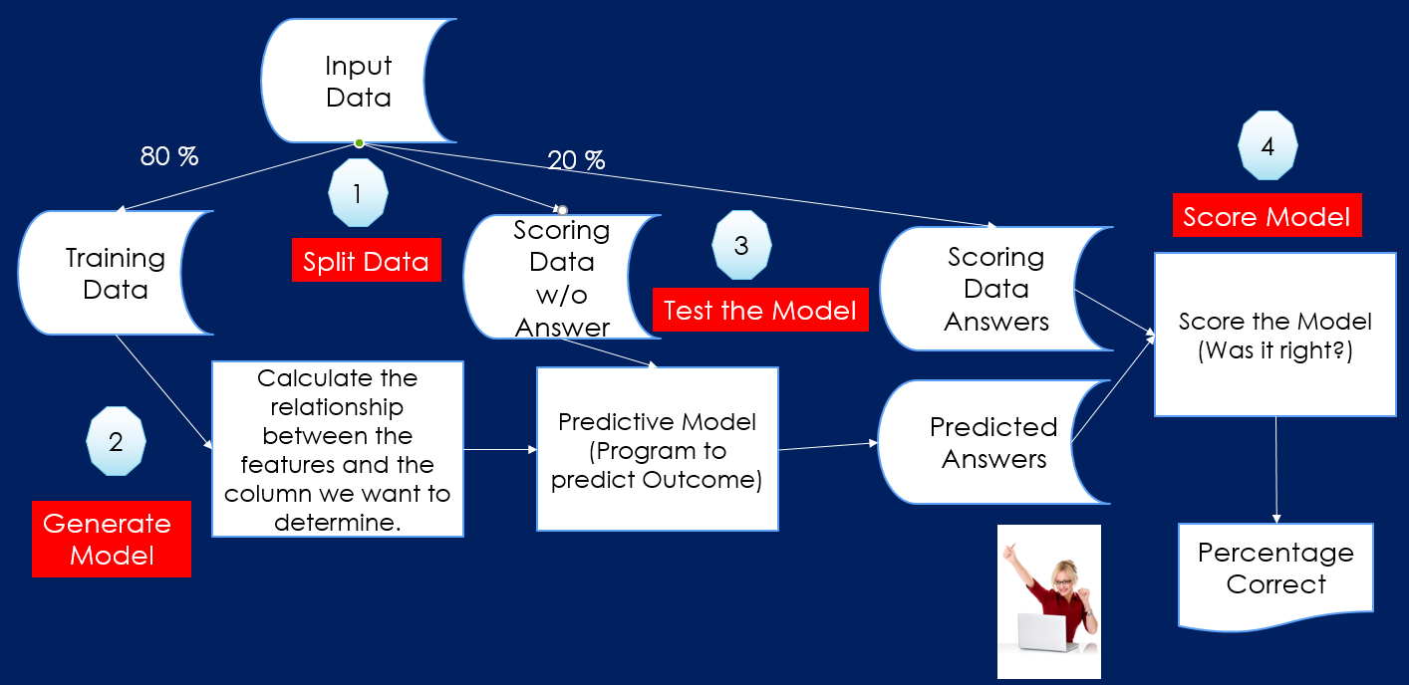
Steps to Predictive Modeling

Slide 22
Demo
Demo Creating a Predictive Model
Based on the following sources:
https://www.r-bloggers.com/using-decision-trees-to-predict-infant-birth-weights/
http://blog.revolutionanalytics.com/2013/06/plotting-classification-and-regression-trees-with-plotrpart.html

Slide 23
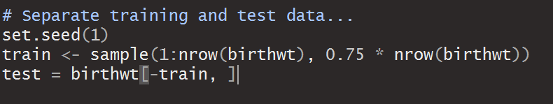
Review: Extracting the Training/Testing Data

Slide 24
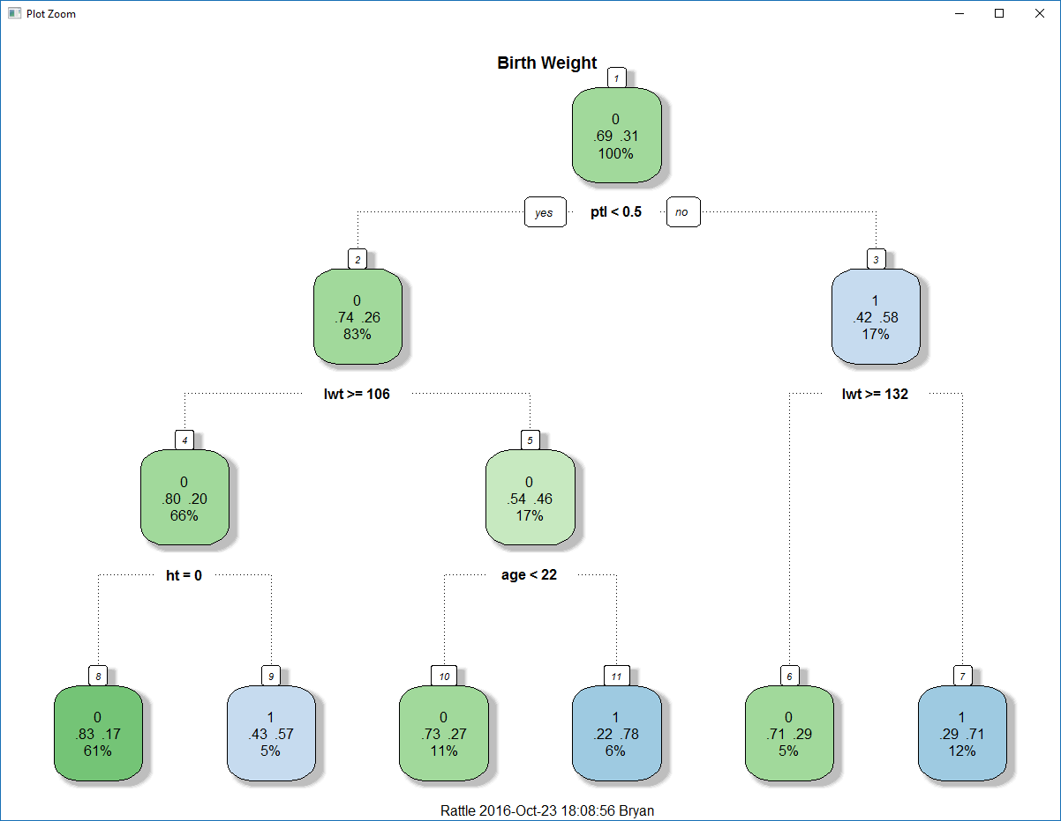
Review: Viewing the Decision Tree
library(rpart)
birthwtTree <- rpart(low ~ . - bwt,
data = birthwt[train, ],
method = 'class')
# Plot the Decision Tree
library(rattle)
fancyRpartPlot(birthwtTree,
main="Birth Weight")

Slide 25
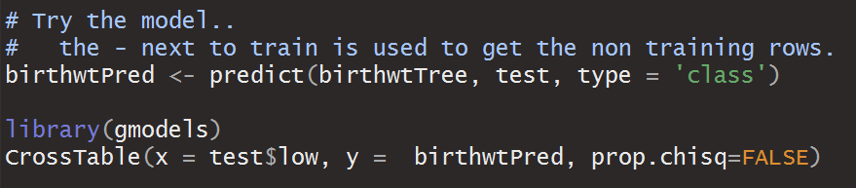
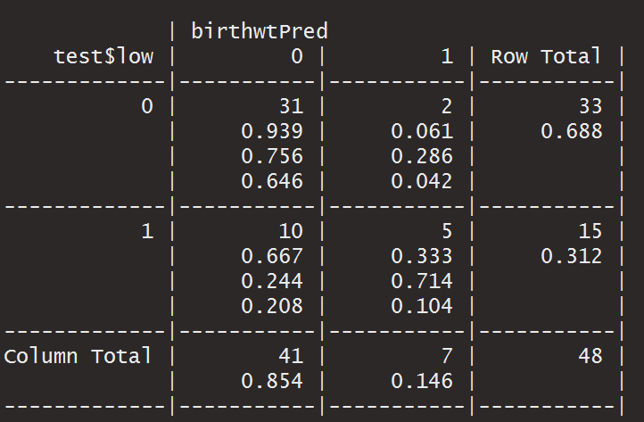
Review: Evaluating the Model

Slide 26
Review
What is a Predictive Model?
Identifying the Input Variables
Steps to Creating a Predictive Model
Evaluating the Model

Slide 27

End of Part 4 - Predictive Modeling

Slide 28
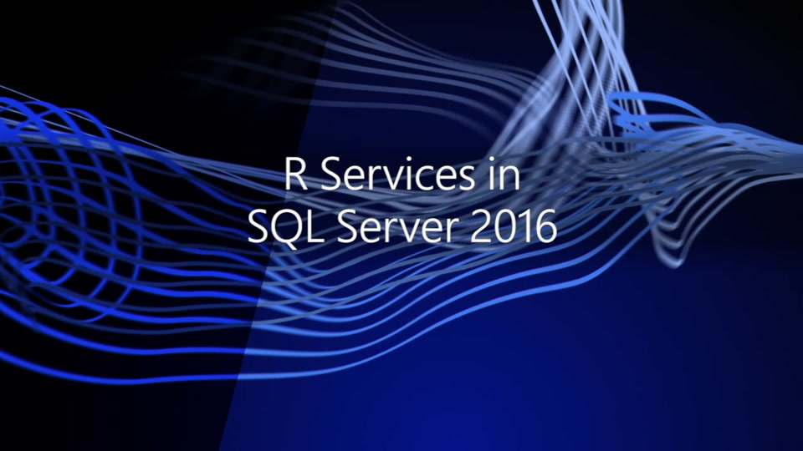
SQL Server/R Integration

Slide 29
SQL Server Machine learning Services
SQL Server 2016
Extensibility Framework
R Support (3.2.2)
Microsoft R Server
SQL Server 2017
Python Support (3.5.2)
R Support (3.3.3)
Native Scoring using PREDICT
In-database Package Management

Slide 30
R Limitations
Client side only tool. No server based processing.
Data limited by client memory.
Single threaded.
Database data must be imported to be used.
Relatively slow.
No scheduling tool.

Slide 31
Microsoft buys Revolution Analytics
Proprietary vendor providing scalability options.
Support for multi-threading.
Provide a shared R server.
Performant versions of common R functions.
Data not limited by memory.

Slide 32
SQL Server 2016: Reaching R's Potential
Stored procedures can be coded in R with the features that entails.
SQL Server and R share memory space.
Work can be split between SQL Server and R Server.

Slide 33
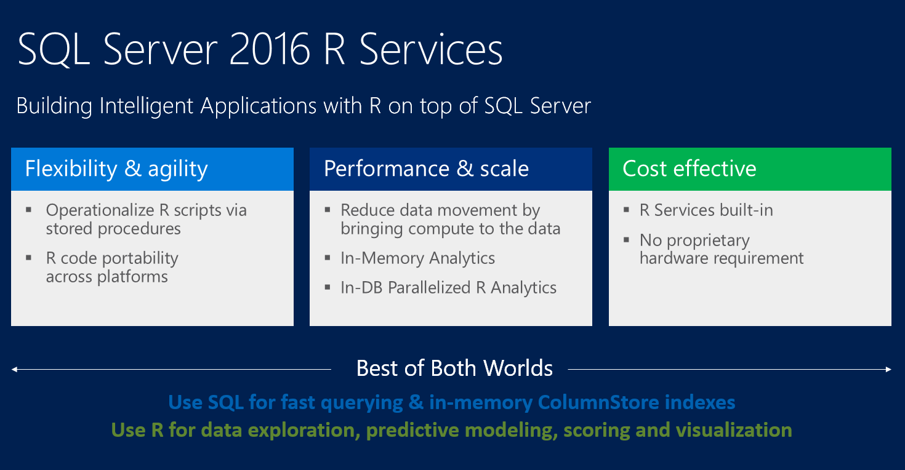
SQL Server Plus R = Value

Slide 34
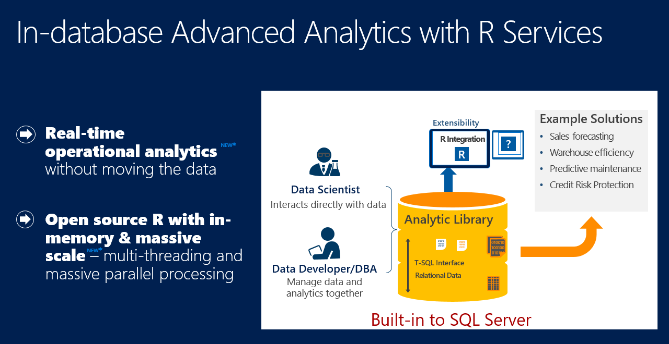
SQL Server: R Operationalized
https://msdn.microsoft.com/en-us/library/mt590947.aspx

Slide 35
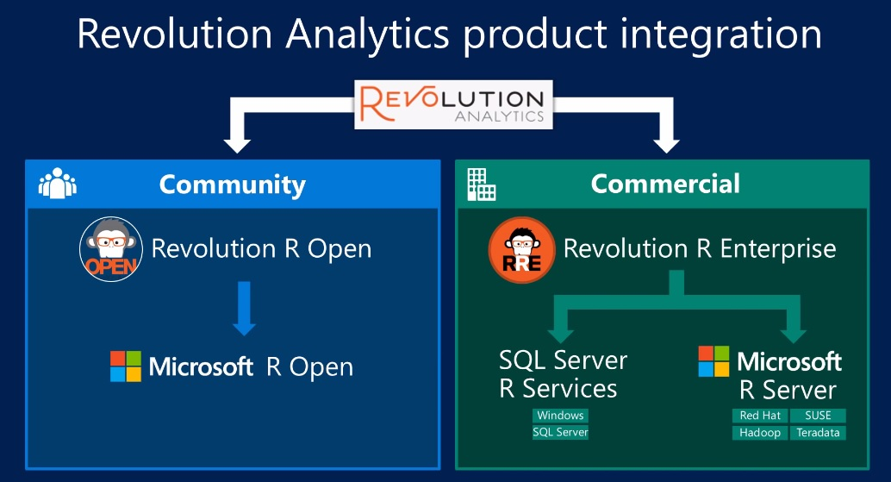
SQL Server: R Operationalized
https://www.youtube.com/watch?v=by2cJ9sQO0Q

Slide 36
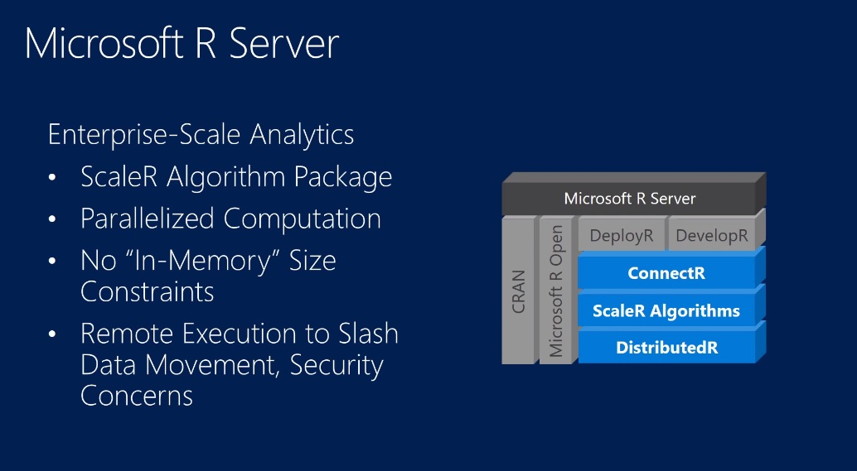
SQL Server/R Architecture
https://www.youtube.com/watch?v=by2cJ9sQO0Q

Slide 37
Microsoft R Open
R Open - an open source R distribution from Microsoft that is fixed stable release.
CRAN is always adding updates to the R language which can be unstable.
Some enhanced performance math functions are included.
Is used in place of the standard CRAN R language download.
Must be used with R scalability features.

Slide 38
Microsoft R Client
Is a set of R packages.
Implements RScale functions but with limited scalability.
Useful for learning and development.
May be a good option when small only scale improvments are needed.

Slide 39
Microsoft R Server
Like an Express Edition of R Server.
A stand alone R execution environment.
Clients submit R requests to R Server for high speed processing.
Can be contained within other environments such as SQL Server.
Versions for Linux, Hadoop and Teradata.
Tight integration with SQL Sever.

Slide 40
Microsoft R Open
Proprietary high performance functions used in place of the standard R functions.
Start with the prefix 'rx', i.e. rxImport.
Can be used with Microsoft R Client (free) or R Server but severly limited scalability on R Client.
scaleR Functions https://msdn.microsoft.com/en-us/microsoft-r/scaler/scaler

Slide 41
SQL Server: DeployR
Known as the R Integration Server.
An optional framework for deploying R analytics inside web, desktop, mobile, and dashboard applications as well as backend systems.
Provides analytics services such as a predictive model as a web service.
Configuration
https://docs.microsoft.com/en-us/machine-learning-server/operationalize/quickstart-publish-r-web-service
Server One Box Set Up
https://docs.microsoft.com/en-us/machine-learning-server/operationalize/configure-machine-learning-server-one-box

Slide 42
Must Install Needed Packages

Slide 43
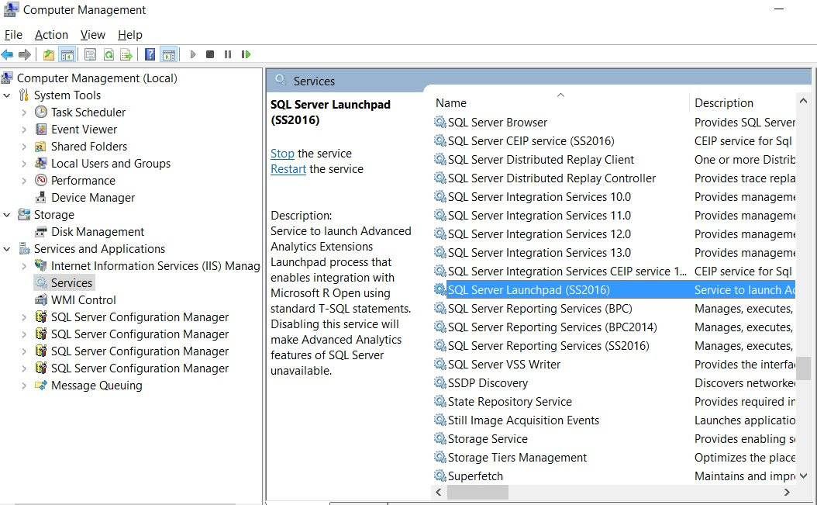
SQL Server Launchpad Service

Slide 44
Demo
SQL Server R Services Demo
Rx Functions – End to End Walk Through
SQL Agent Job
R Stored Procedure
Insert Model into Table

Slide 45
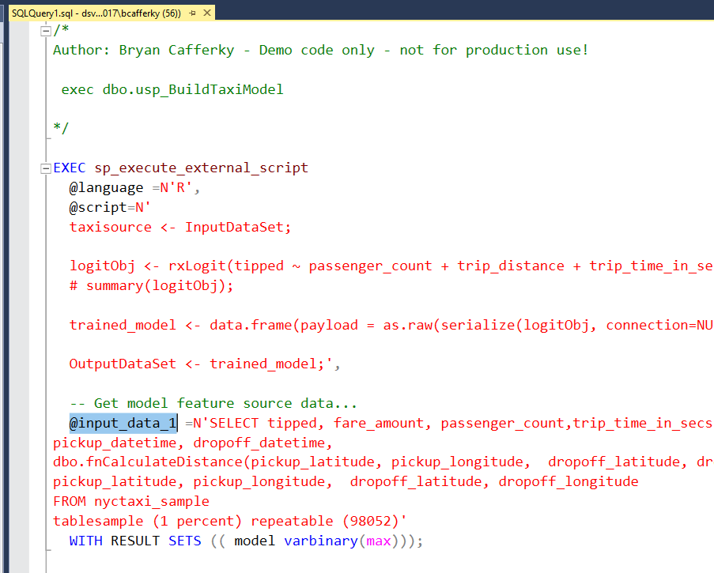
R Code Stored Procedures
Input Data
Output from R
Input via T-SQL

Slide 46
Security, Security, Security
Active Directory and Role Based Security
Always Encrypted for Data and Code
Only Authorized Users Can Call the Models
Model Developers Are Granted Privileges
PII Data Can Be Hidden or Obfuscated

Slide 47
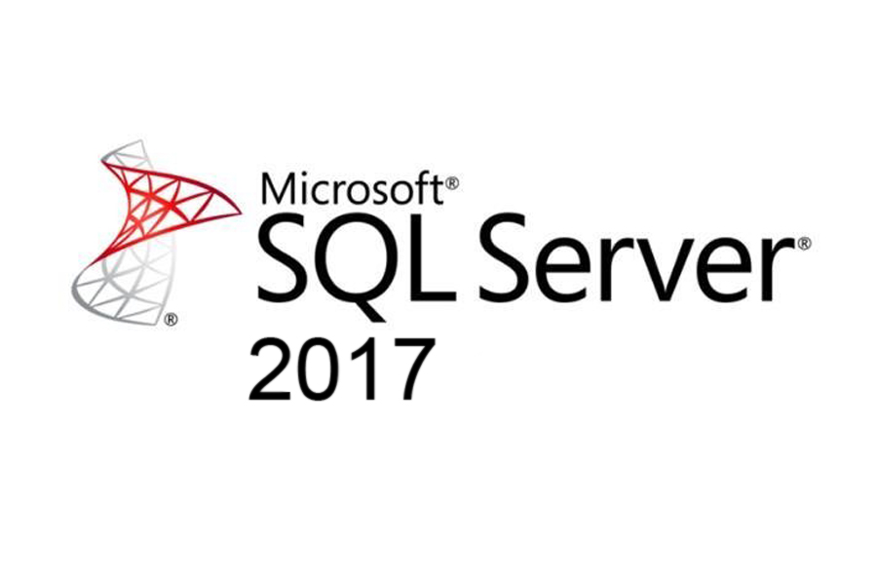

Demo

Slide 48
SQL Server/ML Server with Python
#If you are running SQL Server 2017 RC1 and above:
from revoscalepy import RxComputeContext, RxInSqlServer, RxSqlServerData
from revoscalepy import rx_import
#Connection string to connect to SQL Server instance
conn_str = 'Driver=SQL Server;Server=MYSQLSERVER;Database=TutorialDB;Trusted_Connection=True;'
#Define the columns we wish to import
column_info = {
"Year" : { "type" : "integer" },
"Month" : { "type" : "integer" },
"Day" : { "type" : "integer" },
"RentalCount" : { "type" : "integer" },
"WeekDay" : {
"type" : "factor",
"levels" : ["1", "2", "3", "4", "5", "6", "7"]
},
"Holiday" : {
"type" : "factor",
"levels" : ["1", "0"]
},
"Snow" : {
"type" : "factor",
"levels" : ["1", "0"]
}
}
#Get the data from SQL Server Table
data_source = RxSqlServerData(table="dbo.rental_data",
connection_string=conn_str, column_info=column_info)
computeContext = RxInSqlServer(
connection_string = conn_str,
num_tasks = 1,
auto_cleanup = False
)
RxInSqlServer(connection_string=conn_str, num_tasks=1, auto_cleanup=False)
# import data source and convert to pandas dataframe
df = pd.DataFrame(rx_import(input_data = data_source))
print("Data frame:", df)
# Get all the columns from the dataframe.
columns = df.columns.tolist()
# Filter the columns to remove ones we don't want to use in the training
columns = [c for c in columns if c not in ["Year"]]

Slide 49
Take A Ways
Data Does Not Need to Be Moved
High Performance rx Functions Server Side
Models Can Be Stored in SQL a Server Table
Prediction Results Can Be Stored in a SQL Server Table
R/Python Stored Procedures and Functions
SQL Agent Can Be Used to Schedule Model Builds
Use T-SQL or R/Python As Best Fits the Need

Slide 50
Q & A

Slide 51
SQL Server/R Server Integration

