Slide 1

Introduction to RStudio
By Bryan Cafferky

Slide 2


Bryan cafferky
@bryancafferky
bryan256@msn.com
Data Solutions Consultant
Microsoft MVP
Decades of IT experience
Author of Pro PowerShell for Database Developers by Apress
SQL PASS Chapter Lead
Lead the Southern New England UseR Group

Slide 3

Pre Con: Data Science with R: A to Z Workshop
Friday, December 8th in Franklin, MA
Programming in R
Data Science using R
Predictive Modeling
Visualizations
R Integration with Power BI
SQL Server/R Integration
Using R with Azure Machine Learning Studio
By Bryan Cafferky & John Miner
Use Discount code Microsoft for 20% Off
https://r_programming.eventbrite.com

Slide 4

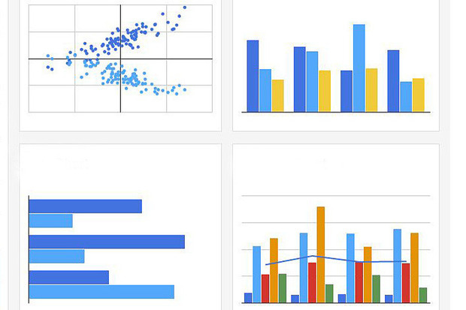
An Introduction to RStudio
What is an Integrated Development Environment (IDE)?
What is RStudio?
Features of RStudio
Installing RStudio
A Guided Tour
Other IDEs
Review

Slide 5
What is an IDE?
Environment to Develop Programs
Text Editing
Language Specific Features
Supports Execution of Programs
Debugging Support

Slide 6

Features of
Features
Advanced Text Editor Designed for R
Integration with the Comprehensive R Archive Network (CRAN)
Customizable
Tools to Help Development
Support for Extensions to R
Designed for the Data Scientist

Slide 7
Installing RStudio
Download RStudio
https://www.rstudio.com/products/rstudio/download/#download

Slide 8
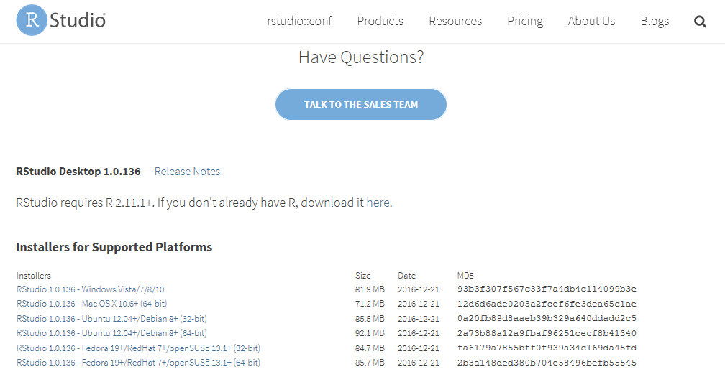
Downloading RStudio
Windows Version

Slide 9
Demo: Installing RStudio

Slide 10
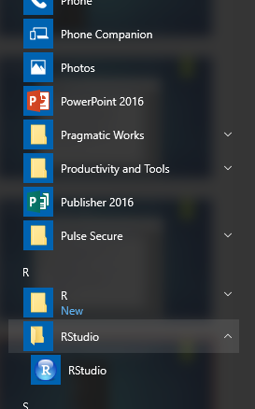
Starting RStudio
RStudio

Slide 11
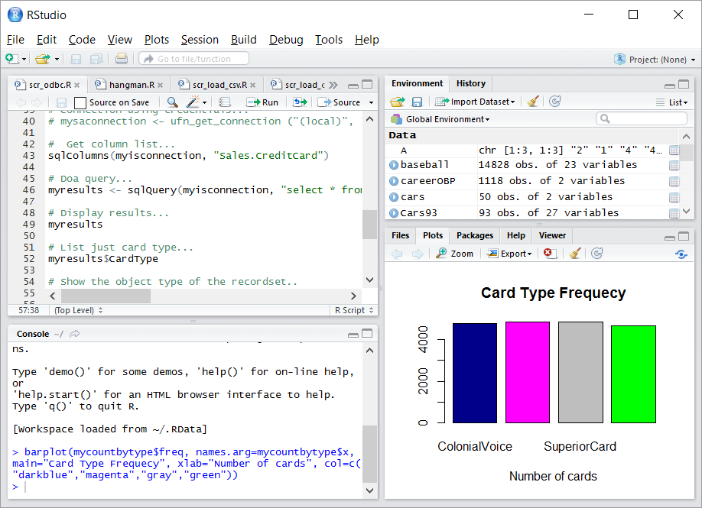
RStudio at a Glance
Environment
And
History
Editor
Tabbed Views
Console

Slide 12

A Tour of RStudio

Slide 13
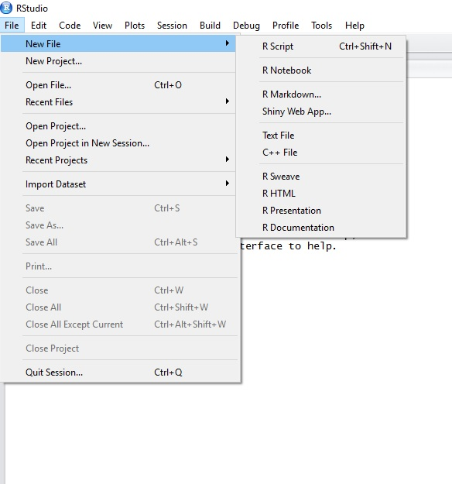
Review of Our Tour
Creating a new script

Slide 14
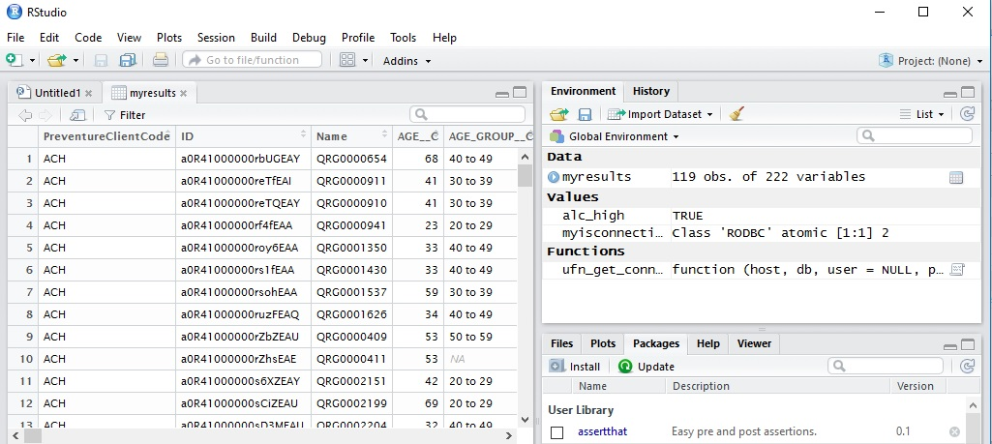
Review of Our Tour
Using the Object Viewer
Click to View

Slide 15
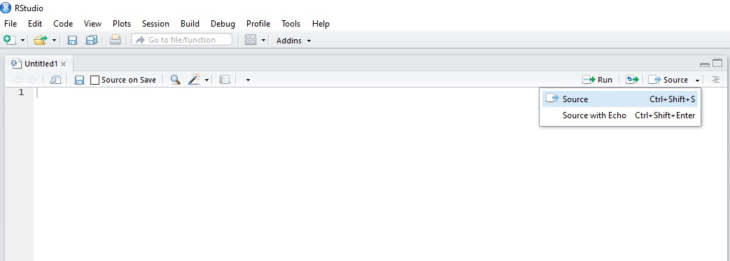
Review of Our Tour
Executing Code
Run selected code
Run the file

Slide 16
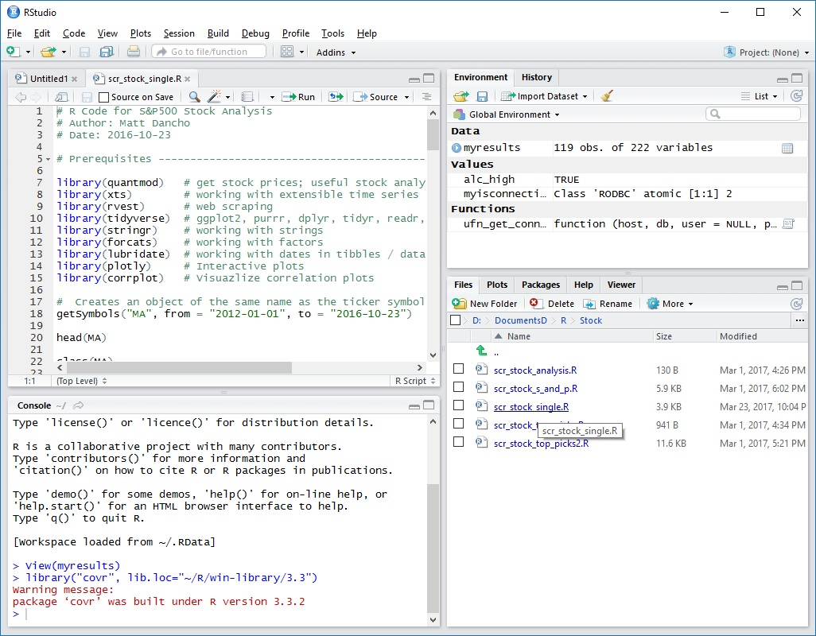
Review of Our Tour
File Navigation
Click to open the script

Slide 17
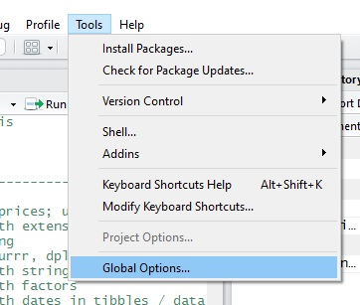
Review of Our Tour
Global Options

Slide 18
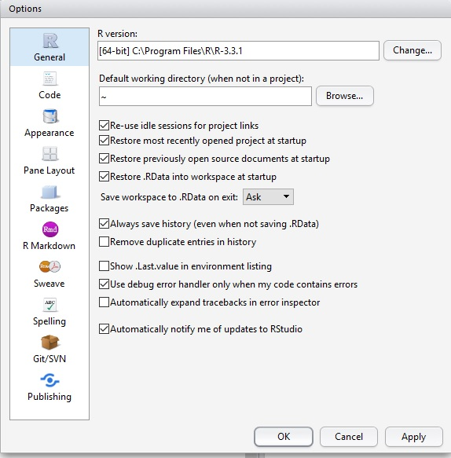
Review of Our Tour
Global Options
Configuration

Slide 19
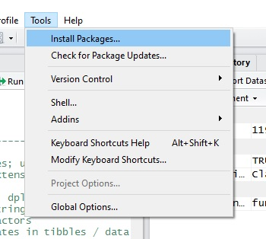
Review of Our Tour
Installing Packages

Slide 20
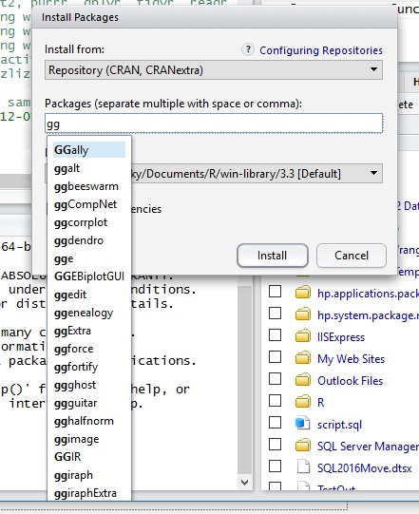
Review of Our Tour
The Install Packages Wizard

Slide 21
Other IDEs
Why RStudio?
Other Options
R Tools for Visual Studio
– See my blog www.sql-fy.com for comparison with RStudio
Visual Studio Code (VS Code)
Eclipse
The R Console

Slide 22
Review
What is an Integrated Development Environment (IDE)?
Data Scientist vs. Developer
Features of RStudio
A Guided Tour
Other Options

