Slide 1

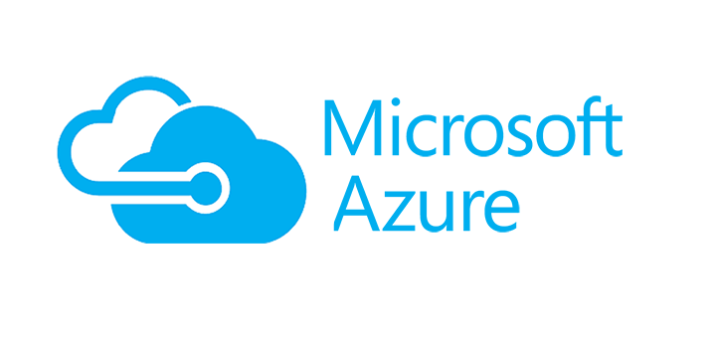

Azure Data Services Overview
Bryan Cafferky
Technical Solutions Professional

Slide 2

Why So Many Options?
https://www.quebechebdo.com/content/dam/tc/quebec-hebdo/images/2010/7/16/une-nouvelle-salle-d-operation-pour-cont-1075320.jpg

Slide 3

Data Science, ML, and AI Perspective

Slide 4
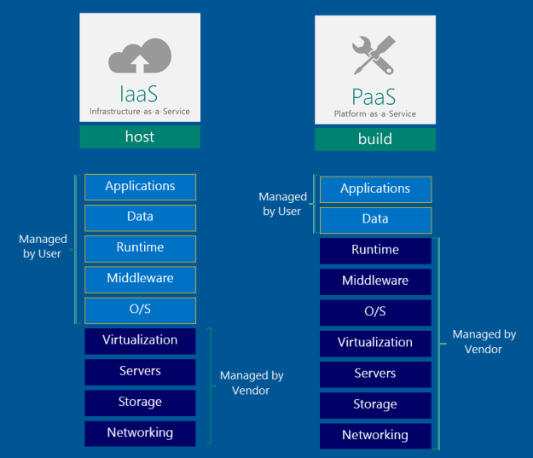
Azure Data Platform

Slide 5
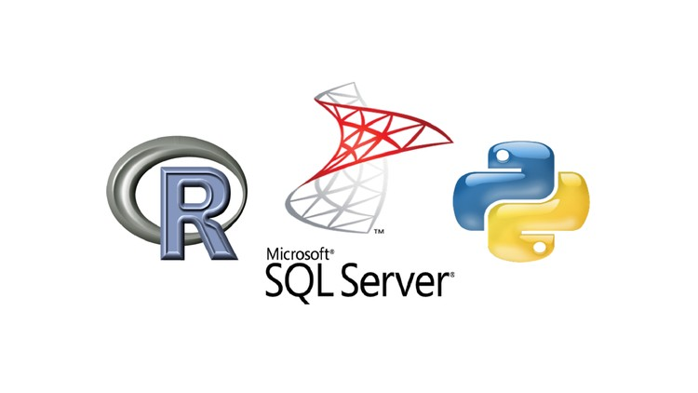
SQL Server/Machine Learning Integration

Slide 6








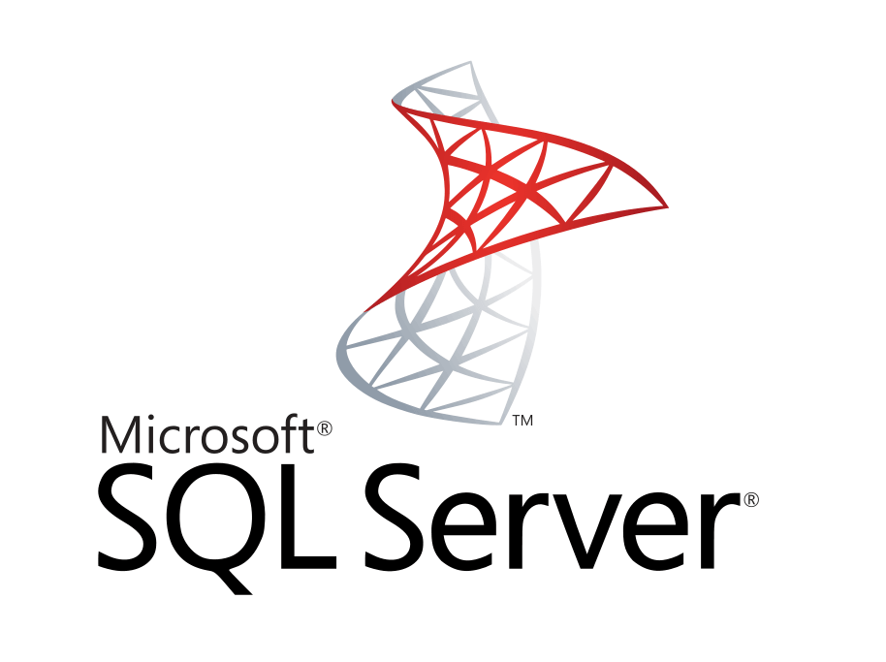


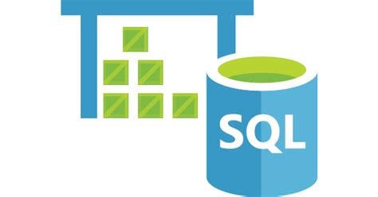
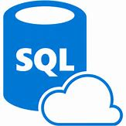



Data Analysis Platform
Client Tools
ML Workbench
Streaming
Azure Data Factory
Data Ingestion
On-Prem
Private
Preview
Analysis Services
Data Lake
Analytics
SQL Data Warehouse
Managed Instance/
SQL DB
Cosmos DB
HDInsight
Databricks
* Planned
PostgreSQL and MySQL Offered as Azure Services (in preview).
Scale

Slide 7
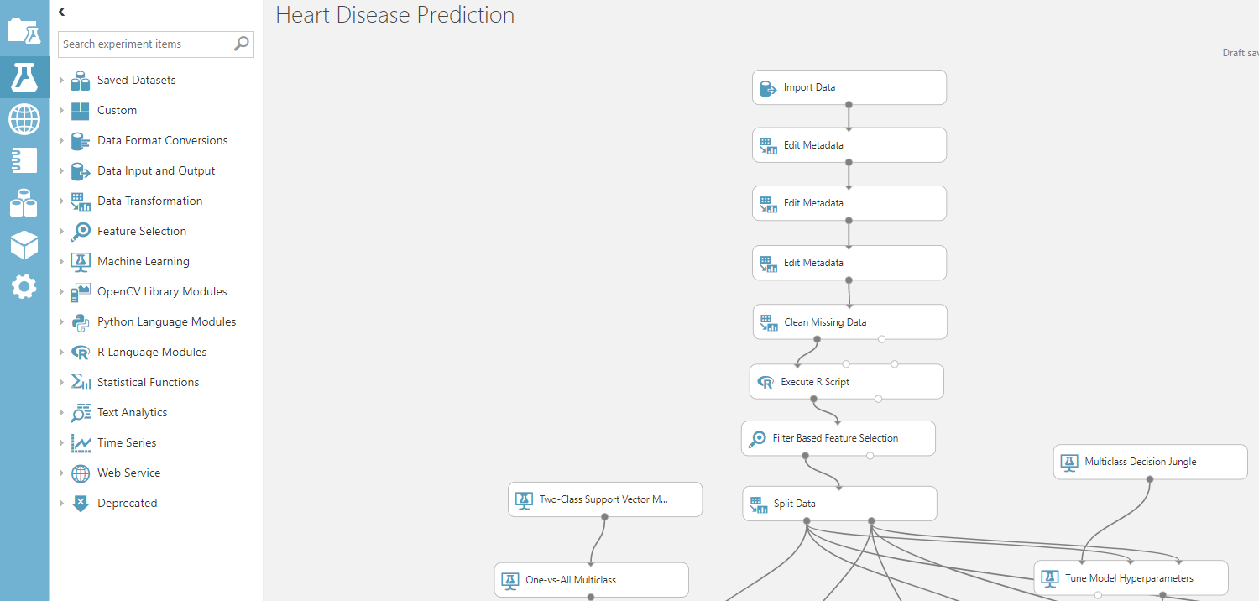
Azure ML Studio

Slide 8
SSIS -> ADFv2
On-Prem
SQL Server/ML Server
Maximizes Multiple CPUs
Multi-Threaded
Not limited to memory
No Data Movement
Azure Analysis Services
Fast Slicing and Dicing of Data
Cubes or Tabular Model
SQL Server MI / SQL DB
MI to Support More SQL Server Features
Can Scale Up
Azure Data Lake
Analytics
Unlimited Scale
No Set Up
Just Pay For Query
U-SQL/R/ Python
Azure DW
Scale Out
Big Data
HDInsight
Unlimited Scale
Streaming Support
R Server/
Spark
Interface
CosmosDB
Scale Out
Multi Model
Globally Distributed
* Planned
Scale

Slide 9

HDInsight

Slide 10
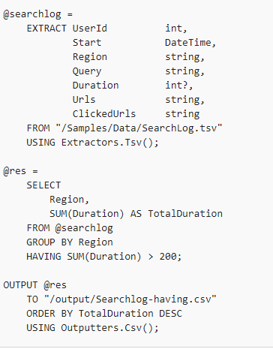
Data Lake Analytics – U-SQL
https://docs.microsoft.com/en-us/azure/data-lake-analytics/data-lake-analytics-u-sql-r-extensions

Slide 11


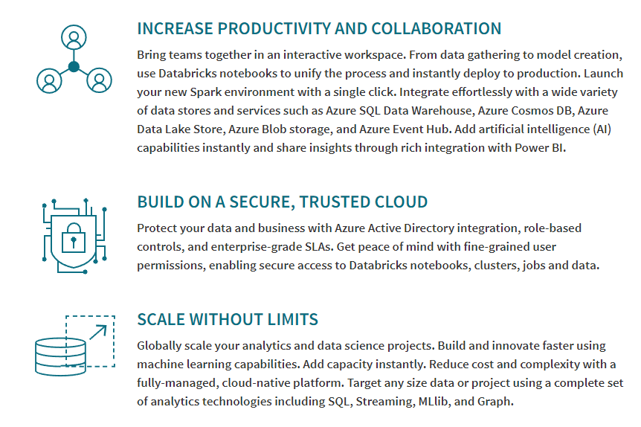

on Azure (Private Preview)
Azure Integration
Security/AD

Slide 12
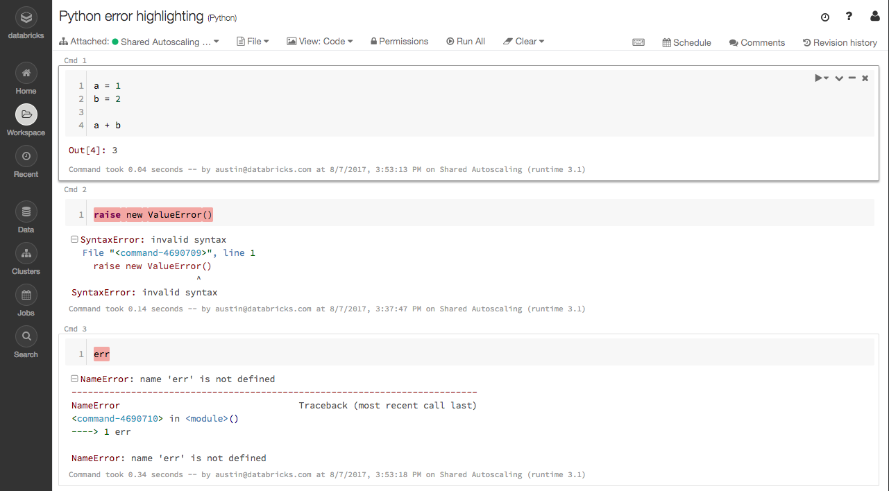
on Azure (Private Preview)

Slide 13
Why Azure?
Enablement and Ease of Use
Integration
Fluid Scaling
Enterprise Solutions
Secure
Support

Slide 14

Wrapping Up
https://www.meetup.com/GreaterBoston-DataScienceGroup

Slide 15
R and Python Support
Power BI
Azure Machine Learning Studio
ML Work
bench
On-Prem
SQL Server/
ML
Server
Azure Analysis Services
Azure Data Lake
Analytics
Azure DW
SQL Server MI/
SQL DB
* Planned
Cosmos DB
HD
Insight
Data
Bricks
Private Preview
PostgreSQL and MySQL Offered as Azure Services (in preview).
Scale

