Slide 1



A Quick Introduction to R Programming
by Bryan Cafferky

Slide 2

About Bryan Cafferky…
Data Solutions Consultant and Trainer.
Decades of IT Experience in health care, insurance, banking, and ecommerce.
Microsoft MVP.
Author of Pro PowerShell for Database Developers.
Founded and lead PASS Chapter The RI Microsoft BI User Group and The SNE R User Group.
Frequent presenter at technical conferences and user groups.
bryan256@msn.com
www.sql-fy.com
https://www.linkedin.com/in/bryancafferky
@BryanCafferky – follow me!
Subscribe to me on YouTube!

Slide 3

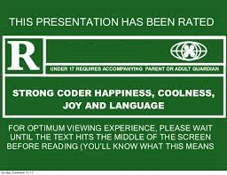
For Language and graphics

Slide 4
Presentation Goals
What is R?
Installing the R Language
A Quick Demo of the R Language

Slide 5
What is R?
R is an open source language for Data Science.

Slide 6
R Features
Scripting language like Python, BASH, Perl, or PowerShell.
Vast library of statistical functions.
Support to create impressive visualizations.
Extensive free open source libraries by the user community.

Slide 7

Where to Get R
R CLI – Command Line interface.
https://cran.r-project.org/
Must install this because it includes the R language interpreter.

Slide 8
Demo
Installing R
Using the R Console
A Look at the R Language
Slides available at:
https://github.com/bcafferky/shared/tree/master/QuickRIntro

Slide 9
Review
R is a popular open source data science language.
The Comprehensive R Archive Network (CRAN) maintains R.
R has rich support for statistics and visualizations.
R is a vectorized language.
R is Extended with new Functionality via Packages.

