Slide 1




Azure Data Services at 50,000 Feet

Slide 2
Azure Data Services at 50,000 Feet
by Bryan Cafferky

Slide 3

Why So Many Options?

Slide 4

Data Science, ML, and AI Perspective

Slide 5
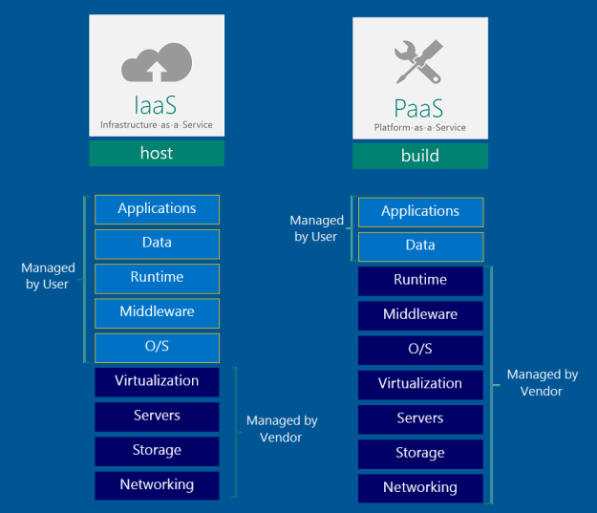
Azure Data Platform

Slide 6

SQL Server/Machine Learning Integration

Slide 7




R and Python Support
Power BI
Azure Machine Learning Studio
ML Work
bench
On-Prem
SQL Server/
ML
Server
Azure Analysis Services
Azure Data Lake
Analytics
Azure DW
SQL Server MI/
SQL DB
* Planned
Cosmos DB
HD
Insight
Data
Bricks
Private Preview
PostgreSQL and MySQL Offered as Azure Services (in preview).
Scale

Slide 8
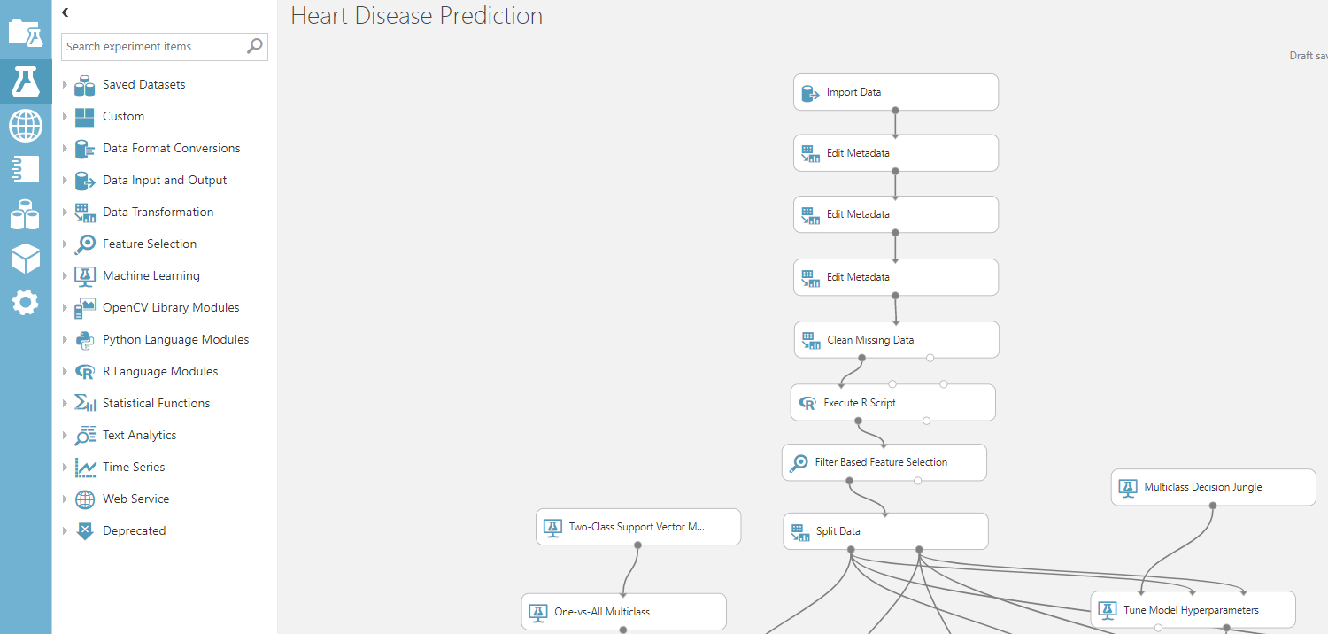
Azure ML Studio

Slide 9
SSIS -> ADFv2
On-Prem
SQL Server/ML Server
Maximizes Multiple CPUs
Multi-Threaded
Not limited to memory
No Data Movement
Azure Analysis Services
Fast Slicing and Dicing of Data
Cubes or Tabular Model
SQL Server MI / SQL DB
MI to Support More SQL Server Features
Can Scale Up
Azure Data Lake
Analytics
Unlimited Scale
No Set Up
Just Pay For Query
U-SQL/R and Python Extensions
Azure DW
Scale Out
Big Data
HDInsight
Unlimited Scale
Streaming Support
R Server/
Spark
Interface
CosmosDB
Scale Out
Multi Model
Globally Distributed
* Planned
Scale

Slide 10

HDInsight

Slide 11
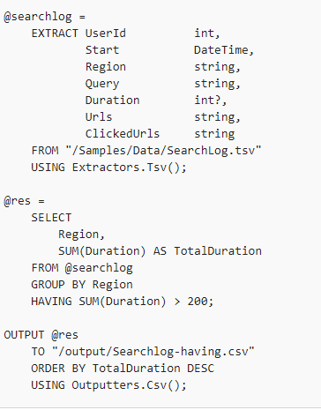
Data Lake Analytics – U-SQL
https://docs.microsoft.com/en-us/azure/data-lake-analytics/data-lake-analytics-u-sql-r-extensions

Slide 12

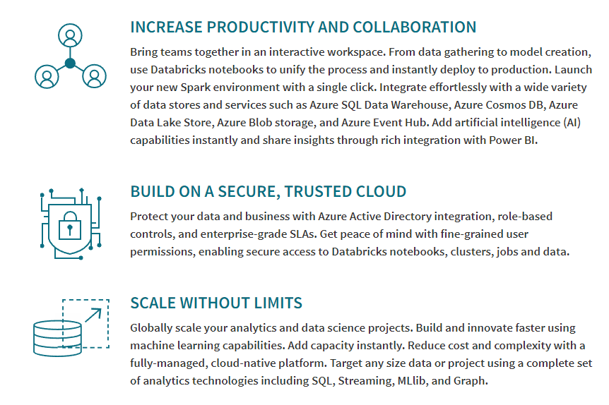

on Azure (Private Preview)
Azure Integration
Security/AD

Slide 13
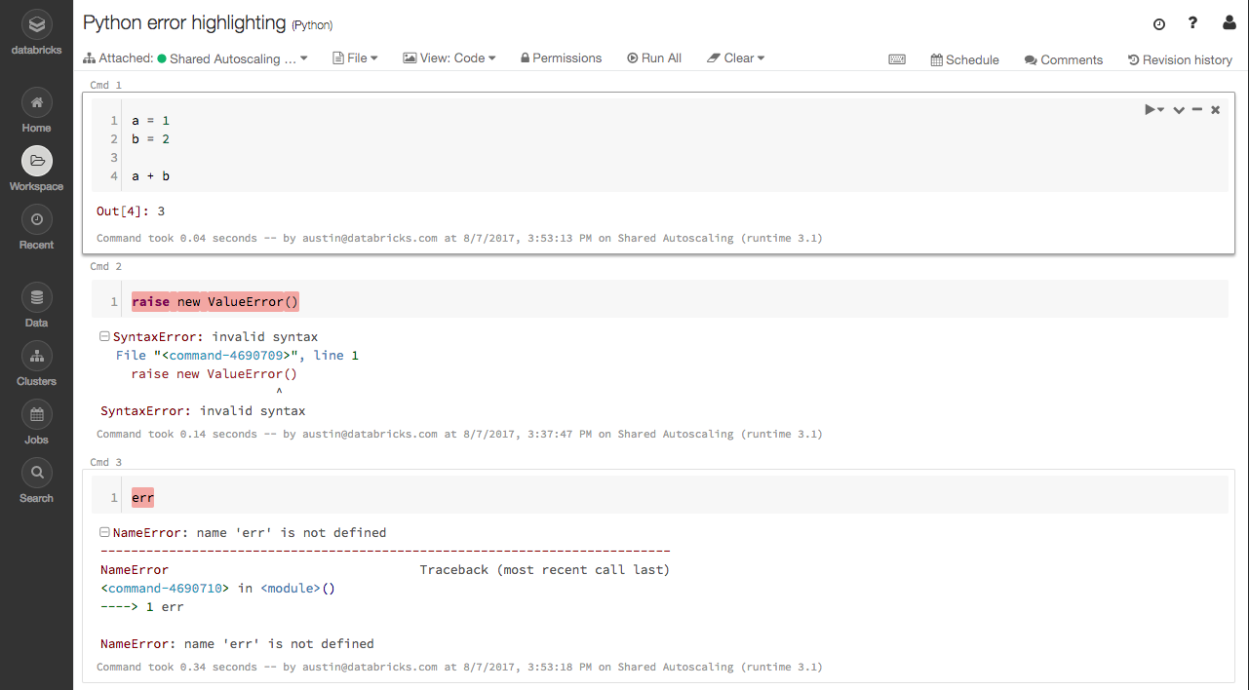
on Azure (Private Preview)

Slide 14
Why Azure?
Enablement and Ease of Use (Don’t Panic!)
Integration
Fluid Scaling
Enterprise Solutions
Full Automation Support
Support

Slide 15

Wrapping Up

Slide 16













Data Analysis Platform
Client Tools
ML Workbench
Streaming
Azure Data Factory
Data Ingestion
On-Prem
Private
Preview
Analysis Services
Data Lake
Analytics
SQL Data Warehouse
Managed Instance/
SQL DB
Cosmos DB
HDInsight
Databricks
* Planned
PostgreSQL and MySQL Offered as Azure Services (in preview).
Scale

