Slide 1
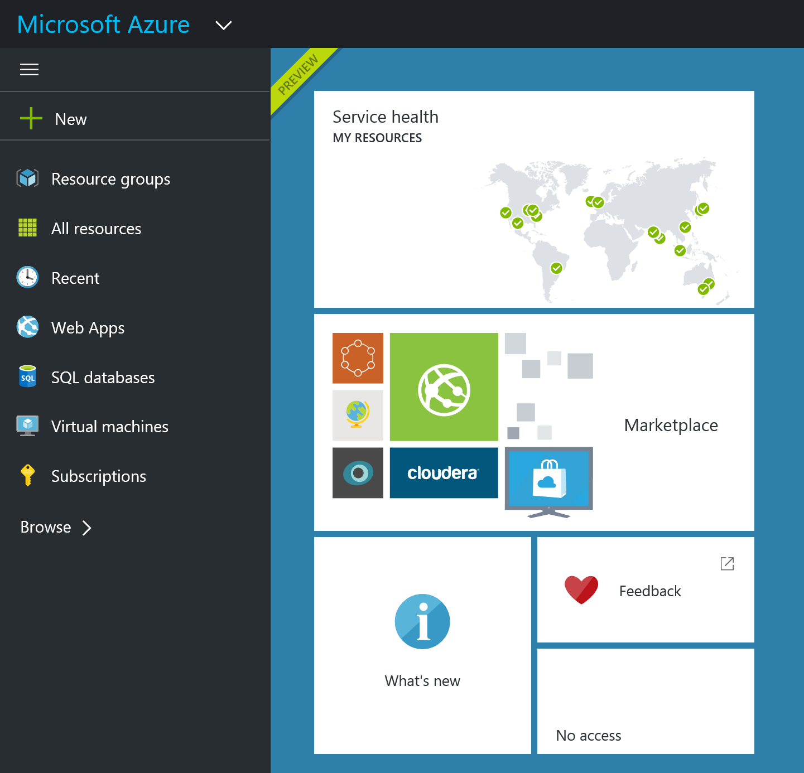
Lightning Tour of the Azure Portal
Resources are Just a Click Away!
Bryan Cafferky

Slide 2
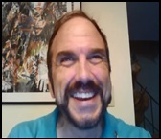
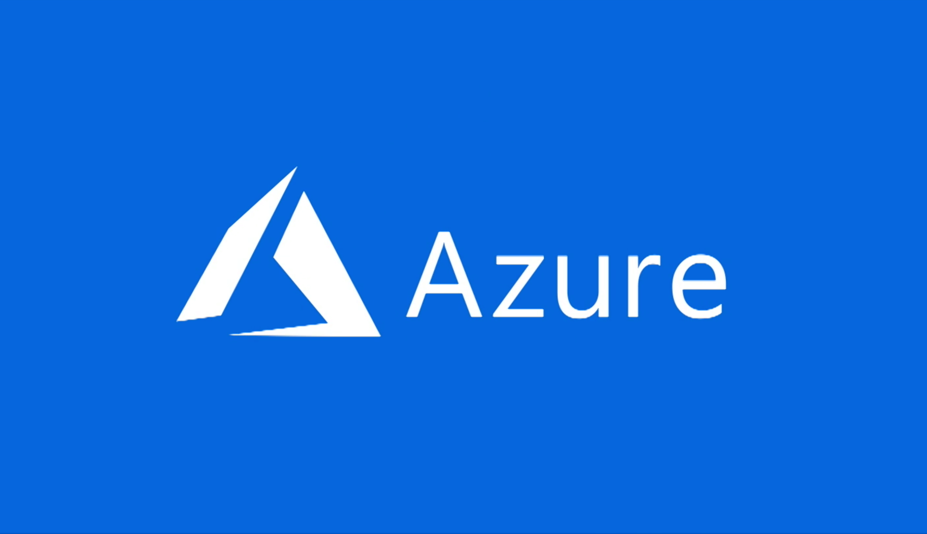
Lightning Tour of the Azure Portal
Bryan Cafferky
Resources are Just a Click Away!

