Slide 1


Azure on Steroids: Full Automation with PowerShell
Bryan Cafferky
Microsoft Technology Solutions Professional
Demo Code at:
https://github.com/bcafferky/shared/FullAutomationWithPowerShell

Slide 2
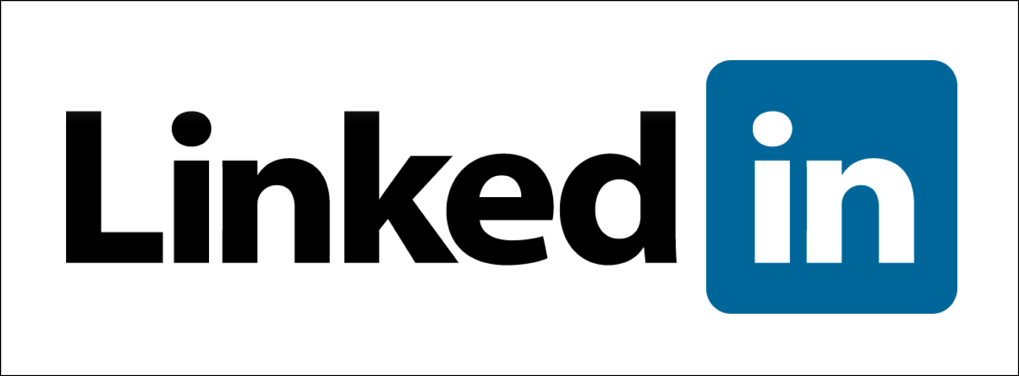


Bryan Cafferky
@bryancafferky
bryan256@msn.com
Microsoft Technology Solutions Professional
Two Microsoft MVP
Decades of IT experience
Author of Pro PowerShell for Database Developers by Apress
SQL PASS Chapter Lead
Lead the Greater Boston Data Science, ML , and AI Group
Got Married to My Partner of 7 Years, Paul, on Saturday, May 27th

Slide 3
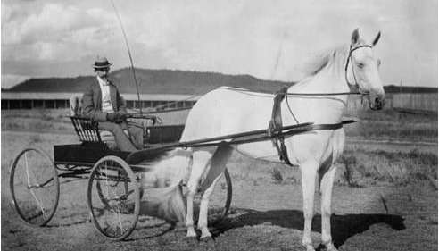

Slide 4
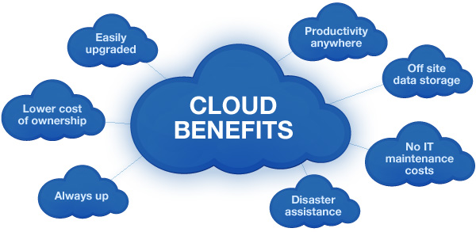

Slide 5
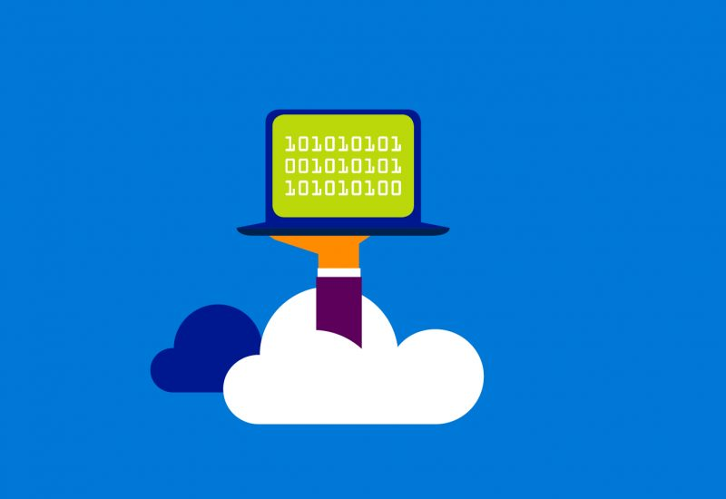
Welcome to Azure – Computing Power On Demand
Create a Powerful Virtual Machines in minutes
Multiple Cores
Any Amount of Memory and Storage
With SQL Server
Web Applications
Big Data Support

Slide 6
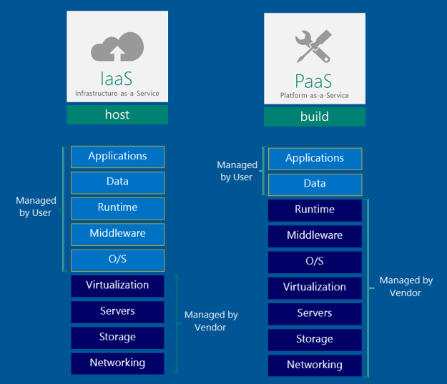

Azure Platform

Slide 7
What is PowerShell?

Slide 8

One Shell to Rule Them All

Slide 9
The Fellowship of the Shell
The Case for Automation
One Shell to Rule Them All
Client Side Automation
Azure Side Automation
Bringing the Client Side and Azure Side Together

Slide 10


Why PowerShell?
Without PowerShell
With PowerShell

Slide 11

Time to Find Your Inner Child!

Slide 12
Delivering on the Promise of IT
Enables Responsive Scaling
“Automation in its many incarnations will be a pivotal linchpin in the future data center.”
Reduces Costs
- Gartner, The Business Case for Automation
Improves Reliability
Security
Dev Ops
http://www.gartner.com/smarterwithgartner/automation-the-next-frontier-for-it-2/

Slide 13
The Promise
“If you learn PowerShell, we vow to make it one of the best investments you ever made and that we will work to extend PowerShell to reuse the skills you learned instead of creating brand new things with different syntax.”
- Jeffrey Snover, Microsoft, PowerShell Architect

Slide 14

The Ecosystem
Ease of Use
Administration
Explorability
Configuration
Extensibility
Remoting
Job System
Providers
Azure
Programming
Extensions
Advanced Functions
Object Orientation
Object Based Piping
Cloud Automation
Work Flows
Desired State Configuration

Slide 15

The Tools
PowerShell ISE
Azure RM Module
Azure Subscription
Azure Automation Account
Azure Add-On

Slide 16
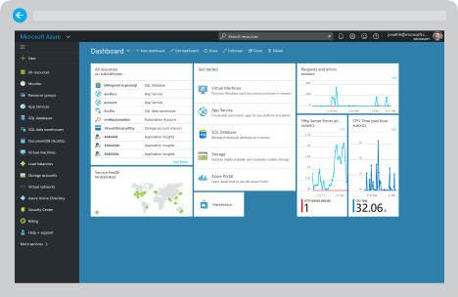
Demo (Portal)

Slide 17
Full Automation with PowerShell

Slide 18

Client Side Azure Automation

Slide 19
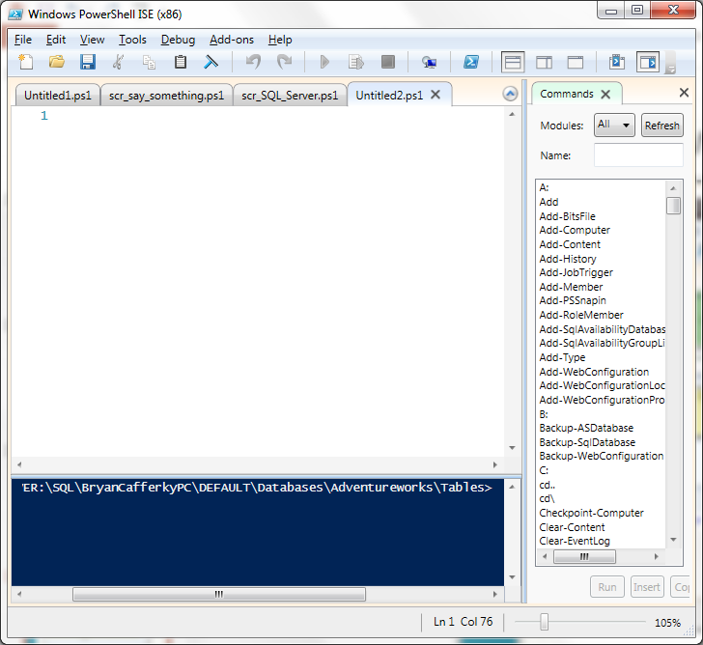
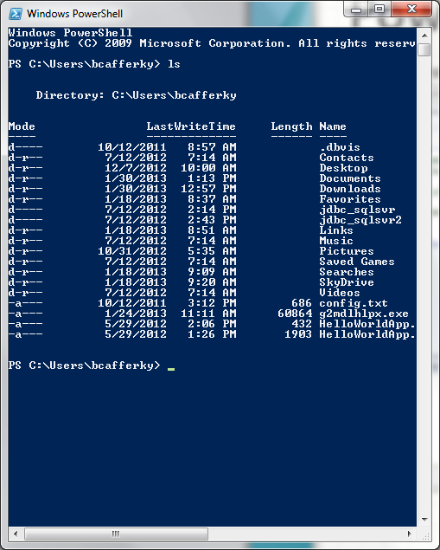
PowerShell Environments
The PowerShell ISE
The PowerShell CLI

Slide 20
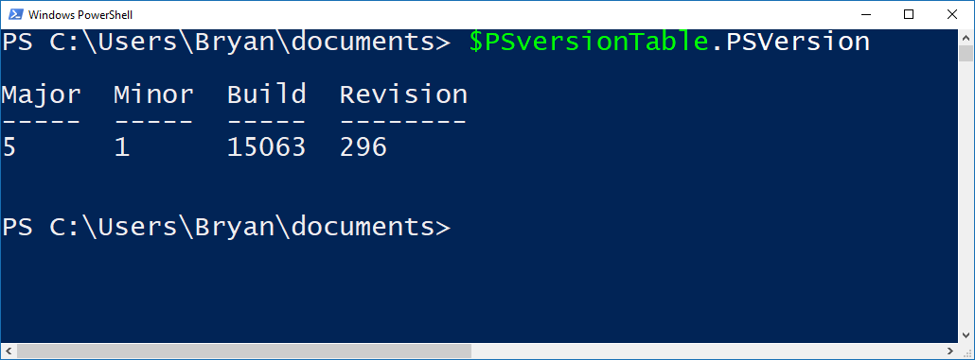
Checking Your PowerShell Version
Latest Version is 5 - Recommended

Slide 21

Azure Automation with PowerShell
Create Resources in Azure
Inquire about Azure Resources
Modify Azure Resources
Shut Down and/or Remove Resources
Application Specific Job Like Data Load

Slide 22
Installing the AzureRM Module
Start PowerShell with Elevated Privileges
Confirm PowerShellGet is Installed and the Correct Version
Get-Module PowerShellGet -list | Select-Object Name,Version,Path # 1.0.0.1 plus
Install the PowerShell AzureRM Module
Install-Module AzureRM
Import the AzureRM Module
Import-Module AzureRM -Force -Verbose # Will list cmdlets being imported
Verify the Azure Module Installation
Get-Module AzureRM # Will list module information
https://docs.microsoft.com/en-us/powershell/azure/install-azurerm-ps?view=azurermps-3.7.0

Slide 23
Demo
Demo Code at:
https://github.com/bcafferky/shared

Slide 24
Inquiring About Resources
Get-AzureRmVM – List Virtual Machines
Get-AzureRmResourceGroup – List resource groups
Get-AzureRmAvailabilitySet – List Availability Sets
Get-AzureRmVirtualNetworkSubnetConfig

Slide 25

Automation with Runbooks

Slide 26
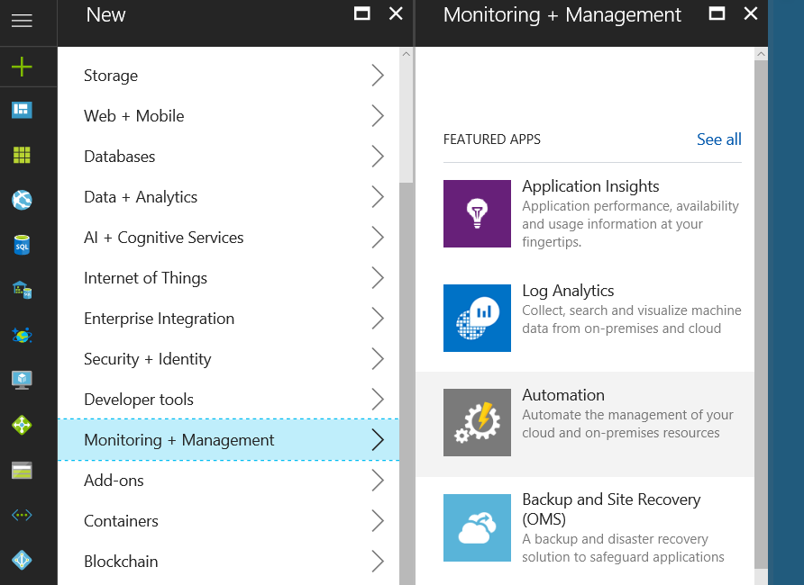
Adding Automation Method 1
Click to Add

Slide 27
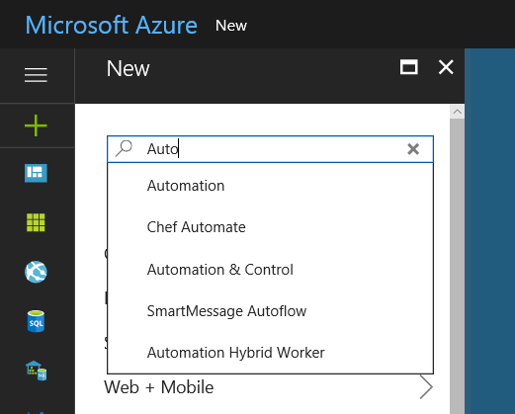
Adding Automation Method 2
Click to Select

Slide 28
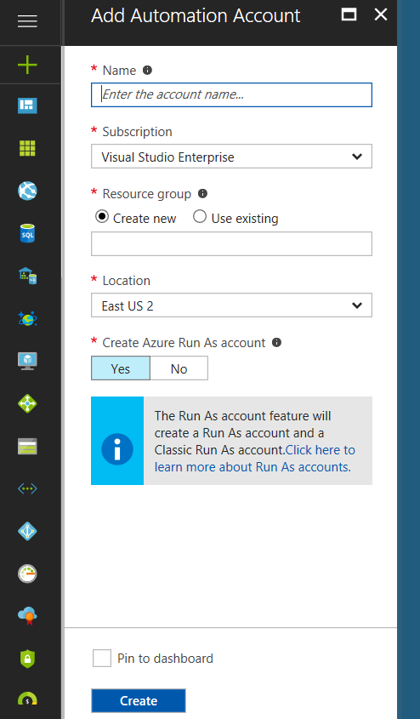
Adding Automation Account
Click to Add Account to Run Our Scripts
Check so Automation is in your Dashboard

Slide 29
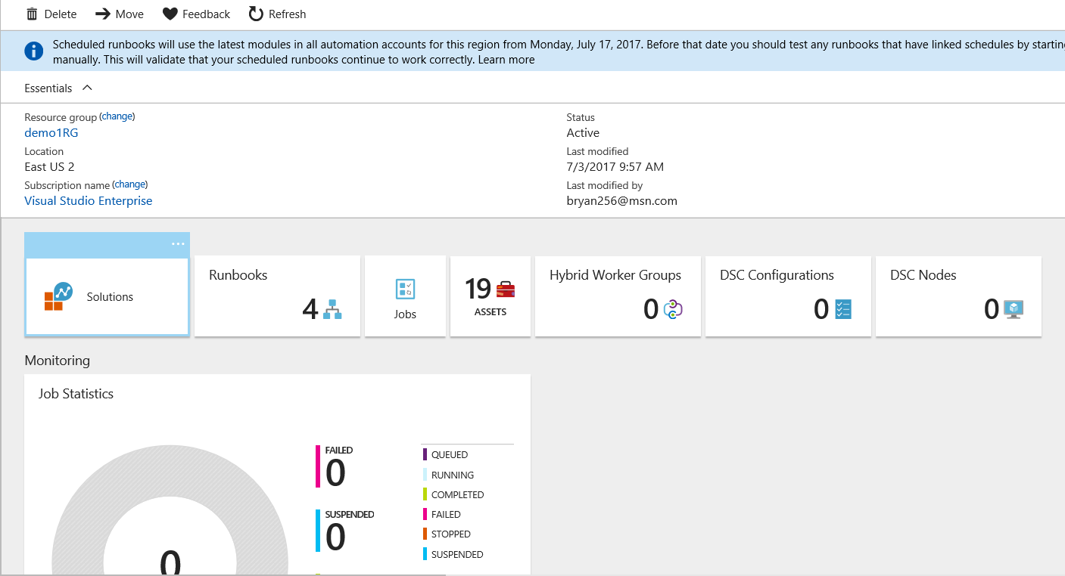
Automation Account Dashboard

Slide 30
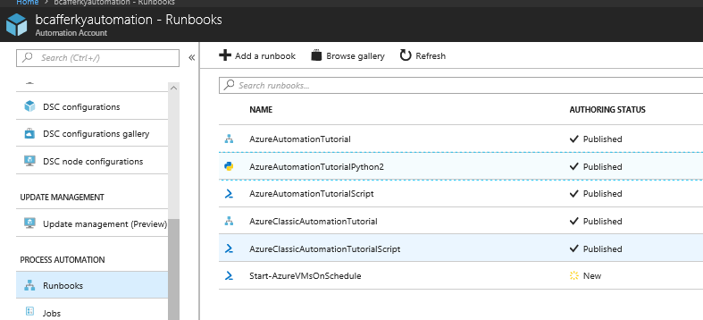
Runbook Types
Not Shown
Workflow Runbook
Graphical Runbook
Python Runbook
PowerShell Script Runbook

Slide 31
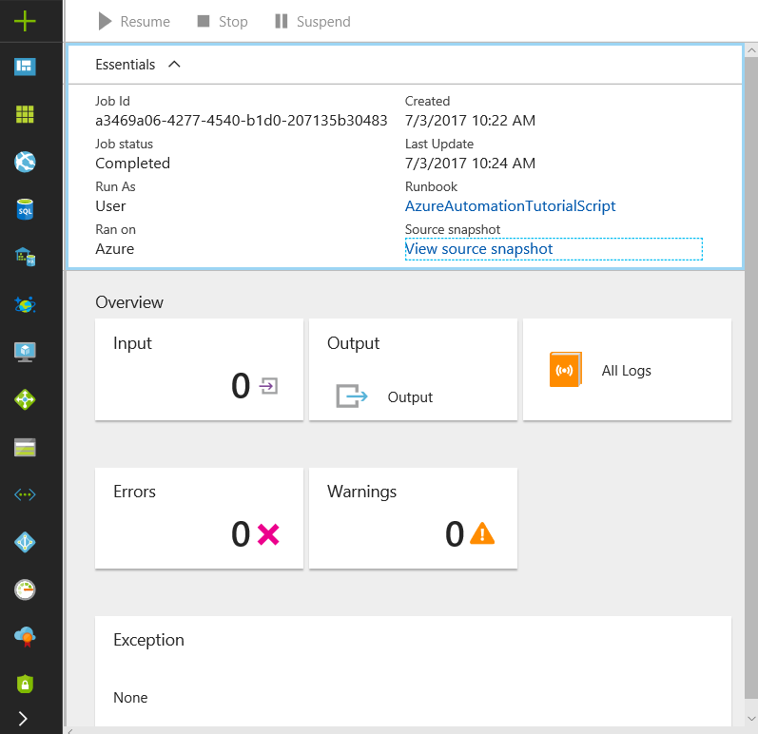
Runbook Job Status

Slide 32
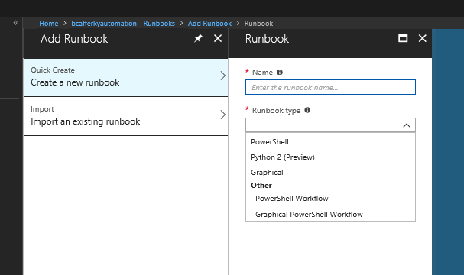
Creating a Runbook
Standard PowerShell Language
Python 2 Language
Standard PowerShell using GUI Designer
PowerShell using Workflow Engine
PowerShell Workflow using GUI Designer

Slide 33
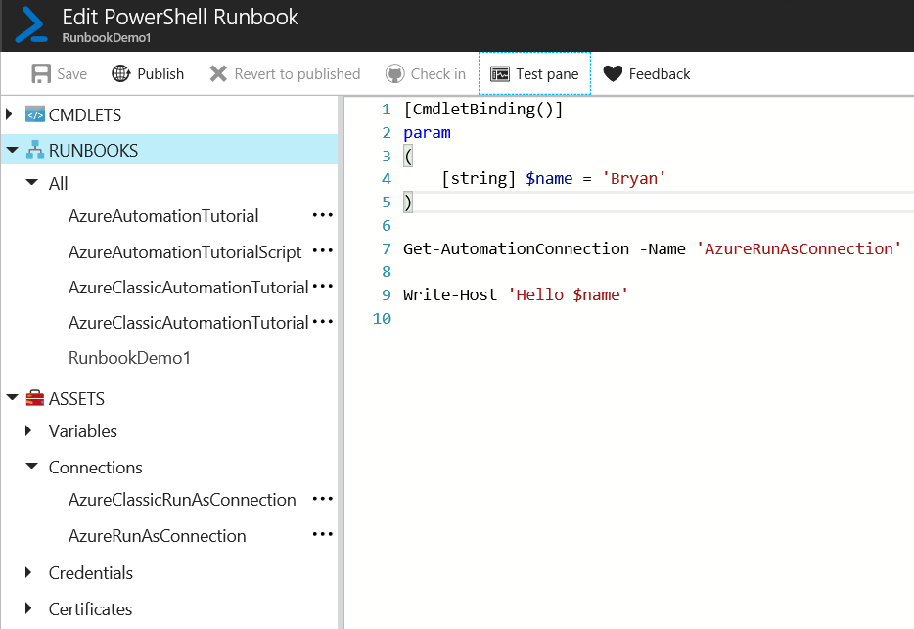
Editing a Runbook
Parameters
Connect with Connection Asset

Slide 34
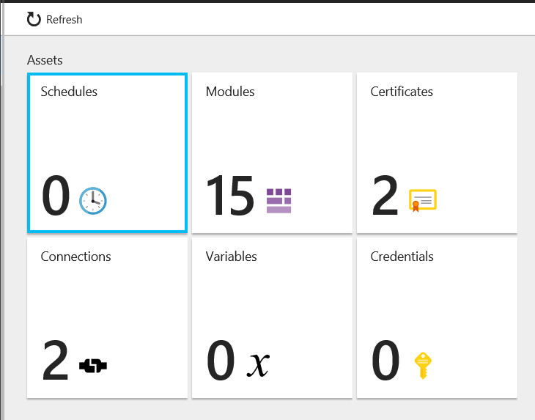
Editing a Runbook
Job Schedules
Built-In or Import Your Own
Authentication
Reusable Azure Connections
Automation Account Scoped Variables

Slide 35
Runbook Demo

Slide 36

There’s No Place Like Home: Staying within Azure
https://www.pdclipart.org/

Slide 37
How Do We Integrate Client Side Development
with
Azure Automation?

Slide 38
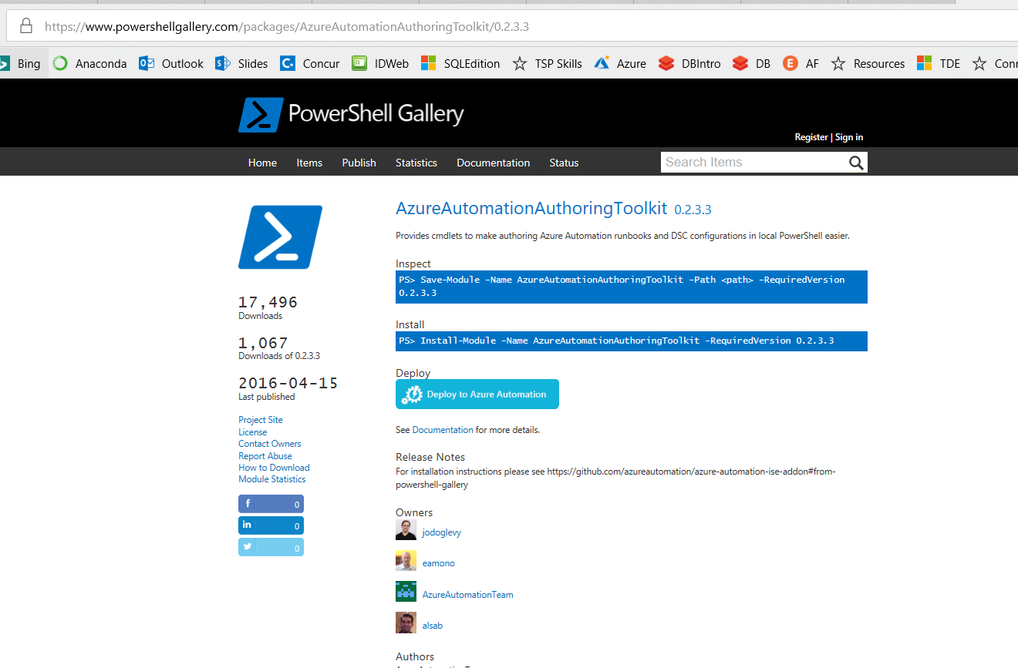
Azure Automation Authoring Toolkit
https://www.powershellgallery.com/packages/AzureAutomationAuthoringToolkit/0.2.3.3

Slide 39
Demo Azure Authoring
Demo Code at:
https://github.com/bcafferky/shared

Slide 40
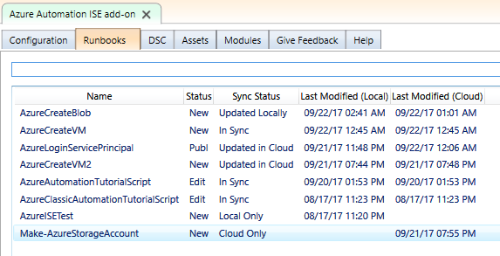
Automation Authoring Toolkit - Runbooks

Slide 41
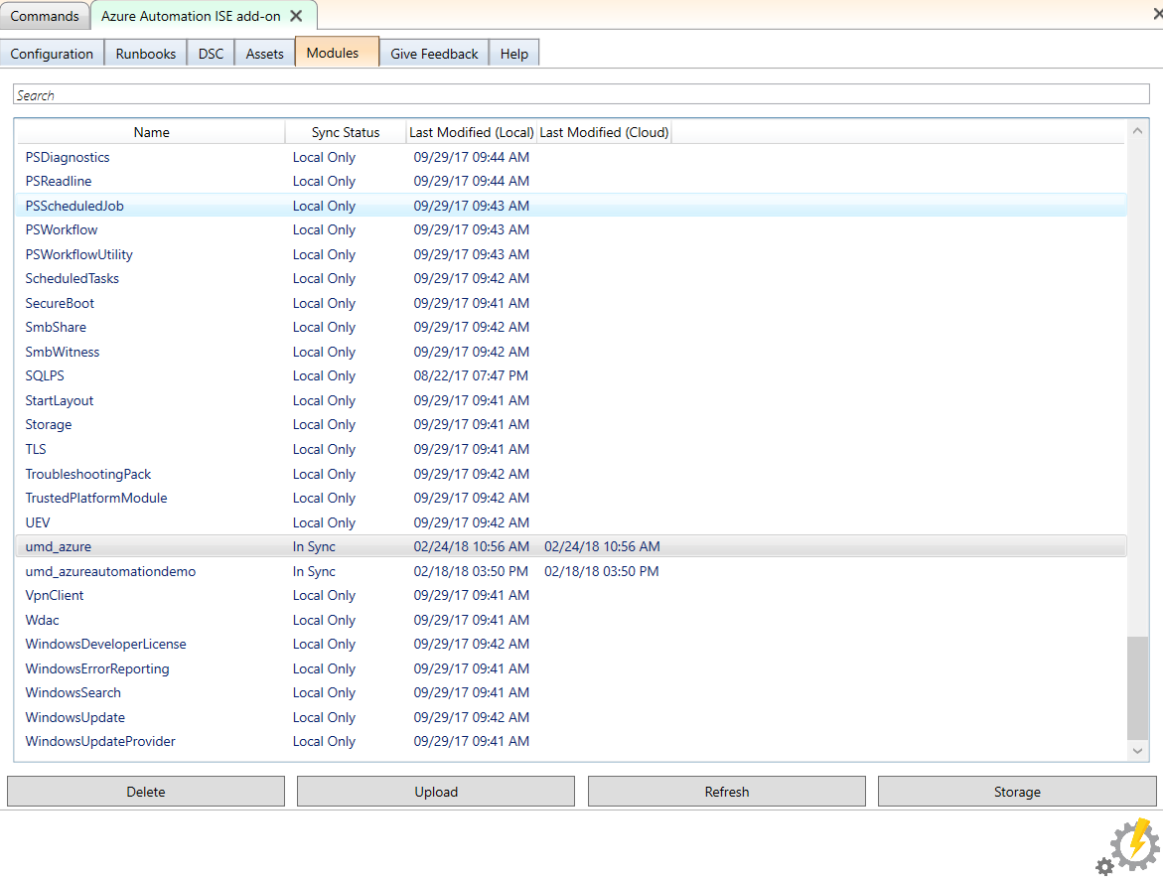
Automation Authoring Toolkit - Storage
No Zipping Required. Can upload directly from you WindowsPowerShell\Modules folder!
Must Create Azure Storage to Hold the Module

Slide 42
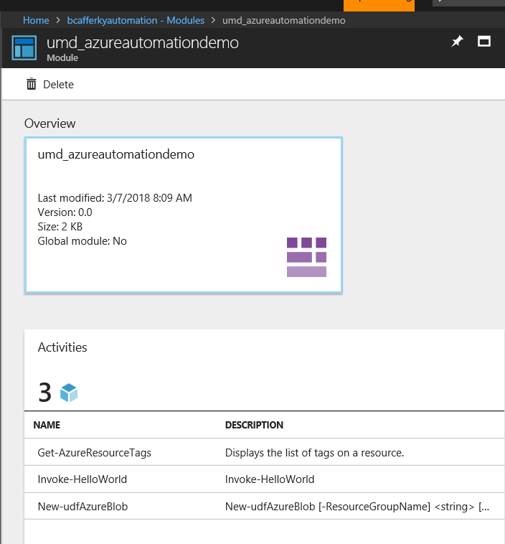
Uploaded Custom Modules
Module Functions Available

Slide 43
Wrapping Up
The Case for Automation
Why PowerShell?
Client Side Automation
Azure Side Automation
Client Side and Azure Side: Azure Automation Authoring Toolkit

Slide 44

Closing: Q & A
Credits
The Doctor – Bryan Cafferky
Set Design – Visual Studio
Callbox Portal – Microsoft
Costume Design - Nerdiacs
PowerShell
Azure
Portal
No droids were harmed in making this film.

