Slide 1

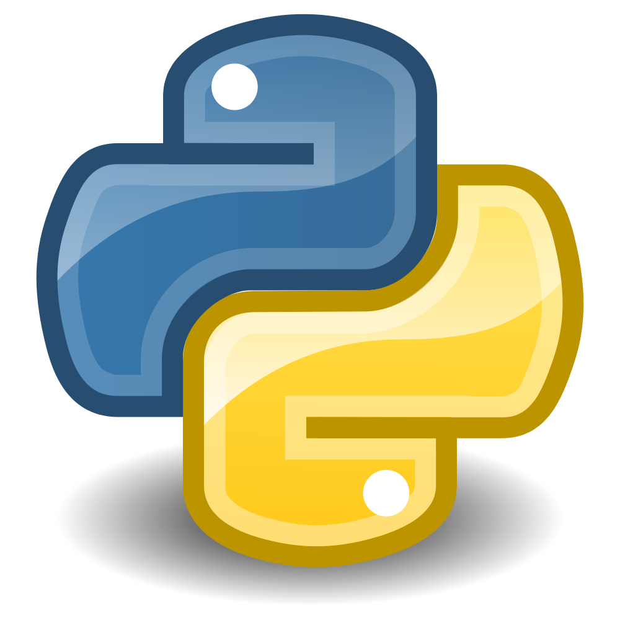
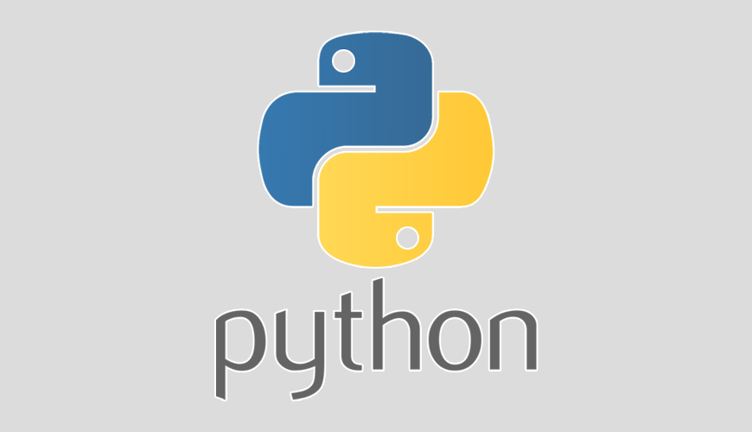
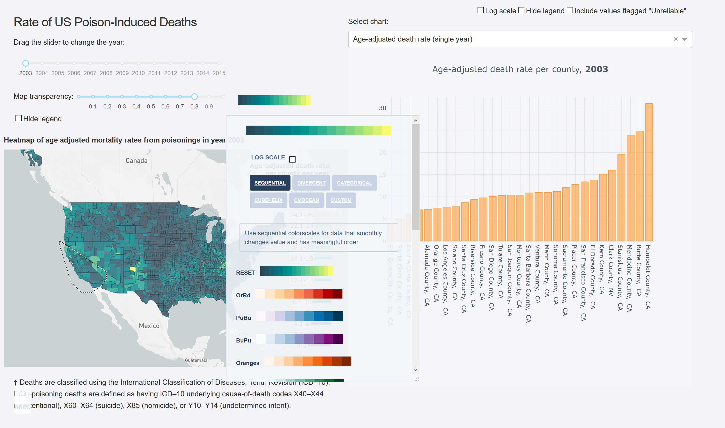


A Lightning Intro to Dash
Bryan Cafferky
Data and AI Solutions Enabler

Slide 2
A Lightning Intro to Dash
What is Dash?
Why do you care?
Installing Dash
Testing Dash

Slide 3
What is Dash?
Provides Interactive Dashboards in Python
Open Source
From Plotly
Think Shiny for Python
Dash is a productive Python framework for building web applications.

Slide 4
Why Do You Care?
Free Way to Get Amazing Dashboards
Power of Python
Very Flexible
Intuitive Design

Slide 5
Installing Dash
Walk Through
https://dash.plot.ly/installation
https://dash.plot.ly/getting-started
https://dash.plot.ly/

Slide 6
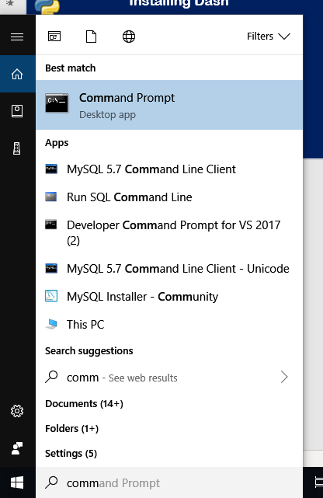
Installing Dash
Start the Command Prompt
2) Click on to execute.
1) In the Windows Search box, enter Command

Slide 7
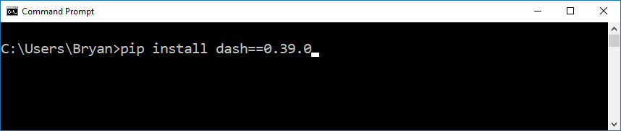
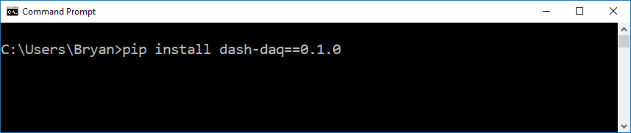
Installing Dash
Install Dash
Enter this.
Enter this.

Slide 8
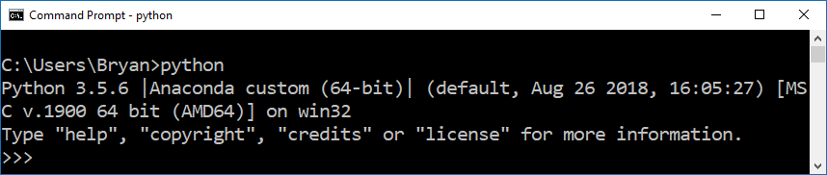
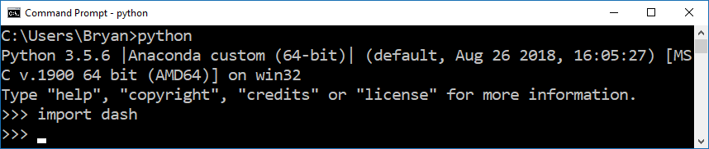

Installing Dash
Test the Installation
Enter this.
Enter this.
You should not get errors.
Enter this. Exits the Python interpreter.

Slide 9
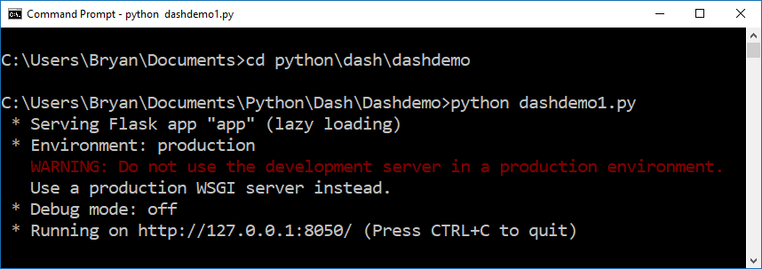
Running Dash
Change to the folder where you put the demo python script.
Run the Python demo script.
Copy this URL

Slide 10
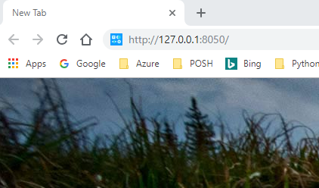
Running Dash
Enter the URL
Not Ideal for Use with Jupyter!

Slide 11
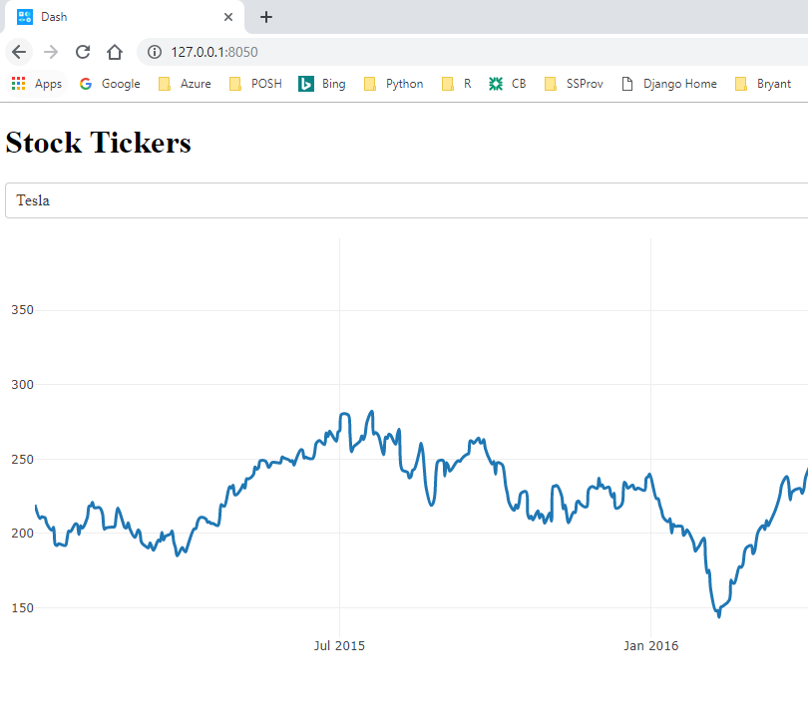
Running Dash
Your Dashboard
Try changing the Drop Down
Dash is Running!

Slide 12
Dash Resources
Installation
https://dash.plot.ly/installation
Demos
https://dash.plot.ly/gallery
Tutorials
https://dash.plot.ly/getting-started

Slide 13
Wrapping Up
What is Dash?
Why do you care?
Installing Dash
Testing Dash
Thanks for Watching!

