Slide 1



Linear Regression Demystified
Bryan Cafferky and Angela H. Chen

Slide 2


About Bryan Cafferky…
Data Solutions Enabler (TSP)
Past Microsoft MVP
Decades of Data Platform Development
Author of Pro PowerShell for Database Developers
Founded and lead PASS Chapter The RI Microsoft BI User Group and The SNE R User Group
Frequent presenter at technical conferences and user groups
Bryan.Cafferky@micrsoft.com
https://www.linkedin.com/in/bryancafferky
@BryanCafferky – follow me!
Subscribe to me on YouTube!

Slide 3
Statistics is Scary!!!
https://github.com/bcafferky/shared

Slide 4
Key Concepts in Statistics
Why do you need to know statistics to do
analytics and machine learning?

Slide 5
Key Concepts in Statistics
Why do you need to know statistics to do
analytics and machine learning?
Input Variables (Features)
Age
Blood Pressure
Diabetic?
Body Mass Index
Sex
Result
Function
Cardiac Risk

Slide 6
Key Concepts in Statistics
The NULL Hypothesis.
The P Value ( < .05 usually used for statistical significance)
What is Linear Regression?
Non Linear Regression
The problem of Confounders
Confusing a Relationship with a Cause

Slide 7
The null hypothesis
Key Concepts in Statistics
The default position that there is no relationship between two measured phenomena, or no association among groups.
In testing a drug, the null hypothesis is that the drug has no effect. You try to prove the NULL hypothesis is false.
You think that older customers are more loyal customers, i.e. repeat business. The NULL hypothesis, that you must disprove, is that older customers are not more loyal.

Slide 8
Key Concepts in Statistics: P value
The p Value is the probability that the results you got is just a fluke, i.e. does not represent a change in assumptions, i.e. the NULL hypothesis is true.
For example, in a test of a cough medicine, the test group that received the new medication showed a ten percent cure rate. The P value is used to say how likely is a ten percent drop in cold symptoms if the cold medicine did nothing.
P Value of <= .05 is usually accepted to confirm statistical significance of the result, i.e. Refutes the NULL Hypothesis.
A P Value of > .05 usually is accepted to mean there is no statistical significance, i.e. the cold medicine cannot be confirmed to work. Cannot refute the NULL Hypothesis.

Slide 9
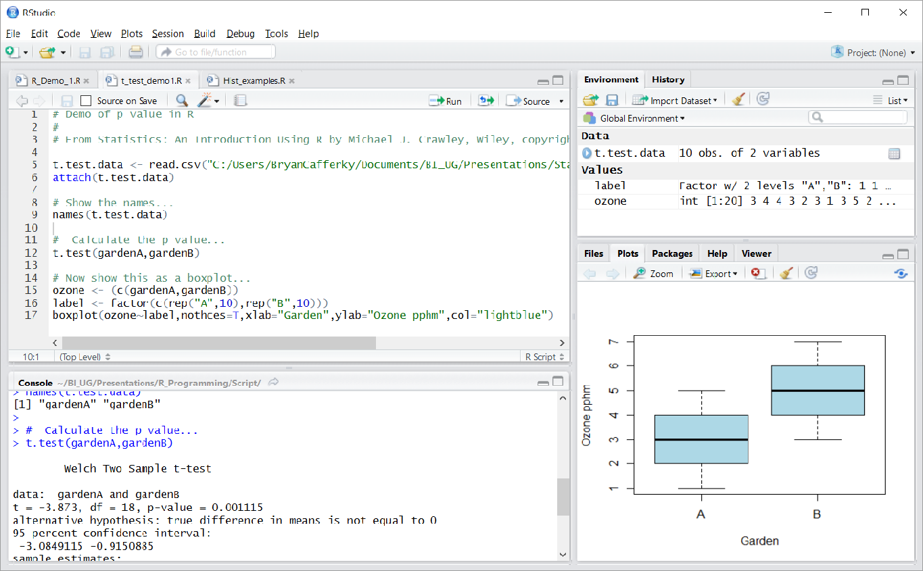
P Value (t test)
p value

Slide 10
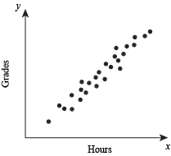
Linear Regression – Scatter Plot
Positive Correlation
A consistent trend exists between the two variables, i.e. the values cluster around a line.

Slide 11
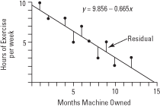
Linear Regression Plot with Line
Negative Correlation
A consistent relationship exists between the predictor variable and the result (what is being predicted), i.e. a line.

Slide 12
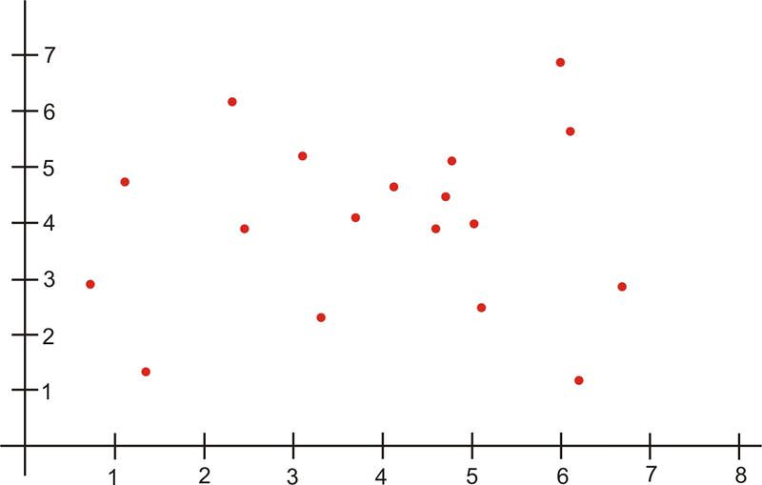
Linear Regression Plot with Line
No Correlation
No consistent relationship exists between the predictor variable and the result

Slide 13
Linear Regression (Demo)
R/Python Script demonstrating linear modeling.
1) Does a scatter plot.
2) Plots the linear regression line over the scatter plot.
3) Shows the residuals, i.e. distance from the line of each point.

Slide 14
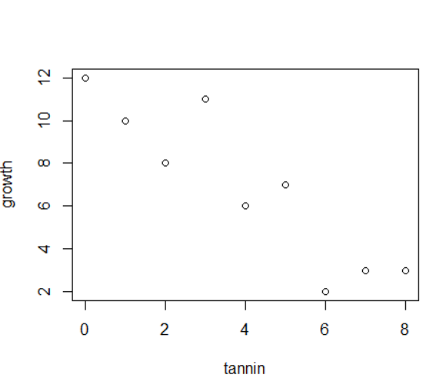
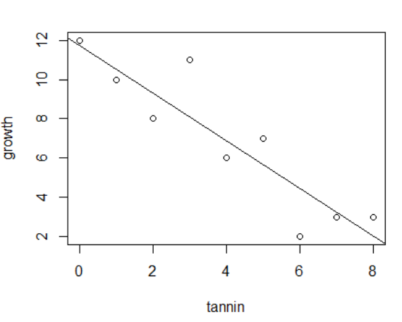
Linear Regression (Demo)

Slide 15
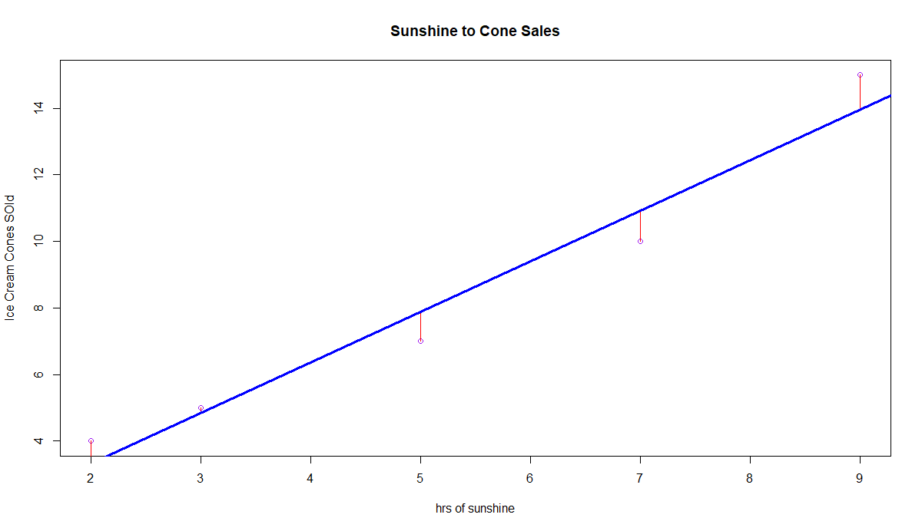
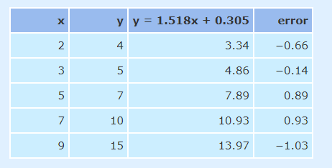
Linear Regression (Demo)
Residual Sum of Squares (RSS)

Slide 16
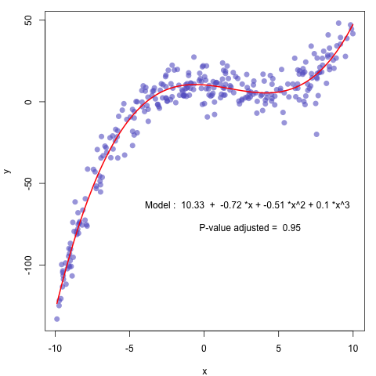
Non Linear Regression – Scatter Plot
No consistent (straight line) trend exists between the two variables, i.e. the values cluster around a line.

Slide 17


Confounders
When something other than the predictor variable has an effect on the result, i.e. has a relationship to the result.
Study linking coffee drinking to cancer. Smokers tend to drink more coffee.
Organic foods and cardiac health. People who buy organic foods may exercise more.

Slide 18
Confusing Cause with relationship
People who drive Toyota’s tend to be taller. Therefore, if I buy a Toyota, I will get taller. Hmmm…
Smoking to Cancer does seem to be a causal relationship. The word here is caution!

Slide 19
Review:
The NULL Hypothesis.
The P Value.
What is Linear Regression?
Non Linear Regression and the Correlation Coefficient.
The problem of Confounders.
Confusing a Relationship with a Cause.

Slide 20

Q & A

Slide 21
Linear Models for Regression
Angela H. Chen

Slide 22


About Angela H. Chen
Research Fellow at National Center for Supercomputing Applications
Masters of Science in Statistics
Developed Machine Learning Models to Study Complex Genetic-interaction (epistasis) Effects on Traits
Worked with Software Engineers to Build Stand-Alone Software for the Bioinformatics Community
Experience in R and Java Programming
angela@angelahsiaohanchen.com
https://www.linkedin.com/in/angelahhchen/

Slide 23
Goals of this lecture
Intuition for linear regression models in ML
Implementation in R
“Essentially, all models are wrong, but some are useful. ” – George Box
Notes:
Why do we model?
Types of linear model : simple/multiple/

Slide 24
The iterative process of ML
Training Data
ML Model
ML Algorithm
Quality Metric
Angela Chen, Linear Model for Regression 1

Slide 25
The iterative process of ML
Training Data
subset of X and Y
X_{i.}
X₁ ... X_{j}
Y₁
Y₂
.
.
.
Y_{i}
X₂₁ .. X_{2j}
Y_{i}
Y_{i} = i^{th} observation
X_{j} = j^{th} feature
X_{ij} = j^{th} feature of i^{th} observation
Angela Chen, Linear Model for Regression 2
Notes:
Subset your data set to two parts : training and testing

Slide 26
The iterative process of ML
Training Data
X_{i.}
ML Model
Y_{i} = a + b * X_{i1}
Initialize
parameter estimation for a and b
Y_{i}
Y_{i}
Angela Chen, Linear Model for Regression 3
Notes:
(Error comes from the unobserved population data)
Bolded font means estimated values
Fit a simple linear model where you want to model the linear relationship between your input and output (number of home run vs salary)
Start with guessing its parameters
a and b are your parameters they are unknown

Slide 27
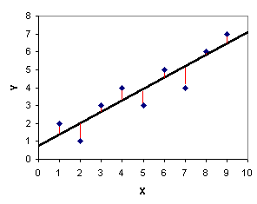
The iterative process of ML
Training Data
X_{i.}
ML Model
Y_{i} = a + b * X_{i1}
Y_{i}
Y_{i}
Quality Metric
e.g. sum(Y_{i}- Y_{i})²
Also called cost function. Goal is to minimize the cost.
Angela Chen, Linear Model for Regression 4
Notes:
Error comes from the unobserved population data
Bolded fonts are estimated values
Use gradient descent as an example

Slide 28
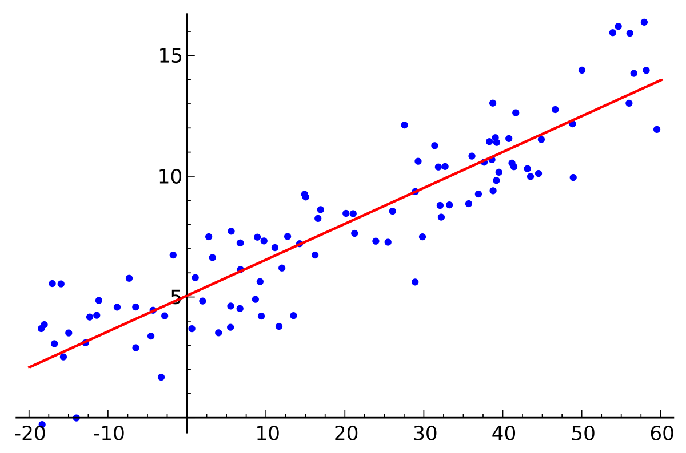
The iterative process of ML
Training Data
X_{i.}
ML Model
Y_{i} = a + b * X_{i1}
Estimate parameters
a and b
Y_{i}
ML Algorithm
Y_{i}
Quality Metric
e.g. sum(Y_{i}- Y_{i})²
Angela Chen, Linear Model for Regression 5
Notes:
Error comes from the unobserved population data
Bolded font means estimated values
The predicted value gets updated after a new set of parameter estimation is computed from any choice of algorithm (e.g. gradient descent)
The iteration stops when the parameter estimation stabilizes and yield the minimum cost
Compare with closed-form solution where there’s a formula for parameter estimation → iterative process is redundant.

Slide 29
ML algorithms
Closed-form solutions: “any formula that can be evaluated in a finite number of standard operations”
E.g. Least squares equations
Numerical solutions: “any approximation that can be evaluated in a finite number of standard operations”
E.g. Gradient descent
Best when parameters don’t have a closed-form solution
Angela Chen, Linear Model for Regression 6
Notes:
Closed-form solutions are not always available. E.g. OLS/quadratic formula
Gradient descent is useful under large dataset
In practice, it is useful when you have a very large dataset either in the number of rows or the number of columns that may not fit into memory

Slide 30
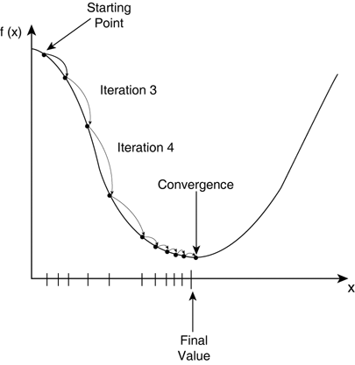
ML Algorithm: Gradient Descent
Two steps of gradient descent:
Goal is to minimize cost function
Initially guess the
parameter
Update it iteratively
until convergence
Angela Chen, Linear Model for Regression 7
Notes:
The goal is to continue to try different values for the coefficients, evaluate their cost and select new coefficients that have a slightly better (lower) cost. Repeating this process enough times will lead to the bottom of the bowl and you will know the values of the coefficients that result in the minimum cost.
The procedure starts off with initial values for the coefficient or coefficients for the function. These could be 0.0 or a small random value.
The coefficients are updated each time after taking the derivative of the cost. This is basically saying the slope gives the direction of the next step.
How big is each step is determined by a parameter alpha (which controls how much the coefficients can change on each update)
This process is repeated until the cost of the coefficients (cost) is 0.0 or no further improve- ments in cost can be achieved.
Model representation: Model + Cost
Gradient = Derivative measures the change of output with respect to the change of input
Partial derivative = change of output with respect to one change in input while other inputs stay constant

Slide 31
Model assessment: Test error
Obtain parameter estimates
Obtain new predicted values
Training set
Testing set
Total data split to a training set and a testing set
Test error = average cost (prediction error) of in the test set
Angela Chen, Linear Model for Regression 8
Notes:
Cost can be any metric e.g. residual sum of square
How you parse your data can greatly matter to your test error
Training dataset too large → overfitting
K-fold cross-validation offers an alternative to splitting training/test set

Slide 32
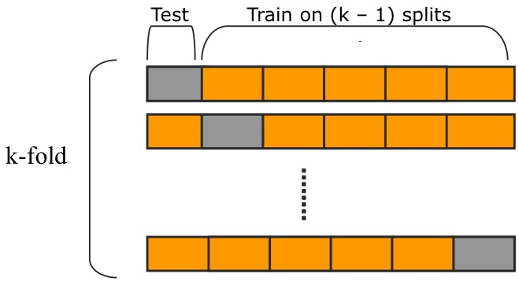
Model Assessment: Cross Validation
K-fold cross validation
Total data partitioned to k splits
Test error = average cost (prediction error) of in each test set
Notes:
Cost can be any metric e.g. residual sum of square
How you parse your data can greatly matter to your test error
K-fold cross-validation offers an alternative to splitting training/test set

Slide 33
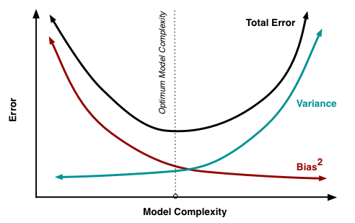
Bias-Variance Trade-Off
Prediction error ≈ bias error + variance error
Variance:
changes to parameter estimation with changes to the training dataset
High variance
Large change to estimation
Low variance
Small change to estimation
Bias:
assumptions about the model
High bias
→ More assumptions
Low bias
→ Less assumptions
Angela Chen, Linear Model for Regression 9
Notes:
How to determine optimal complexity?
Bullseye = the true parameter (unobserved)
Dots represents estimated parameter
Linear models have high bias low variance
Define bias (distance from the truth) and variance (spread of data)
Overfitting → variance increases; bias decreases
Prediction error = bias + variance + random

Slide 34
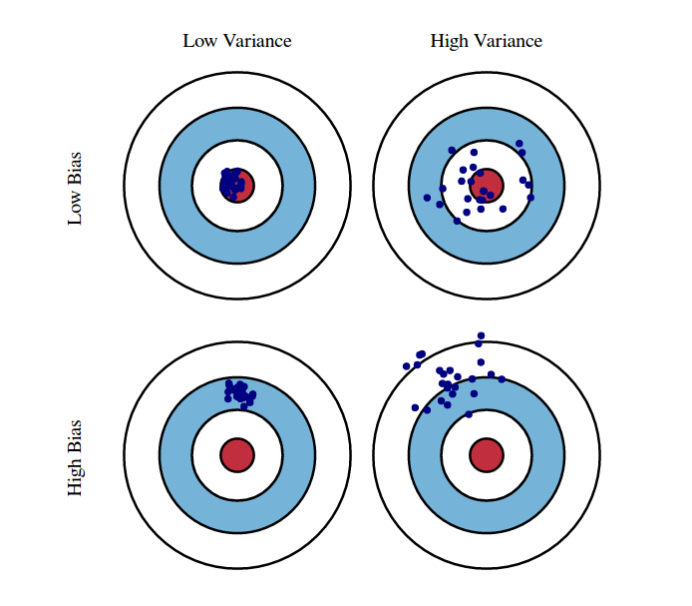
Bias-Variance Trade-Off
Prediction error ≈ bias error + variance error
Variance:
changes to parameter estimation with changes to the training dataset
High variance
Large change to estimation
Low variance
Small change to estimation
Bias:
assumptions about the model
High bias
→ More assumptions
Low bias
→ Less assumptions
Angela Chen, Linear Model for Regression 10
Notes:
How to determine optimal complexity?
Bullseye = the true parameter (unobserved)
Dots represents estimated parameter
Linear models have high bias low variance
Define bias (distance from the truth) and variance (spread of data)
Overfitting → variance increases; bias decreases
Prediction error = bias + variance + random

Slide 35
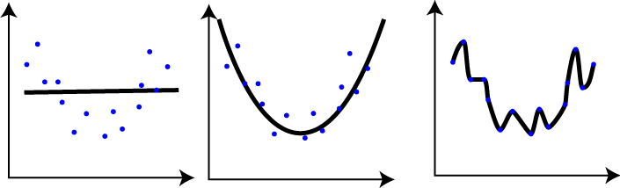
Overfitting vs Underfitting
Reduce model complexity (over-fitting)
Increase model generality
Under-fit
Good-fit
Over-fit
Angela Chen, Linear Model for Regression 11
Notes:
Simple linear regression: under fit
Multiple linear regression: over fit
Overfitting refers to a model that models the training data too well, picking up all signals and noises

Slide 36
Regularization Regression
Reduces model complexity by penalizing the magnitude of coefficients
Cost = RSS + Measure of model complexity
Ridge Regression: squared absolute sum of the coefficients (L2 regularization)
Least Absolute Shrinkage and Selection Operator (LASSO): absolute sum of the coefficients (L1 regularization)
Notes:
RSS = residual sum of squares (sum of squared errors between predicted outcomes and observed outcomes)

Slide 37
Demo

Slide 38
Take home message
Ridge and LASSO reduce model complexity
Regularization methods work well under high dimensionality and multicollinearity

Slide 39
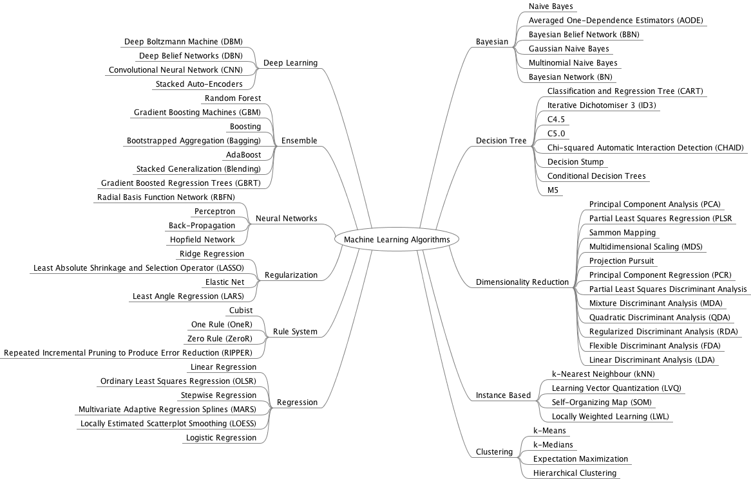
Learning Algorithms Mind Map
Notes:
Supervised vs Unsupervised learning: based on whether the output is known

Slide 40
Next time
Regularization regression: Ridge and LASSO
More on gradient descent
Logistic regression
?

Slide 41
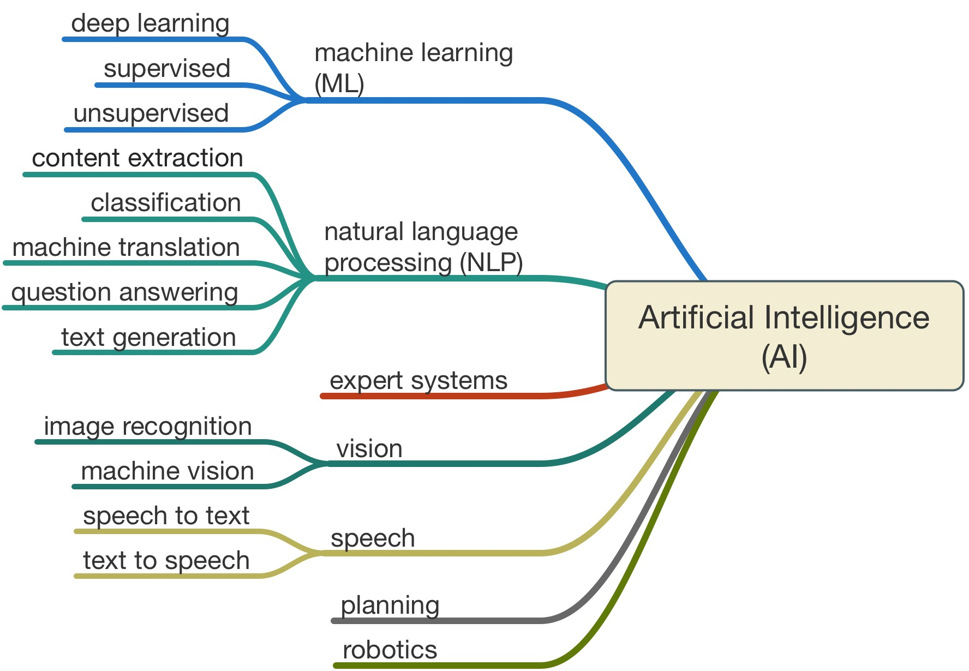
AI Mind Map
Notes:
Supervised vs Unsupervised learning: based on whether the output is known

Slide 42

Questions?

