Slide 1


R Programming Getting Things Set Up

Slide 2

What You Need
R Language Console
RStudio
Most popular and feature rich IDE.
Only Supports R Language

Slide 3

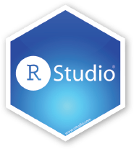
Lab: Get and Install R and R Studio
R CLI – Command Line interface.
https://cran.r-project.org/bin/windows/base/
Designed for interactive single command at a time. Must install this.
R Studio – An Integrated Development Environment.
https://www.rstudio.com/products/rstudio/download/
A complete script development environment.
See Next Slide for versions

Slide 4
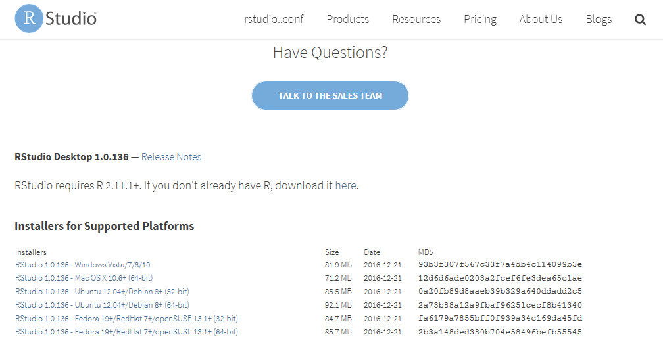
Downloading RStudio
Windows Version

Slide 5
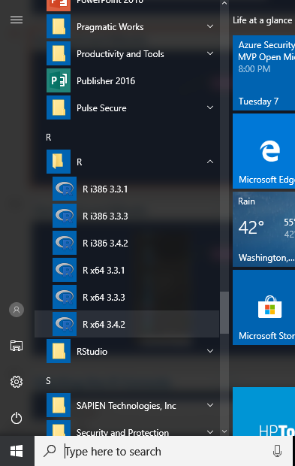
Testing things Out: Starting R and RStudio
64 Bit Most Recent Version

Slide 6
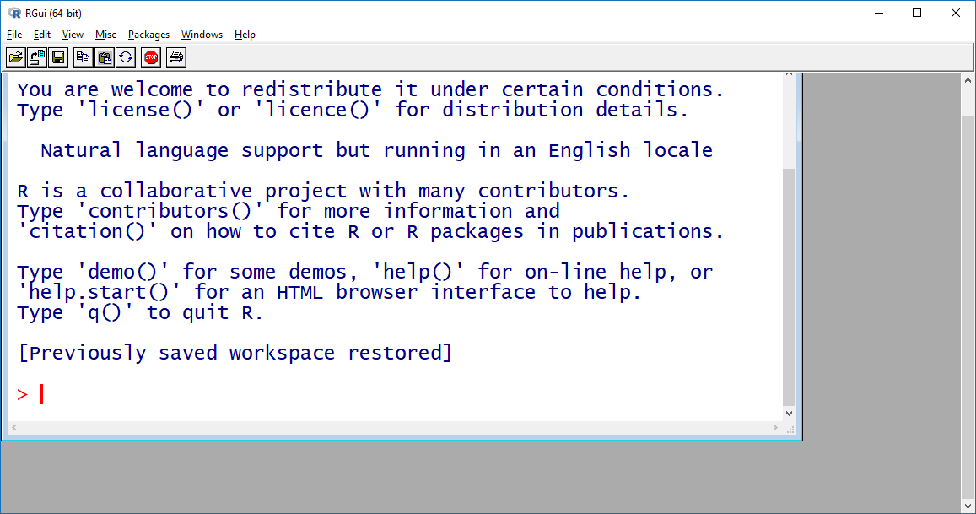
The R Console
Windows Version

Slide 7
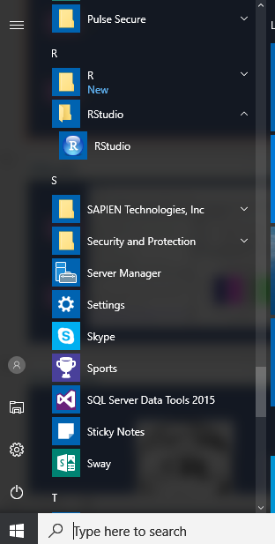
Starting R and RStudio
Start RStudio

Slide 8
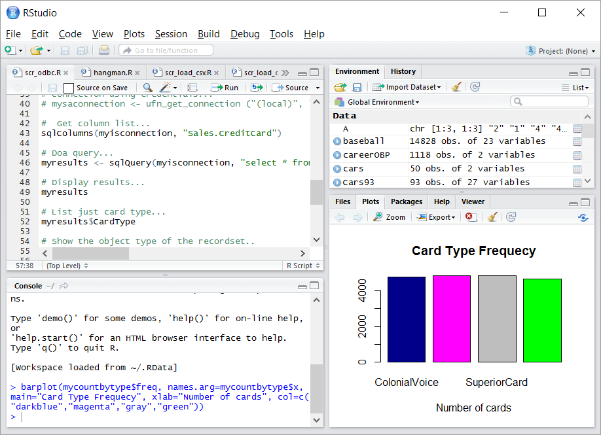
RStudio
Environment Memory
Script Editor
Tabbed Views
R Console

Slide 9
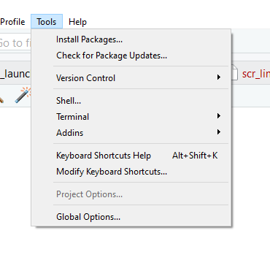
RStudio – Installing Packages
Click on Install Packages

Slide 10

Python Programming Getting Things Set Up

Slide 11

Installing Anaconda
Anaconda Distribution
https://www.anaconda.com/download/

Slide 12
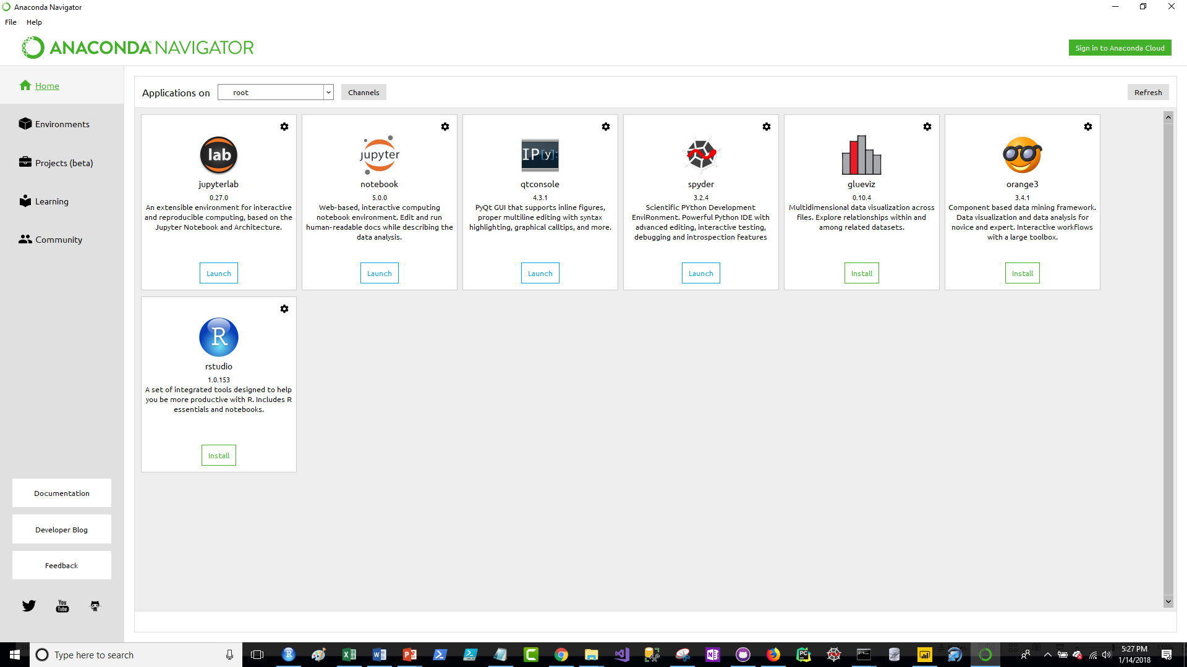
Anaconda Goodies

Slide 13
Anaconda Libraries
Matplotlib - Visualizations
NumPy – Arrays and Number Crunching
Scikit-learn – Data Science
Pandas – Data Wrangling
Seaborn – Visualizations
SQLAlchemy – SQL Support and Database Access
https://docs.anaconda.com/anaconda/packages/py3.6_win-64

Slide 14
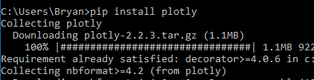
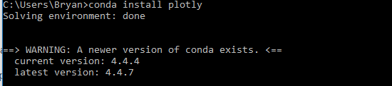
Package Management
pip
conda

