Slide 1
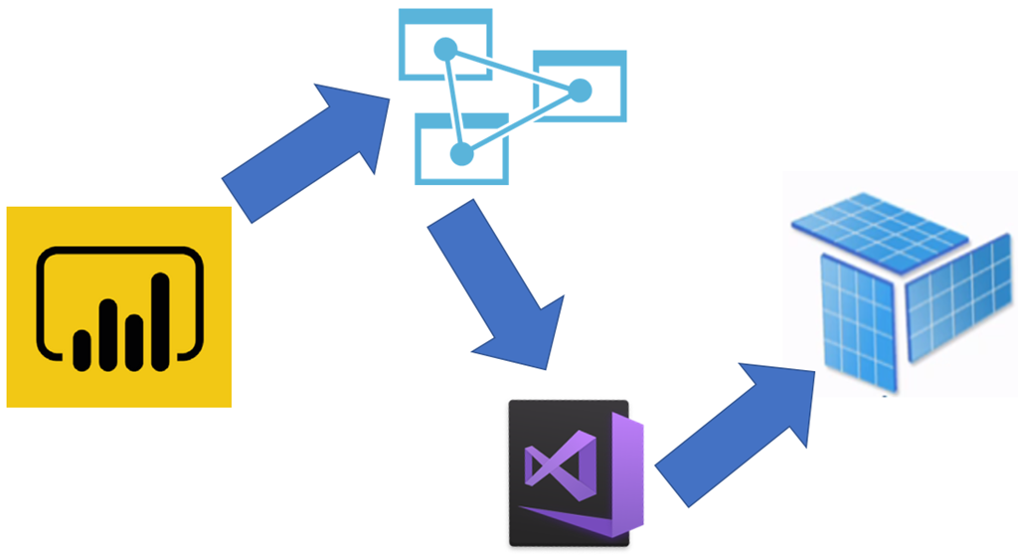
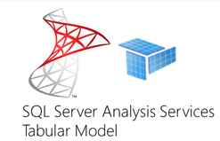
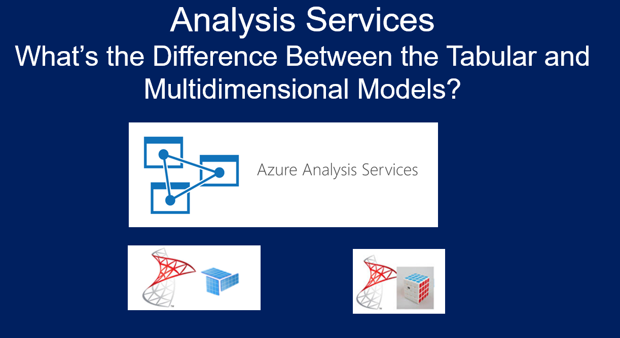

Analysis Services
Azure
&
SQL Server
Part 1: The Tabular Model and Why You Need it!
Delivering the Full Value of Business Intelligence
Bryan Cafferky

Slide 2
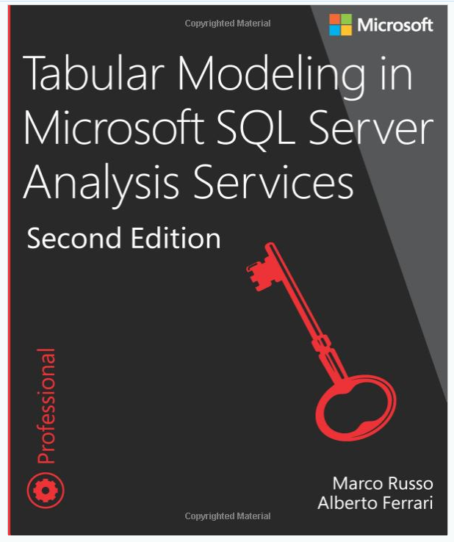
The Multidimensional Model
https://www.microsoft.com/en-us/p/tabular-modeling-in-microsoft-sql-server-analysis-services/fgqpf3gzm3gh

Slide 3
Today’s discussion
In the beginning…
Users needed to analyze data
So Business Intelligence was created
But there were too many requests and users started doing their own analysis
And the world descended into chaos
And Microsoft said let their be Power BI and the Tabular Data Model
And all was good!

Slide 4
Today’s discussion
What is the Goal of Business Intelligence?
Leverage an Enterprise’s Data to Provide Actionable Insights to Management

Slide 5
Today’s discussion
Where Are We Heading?
What is the Tabular Data Model?
Why Analysis Services?
What is Analysis Services?
Features and Benefits
Tools
Presentation content @
https://github.com/bcafferky/shared

Slide 6
What is the Tabular Model?

Slide 7
What is the Tabular Model?
An In Memory Table
Highly Compressed
Rows are Stored at the Lowest Level of Detail (Grain)
Includes the Rules on How to Import and Structure the Data
Includes Calculations, Measures, and More
Can think of it as like a SQL View but Held In Memory
Ready
To
Consume

Slide 8
Demo
Power BI Desktop Free Download
https://powerbi.microsoft.com/en-us/desktop/
Power BI Tabular Model

Slide 9
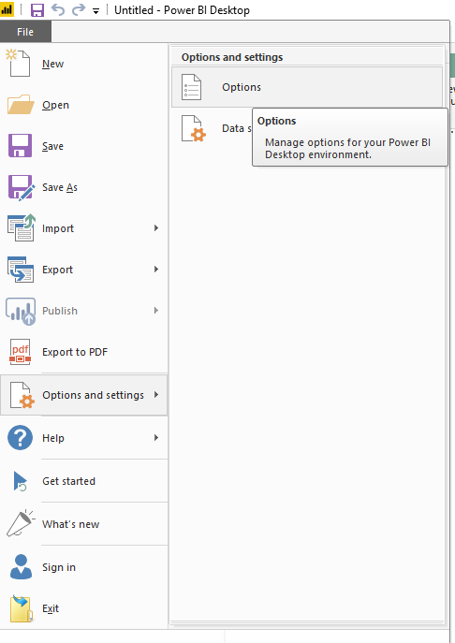
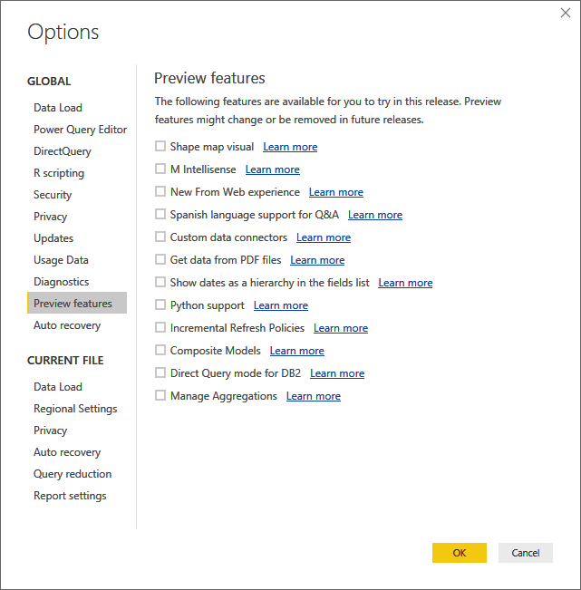
Preview Features
Python!!!

Slide 10
Microsoft provides a complete solution
End User BI
Corporate BI
Enterprise Self Service BI
Balanced Solution

Slide 11


Business Intelligence Team
Without Analysis Services
With Analysis Services
Enables the BI Team to Have a Bigger Business Impact!!!

Slide 12

The Wild West and Data Model Proliferation

Slide 13

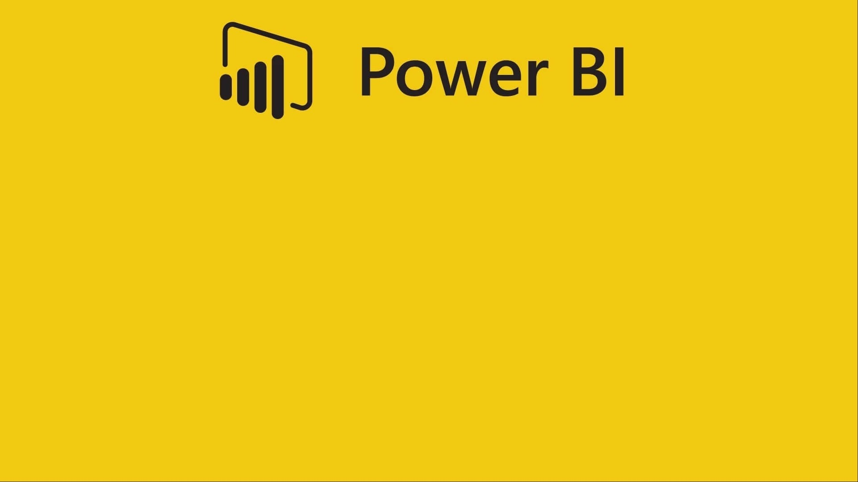
Data Model Duplication
Tabular Data Model
Tabular Data Model
Tabular Data Model
https://openclipart.org/detail/297836/female-computer-user-8

Slide 14
Model Duplication Spreads Fast!
Tabular Model
Tabular Model
Tabular Model
Tabular Model
Tabular Model
Tabular Model
Tabular Model
Tabular Model
Tabular Model
Tabular Model
Tabular Model
Tabular Model
Tabular Model
Tabular Model
Tabular Model
Tabular Model
Tabular Model
Tabular Model
https://openclipart.org/detail/297836/female-computer-user-8

Slide 15

What if we could move the model to a high end server?
Scale
High Speed
Analysis
Services
Reuse
Tabular Data Model
Single Source of Truth
Governance
BI Team
Documented
https://openclipart.org/detail/297836/female-computer-user-8

Slide 16


Enterprise Level Self Service BI
Lightning
Response
Larger Models
Reusability
Analysis
Services
Data Governance
Single Source of Truth
Documented
Tableau
https://openclipart.org/detail/297836/female-computer-user-8

Slide 17
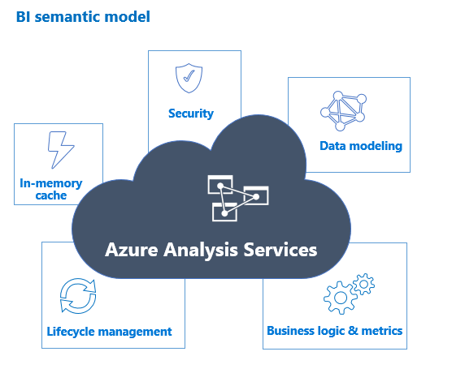
Analysis Services Value Add
Control Who Gets Access
Speed of Thought
Rich Semantic Layer
Correct Measures like Profit and ROI
Source Code Control
Model Compare

Slide 18
Demo
Azure Analysis Services Web Designer and Importing a Power BI Model
Creating an Analysis Services Tabular Model in Visual Studio aka SQL Server Data Tools

Slide 19
Analysis Services and the Ability to Sleep Well
Single Source of Truth
Reusability/Supportability
Models/Measures/Calculations/KPIs
Accessibility
Governance & Security
Scale and Click Speed Response

Slide 20
Analysis Services Key Features
Partitions
Languages
MDX, DAX, M, TMSL, AMO/TOM, PowerShell
Models are Text
Roles
Direct Query
Tabular Model Compare Tool

Slide 21
Today’s discussion
Where We’ve Been?
What is the Tabular Data Model?
Why Analysis Services?
What is Analysis Services?
Features and Benefits
Tools
Presentation content @
https://github.com/bcafferky/shared

Slide 22

Analysis Services
Part 1: The Tabular Model and Why You Need it!
Bryan Cafferky

