Slide 1


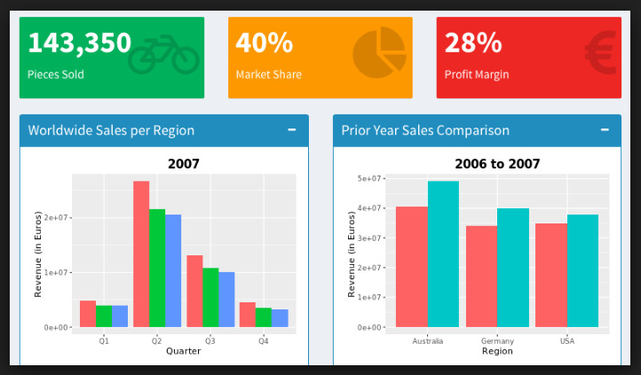

Develop Custom Web Dashboards in R with
by Bryan Cafferky

Slide 2
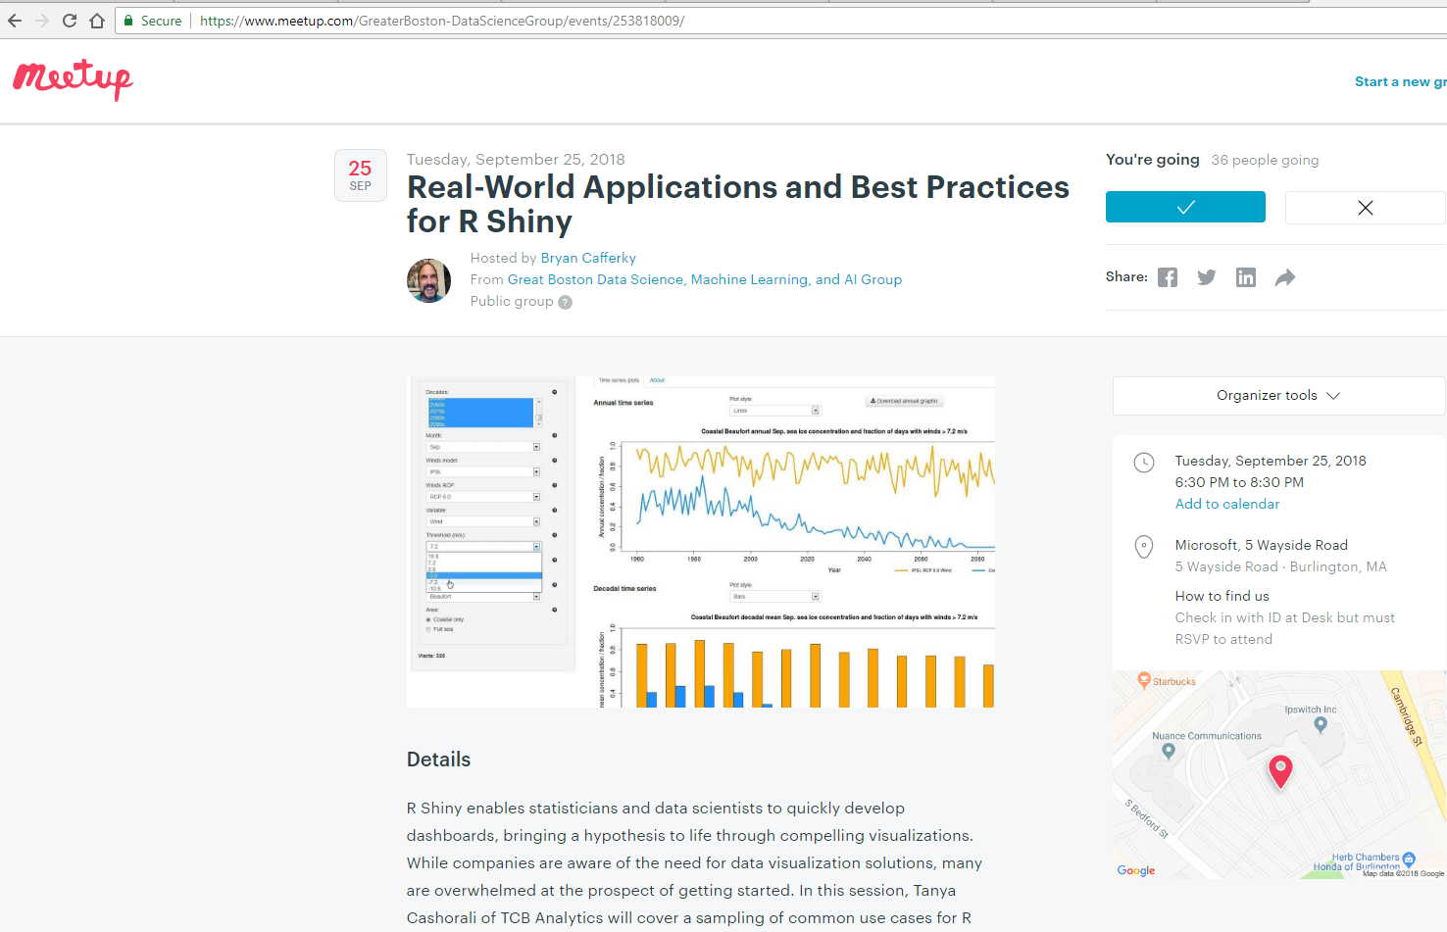
Data Science Meetup
https://www.meetup.com/GreaterBoston-DataScienceGroup/

Slide 3
Today’s Goals
What is Shiny?
What can we do with it?
Features
How do we use it?
Where do we go from here?
Course Content @
https://github.com/bcafferky/shared

Slide 4

Time to Find Your Inner Child!

Slide 5
What is R?
R is an open source language for Data Science and Machine Learning.

Slide 6

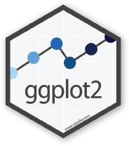


Review of Our Tour
R Packages

Slide 7
What is Shiny?
Shiny is an R package that makes it easy to build interactive web apps using the R programing language.
You can host standalone apps on a webpage or embed them in R Markdown documents or build web based dashboards.
You can also extend your Shiny apps with CSS themes, htmlwidgets, and JavaScript actions.
https://shiny.rstudio.com/

Slide 8

Getting Things Set Up

Slide 9


Lab: Get and Install R and R Studio
R CLI – Command Line interface.
https://cran.r-project.org/bin/windows/base/
Designed for interactive single command at a time. Must install this.
R Studio – An Integrated Development Environment.
https://www.rstudio.com/products/rstudio/download/
A complete script development environment.
See Next Slide

Slide 10

Getting Started with R
RStudio
Most popular and feature rich IDE.
Designed for R Language

Slide 11
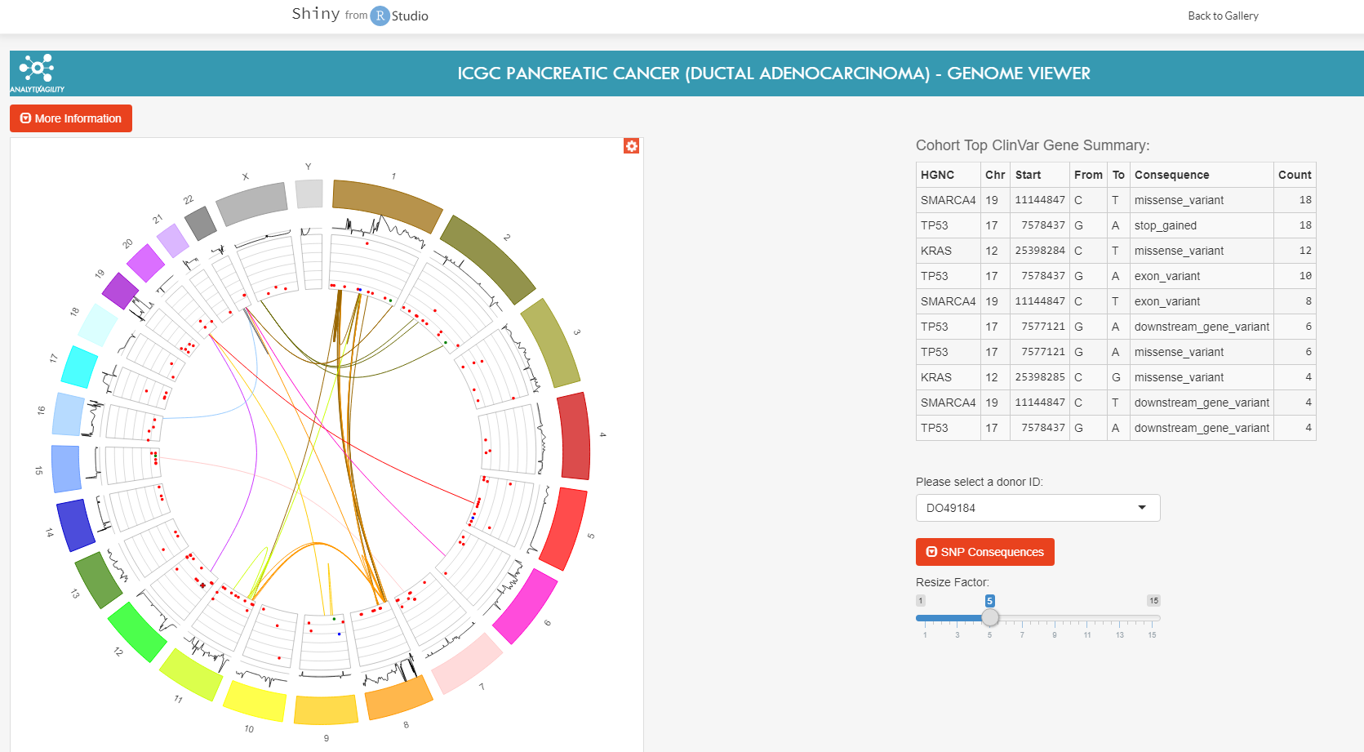
With Shiny You Can?
Create Complete Web Applications
Add Interactive Dashboards
Customize the app using the R Programming Language
Deploy to Cloud or on Premise
https://shiny.rstudio.com/gallery/

Slide 12
Key Shiny Features
Mind Blowingly Simple to Create a Web App using R
Integrated with RStudio
Suited for Data Science Dashboards
Gallery of Jump Start Options
Full Capabilities of the R Language

Slide 13
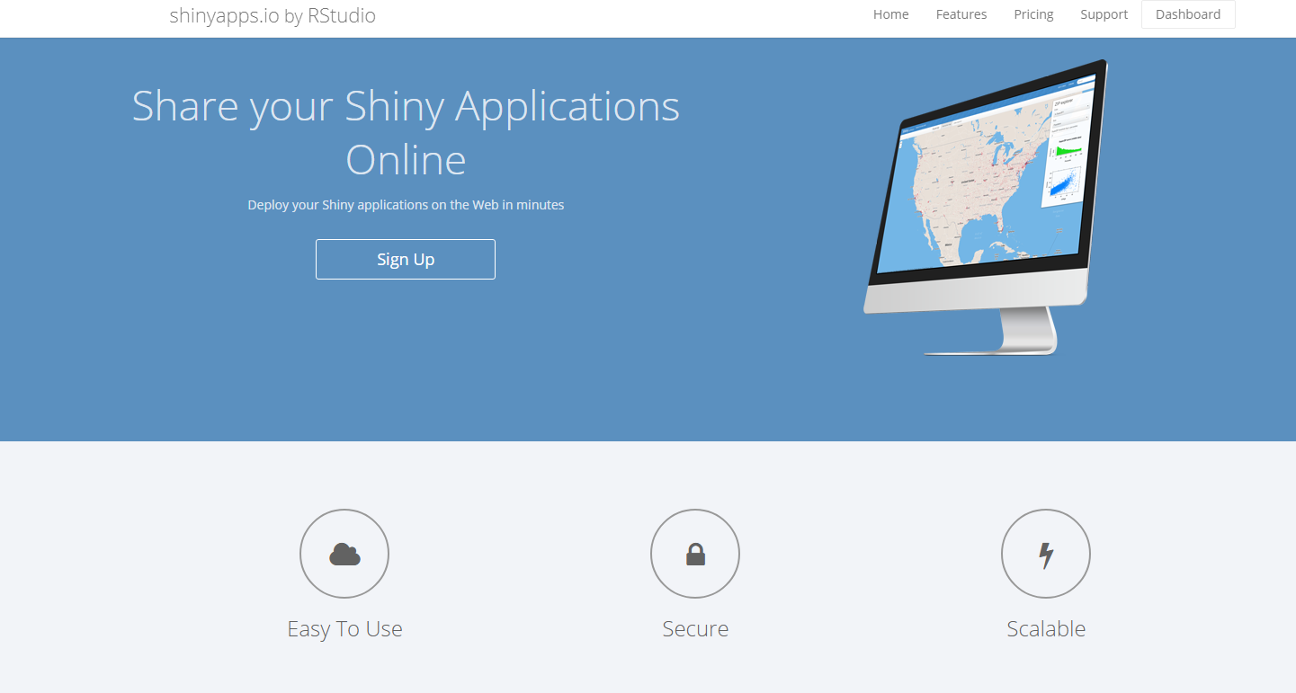
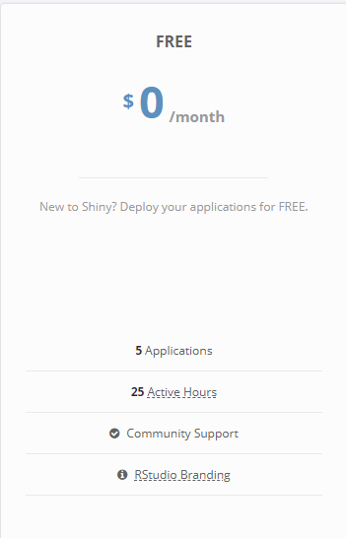
Publishing to Shiny IO…
https://www.shinyapps.io/

Slide 14



Web Server Side Scripting Model
Java Server Pages
Active Server Pages
Python Django
R Shiny
Request
Backend Scripting Engine
Web
Server
Response
Standard HTML Page
Dynamically
Generated
https://openclipart.org/detail/297836/female-computer-user-8

Slide 15
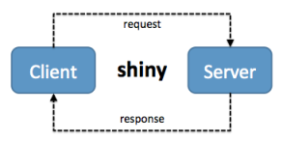
What Can Shiny Do?
Designed for Interaction
https://ryouready.wordpress.com/2013/11/20/sending-data-from-client-to-server-and-back-using-shiny/

Slide 16
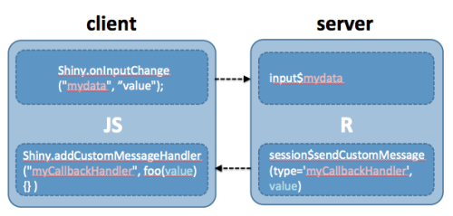
What Can Shiny Do?
Designed for Interaction
https://ryouready.wordpress.com/2013/11/20/sending-data-from-client-to-server-and-back-using-shiny/

Slide 17
What Can Shiny Do?
Demo – Creating a Shiny App Instantly

Slide 18
Shiny Deployment

Slide 19
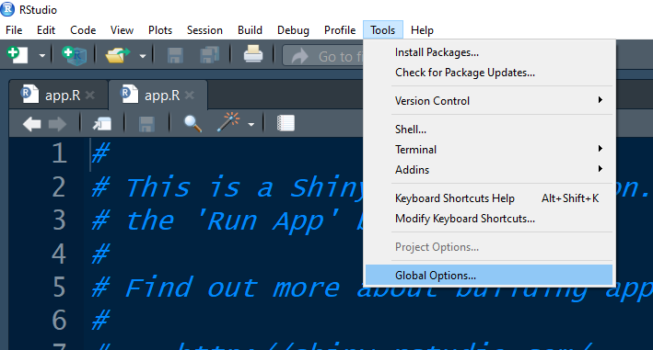
Publishing to Shiny IO…
https://www.shinyapps.io/

Slide 20
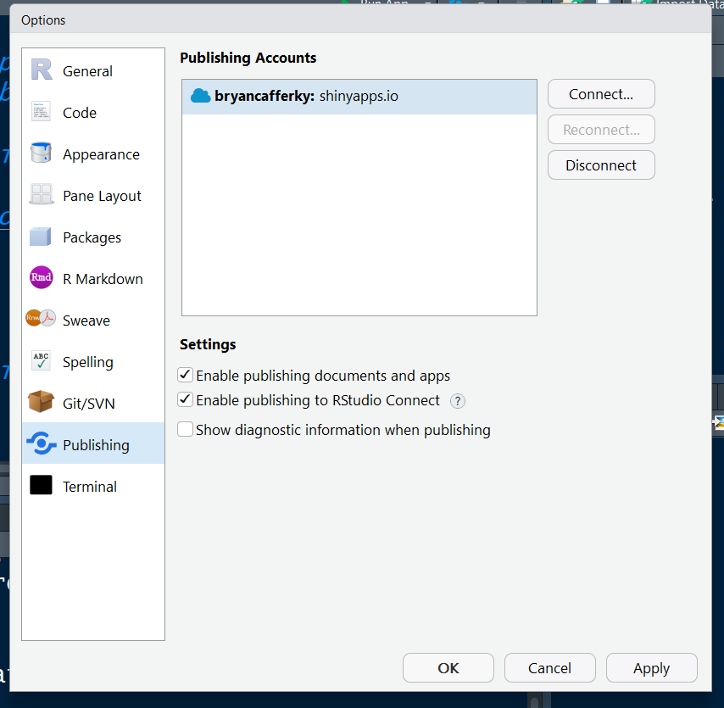
Publishing to Shiny IO…

Slide 21
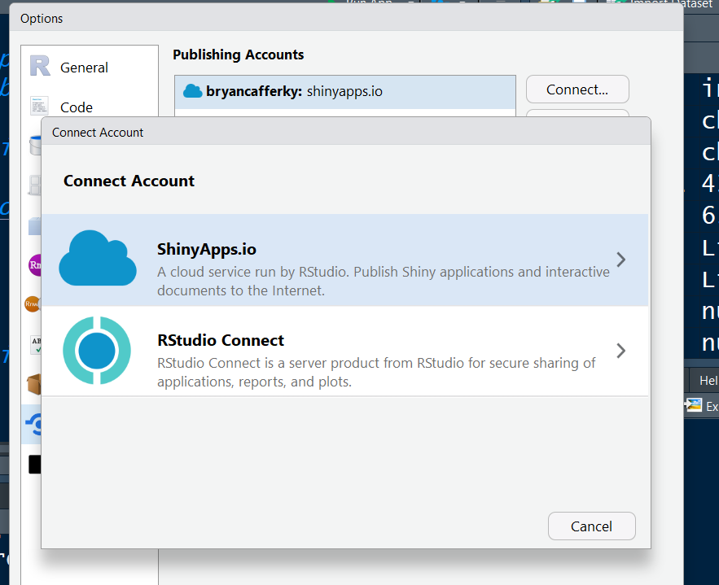
Publishing to Shiny IO…
On Premise or Containerized Option

Slide 22

Publishing to Azure
Secure
High Availability
Scalable
Reliable
Many Complementary Services

Slide 23
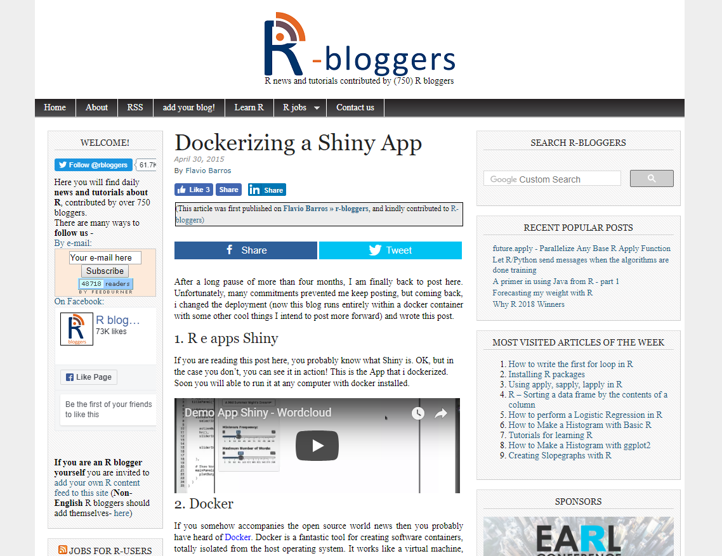
Publishing Docker Containers
https://www.r-bloggers.com/dockerizing-a-shiny-app/

Slide 24
Shiny Limitations
Not Designed for General Web Applications
Nested Coding of Shiny Functions Can Get Gnarly (FlexDashboard)
May Become Unwieldy for Complex Websites
Integration? Consider: https://rviews.rstudio.com/2018/04/17/reticulated-shiny/
Debugging?
https://shiny.rstudio.com/articles/debugging.html

Slide 25
Review
What is Shiny?
What can we do with it?
How do we use it?
Where do we go from here?

