Slide 1
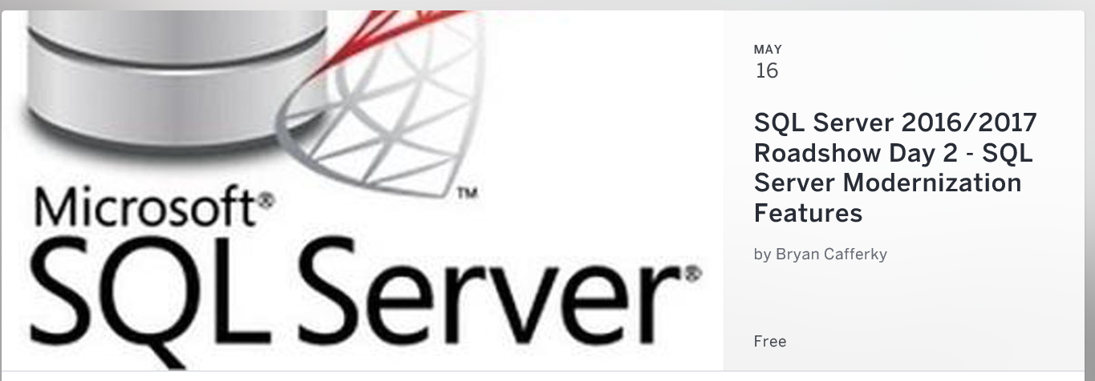
Welcome!!!

Slide 2



Full Azure Automation with PowerShell Part 1: The Azure Automation Service
Bryan Cafferky
Microsoft Technology Solutions Professional
Slides/Code at:
https://github.com/bcafferky/shared/PowerShellAutomation

Slide 3


Bryan Cafferky
@bryancafferky
Microsoft Technology Solutions Professional
Two Microsoft MVP
Decades of IT experience
Author of Pro PowerShell for Database Developers by Apress
SQL PASS Chapter Lead
Lead the Greater Boston Data Science, ML , and AI Group

Slide 4
Goals
Why Do We Need Automation?
PowerShell to the Rescue
Azure Operations Management Suite (OMS)
Azure Automation Account
PowerShell Runbooks

Slide 5
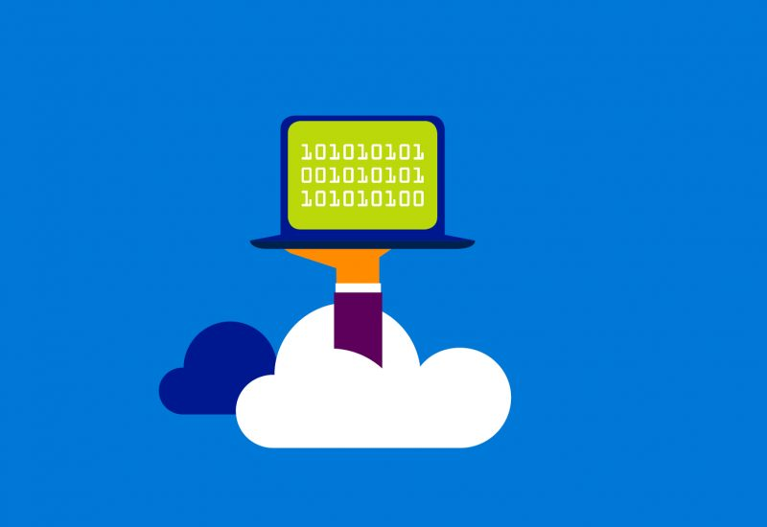
Welcome to Azure – Computing Power On Demand
Create a Powerful Virtual Machines in minutes
Create and Consume Services and Pay as You Go (PaaS, SaaS)
Any Number of Cores
Any Amount of Memory and Storage
With Many Data Platform Choices
Web/Mobile Applications
Big Data Support
AI and Machine Learning

Slide 6
Why Automation?
More Computing Resources to Manage
Poor Cloud Resource Management = Higher Costs (Turn off the lights!)
Need to Scale Administration
Need to Start with an Automation Mindset

Slide 7


Why Automation?
Without PowerShell
With PowerShell

Slide 8
Azure Templates
JSON Files that specify Azure Resources
Automatically Created in Azure for you
Can be called from PowerShell Scripts or Executed within Azure
Does Not Have the Full Programmatic Control that PowerShell Has
Are Part of An Automation Strategy

Slide 9
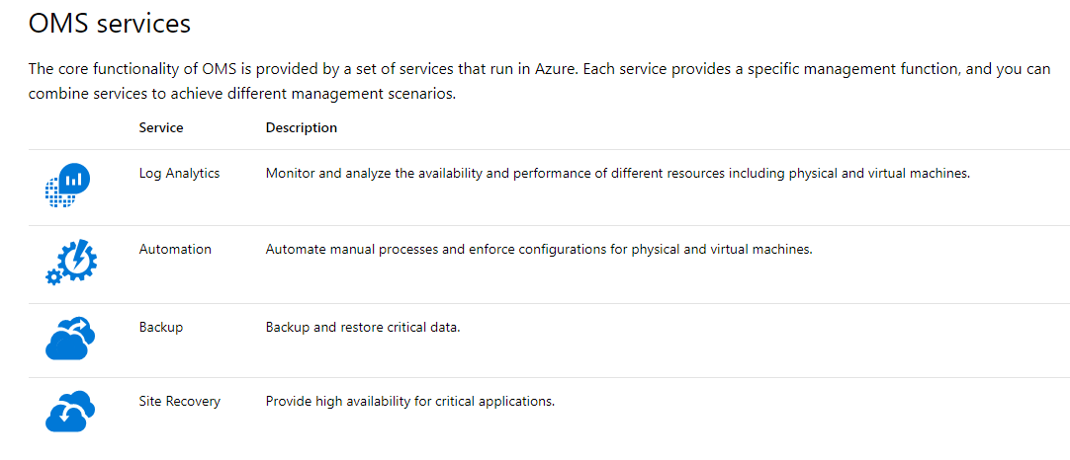
Operations Management Suite
https://docs.microsoft.com/en-us/azure/operations-management-suite/operations-management-suite-overview

Slide 10
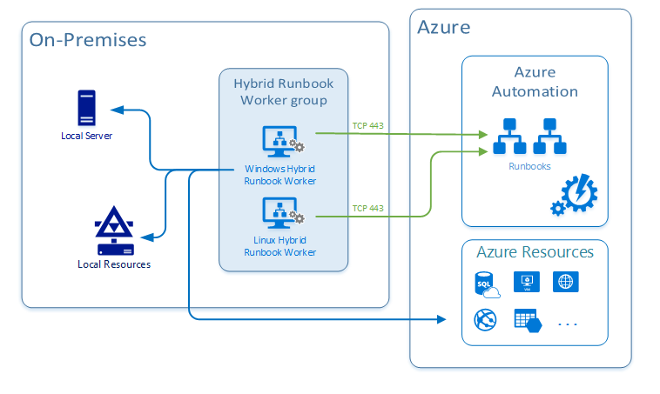
Azure Hybrid Runbook Worker
https://docs.microsoft.com/en-us/azure/automation/automation-hybrid-runbook-worker

Slide 11
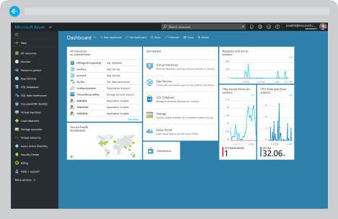
Demo (Portal)

Slide 12

Using Azure Automation Services

Slide 13
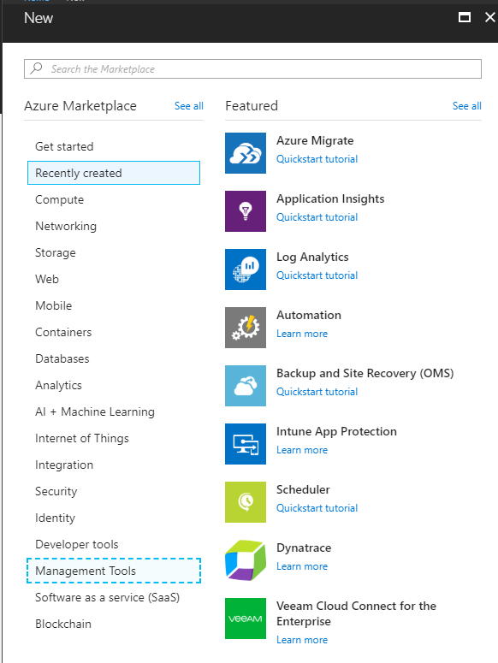
Adding Azure Automation Method 1
Click to Add

Slide 14
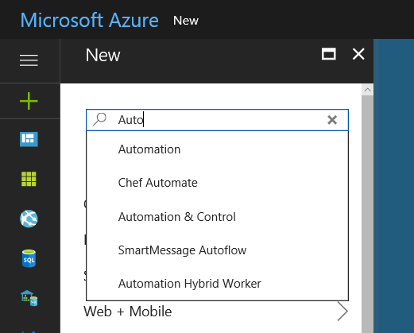
Adding Automation Method 2
Click to Select

Slide 15
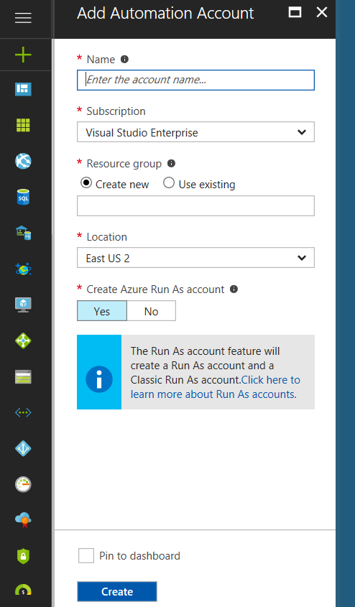
Adding Automation Account
Click to Add Account to Run Our Scripts
Check so Automation is in your Dashboard

Slide 16
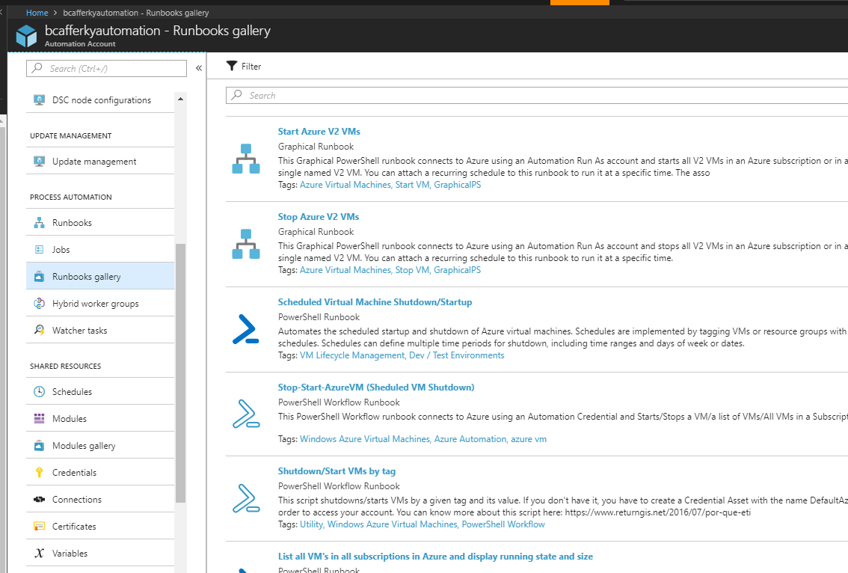
Automation Account Dashboard
Desired State Configuration
Scripts
Jobs
Share Work with On Prem Resources
Event Triggers
Things your jobs can share
https://docs.microsoft.com/en-us/azure/monitoring/monitoring-solutions-resources-automation

Slide 17
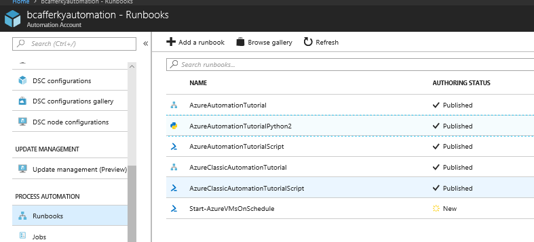
Runbook Types
Not Shown
Workflow Runbook
Graphical Runbook
Python Runbook
PowerShell Script Runbook

Slide 18
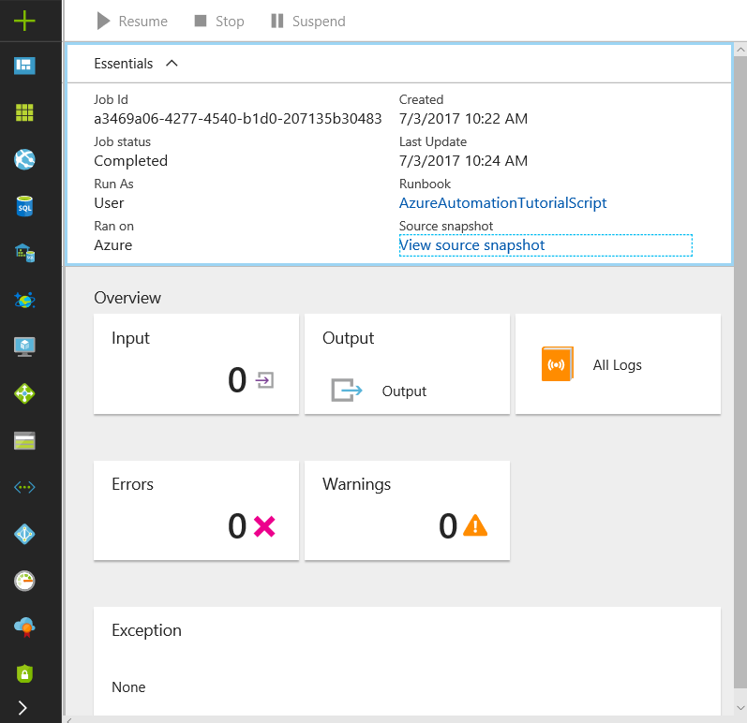
Runbook Job Status

Slide 19
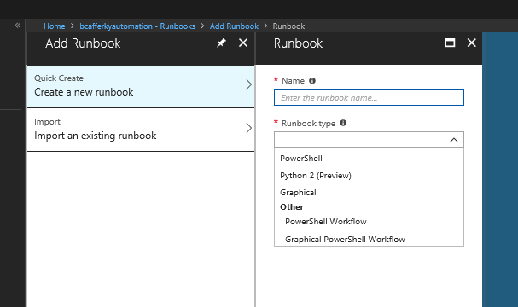
Creating a Runbook
Standard PowerShell Language
Python 2 Language
Standard PowerShell using GUI Designer
PowerShell using Workflow Engine
PowerShell Workflow using GUI Designer

Slide 20
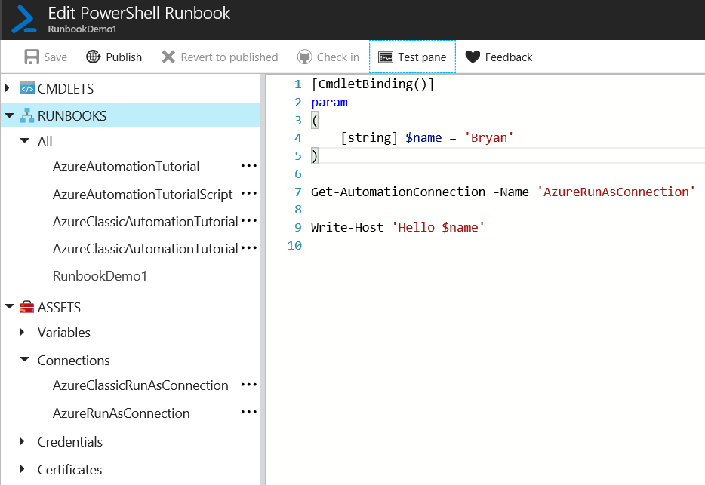
Editing a Runbook
Parameters
Connect with Connection Asset

Slide 21
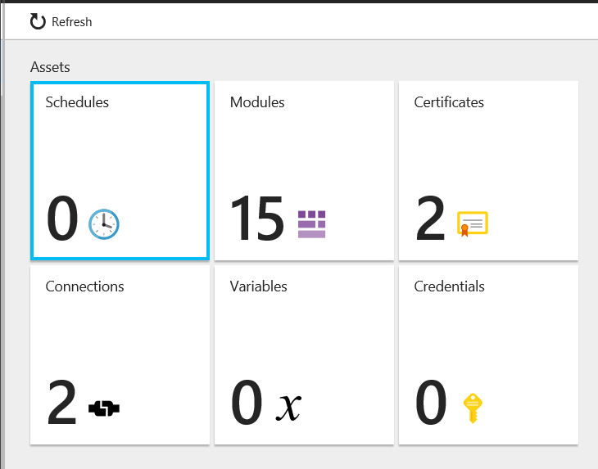
Editing a Runbook
Job Schedules
Built-In or Import Your Own
Authentication
Reusable Azure Connections
Automation Account Scoped Variables

Slide 22
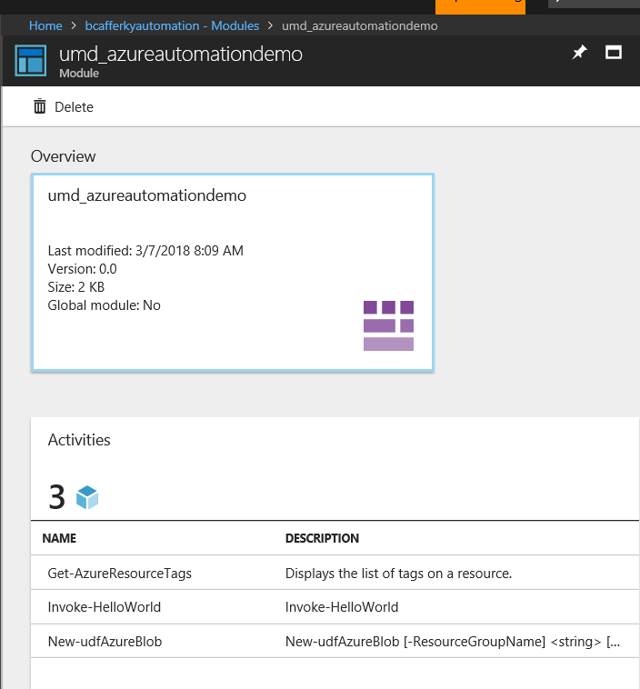
Uploaded Custom Modules
Module Functions Available

Slide 23
Runbook Demo

Slide 24
Wrapping Up
The Need for Automation
PowerShell to the Rescue
Azure OMS
Azure Automation Account
PowerShell Runbooks
https://github.com/bcafferky/shared/PowerShellAutomation

