Slide 1

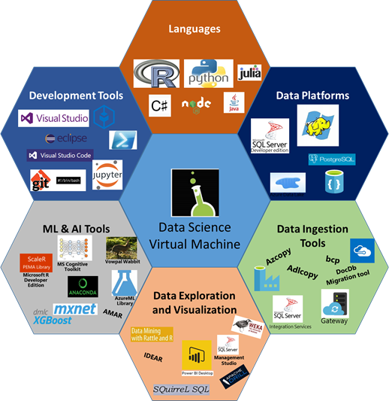

Azure Data Science
Virtual Machine
Jump
Start
Machine
Learning!
Bryan Cafferky
Course Content @
https://github.com/bcafferky/shared/tree/master/DataScienceVM

Slide 2


About Bryan Cafferky…
Data Solutions Enabler (TSP)
Decades of IT Experience in health care, insurance, banking, and ecommerce.
Microsoft MVP.
Author of Pro PowerShell for Database Developers.
Founded and lead PASS Chapter The RI Microsoft BI User Group.
Greater Boston Area Data Science, ML, and AI Group.
Frequent presenter at technical conferences and user groups.
bryan256@msn.com
www.sql-fy.com
https://www.linkedin.com/in/bryancafferky
@BryanCafferky – follow me!
Subscribe to me on YouTube!

Slide 3
Why Use an Azure Data Science VM?
Quick and Easy to Set Up
Installs All the Tools You Need
No Configuration Hassles
Inexpensive. Auto Turn Off Feature.
Focus on Learning

Slide 4










What You Get on an Azure Data Science VM

Slide 5
Demo
Creating a Data Science Virtual Machine

Slide 6
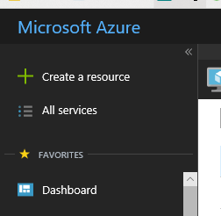
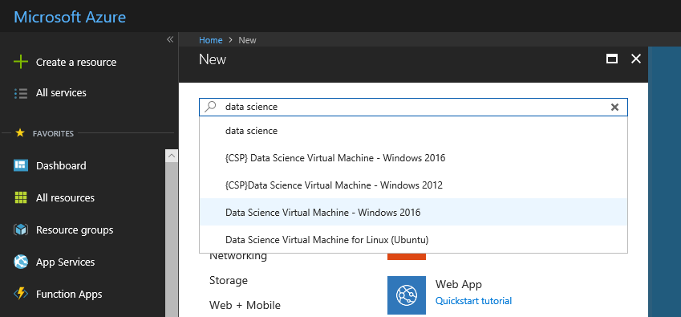
Creating an Azure Data Science VM
Start typing what you need…
Click on Create a resource

Slide 7
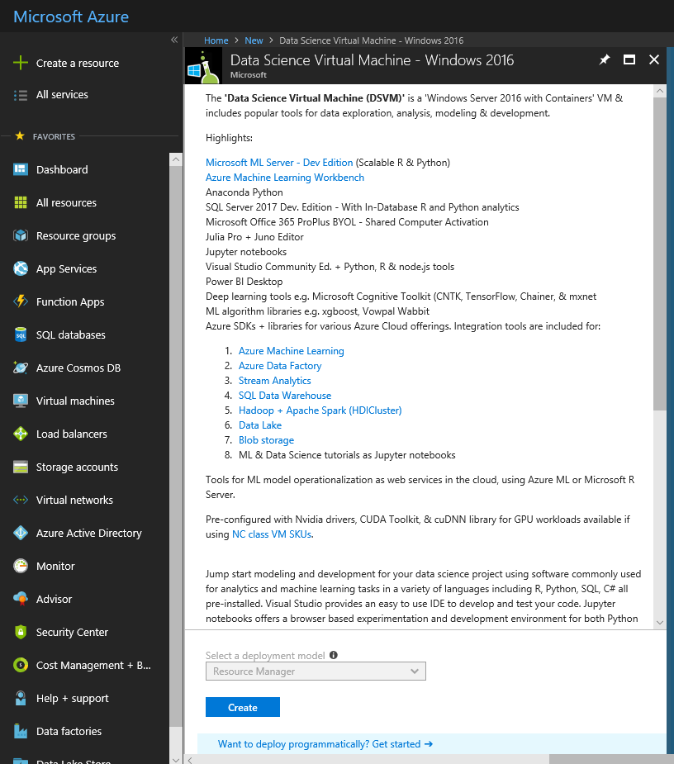
Creating an Azure Data Science VM
Click on Create

Slide 8
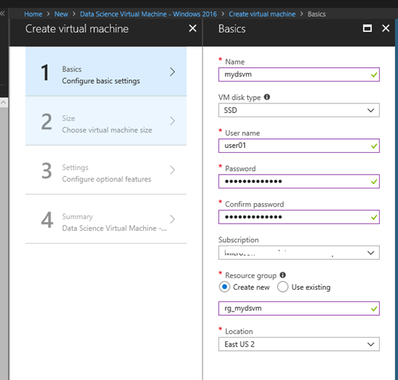
Creating an Azure Data Science VM
Fill in the Details…
The resource group is a container that holds all the asseets created as part of your VM

Slide 9
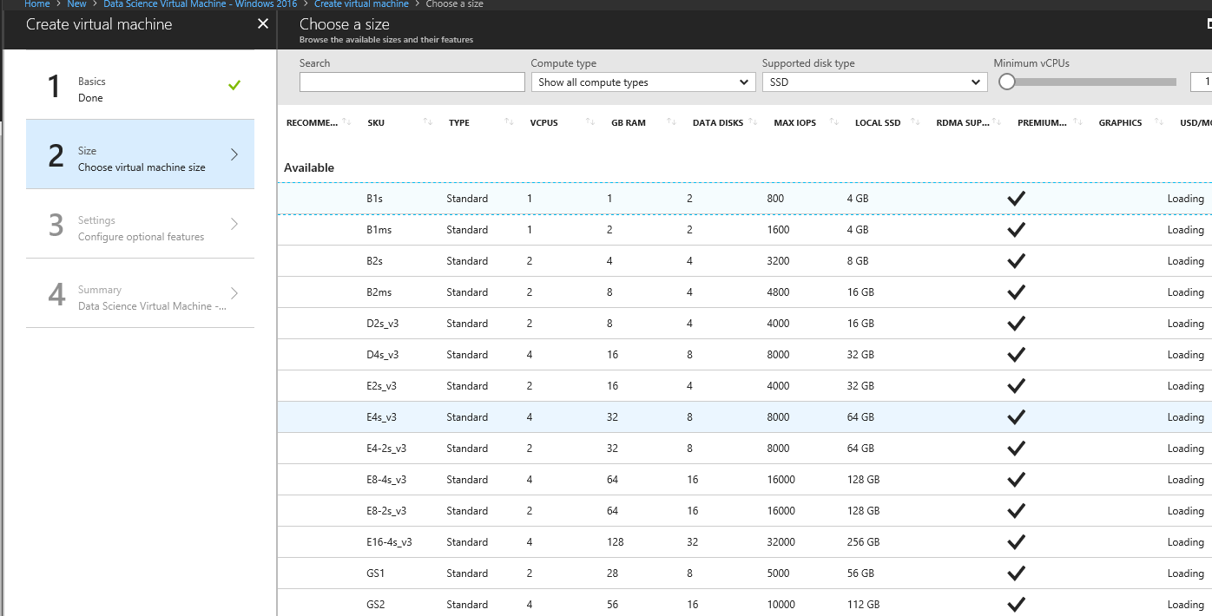
Creating an Azure Data Science VM
Make sure you select enough resources to run the tools!

Slide 10
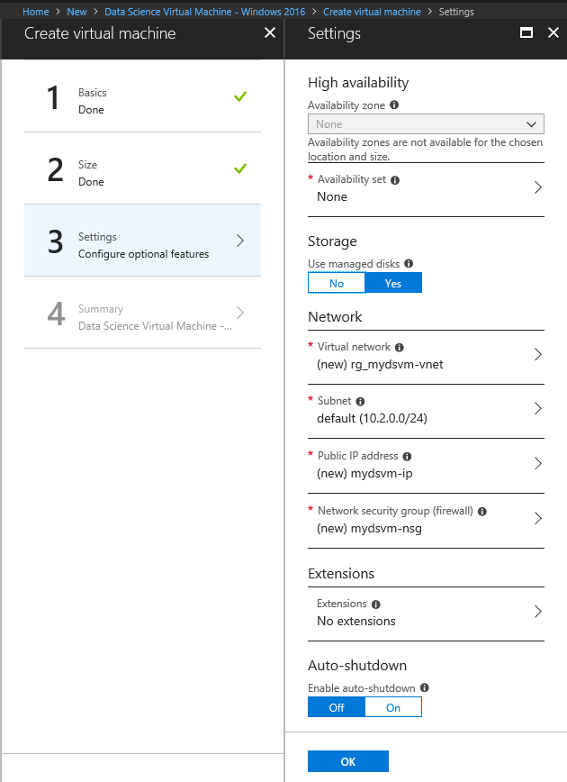
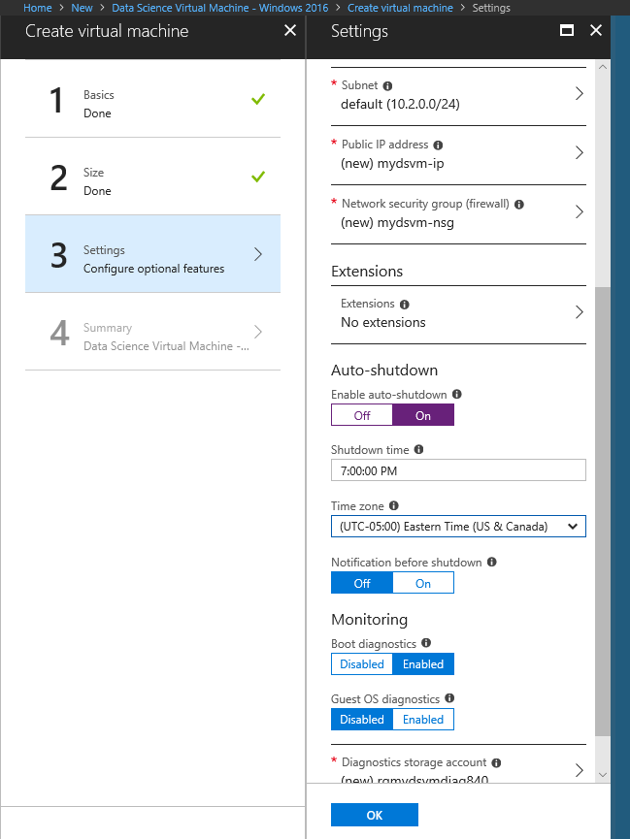
Creating an Azure Data Science VM
Define when to shut the VM down.
Auto Shutdown will save you money!

Slide 11
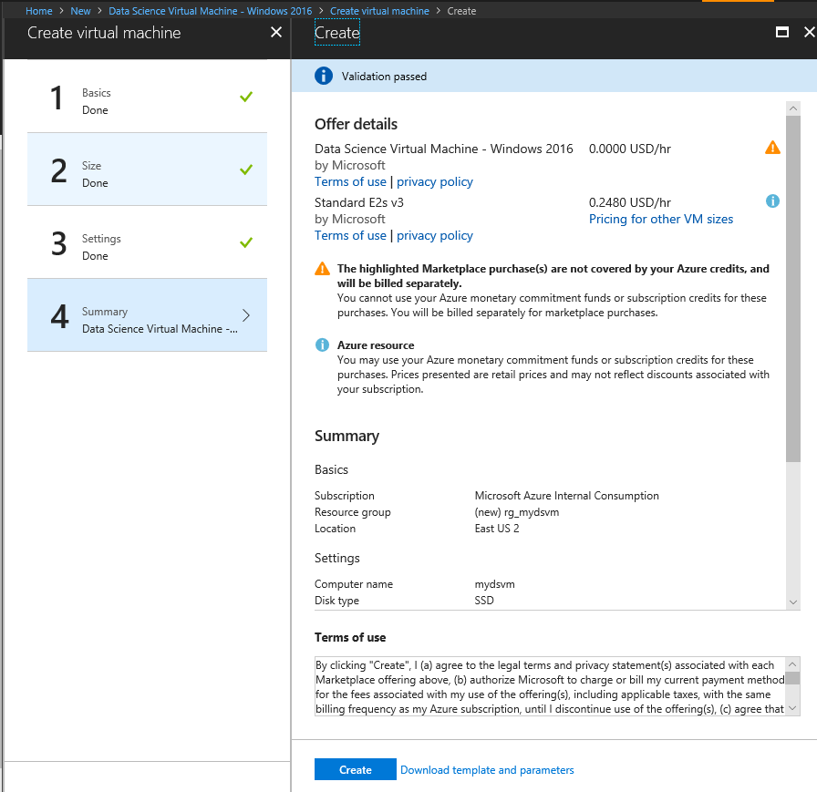
Creating an Azure Data Science VM
Click on Create.

Slide 12
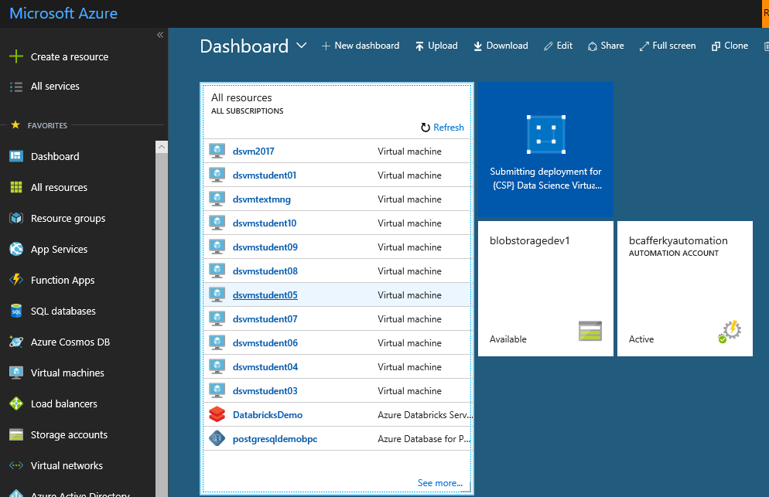
Creating an Azure Data Science VM
Resource is being created.

Slide 13
Connecting to Your DSVM

Slide 14
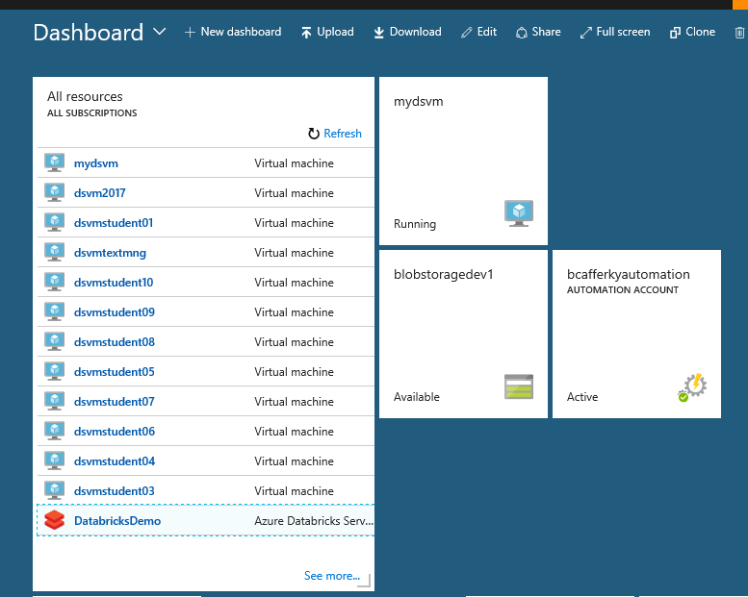
Connecting to Your DSVM
Select the VM.

Slide 15
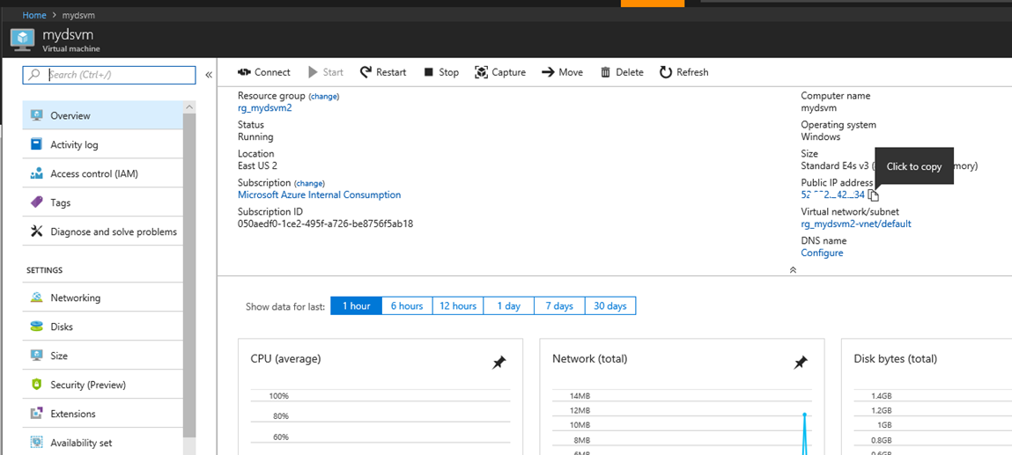
Connecting to Your DSVM
Copy the IP Address

Slide 16
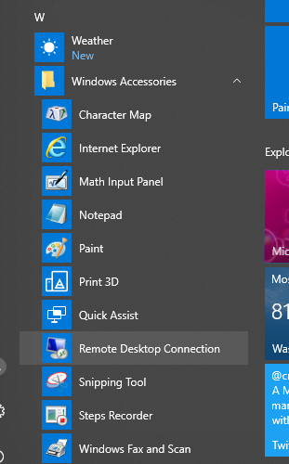
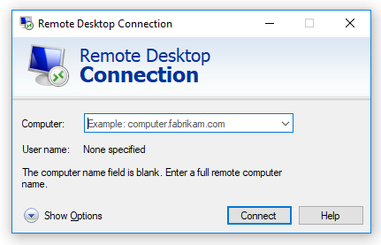
Connecting to Your DSVM
Paste the VM IP Address and click Connect.
Start Remote Desktop.

Slide 17
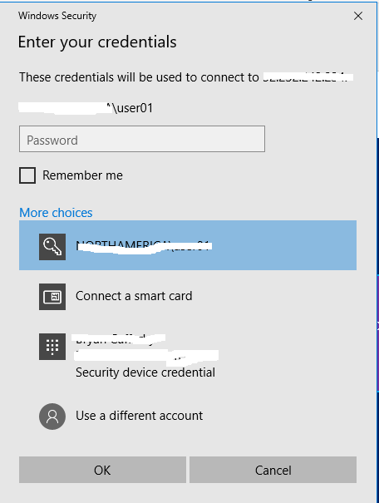
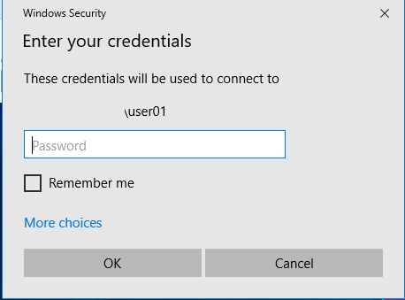
Connecting to Your DSVM
You may need to click on More choices.
Use a different account.

Slide 18
Connecting to Your DSVM
Enter the admin user account and password you set for the VM and click Ok.

Slide 19
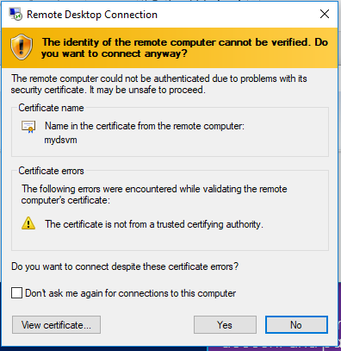
Connecting to Your DSVM
If you see this popup, just check the Don’t Ask me again check box and click Yes.

Slide 20
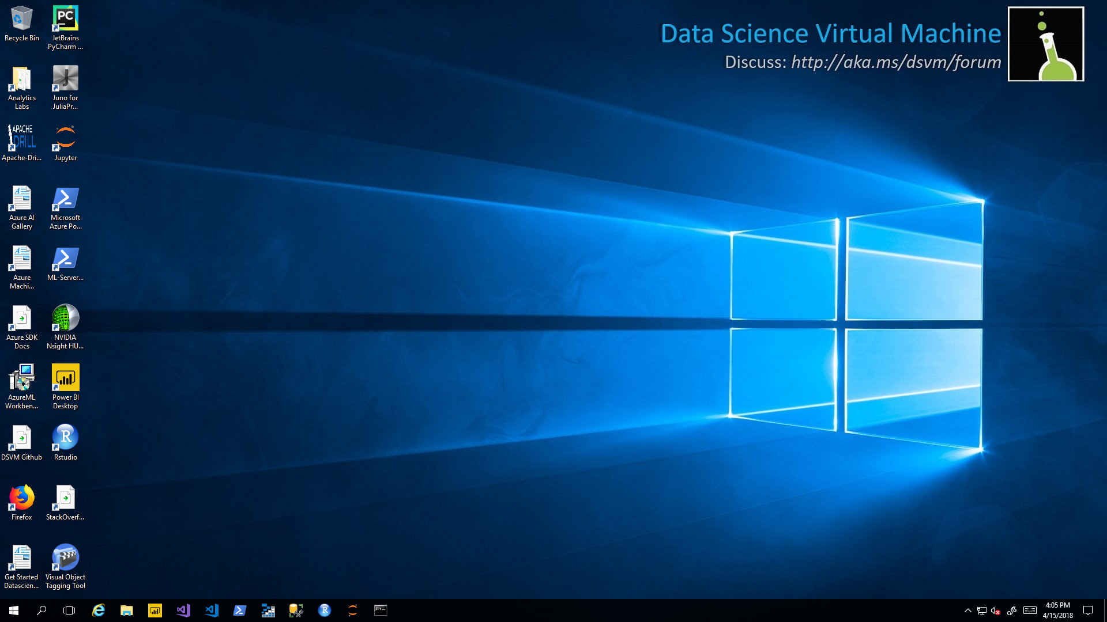
Connecting to Your DSVM
Wait until the VM is set up and Initialized. This can take a few minutes. Be patient.

Slide 21
Connecting to Your DSVM
You’re Good to Go!!!

