Slide 1
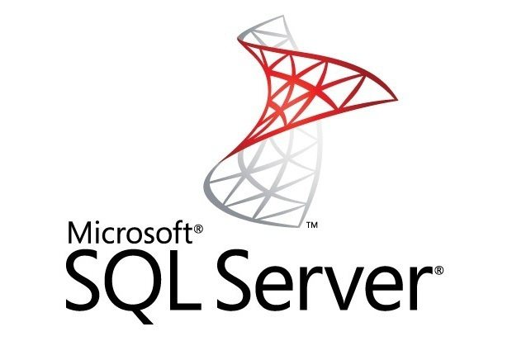





Machine Learning with
SQL Server and ML Server
Bryan Cafferky
Data Solutions Enabler
Subscribe to me on:
GitHub:
https://github.com/bcafferky/shared

Slide 2

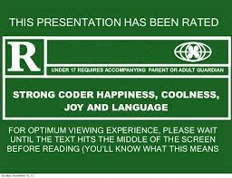
For Language and graphics

Slide 3
Goals
Data Science Collaboration
SQL Server/Machine Learning Server
Features and Benefits of Machine Learning Server

Slide 4




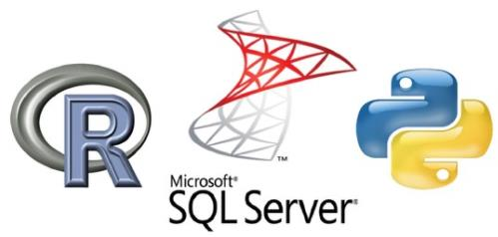


Azure Supported Machine Learning Approaches
Custom Build Your Own
Pre Built
Scalable
Scalable
Non Scalable
Poor Scalability
Language Dependent
Model Performance Varies
Examples:
Very High Scalability
General API
Examples:
High Scalability
Support
Examples:
Services
Pre Trained
Easy to Use
Fitted to a Purpose
Examples:
Cognitive Services
Open Source
Commercial

Slide 5
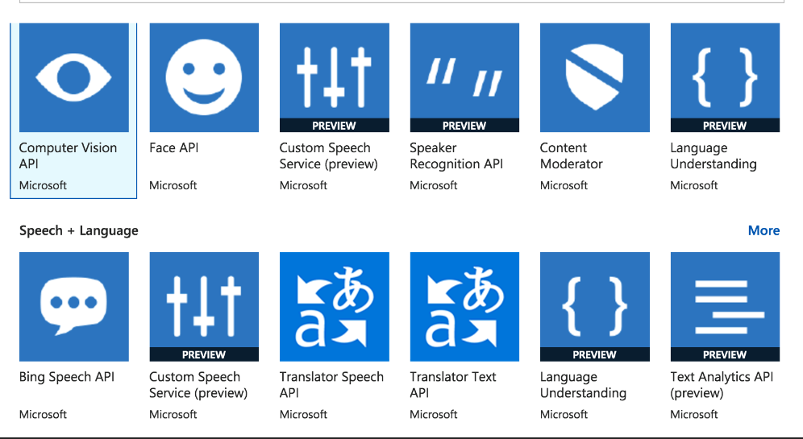
Cognitive Services

Slide 6


Machine Learning Solutions
Partner Solutions
Pre Built Solutions
Customize to Your Needs
Examples

Slide 7


Scale Up vs. Scale Out
Scale Up
Scale Out

Slide 8

Scale Up vs. Scale Out
Scale Out

Slide 9
Scale Up vs. Scale Out
Large
Medium
Small
Open Source
Scale Up
Scale Out

Slide 10


Statistics & Data Science Roles
Data Scientist
Model Selection
Advanced Degree in Statistics
Research/Discovery Orientated
Conceptualize/Develop Models
Domain Expert
Feature Selection
Has deep domain knowledge
Blends Operational Reporting & Analytics
Some Knowledge of Statistics
Less Complex Models/Solutions
Data Engineer
Data Wrangling
Focuses on Scaling Up/Out and Automation
May Modify Solution/Model to Scale It
Basic Understanding of Statistics and Models

Slide 11

Predictive Modeling, Supervised Learning
Input Data is Fed into the Program
The Program is to Determine the Relationship Between the Input Columns and a Result Output Column
Based on Analysis of Inputs to Result, a Model is Created to Predict the Result Based on a Given Set of Inputs
History is used to predict the future.

Slide 12
Applications of Predictive ModelingModeling
What is the level of surgical risk?
Will a person contract a certain illness?
Will the patient be readmitted?
Is the person a high health risk?

Slide 13
Applications of Other Forms of Machine Learning
Extract handwritten notes from images.
Speech recognition and conversion to text.
Radiology – is there a tumor on the spine?
Genomics
Did a patient fall out of their bed?

Slide 14
Steps to Creating a Predictive Model
Analyze/Clean the Data
Determine the Columns that Predict the Answer
Select a Model to Use
Train the Model
Evaluate the Model’s Effectiveness
Use the Model

Slide 15
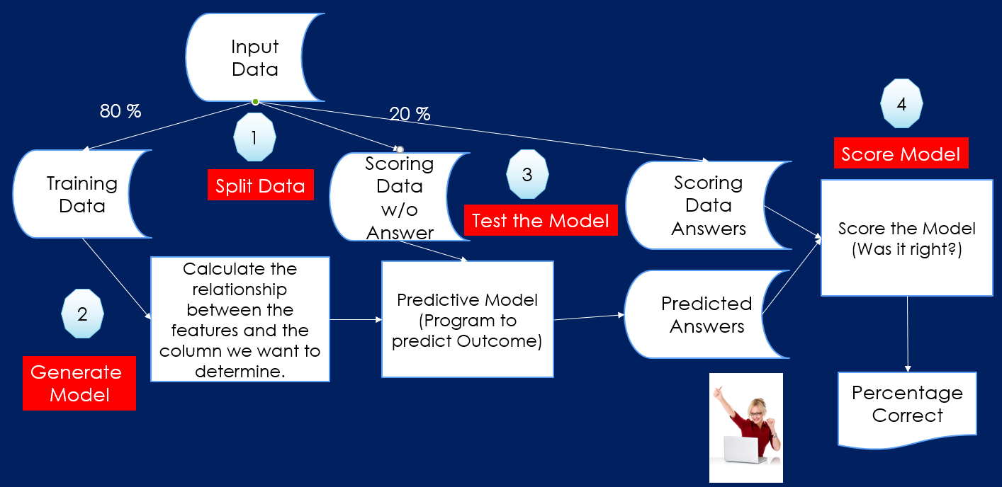
Steps to Predictive Modeling

Slide 16
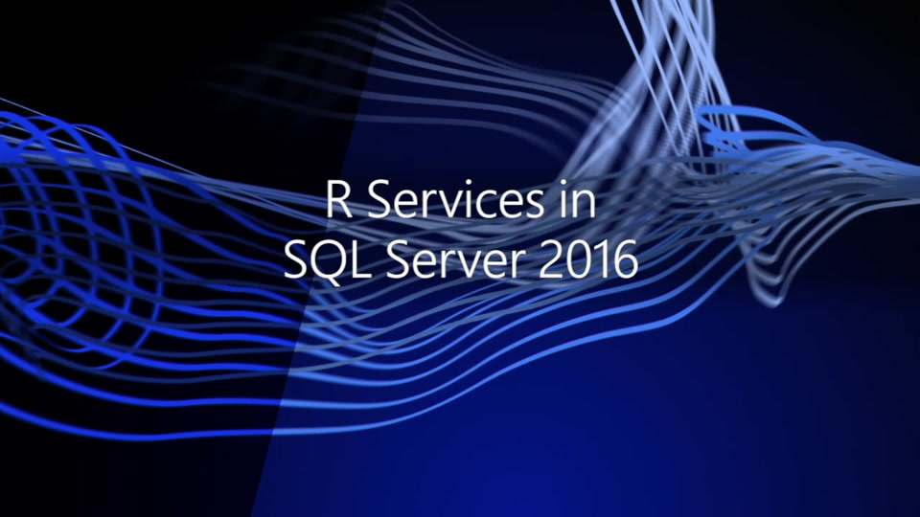

SQL Server/R Integration

Slide 17
SQL Server Machine learning Services
SQL Server 2016
Extensibility Framework
R Support (3.2.2)
Microsoft R Server
SQL Server 2017
Python Support (3.5.2)
R Support (3.3.3)
Native Scoring using PREDICT
In-database Package Management

Slide 18
R Limitations
Client side only tool. No server based processing.
Data limited by client memory.
Single threaded.
Database data must be imported to be used.
Relatively slow.
No scheduling tool.

Slide 19
Microsoft buys Revolution Analytics
Proprietary vendor providing scalability options.
Support for multi-threading.
Provide a shared R server.
Performant versions of common R functions.
Data not limited by memory.

Slide 20
SQL Server 2016: Reaching R's Potential
Stored procedures can be coded in R with the features that entails.
SQL Server and R share memory space.
Work can be split between SQL Server and R Server.

Slide 21
SQL Server 2016: Reaching R's Potential
Stored procedures can be coded in R with the features that entails.
SQL Server and R share memory space so no data movement.
Work can be split between SQL Server (T-SQL) and R Server.
Operationalize with SQL Agent.
Leverage all the Security Features of SQL Server.
Perfect Solution for Machine Learning with Structured Data.

Slide 22
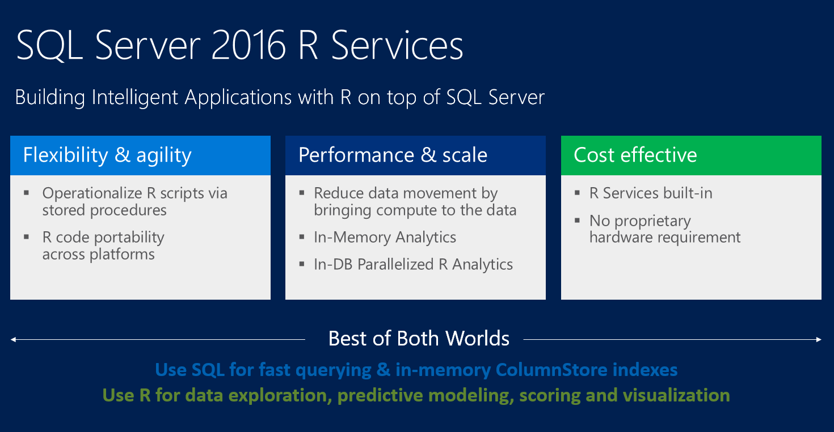
SQL Server Plus R = Value

Slide 23
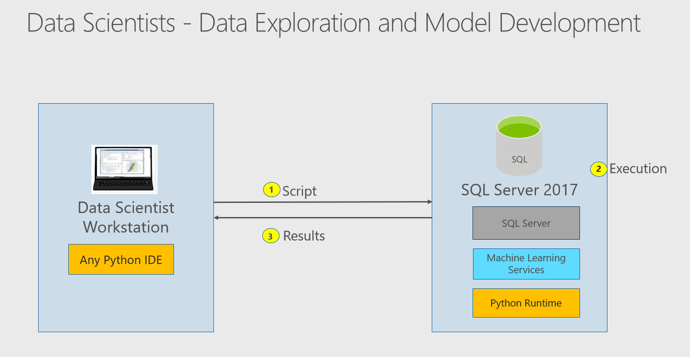
SQL Server Plus Machine Learning Server = Value
Python and R Supported
Python/R Stored Procedures/
Functions

Slide 24
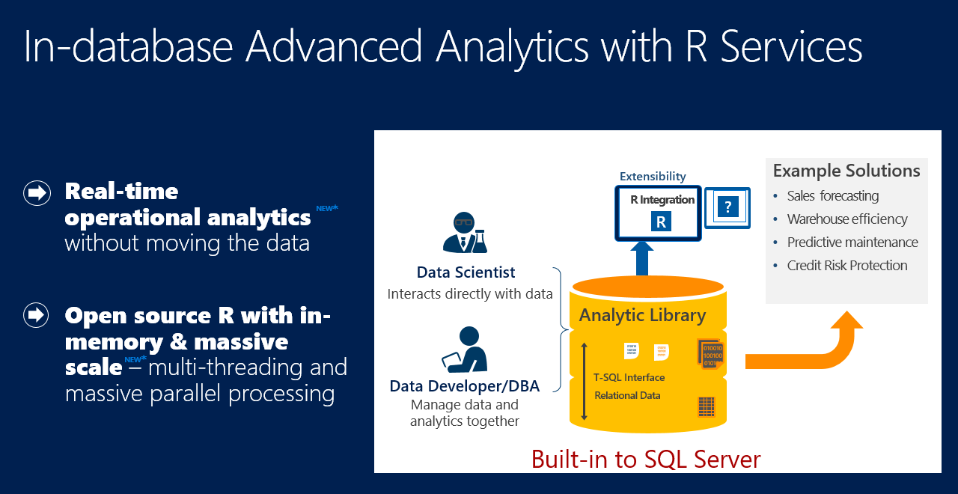
SQL Server: R Operationalized
https://msdn.microsoft.com/en-us/library/mt590947.aspx

Slide 25
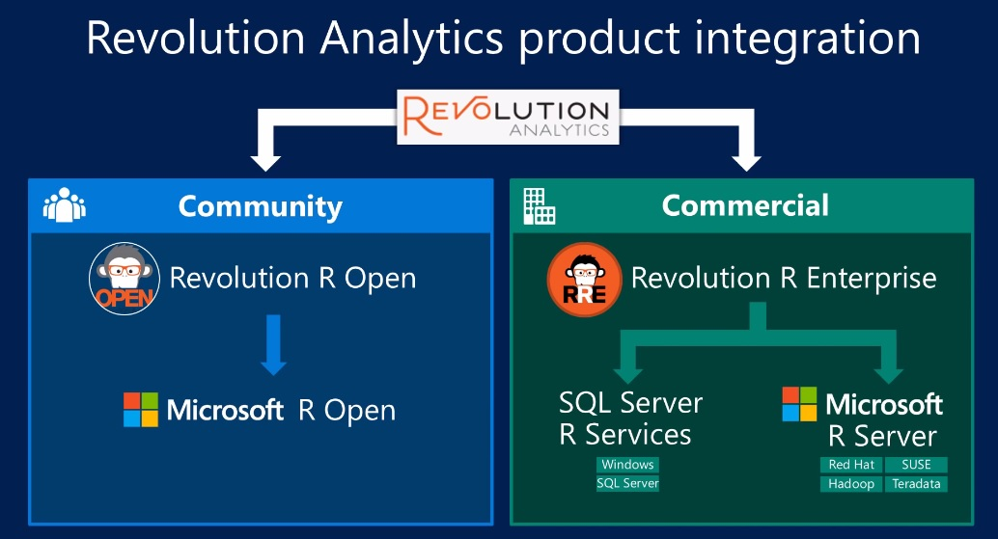
SQL Server: R Operationalized
https://www.youtube.com/watch?v=by2cJ9sQO0Q

Slide 26
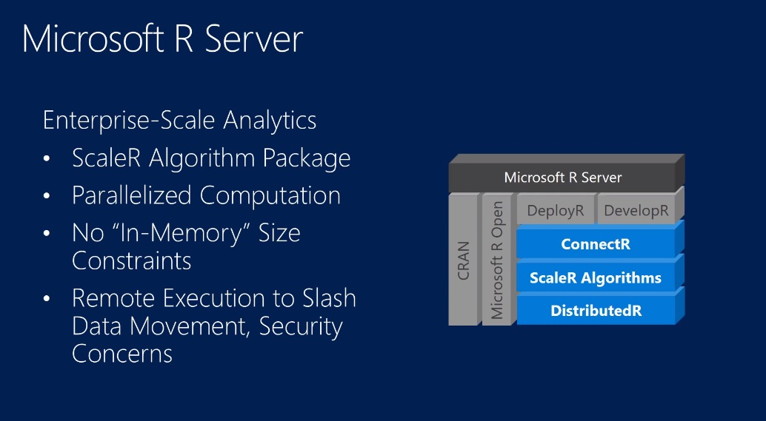
SQL Server/R Architecture
https://www.youtube.com/watch?v=by2cJ9sQO0Q

Slide 27
Microsoft R Open
R Open - an open source R distribution from Microsoft that is fixed stable release.
CRAN is always adding updates to the R language which can be unstable.
Some enhanced performance math functions are included.
Is used in place of the standard CRAN R language download.
Must be used with R scalability features.

Slide 28
Microsoft R Client
Is a set of R packages.
Implements RScale functions but with limited scalability.
Useful for learning and development.
May be a good option when small only scale improvments are needed.

Slide 29
Microsoft R Server
A stand alone R execution environment.
Clients submit R requests to R Server for high speed processing.
Can be contained within other environments such as SQL Server.
Versions for Linux, Hadoop and Teradata.
Tight integration with SQL Sever.

Slide 30
Microsoft R Open
Proprietary high performance functions used in place of the standard R functions.
Start with the prefix 'rx', i.e. rxImport.
Can be used with Microsoft R Client (free) or R Server but severly limited scalability on R Client.
scaleR Functions https://msdn.microsoft.com/en-us/microsoft-r/scaler/scaler

Slide 31
SQL Server: DeployR
Known as the R Integration Server.
An optional framework for deploying R analytics inside web, desktop, mobile, and dashboard applications as well as backend systems.
Provides analytics services such as a predictive model as a web service.

Slide 32
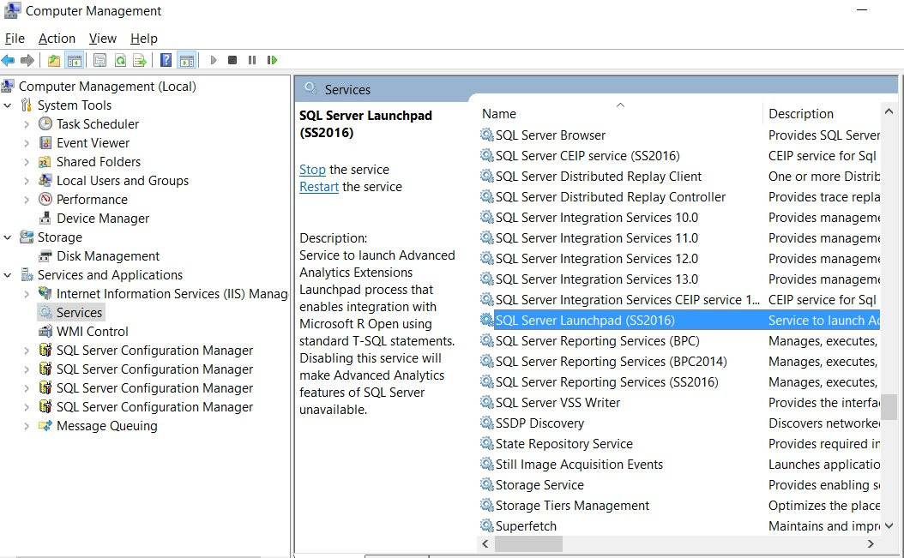
SQL Server Launchpad Service

Slide 33
Demo
SQL Server R Services Demo

Slide 34
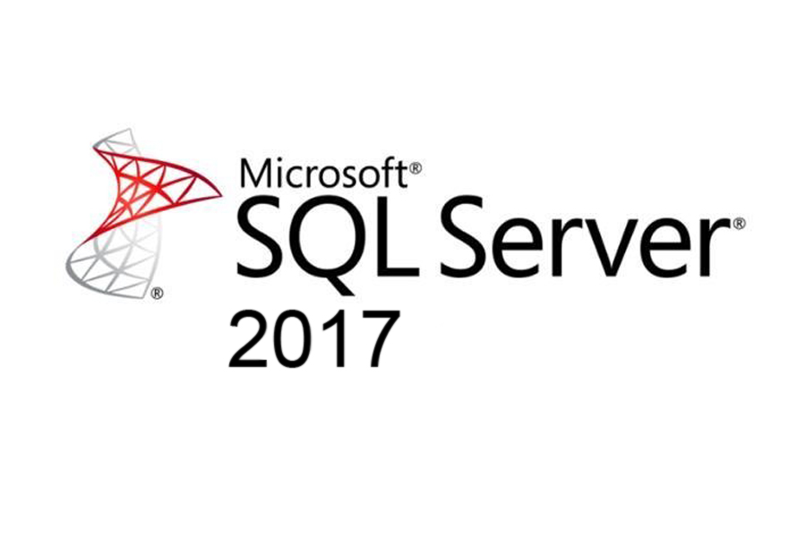

Adding Python Support

Slide 35
SQL Server/ML Server with Python
#If you are running SQL Server 2017 RC1 and above:
from revoscalepy import RxComputeContext, RxInSqlServer, RxSqlServerData
from revoscalepy import rx_import
#Connection string to connect to SQL Server instance
conn_str = 'Driver=SQL Server;Server=MYSQLSERVER;Database=TutorialDB;Trusted_Connection=True;'
#Define the columns we wish to import
column_info = {
"Year" : { "type" : "integer" },
"Month" : { "type" : "integer" },
"Day" : { "type" : "integer" },
"RentalCount" : { "type" : "integer" },
"WeekDay" : {
"type" : "factor",
"levels" : ["1", "2", "3", "4", "5", "6", "7"]
},
"Holiday" : {
"type" : "factor",
"levels" : ["1", "0"]
},
"Snow" : {
"type" : "factor",
"levels" : ["1", "0"]
}
}
#Get the data from SQL Server Table
data_source = RxSqlServerData(table="dbo.rental_data",
connection_string=conn_str, column_info=column_info)
computeContext = RxInSqlServer(
connection_string = conn_str,
num_tasks = 1,
auto_cleanup = False
)
RxInSqlServer(connection_string=conn_str, num_tasks=1, auto_cleanup=False)
# import data source and convert to pandas dataframe
df = pd.DataFrame(rx_import(input_data = data_source))
print("Data frame:", df)
# Get all the columns from the dataframe.
columns = df.columns.tolist()
# Filter the columns to remove ones we don't want to use in the training
columns = [c for c in columns if c not in ["Year"]]

Slide 36
Take A Ways
Data Does Not Need to Be Moved
High Performance rx Functions Server Side
Models Can Be Stored in SQL a Server Table
Prediction Results Can Be Stored in a SQL Server Table
R/Python Stored Procedures and Functions
SQL Agent Can Be Used to Schedule Model Builds
Use T-SQL or R/Python As Best Fits the Need

Slide 37
Q & A

Slide 38

SQL Server/R Server Integration

