Slide 1







The Technical Skills You Need Now!!!
Are you becoming a dinosaur?
Bryan Cafferky
https://github.com/bcafferky/shared
https://www.clipartmax.com/download/m2K9A0d3b1m2Z5G6_rex-dinosaur-clip-art-dinosaure-clipart-t-rex/

Slide 2

Inspired By…
Ask for
Tom Anderson
https://www.newdirectionsstaffing.com/

Slide 3

The Technical Skills You Need Now!!!
Are you becoming a dinosaur?
Bryan Cafferky
https://github.com/bcafferky/shared
https://www.clipartmax.com/download/m2K9A0d3b1m2Z5G6_rex-dinosaur-clip-art-dinosaure-clipart-t-rex/

Slide 4
Where Are We Going?
Disclaimer
Mainframes and the T-Rex
Your Skills and a Bar Stool
The Three Skills You Need to Stay Employed
Advice on Skilling Up

Slide 5
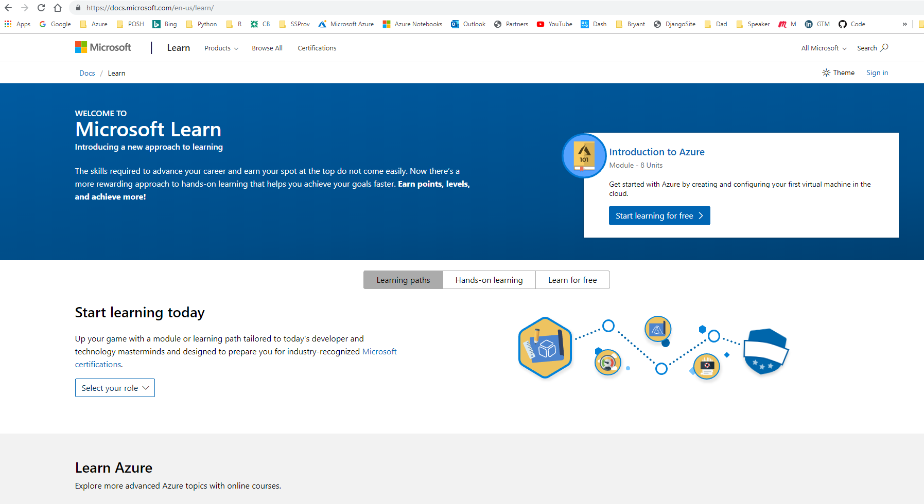
The Cool Way to Learn
https://docs.microsoft.com/en-us/learn/

Slide 6

Mainframes Can Never Be Replaced
On Premises is the New Mainframe

Slide 7

Job security
‘Danger! Danger! Will Robinson!’
Your only job security is your skills!!!

Slide 8
Is it just a fad?
Paradigm Shift

Slide 9

Surviving the Changing Landscape

Slide 10

The Current Data Professional
Are
You
Ready?
Hands Off Automation
Platform Agnostic
Myriad Technologies
http://clipart-library.com/clipart/204283.htm
Cloud
AI
Big Data

Slide 11
The Current Data Professional
Are
You
Ready?
Python
Data Science
Jupyter
Azure Data Factory
Machine Learning
Scala
Azure DW
Azure
AWS
Spark
Kubernetes
Cloud Automation

Slide 12
Where is your role going?
Database Administrator
BI Engineer/Database Developer
Report Developer
New Opportunities

Slide 13
Where is your role going?
DBA
Can Be Automated on
Azure
Performance tuning
Software Maintenance
Scaling Up and Down
Running Utilities
Monitoring Security
Mission Critical Data

Slide 14
Where is your role going?
DBA -> Big Data Architect
Cloud Based Development
Creating/Maintaining Spark Clusters
Scaled Out Performance Tuning
Big Data Solution Design
Securing Solutions
Data Platform Automation

Slide 15
Where is your role going?
BI Engineer/Database Developer/ETL
What about?
Write Stored Procedures
Create Database Objects
Data Warehouse Design
Develop SSIS Packages
Create SQL Agent Jobs
Streaming
Video and Images
Petabytes
Python
Kubernetes

Slide 16
Where is your role going?
BI Engineering -> Data Engineer
Big Data Solutions Design and Orchestration
Cloud ETL with Azure Data Factory
Data Lake Design
Python Development
Cloud Automation
Spark
NoSQL Databases

Slide 17
Where is your role going?
Report Developer
Develop Operational Reports with SSRS
Use Business Objects or other Reporting Tool
Columnar Reports
On Premises

Slide 18
Where is your role going?
Data Visualization Developer
Tell Data Stories with Power BI
Wrangle Data from Many Sources
Cloud Deployment and Admin
Advanced Visualization Functionality
Python and R Language
Incorporate Machine Learning

Slide 19
New roles
Cloud Data Scientist
Strong background in statistics.
Defines the business opportunity for ML.
Works with the data engineer to define the data required.
Feature Engineering.
Train Models and Compare to Select the Best model.
Work with the Data Science Operationalizer to Deploy the solution.
Monitors the ML pipeline and refactors solutions as needed.

Slide 20
New roles
Cloud Data Science Operationalizer
Architects and Designs the Data Science Solution.
Designs and Implements Machine Learning Pipeline.
Incorporates Security, Scale, Extensibility into Solutions.
Determines best model training compute, model deployment compute, data storage technologies, and orchestration architecture.
Well Versed in Data Science and Big Data technologies.

Slide 21
Short term opportunity
Cloud Migration Specialist
Re-architect On Premises Systems to the Cloud
Plan for Cloud Security
Develop Migration Plans
Project Manage Migration Process
Leverages On Premises Knowledge

Slide 22
Don’t Fall Off Your Stool!
The 10% Myth

Slide 23

Don’t Go the Way of the Dinosaur
https://www.clipartmax.com/middle/m2K9A0d3b1m2Z5G6_rex-dinosaur-clip-art-dinosaure-clipart-t-rex/

Slide 24
Good News
Cloud Services are making using the technology easier.
You can focus on solving problems.
Have fun!
You will be more valuable because you deliver more value.
Easy to Get Training.

Slide 25

Advice
You Inc. You are a Business!!!
Learning is Your Right!
Learning is YOUR RESPONSIBILITY!
Keep Re-Investing in Yourself!
Get Involved in the Technical Community.
Never Get Comfortable!

Slide 26
Wrapping Up
Disclaimer
Mainframes and the T-Rex
Your Skills and a Bar Stool
The Three Skills You Need to Stay Employed
Old to New Roles Mapping
Good News and Advice
https://www.clipartmax.com/middle/m2K9A0d3b1m2Z5G6_rex-dinosaur-clip-art-dinosaure-clipart-t-rex/

