Slide 1

Bryan cafferky
Bryan Cafferky
@bryancafferky
bryan256@msn.com
Data Solutions Consultant
Microsoft MVP
Decades of IT experience
Author of Pro PowerShell for Database Developers by Apress
SQL PASS Chapter Lead
Lead the Southern New England UseR Group

Slide 2

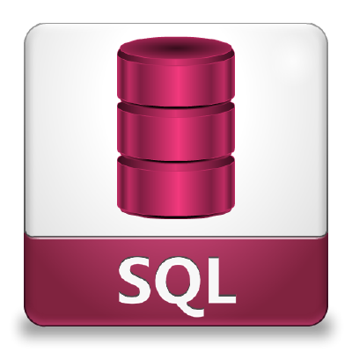
Using SQL to Wrangle Data in R
with SQLDF
Bryan Cafferky

Slide 3
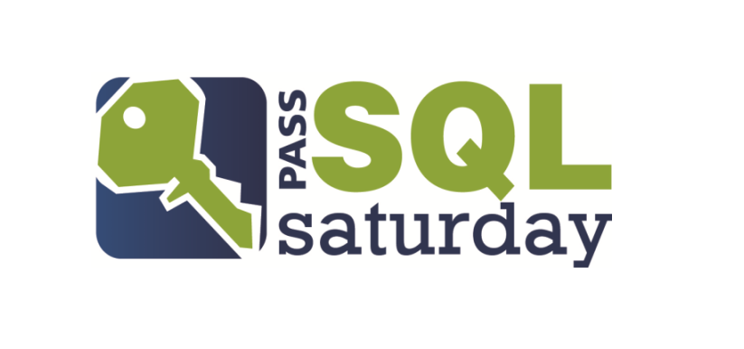

SQL Saturday in Smithfield, RI December 9th Pre Con: Data Science with R from A to Z
http://www.sqlsaturday.com/694/EventHome.aspx
Use Discount Code Microsoft
For 20% Off
https://r_programming.eventbrite.com

Slide 4
What is a Package?
A collection of functions and/or data that can be easily shared
Used to extend R capabilities
Community Developed
Downloaded from Repositories
A Library is the folder where the packages are stored
All Code Shown is ‘as is’ and not intended for production use.

Slide 5
Two Steps to Using a Package
Download and Install the Package (1 Time)
Load the Package into Memory (before you need to use it)

Slide 6
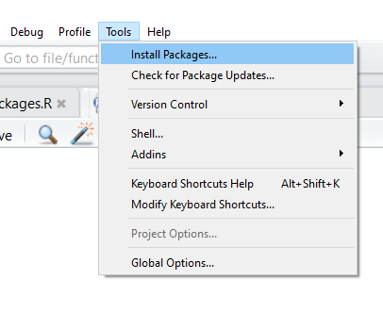
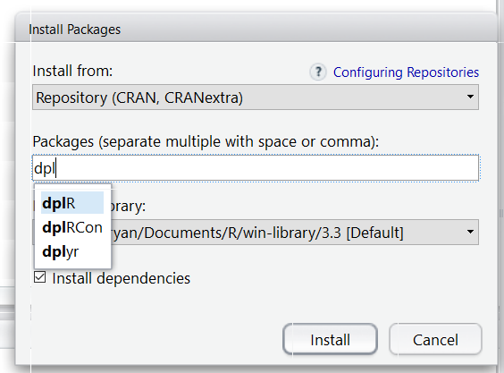
Installing a Package with RStudio
Select Tools/Install Packages
Enter the Package Name, Click Install

Slide 7
Installing a Package
Use the install.packages function to download and install from CRAN.
install.packages(“dplyr”)
To download and install from GitHub, you need to install “devtools”.
install.packages(“devtools”)
Then install packages from GitHub
library(“devtools”)
install_github("hadley/babynames")

Slide 8

Installing From Other Repositories
install_bioc()
install_bitbucket()
install_git()
install_local()
install_svn()
install_url()
install_version()

Slide 9
Popular Packages: sqldf
Adds Structured Query Language (SQL) Support
Manipulate Data Without Learning New Functions
Easy to Use and Understand
Relies on SQLite

Slide 10
sqldf

Slide 11
Wrapping Up
Adds Structured Query Language (SQL) Support
Manipulate Data Without Learning New Functions
Easy to Use and Understand
Relies on SQLite

