Slide 1
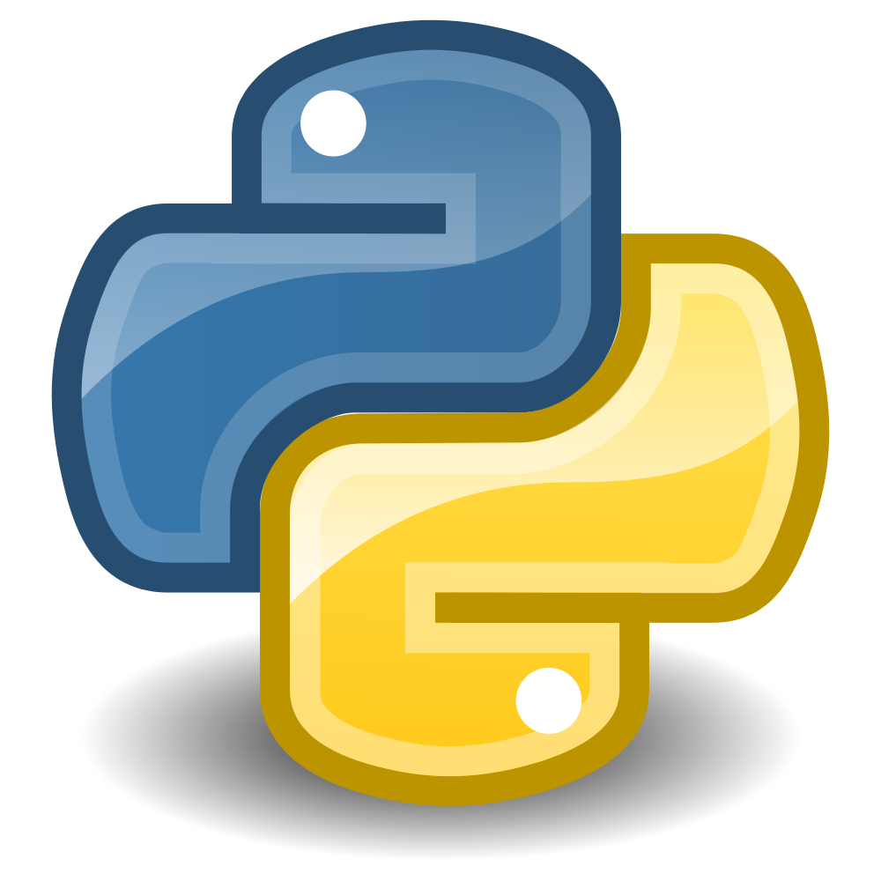

Data Science with Python and the Shiny Toys of Anaconda
Bryan Cafferky

Slide 2

Python Programming : Getting Started with Anaconda

Slide 3
Anaconda Libraries
Matplotlib - Visualizations
NumPy – Arrays and Number Crunching
Scikit-learn – Data Science
Pandas – Data Wrangling
Seaborn – Visualizations
SQLAlchemy – SQL Support and Database Access
https://docs.anaconda.com/anaconda/packages/py3.6_win-64

Slide 4

Installing Anaconda
Anaconda Distribution
https://www.anaconda.com/download/

Slide 5
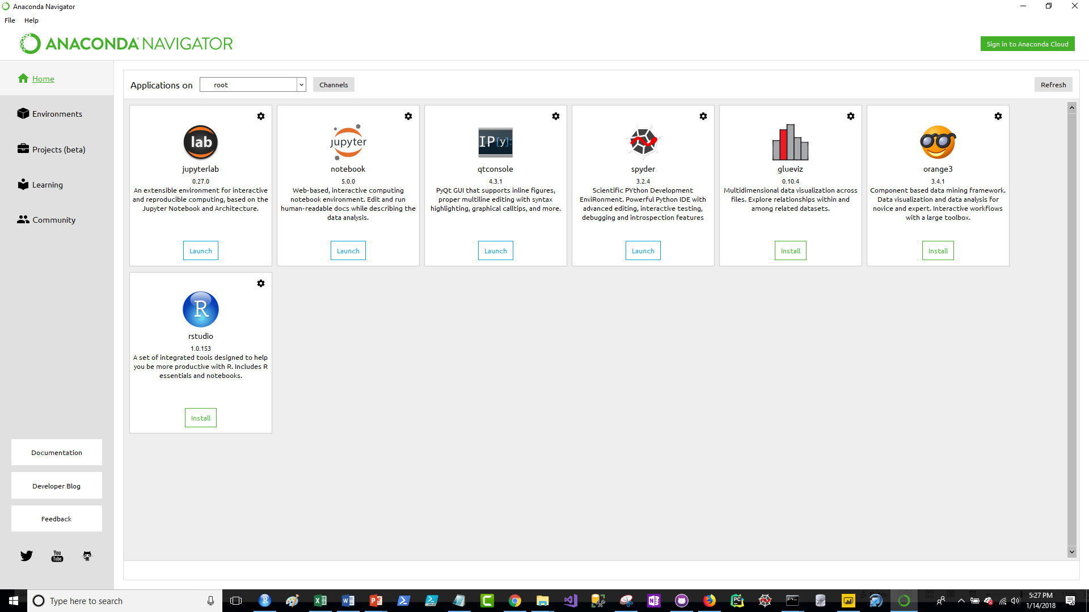
Anaconda Goodies

Slide 6
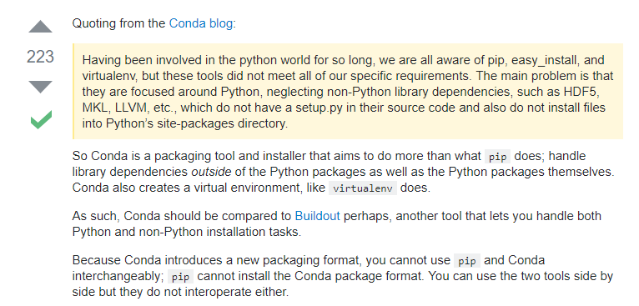
Pip vs. Conda

Slide 7
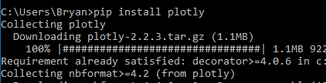
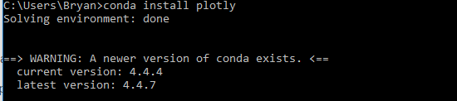
Package Management
pip
conda

