Slide 1
IP Address

Slide 2
IP Address Format
Unique IP (Internet Protocol) addresses are assigned to each physical connection of a device on net.
If a device (host) has more than one connection to a network or networks, then it will have more than one IP address.
An IP address is 32 bits long and is represented as four decimal integers, with each integer corresponding to one byte.
Ex. 162. 146. 93. 14 in dotted decimal
10100010. 10010010. 01011101. 00001110 in binary

Slide 3
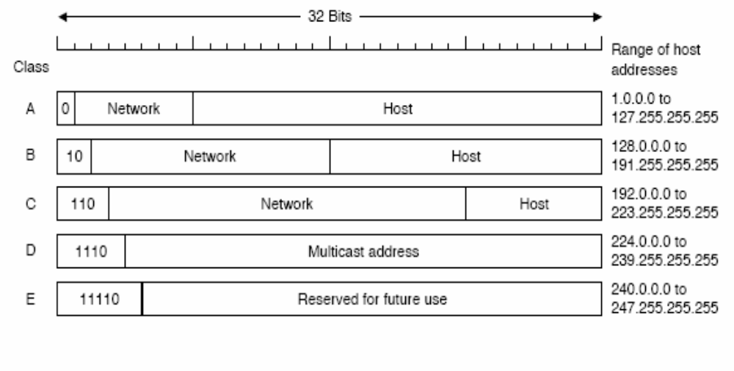
IP Address Format

Slide 4
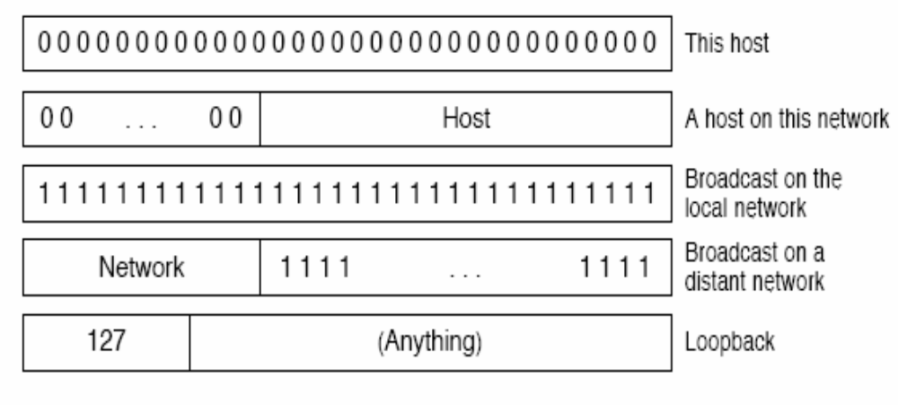
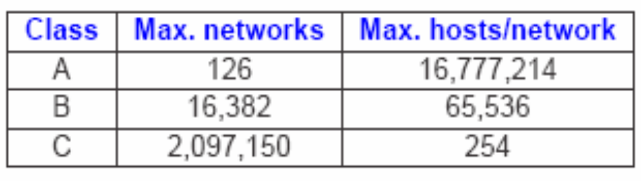
Special IP Addresses

Slide 5
IP Address Format
IP addresses are divided into two parts, a Network ID and a Host ID each of which can be of varying bit lengths but always making 32 bits altogether.
There are five primary classes of IP addresses and it is the high order 3 bits of the address which identify the class as shown below:-
First Octet Example Network Host
  Class A 0xxxxxxx 1-127 25.234.45.0 1
  Class B 10xxxxxx 128-191 140.250.43.0 1
  Class C 110xxxxx 192-223 192.2.3.0 1
  Class D 1110xxxx 224-239 232.56.4.0 1
  Class E 11110000 240-254 242.5.7.0 1

Slide 6
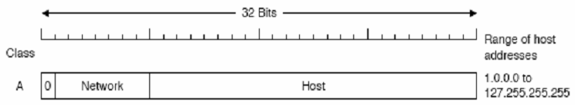
IP Address Format
Class A addresses contain 7 bits in the network portion giving 27 - 2 = 126 possible networks since all 1's and all 0's are not allowed.
Consequently 24 bits remain for the host portion allowing a total of 224 - 2 = 16,777,214 hosts.
127.0.0.0/8 is reserved for loopback address purposes where just 127.0.0.1 is used normally.
The address 255.255.255.255 is used as broadcast addresses.
0.0.0.0 as a default route address, meaning any network.
The address 0.0.0.0 is sometimes used by hosts that have yet to receive an IP address.

Slide 7
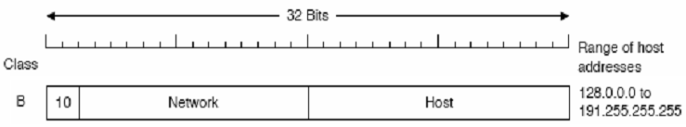
IP Address Format
Class B addresses
  contain 14 bits in the network portion allowing 2¹⁴ - 2 = 16,384 possible networks.
  and 16 bits for the host portion allowing a possible total number of 2¹⁶ - 2 = 65,534 hosts.

Slide 8
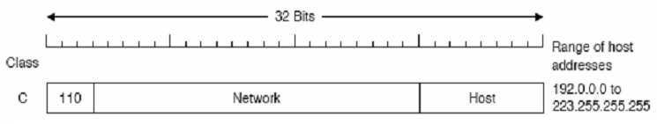
IP Address Format
Class C addresses contain
  21 bits for the network portion giving a possible total of 2²¹ - 2 = 2,097,152 networks.
  and 8 bits for the host portion giving a possible 2⁸ - 2 = 254 hosts.
Class D addresses are used for multicasting and Class E addresses are used in research.

Slide 9
IP Address Format
Historically, a company may have been allocated just one Class A, B or C IP address by the Network Information Centre (NIC).
Currently, all Class A addresses have been allocated and most if not all of the Class B addresses have gone.
If a company have a number of networks to manage then the network administrator may wish to subnet his network.
That is create subnet addresses within the scope of the IP address that the administrator has been given.

Slide 10
Subnets: Subnetting Example
A customer has been given an IP address of 128.100.0.0 (a Class B address) for his company.
He has specified that he requires 3 separate networks with the maximum possible number of host connections on each network.
The first two octets 128.100 are fixed since these are given by NIC as the Class B address, therefore we have the last two octets to play with.

Slide 11
Subnets: Subnetting Example
Let us examine the possibilities more closely:
The address given
  Octet 1 Octet 2 Octet 3 Octet 4
  10000000 01100100 00000000 00000000
  128. 100. 0. 0
We need to create a minimum of 3 different subnets but not at the expense of the number of host addresses available to us.
The following process would seem to give us 4 permutations of subnets:
  Looking at octet 3 specifically in binary, let us just use the first 2 bits for a subnet address:
  128 64 32 16 8 4 2 1
  1 1 0 0 0 0 0 0

Slide 12
Subnets: Subnetting Example
The possible combinations for the first two bits are:
  11 = 192 -> 128.100.192.0 10 = 128 -> 128.100.128.0
  01 = 64 -> 128.100.64.0 00 = 0 -> 128.100.0.0
However all 1's and all 0's used to be not allowed for a subnet.
These subnets are called the All One's Subnet and Subnet Zero.
The reason for this was that older software found it difficult to distinguish between networks 128.100.0.0/16 and the all-zeros subnet 128.100.0.0/18.
The same was true of the all-ones subnet.
RFC 950 therefore rules out '11' and '00' as useable subnets, we are therefore left with only two subnet addresses instead of the 3 we require.

Slide 13
Subnets: Subnetting Example
Let us try and use an extra bit in octet 3:
  128 64 32 16 8 4 2 1
  1 1 1 0 0 0 0 0
The possible combinations are now:
  111 = 224 -> 128.100.224.0
  110 = 192 -> 128.100.192.0
  101 = 160 -> 128.100.160.0
  011 = 96 -> 128.100.96.0
  001 = 32 -> 128.100.32.0
  010 = 64 -> 128.100.64.0
  100 = 128 -> 128.100.128.0
  000 = 0 -> 128.100.0.0
As before all 1's and all 0's are not permitted for subnets, therefore we are left with 6 (2³ - 2) possible subnets.

Slide 14
Subnets: Subnetting Example
This leaves the rest of the bits (from power 16 downwards) in octet 3 and all the bits in octet 4 to construct the individual host addresses, the permutations amount to many thousands of hosts which should be plenty.
128.100.194.23 is an example of a host address in subnet 128.100.192.0.
On first inspection it would appear that address 128.100.194.23 has nothing to do with the subnet.
The final two octets of the host address:
    Octet 3 = 194 Octet 4 = 23
    128 64 32 16 8 4 2 1 128 64 32 16 8 4 2 1
    1 1 0 0 0 0 1 0 0 0 0 1 0 1 1 1

Slide 15
Subnets: Subnetting Example
Routers are used to minimize unnecessary traffic, and when running IP it is important to tell it which subnet an address is supposed to go.
The way this is done, is at configuration by entering a subnet mask.

Slide 16
Subnet masks
The subnet mask is used to specify the portion of the IP address that is going to be used for subnetworks .
For every bit position in the IP address that is part of the network ID or subnetwork ID, a '1' is set, and for every bit position in the IP address that is part of the host id portion, a '0' is set.
The router uses the boolean AND operation with an incoming IP address to 'lose' the host portion of the IP address i.e. the bits that are '0', and match the network portion with its routing table.
From this, the router can determine out of which interface to send the datagram.
This means that the 'Don't care bits' are represented by binary 0's whilst the 'Do care bits' are represented by binary 1's.

Slide 17
Subnet masks
For our example above, because we used the first three bits in octet 3 for our subnet addressing the subnet mask would be:
11111111 11111111 11100000 00000000
255. 255. 224. 0
For host address 128.100.194.23 i.e. 10000000 01100100 11000010 00010111 11111111 11111111 11100000 00000000 10000000 01100100 11000000 00000000 128 100 192 0
What is important, is that the same mask is applied throughout the physical networks that share the same subnet part of the IP address.
All devices connected to the networks that compose the subnet must have the same mask.

Slide 18
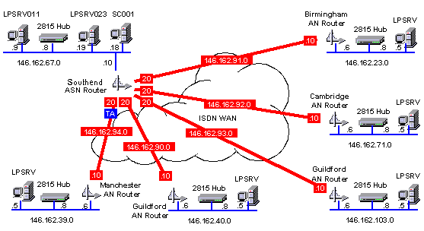
Subnet masks

