Slide 1
CS561 – Computer
Networks
Application LAYER

Slide 2
Contents
DNS
The WEB & HTTP
Electronic Mail
FTP etc.

Slide 3
Domain Name System
To map a name onto an IP address.
In the ARPANET, there was simply a file, hosts.txt, that listed all the hosts and their IP addresses.
The DNS is
  A distributed database implemented in a hierarchy of name servers
  An application-layer protocol that allows hosts and name servers to communicate in order to provide the translation service.

Slide 4
Domain Name System
The DNS protocol runs over UDP and uses port no 53.
Three classes of DNS
  Root DNS Server: There are aprox 13 root DNS labeled A through M.
  Top Level Domain (TLD) Server: Generic domain: com, org, net, edu, gov and country domain: in, us, ca, uk jp etc.
  Authoritative name servers: Every host is registered with an authoritative name server. Typically, the authoritative name server for a host is a name server in the host's local ISP.

Slide 5
Domain Name System
DNS is used is as follows.
  To map a name onto an IP address, an application program calls a library procedure called the resolver, passing it the name as a parameter.
  The resolver sends a UDP packet to a local DNS server, which then looks up the name and returns the IP address to the resolver, and then resolver returns it to the caller.
  Armed with the IP address, the program can then establish a TCP connection with the destination or send it UDP packets.

Slide 6
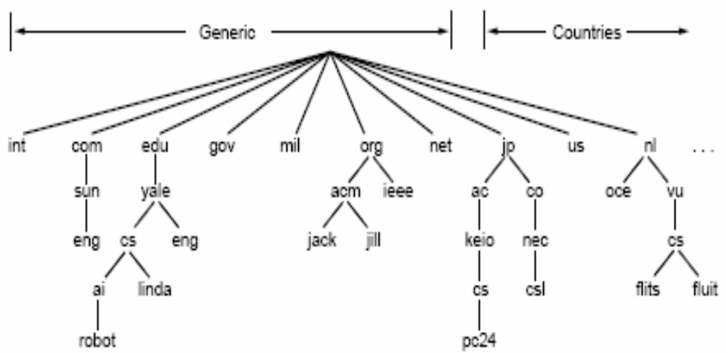
Domain Name System

Slide 7
DNS- Resource Records
Every domain has a set of resource records associated with it.
When a resolver gives a domain name to DNS, what it gets back are the resource records associated with that name.
Thus, the primary function of DNS is to map domain names onto resource records.
The DNS is specified in [RFC 1034] and [RFC 1035], and updated in several additional RFCs.

Slide 8
DNS- Resource Records
A resource record is a five-tuple:
Domain_name, Time_to_live, Class, Type, Value
The Domain_name tells the domain to which this record applies.
The Time_to_live field gives an indication of how stable the record is. Its value varies from 86400 (the number of seconds in 1 day) to 60 (1 minute).
The third field of every resource record is the Class which is always IN for Internet information.

Slide 9
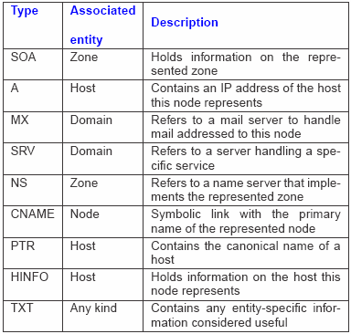
DNS- Resource Records
The most important types are:

Slide 10
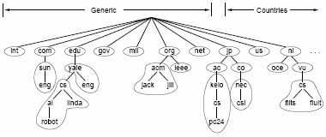

Slide 11
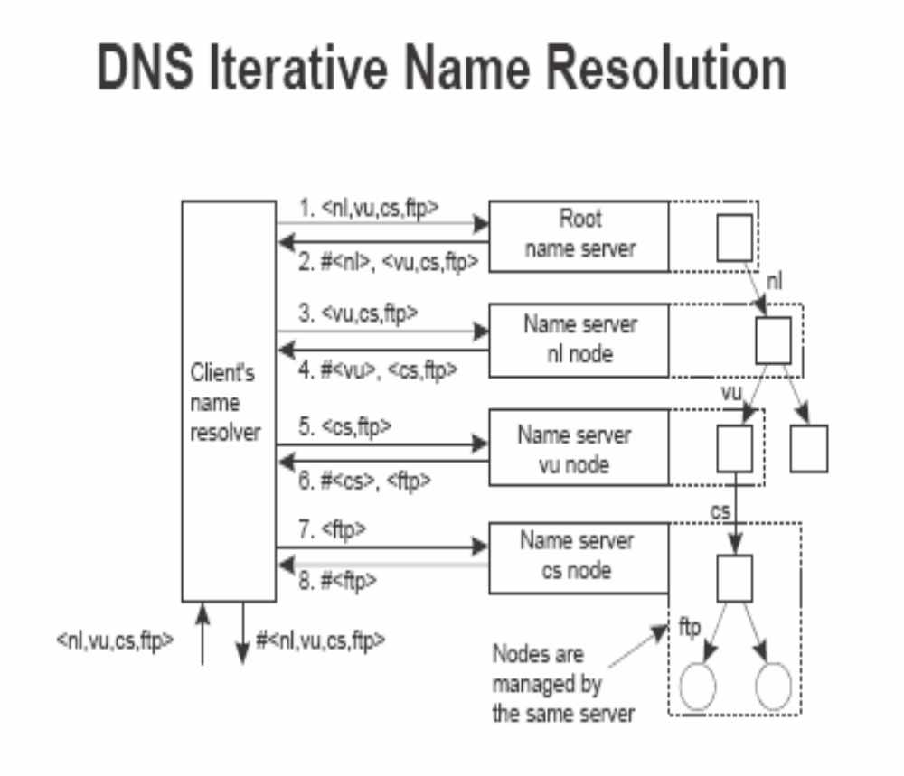

Slide 12
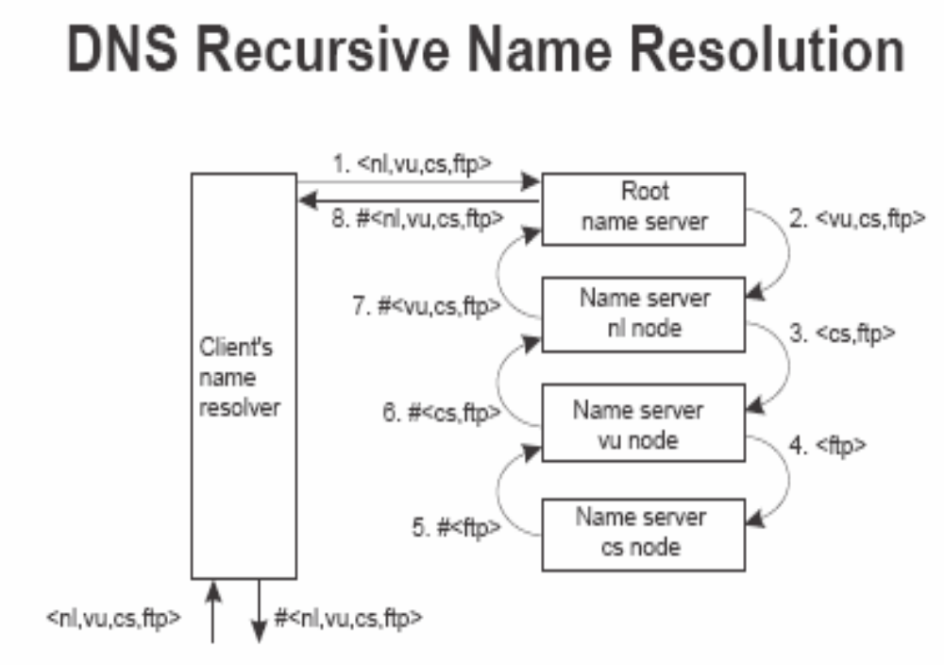

Slide 13
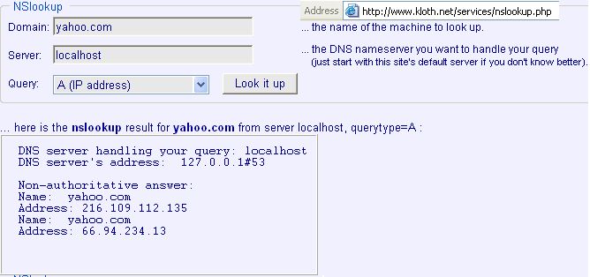

Slide 14
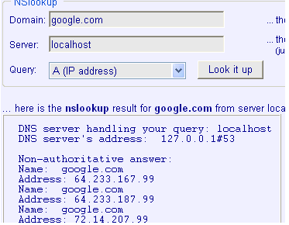

Slide 15
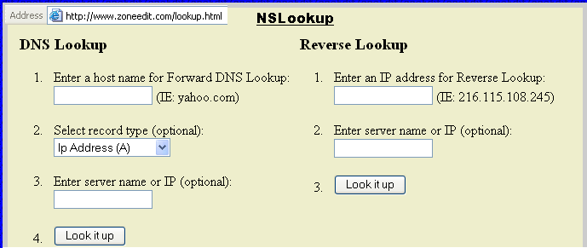

Slide 16
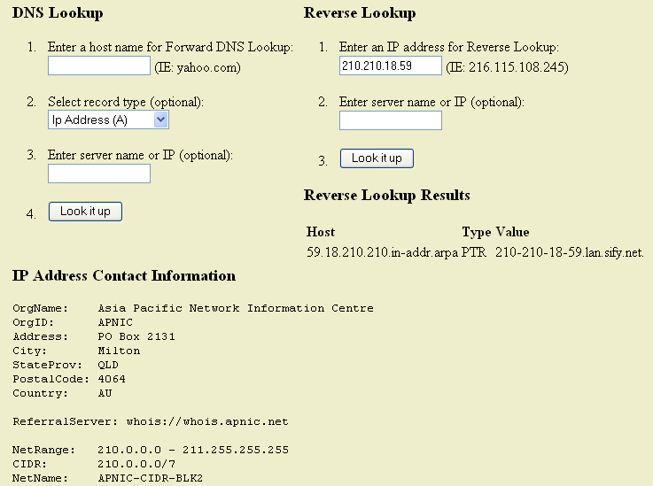

Slide 17
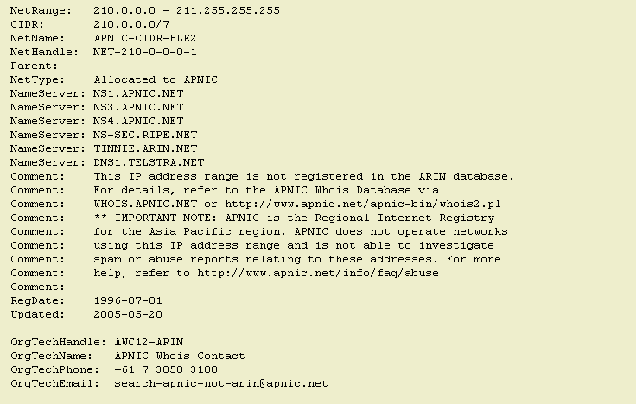

Slide 18
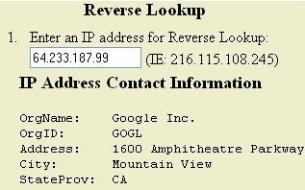
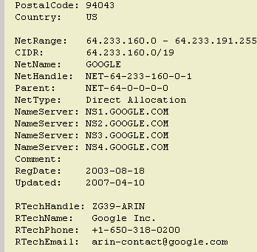
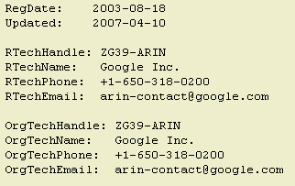

Slide 19
Web and HTTP

Slide 20
WEB & HTTP
1870s : Telephone invention.
The next electronic communication technology was
broadcast radio/television arrived in the 1920s and 1930s.
Until 1990s : The Internet was used by researchers, academics and university students to login to remote hosts, to transfer files from local hosts to remote hosts and vice versa, to receive and send news, and to receive and send electronic mail.
1990s the Internet's killer application arrived on the scene -- the World Wide Web.

Slide 21
WEB & HTTP
Web operates on demand i.e. Users receive what they want and when they want.
This is unlike broadcast radio and television.
Everyone can become a publisher at extremely low cost.
Hyperlinks and search engines help us navigate through an ocean of Web sites.
The Hypertext Transfer Protocol (HTTP) is the Web's application-layer protocol.
HTTP is implemented in two programs: a client program and server program.

Slide 22
WEB
A Web page (a document) consists of objects.
An object is a simply file -- such as a HTML file, a JPEG image, a GIF image, a Java applet, an audio clip, etc. addressable by a single URL.
Most Web pages consist of a base HTML file and several referenced objects.
Each URL has two components: the host name of the server that houses the object and the object's path name. For example:
www.someSchool.edu/someDepartment/picture.gif
has www.someSchool.edu for a host name and /someDepartment/picture.gif for a path name.

Slide 23
WEB
A browser is a user agent for the Web; it displays to the user the requested Web page and provides numerous navigational and configuration features.
Web browsers also implement the client side of HTTP.
A Web server houses Web objects, each addressable by a URL.
Web servers also implement the server side of HTTP.
Popular Web servers include Apache, Microsoft Internet Information Server, and the Netscape Enterprise Server.

Slide 24
WEB & HTTP
When a user requests a Web page (e.g., clicks on a hyperlink), the browser sends HTTP request messages for the objects in the page to the server.
The server receives the requests and responds with HTTP response messages that contain the objects.
HTTP uses TCP as their underlying transport protocol.
HTTP is said to be a stateless protocol as HTTP server maintains no information about the clients.
A Web Server is always on, with a fixed IP address.

Slide 25
WEB & HTTP
HTTP can use both non-persistent connections and persistent connections.
Non-persistent connections is the default mode for HTTP/1.0 where as persistent connections is the default mode for HTTP/1.1.
Port number 80 is used as the default port number at which the HTTP server will be listening for HTTP clients that want to retrieve documents using HTTP.

Slide 26
WEB & HTTP
Let us see the steps of transferring a Web page from server to client for the case of non-persistent connection.
Suppose the page consists of a base HTML file and 10 JPEG images, and that all 11 of these objects reside on the same server.
Suppose the URL for the base HTML file is www.someSchool.edu/someDepartment/home.index .

Slide 27
WEB & HTTP
Now the steps are as follows:
1. The HTTP client initiates a TCP connection to the server www.someSchool.edu.
2. The HTTP client sends a HTTP request message into the socket associated with the TCP connection that was established in step 1.The request message either includes the entire URL or simply the path name /someDepartment/home.index.

Slide 28
WEB & HTTP
3. The HTTP server receives the request message via the socket associated with the connection that was established in step 1, retrieves the object /someDepartment/home.index from its storage, encapsulates the object in a HTTP response message, and sends the response message into the TCP connection.
4. The HTTP server tells TCP to close the TCP connection. (But TCP doesn't actually terminate the connection until the client has received the response message in tact.)

Slide 29
WEB & HTTP
5. The HTTP client receives the response message. The TCP connection terminates. The message indicates that the encapsulated object is an HTML file. The client extracts the file from the response message, parses the HTML file and finds references to the ten JPEG objects.
6. The first four steps are then repeated for each of the referenced JPEG objects.

Slide 30
WEB & HTTP
With persistent connections, the server leaves the TCP connection open after sending responses.
Subsequent requests and responses between the same client and server can be sent over the same connection.

Slide 31
WEB & HTTP
HTTP Request Message: Below is a typical HTTP request message:
GET /somedir/page.html HTTP/1.1
Host: www.someschool.edu
Connection: close
User-agent: Mozilla/4.0
Accept: text/html, image/gif, image/jpeg
Accept-language: fr

Slide 32
WEB & HTTP
HTTP Response Message: A typical HTTP response message is:
HTTP/1.1 200 OK
Connection: close
Date: Thu, 06 Aug 2007 12:00:15 GMT
Server: Apache/1.3.0 (Unix)
Last-Modified: Mon, 22 Jun 2007 09:23:24 GMT
Content-Length: 6821
Content-Type: text/html
(data data data data data ...)

Slide 33
Cookies
Cookies are used for User-Server Interaction.
As we discussed that an HTTP server is stateless. This simplifies server design, and has permitted engineers to develop very high performing Web servers.
Some times it is desirable for a Web site to identify users, either because the server wishes to restrict user access or because it wants to serve content as a function of the user identity.
For this purpose HTTP uses cookies.
Cookies allow sites to keep track of users.

Slide 34
Cookies
Most major portals (Yahoo …), e-commerce (e-bay…) and advertising sites make extensive use of cookies.
Cookie technology has four components.
  A cookie header line in HTTP response message
  A cookie header line in HTTP request message
  A cookie file is kept on the users end system and managed by the users browser.
  A back end database at the Web-site.

Slide 35
Cookies
Suppose a client contacts a Web site for the first time, and this site uses cookies.
The server’s response will include a
  Set-cookie: header. (Identification number i.e. 1678453 generated by the Web server.)
When the HTTP client receives the response message, it sees the Set-cookie: header
It then appends a line to a special cookie file that is stored in the client machine.
This line typically includes the host name of the server and user's associated identification number.

Slide 36
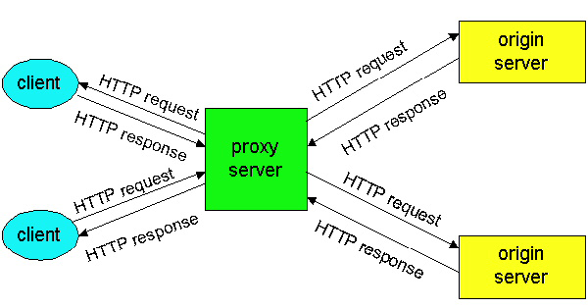
Proxy Server

Slide 37
Proxy Server
A Proxy server also called a Web cache is a network entity that satisfies HTTP requests on the behalf of a server.
The Proxy server has its own disk storage, and keeps in this storage copies of recently requested objects.
The browser establishes a TCP connection to the proxy server and sends an HTTP request for the object to the Web cache.
The Web cache checks to see if it has a copy of the object stored locally. If it does, the Web cache forwards the object within an HTTP response message to the client browser.

Slide 38
Proxy Server
If the Web cache does not have the object, the Web cache opens a TCP connection to the original server.
The Web cache then sends an HTTP request for the object into the TCP connection. After receiving this request, the original server sends the object within an HTTP response to the Web cache.
When the Web cache receives the object, it stores a copy in its local storage and forwards a copy, within an HTTP response message, to the client browser (over the existing TCP connection between the client browser and the Web cache).

Slide 39
File Transfer Protocol
FTP (File Transfer Protocol) is a protocol.
It is used to transfer a file from one host to another host.
The protocol came around 971 (when the Internet was still an experiment), but still enormously popular.
It is described in [RFC 959].
In a typical FTP session, the user wants to transfer files to or from a remote host.
In order for the user to access the remote account, the user must provide a user identification and a password.
After providing this authorization information, the user can transfer files from the local file system to the remote file system and vice versa.

Slide 40
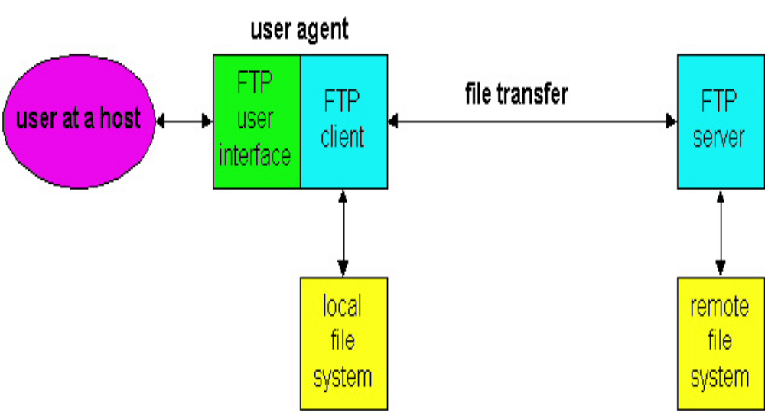
File Transfer Protocol

Slide 41
File Transfer Protocol
the user interacts with FTP through an FTP user agent.
The user first provides the hostname of the remote host.
FTP client process in the local host, establishes a TCP connection with the FTP server process in the remote host.
The user then provides the user identification and password, which get sent over the TCP connection as part of FTP commands.
Once the server has authorized the user, the user copies one or more files stored in the local file system into the remote file system (or vice versa).

Slide 42
File Transfer Protocol
HTTP and FTP are both file transfer protocols and have many common characteristics.
Both run on top of TCP, the Internet's connection-oriented, transport-layer, reliable data transfer protocol.
However, the two application-layer protocols have some important differences.
The most striking difference is that FTP uses two parallel TCP connections to transfer a file, a control connection and a data connection.

Slide 43
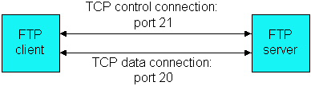
File Transfer Protocol

Slide 44
File Transfer Protocol
The control connection is used for sending control information between the two hosts -- information such as user identification, password, commands to change remote directory, and commands to "put" and "get" files.
The data connection is used to actually send a file.
Because FTP uses a separate control connection, FTP is said to send its control information out-of-band.
HTTP sends request and response header lines into the same TCP connection that carries the transferred file itself (in-band).

Slide 45
File Transfer Protocol
Some FTP Commands and Replies:
  USER username : Used to send the user identification to server.
  PASS password : Used to send the user password to the server.
  LIST : Used to ask the server to send back a list of all the files in the current remote directory. The list of files is sent over a (new and non-persistent) data TCP connection and not over the control TCP connection.
  RETR filename : Used to retrieve (i.e. get) a file from the current directory of the remote host.
  STOR filename : Used to store (i.e., put) a file into the current directory of the remote host.

Slide 46
Electronic Mail
Electronic Mail is the application layer protocol.
It allows users to send and read messages when it is convenient for them.
Internet mail system has three major components:
  User agents
  Mail server
  SMTP
User agents allow users to read, reply to, forward, save, and compose messages.
Currently, Eudora, Microsoft's Outlook Express, and Netscape's Messenger are among the popular GUI user agents for email.
There are also many text-based email user interfaces in the public domain, including mail, pine and elm.

Slide 47
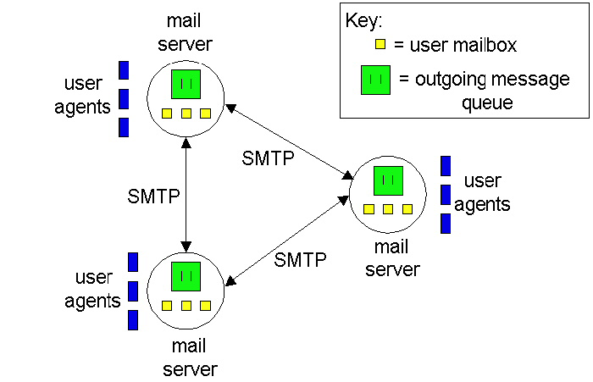
Electronic Mail

Slide 48
Electronic Mail
Mail servers form the core of the e-mail infrastructure.
Each recipient has a mailbox located in one of the mail servers.
Mailbox manages and maintains the messages.
A typical message starts its journey in the sender's user agent, travels to the sender's mail server, and then travels to the recipient's mail server, where it is deposited in the recipient's mailbox.
SMTP transfers messages from senders' mail servers to the recipients' mail servers.

Slide 49
SMTP
The Simple Mail Transfer Protocol (SMTP) is the principle application-layer protocol for Internet electronic mail.
It uses the reliable data transfer service of TCP to transfer mail from the sender's mail server to the recipient's mail server.
Both the client and server sides of SMTP run on every mail server.
When a mail server sends mail (to other mail servers), it acts as an SMTP client. When a mail server receives mail (from other mail servers) it acts as an SMTP server.

Slide 50
SMTP
SMTP restricts the body (not just the headers) of all mail messages to be in simple seven-bit ASCII.
The binary multimedia data to be encoded to ASCII before being sent over SMTP; and it requires the corresponding ASCII message to be decoded back to binary after SMTP transport.
Illustration of the basic operation of SMTP: Suppose A wants to send a simple ASCII message to B:
A invokes its user agent for email, provides B's email address, composes a message and instructs the user agent to send the message.

Slide 51
SMTP
A's user agent sends the message to its mail server, where it is placed in a message queue.
Now the client SMTP establishes a TCP connection on port 25 to the server SMTP.
The client side of SMTP, running on A's mail server, sees the message in the message queue.
At B's mail server host, the server side of SMTP receives the message and places the message in B's mailbox.
B invokes its user agent to read the message at his convenience.

Slide 52
SMTP
Comparison with HTTP
  Both protocols are used to transfer files from one host to another.
  HTTP transfers files (or objects) from Web server to Web user agent; SMTP transfers files from one mail server to another mail server.
  While transferring files, both persistent HTTP and SMTP use persistent connections

Slide 53
SMTP
However, there are important differences:
  HTTP is principally a pull protocol. On the other hand, SMTP is primarily a push protocol
  SMTP requires each message, including the body of each message, to be in seven-bit ASCII format. HTTP does not bother the type of data.
  Internet mail places all of the message's objects into one message. HTTP encapsulates each object in its own HTTP response message.

Slide 54
SMTP
Problems with SMTP
SMTP can not transfer executable files and binary objects.
SMTP can not transmit text data of the languages which are represented in 8 bit.
SMTP servers may reject mails having size greater than a certain size.
SMTP can not handle picture, images and audio/video

Slide 55
MIME
Multipurpose Internet Mail Extension (MIME) is a supplementary protocol.
It resolves the above mentioned issues and allow non ASCII data to be sent through SMTP.
It is an extension protocol and cannot replace SMTP.

Slide 56
MIME HEADER
MIME is realized using five headers:
  MIME-Version: 1.0
  Content-Type: text/image/audio/video
  Content-Transfer-Encoding:base64/binary/7bit/8bit/ x-token
  Content-ID: Uniquely identify the MIME Version
  Content-Description: It is a plain text and is required
  base64 encoded data .....
  .........................
  ......base64 encoded data

Slide 57
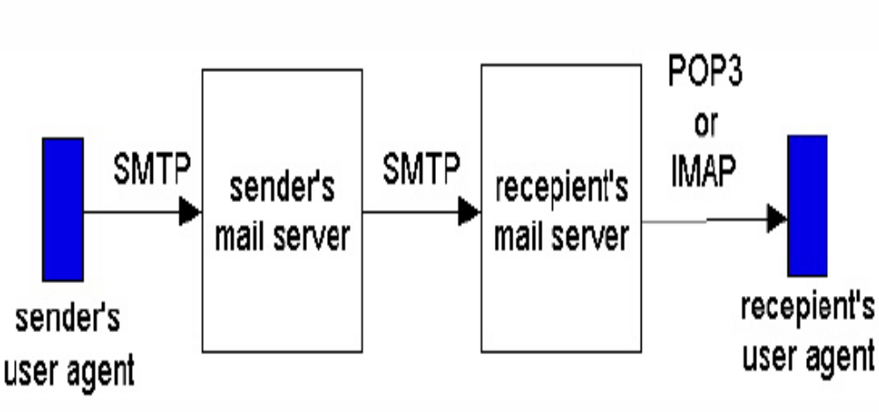
E-Mail

Slide 58
POP3
POP3, defined in [RFC 1939].
POP3 begins when the user agent (the client) opens a TCP connection to the mail server (the server) on port 110.
POP3 progresses through three phases:
  Authorization
  Transaction
  Update
In authorization, the user agent sends a user name and a password.

Slide 59
POP3
In transaction, the user agent retrieves messages, mark messages for deletion, remove deletion marks, and obtain mail statistics.
Update occurs after the client has issued the quit command ending the POP3 session; at this time, the mail server deletes the messages that were marked for deletion.

Slide 60
IMAP
Maintaining a folder hierarchy on a remote server that can be accessed by from any computer, is not possible with POP3.
To solve this and other problems, the Internet Mail Access Protocol (IMAP), defined in [RFC 1730], was invented.
Like POP3, IMAP is a mail access protocol. It has many more features than POP3, but it is also significantly more complex.

Slide 61
IMAP
IMAP is designed to allow users to create and maintain multiple message folders at the mail server.
IMAP also provides commands that allow Bob to search remote folders for messages matching specific criteria.
One reason why an IMAP implementation is much more complicated than a POP3 implementation is that the IMAP server must maintain a folder hierarchy for each of its users.
This state information persists across a particular user's successive accesses to the IMAP server.

Slide 62
IMAP
An IMAP session consists of the establishment of a connection between the client and the IMAP server, an initial greeting from the server, and client-server interactions.
The IMAP server is always in one of four states.
In the non-authenticated state, which starts when the connection starts, the user must supply a user name and password before most commands will be permitted.
In the authenticated state, the user must select a folder before sending commands that affect messages.

Slide 63
IMAP
In the selected state, the user can issue commands that affect messages (retrieve, move, delete, retrieve a part in a multipart message, etc.).
Finally, the logout state is when the session is being terminated.

Slide 64
HTTP
These days people are using browser-based email services such as Hotmail or Yahoo! Mail.
With these servers, the user agent is an ordinary Web browser.
When a recipient wants to access the messages from his mailbox, the messages are sent from mail server to his browser using the HTTP protocol rather than the POP3 or IMAP protocol.
Similarly when a sender with an account on an HTTP-based email server wants to send a message, the message is sent from browser to mail server over HTTP rather than over SMTP.

Slide 65
HTTP
The mail server, however, still sends messages to, and receives messages from, other mail servers using SMTP.
As with IMAP, users can organize their messages in a hierarchy of folders on the remote server.
In fact, Web based email is so convenient that it may replace POP3 and IMAP access in the upcoming years.
Its principle disadvantage is that it can be slow, as the server is typically far from the client and interaction with the server is done through CGI scripts.

Slide 66
Cryptography
Historically, three groups of people have used and contributed to the art of cryptography: military, diplomatic corps and lovers.
Plaintext: The messages to be encrypted
Key: The transformation function
Ciphertext: The output of the encryption process.
Cryptanalysis: The art of breaking ciphers

Slide 67
Cryptography
C = E_{K}(P) to mean that the encryption of the plaintext P using key K gives the ciphertext C.
Similarly, P = D_{K}(C) represents the decryption of C to get the plaintext again.
Methods: Substitution, Transposition Ciphers Etc.
symmetric-key algorithms: Uses the same key for encryption and decryption.

Slide 68
Public-Key Algorithms
Here, the (keyed) encryption algorithm, E, and the (keyed) decryption algorithm, D, had to meet three requirements. These requirements can be stated simply as follows:
D(E(P)) = P.
It is exceedingly difficult to deduce D from E.
E cannot be broken by a chosen plaintext attack

Slide 69
Thank You

