Slide 1
Data link LAYER
Error Control

Slide 2
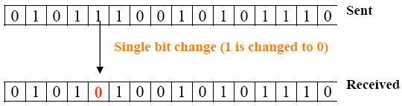
ERROR Control
The errors can be divided into two types:
  Single-bit error and Burst error.
Single-bit Error: means that only one bit of given data unit (such as a byte, character, or data unit) is changed from 1 to 0 or from 0 to 1.

Slide 3
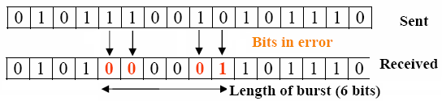
ERROR Control
Burst Error: means that two or more bits in the data unit have changed from 0 to 1 or vice-versa.
Note that burst error doesn’t necessary means that error occurs in consecutive bits.
The length of the burst error is measured from the first corrupted bit to the last corrupted bit.
Some bits in between may not be corrupted.

Slide 4
Error Detecting Codes
Basic approach used for error detection is the use of redundancy, where additional bits are added to facilitate detection and correction of errors.
Popular techniques are:
  Simple Parity check
  Two-dimensional Parity check
  Checksum
  Cyclic redundancy check

Slide 5
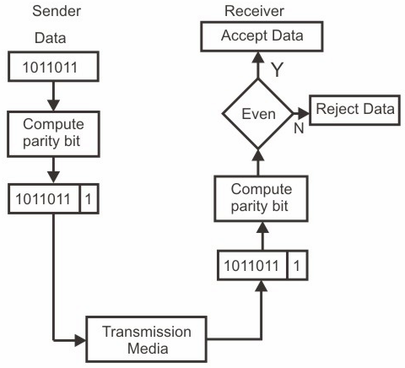
Simple Parity check

Slide 6
Simple Parity check
Simple Parity Check or One-dimension Parity Check
The most common and least expensive mechanism for single bit error- detection.
Here, a redundant bit called parity bit, is appended to every data unit so that the number of 1s in the unit (including the parity) becomes even.
At the receiving end the parity bit is computed from the received data bits and compared with the received parity bit.
This scheme makes the total number of 1’s even, that is why it is called even parity checking.

Slide 7
Two-dimension Parity Check
Two-dimensional parity check organizes the block of bits in the form of a table.
Parity check bits are calculated for each row, which is equivalent to a simple parity check bit.
Similarly parity check bits are also calculated for each column and then both are sent along with the data.
At the receiving end these are compared with the parity bits calculated on the received data.

Slide 8
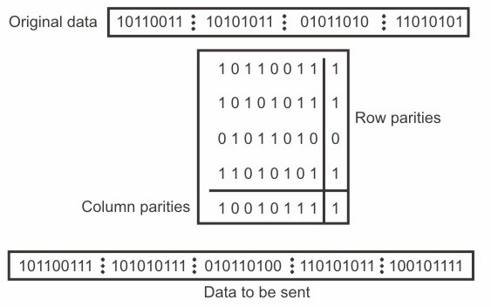
Two-dimension Parity Check

Slide 9
Two-dimension Parity Check
Two- Dimension Parity Checking increases the likelihood of detecting burst errors.
A 2-D Parity check of n bits can detect a burst error of n bits.
A burst error of more than n bits is also detected by 2-D Parity check with a high-probability.
There is, however, one pattern of error that remains elusive.
If two bits in one data unit are damaged and two bits in exactly same position in another data unit are also damaged, the 2-D Parity check checker will not detect an error.

Slide 10
Checksum
Here the data is divided into k segments each of m bits.
In the sender’s end the segments are added using 1’s complement arithmetic to get the sum.
The sum is complemented to get the checksum.
The checksum segment is sent along with the data segments.
At the receiver’s end, all received segments are added using 1’s complement arithmetic to get the sum.
The sum is complemented. If the result is zero, the received data is accepted, otherwise discarded.
It detects - all errors involving an odd number of bits and - most errors involving even number of bits.

Slide 11
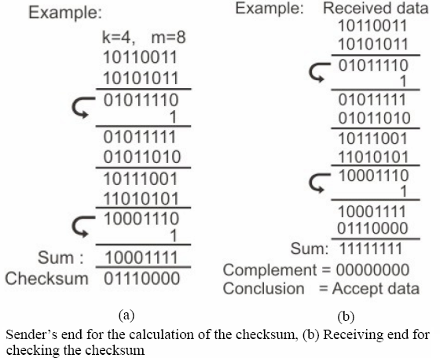
Checksum

Slide 12
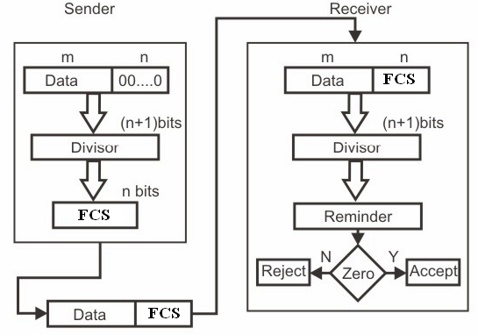
Cyclic Redundancy Check

Slide 13
Cyclic Redundancy Check (CRC)
CRC is based on binary division.
In CRC, a sequence of redundant bits, called cyclic redundancy check bits, are appended to the end of data unit so that the resulting data unit becomes exactly divisible by a predetermined binary number.
At the destination, the incoming data unit is divided by the same number.
If there is no remainder, the data unit is accepted otherwise rejected.

Slide 14
Cyclic Redundancy Check
Original message: m bit.
Predetermined number (Generator Polynomial): (n+1) bit.
Original m bit message appended by n zeros is divided (binary) by generator polynomial.
The remainder of this division process is of n-bits and known as Frame Check Sequence (FCS).

Slide 15
Cyclic Redundancy Check
The n zeros are replaced by FCS and (m+n) bits are being transmitted.
On receiving the packet, the receiver divides the (m+n) bit frame by the same predetermined number.
If there is no remainder, the data unit is accepted otherwise rejected.

Slide 16
CRC Example
Original message: 1101 or x³+x²+1.
Generator Polynomial: 1011 or x³+x+1.
Original message appended by 3 zeros is divided by Generator Polynomial using the modulo-2 arithmetic.
Modulo-2 arithmetic is a binary addition process without any carry over, which is just the Exclusive-OR operation.

Slide 17
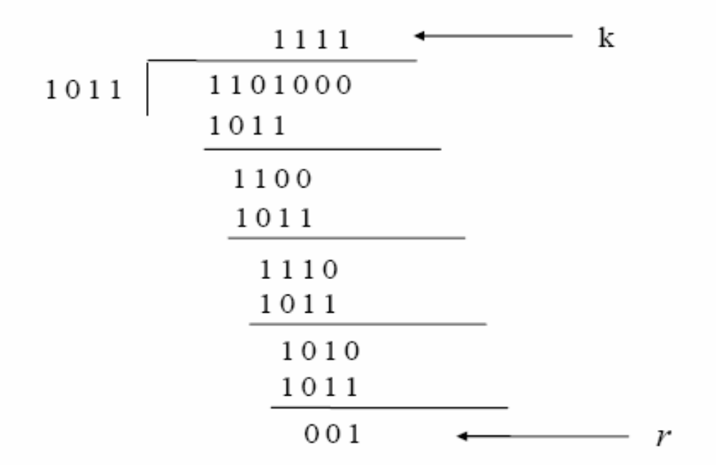
CRC Example

Slide 18
CRC Example
That is 1101000 by 1011, which produces the remainder 001.
So that the bit frame (m+n) = 1101001 is actually being transmitted.
At the receiving end, if the received number, i.e., 1101001 is divided by the same generator polynomial 1011 to get the remainder as 000, it can be assumed that the data is free of errors.

Slide 19

CRC Example
Original message: 10011010
Generator Polynomial: 1101
T(x) = x^{r} M(x) where r is the degree of generator polynomial.
T(x) = x¹⁰ + x⁷ + x⁶ + x⁴ = 10011010000
T’(x) = 10011010101 will be transmitted.

Slide 20
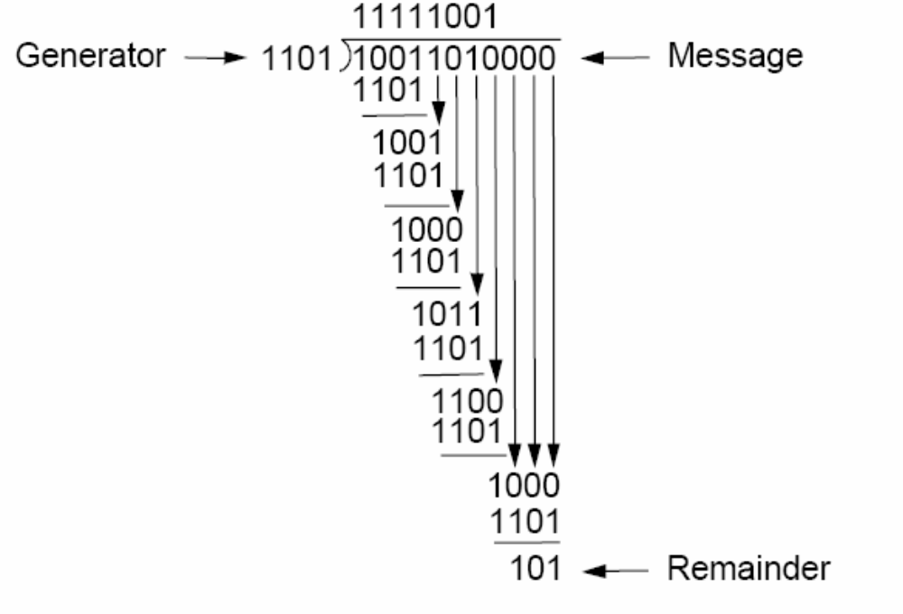
CRC Example

Slide 21
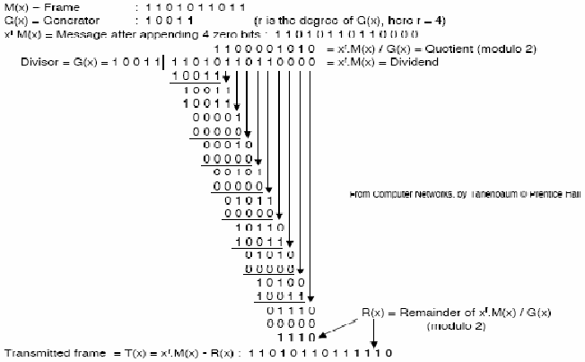
CRC Example

Slide 22
Why does it work?
We have T(x) = x^{r}.M(x) - R(x)
Therefore, the remainder of T(x) / G(x) is zero!
This is easy to check at the receiver, provided that the sender and the receiver agree on a certain G(x).
Suppose some errors occur during transmission.
The received frame is T(x) + E(x)
The receiver will then calculate the remainder of (T(x) + E(x)) / G(x)
This remainder is equal to the remainder of E(x) / G(x)
If there is an error such that E(x) is not divisible by G(x), it is detected!
The choice of G(x) is thus very important.

Slide 23
CRC
Generator polynomial is selected to have at least the following properties:
  It should not be divisible by X.
  It should be divisible by (X+1) (in modulo 2 arithmetic).
  In modulo 2 arithmetic a polynomial with an odd number of terms is not divisible by x+1
The first condition guarantees that all burst errors of a length equal to the degree of polynomial are detected.
The second condition guarantees that all burst errors affecting an odd number of bits are detected.
CRC process can be expressed as:
  X^{r}M(X)/P(X) = Q(X) + R(X) / P(X)

Slide 24
CRC
Commonly used divisor polynomials are:
CRC-16 = X¹⁶ + X¹⁵ + X² + 1
CRC-CCITT = X¹⁶ + X¹² + X⁵ + 1
CRC-32 = X³² + X²⁶ + X²³ + X²² + X¹⁶ + X¹² + X¹¹ + X¹⁰ + X⁸ + X⁷ + X⁵ + X⁴ + X² + 1

Slide 25
CRC Performance
If the divisor is chosen according to the previously mentioned rules, its performance can be summarized as follows:
CRC can detect all single-bit errors.
CRC can detect all double-bit errors (three 1’s).
CRC can detect any odd number of errors (X+1).
CRC can detect all burst errors of less than the degree of the polynomial.
CRC detects most of the larger burst errors with a high probability.
For example CRC-12 detects 99.97% of errors with a length 12 or more.

Slide 26
Error Correction
A single additional bit can detect error, but it’s not sufficient enough to correct that error too.
For correcting an error one has to know the exact position of error, i.e. exactly which bit is in error (to locate the invalid bits).
To do this, we have to add some additional redundant bits.
Numbers of redundant bits (k) required to correct m data bits:
  The total number of bits to be transmitted: m+k.

Slide 27
Error Correction
  Here r must be able to indicate at least m+k+1 different values.
  One value for no error, and remaining m+k values indicate error in each of m+k locations.
  So, m+k+1 states must be distinguishable by k bits.
  k bits can indicates 2^{k} states. Hence, 2^{k} must be greater than m+k+1.
For example, if d is 7, then the smallest value of r that satisfies the above relation is 4.
So the total bits, which are to be transmitted is 11 bits (m+k = 7+4 =11).

Slide 28
Hamming Code
Basic approach for error detection by using Hamming code is as follows:
  To each group of m information bits k parity bits are added to form (m+k) bit code.
  The k parity bits are placed in positions 1, 2, …, 2^{k-1} positions.
  A bit may be included in several parity computations.
  To see which redundant bits the data bit in position k contributes to, rewrite k as a sum of powers of 2.
  For example, 5 = 1 + 4, 7 = 1 + 2+ 4, 11 = 1 + 2 + 8 and 29 = 1 + 4 + 8 + 16.

Slide 29
Hamming Code
Similarly three redundant bits r₁, r₂ and r₄ is responsible for following bit positions: r₁: 1,3,5,7… r₂: 2,3,6,7,10,11… and r₄: 4,5,6,7,12,13…
The parity bit value for k (=1,2,4,8…) position is calculated and m+k bit length data is being transmitted.
The decimal value of the k parity bits provides the bit-position in error, if any.
At the receiving end the parity bits are recalculated. The decimal value of the k parity bits provides the bit-position in error, if any.

Slide 30
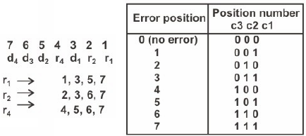
Hamming Code

Slide 31
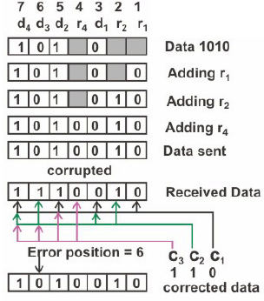
Hamming Code

Slide 32
Thank You

