Slide 1
CS561 – Computer
Networks
Application LAYER

Slide 2

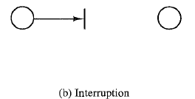
Network Security
A categorization of attacks is in terms of passive attacks and active attacks:

Slide 3
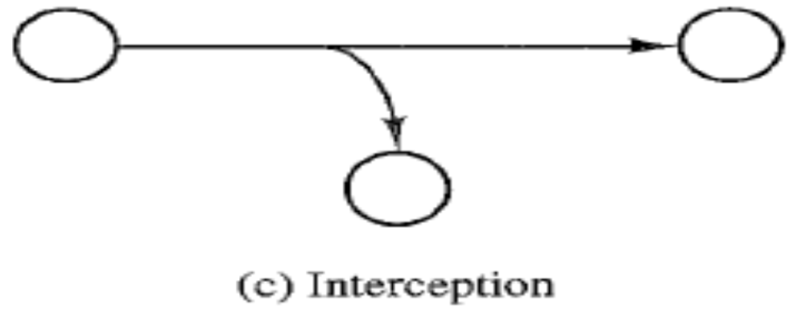
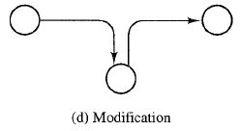
Network Security

Slide 4
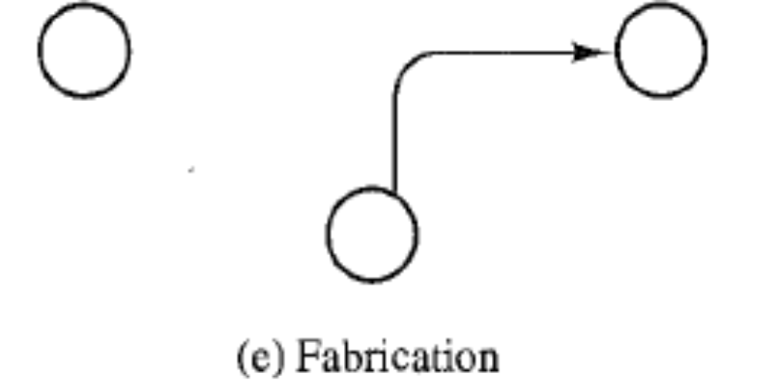
Network Security

Slide 5
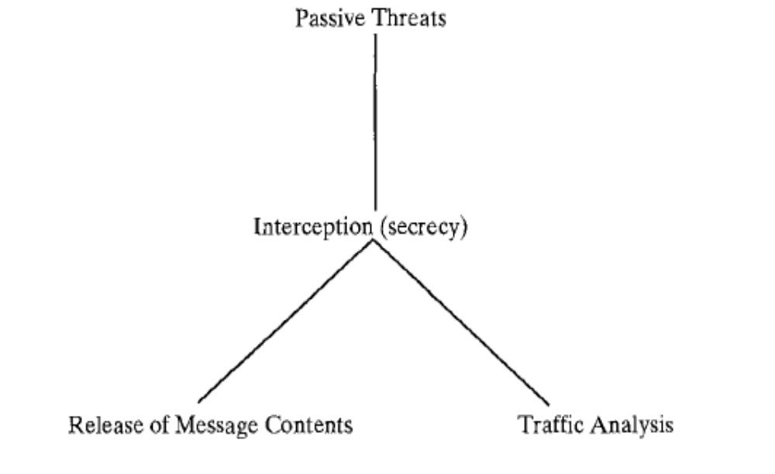
Network Security

Slide 6
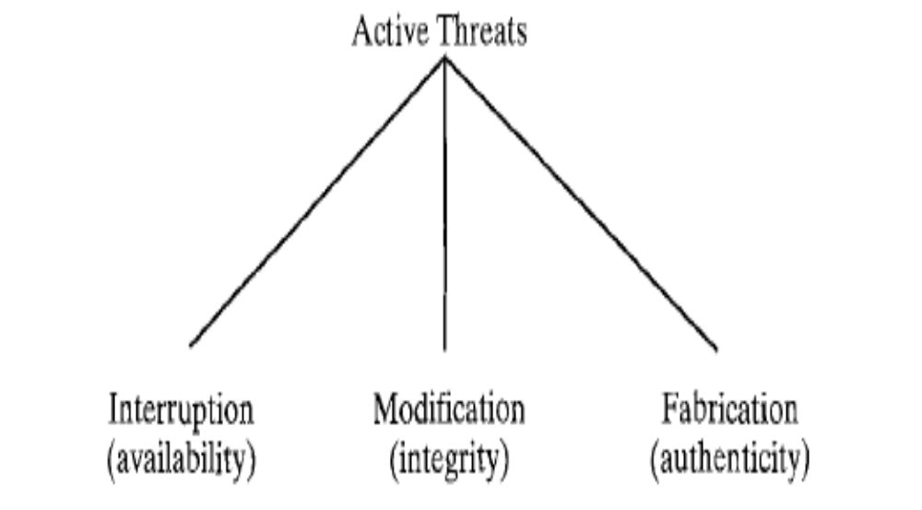
Network Security

Slide 7
Cryptography
Cryptography is a process associated with scrambling plaintext into ciphertext (encryption) then back again (decryption).
Plaintext: The messages to be encrypted
Key: The transformation function
Ciphertext: The output of the encryption process.
Cryptanalysis: The art of breaking ciphers

Slide 8
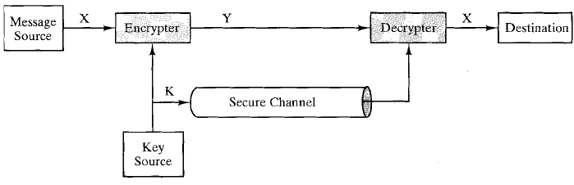
Cryptography

Slide 9
Cryptography
C = E_{K}(P) to mean that the encryption of the plaintext P using key K gives the ciphertext C.
Similarly, P = D_{K}(C) represents the decryption of C to get the plaintext again.
Methods: Substitution, Transposition Ciphers Etc.
symmetric-key algorithms: Uses the same key for encryption and decryption.

Slide 10
Public-Key Algorithms
Public-key cryptography uses a pair of keys.
One that is designated the private key and kept secret.
The other key is called the public key and is generally made available.
Information encrypted using one key can only be decrypted using the other, and vice versa.
C = E_{Ku} (P) and P = E_{Kr} (C) where Kr is private key and Ku is public key.
Similarly C = E_{Kr} (P) and P = E_{Ku} (C)

Slide 11
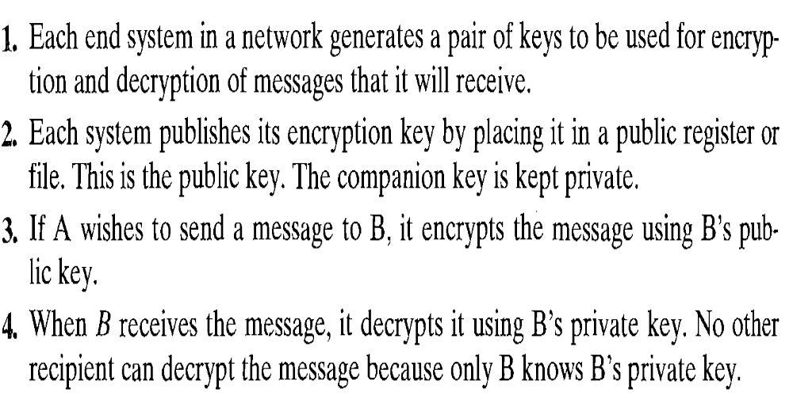
Public-Key Algorithms

Slide 12
Public-Key Algorithms
Based on mathematical algorithms
Asymmetric
  Use two separate keys
Ingredients
  Plain text
  Encryption algorithm
  Public and private key
  Cipher text
  Decryption algorithm

Slide 13
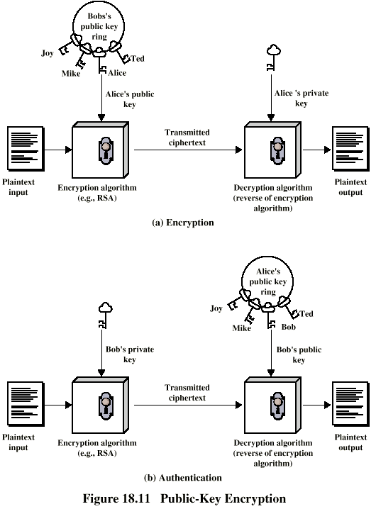
Public-Key Algorithms

Slide 14
Digital Signature
Sender A encrypts message with his private key and B’s public key.
  C = E_{Kub}(E_{Kra} (P))
Receiver B can decrypt using his private key and senders public key.
      P = E_{Krb}(E_{Kua}(C))
This authenticates sender, who is only person who has the matching key

Slide 15
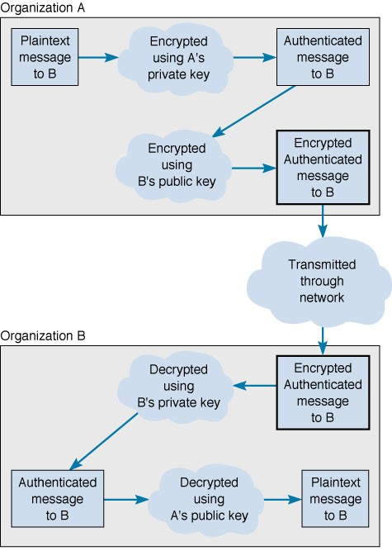
Digital Signature

Slide 16
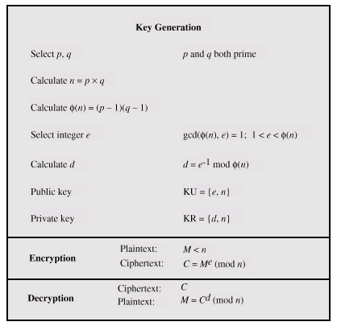
RSA Algorithm

Slide 17
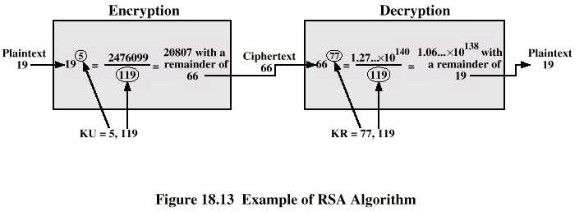
RSA Example

Slide 18
Thank You

