Slide 1
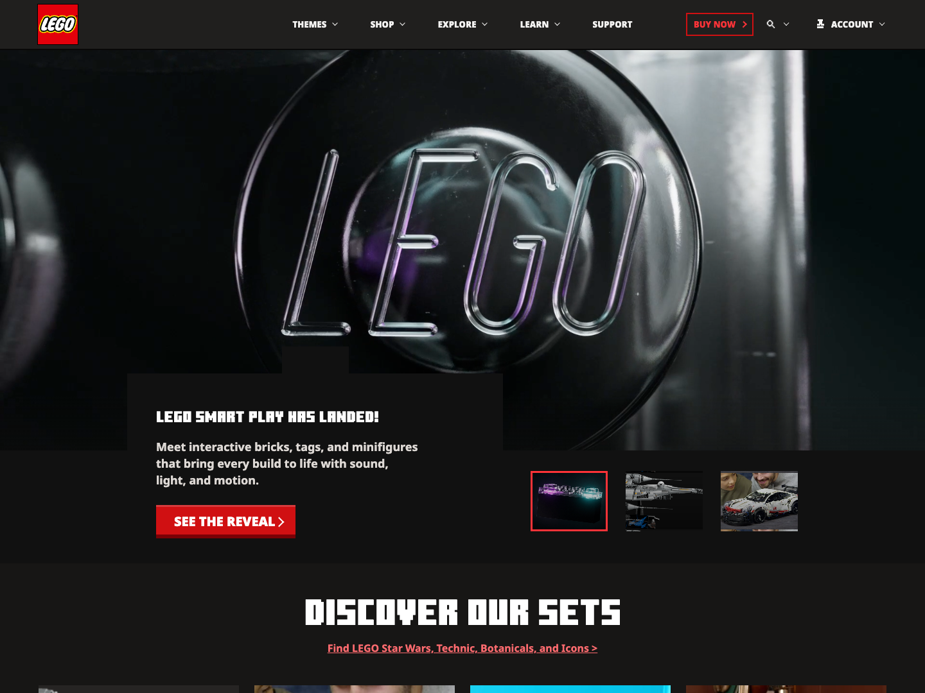
MINECRAFT -> LEGO
enhanced presentation
minecraft cave direction
01
CLONE
GUIDE
Minecraft homepage structure rebuilt with LEGO content, then presented as a blocky interface system.
desktop screenshot now acts as the world view
stone texture + block frames + redstone accents
PROJECT THEME
Minecraft skeleton / LEGO content / custom front-end code

Slide 2
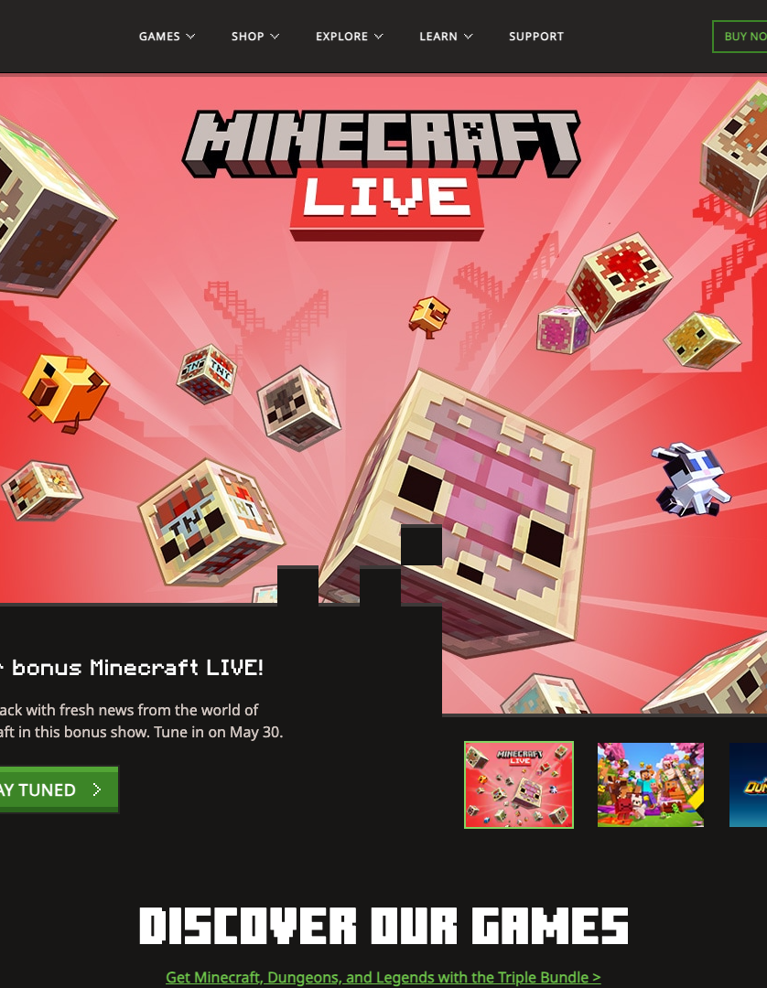
MINECRAFT -> LEGO
reference map
same skeleton, new content
02
MINECRAFT
TO LEGO
The presentation shows the source structure first, then the LEGO clone that keeps the same homepage behavior.
original minecraft.net
clone content direction

Slide 3
MINECRAFT -> LEGO
content inventory
page roles
03
STRUCTURE
Each Minecraft page role is translated into a LEGO content role.
Header
Navigation, search, account, Buy Now
LEGO theme navigation and mega panels
Hero
Campaign visual, card copy, CTA, tabs
SMART Play, Star Wars, Technic, Botanicals
Discovery
Game cards and news rhythm
Sets, stories, marketplace rows
Media
Trailer and video panels
Featured LEGO videos with controls
Footer
Social, links, legal structure
LEGO social and footer columns
inventory grid replaces the flat table

Slide 4
MINECRAFT -> LEGO
full desktop image
wide screenshot proof
04
FULL WIDTH
Desktop screenshot is now the main proof object, not a small thumbnail.
fixed nav
hero card
tabs
discovery rows
LEGO theme swap
The clone keeps the homepage hierarchy but changes the visual world from Minecraft media into LEGO products.

Slide 5
MINECRAFT -> LEGO
crafting code
HTML and CSS proof
05
CODE
The layout is assembled as reusable page regions and section blocks.
<header class="site-header">
<nav class="navbar">...</nav>
<div class="mega-panel" hidden>...</div>
</header>
<main id="main-content">
<section class="hero-section">...</section>
<section class="discover-section">...</section>
<section class="marketplace-section">...</section>
<section class="trailer-section">...</section>
</main>
.navbar {
display: flex;
align-items: center;
padding: 0 clamp(24px, 4.05vw, 64px);
}
.mega-shell {
display: grid;
grid-template-columns:
254px minmax(620px, 888px)
minmax(180px, 255px);
}
.hero-tab { transition: transform .3s ease; }
index.html
styles/layout.css

Slide 6
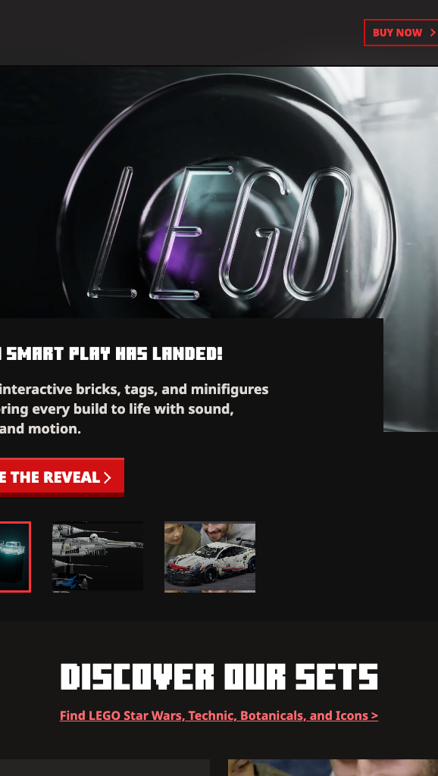
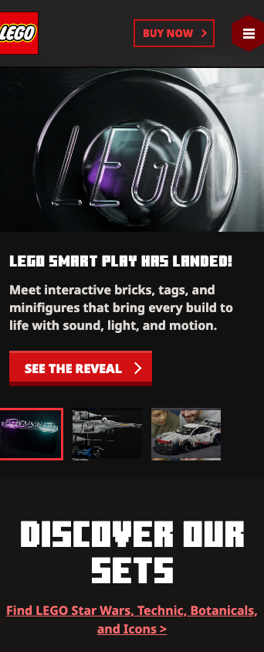
MINECRAFT -> LEGO
responsive world
desktop first proof
06
SCREEN SYSTEM
Desktop stays dominant; tablet and mobile become device overlays.
desktop: full navigation + wide hero
tablet: compressed cards
mobile: stacked menu and reduced scale
responsive.css
Desktop screenshot becomes the largest proof object on the page.

Slide 7
MINECRAFT -> LEGO
redstone interaction
JavaScript state
07
STATE
The JavaScript layer changes UI state through data attributes and class names.
q("[data-menu-toggle]")?.addEventListener("click", (e) => {
const menu = q("[data-nav-menu]");
const on = menu.classList.toggle("is-open");
setOpen(e.currentTarget, on);
document.body.classList.toggle("is-menu-open", on);
});
// same controller handles:
// mega panels, search overlay, hero tabs,
// trailer controls, scroll buttons, Escape close.
data-panel-trigger
opens mega panels
data-search-open
reveals search overlay
hero-tab
switches hero media
data-scroll-track
moves carousels

Slide 8
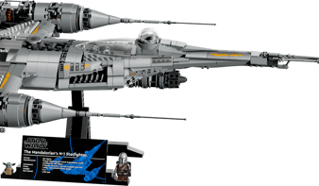
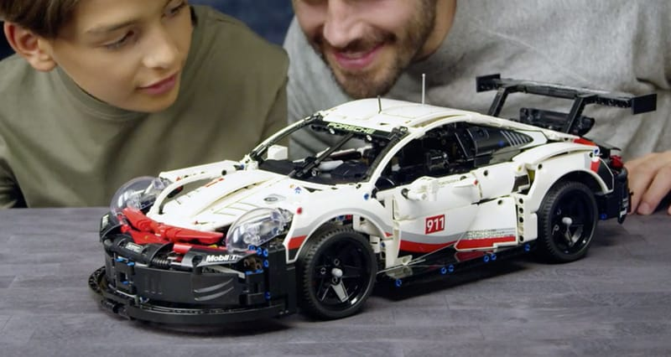

MINECRAFT -> LEGO
resource wall
CSS references
08
CSS
CSS variables: --token and var()
CSS nesting: &:hover, &::after, &[aria-expanded]
Responsive math: calc(), min(), clamp()
REFERENCES
Media fitting: aspect-ratio and object-fit
Effects: backdrop-filter, filter, box-shadow, clip-path
Motion access: prefers-reduced-motion
Reference source: MDN Web Docs

