Slide 1
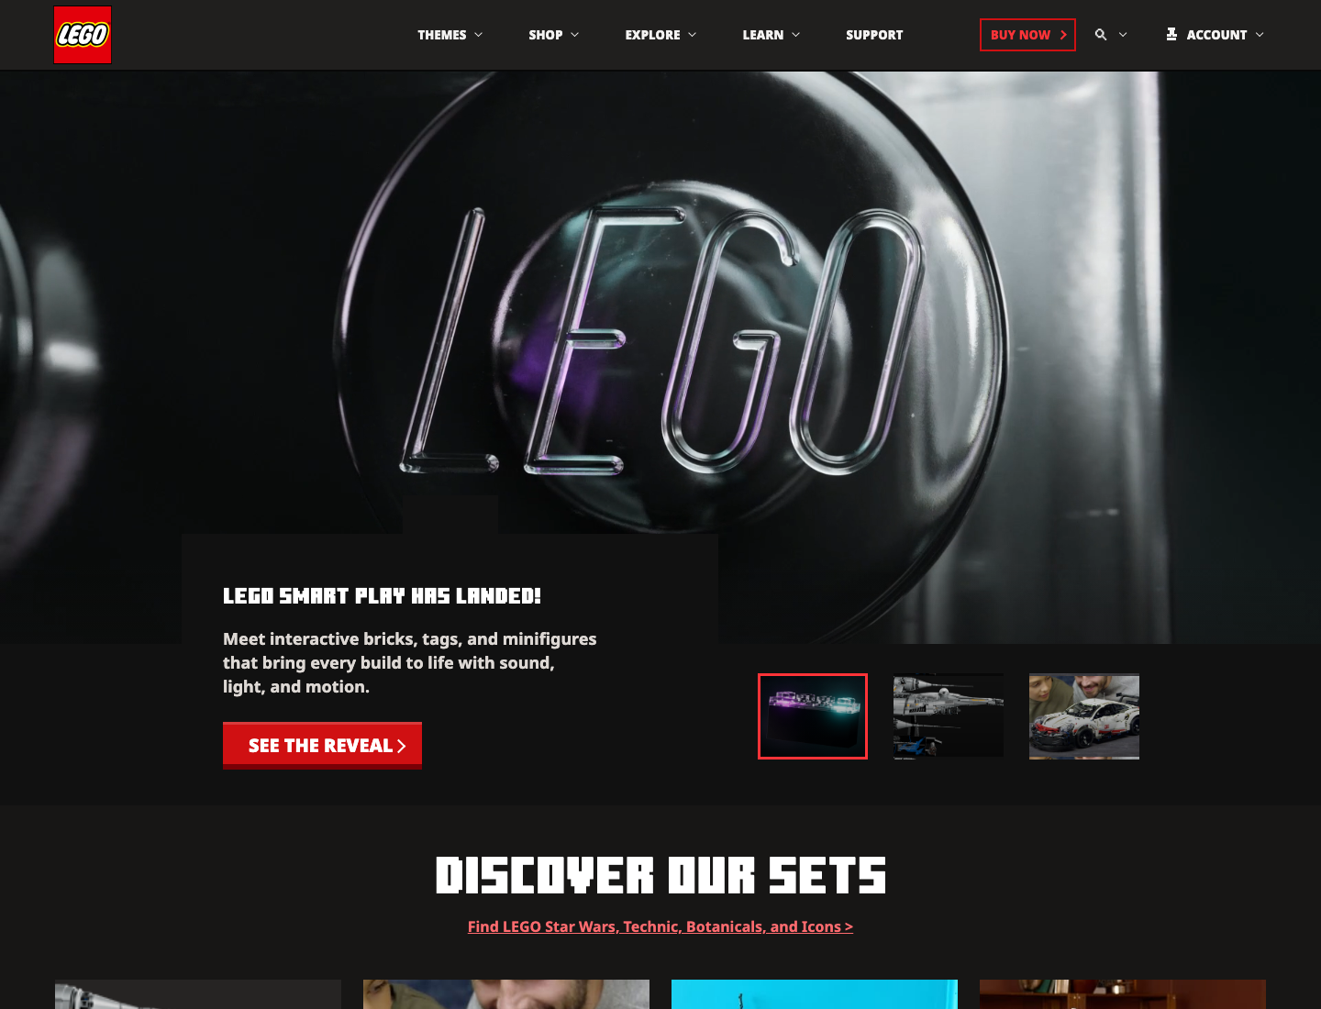
PROJECT OVERVIEW
Minecraft homepage clone with LEGO-themed content
The project keeps the homepage structure, section rhythm, responsive behavior, and interaction model from Minecraft, then replaces the subject matter with a LEGO product/content direction.
ORIGINAL: minecraft.net/en-us
CLONE: local / hosted project
Presentation goal
Prove similarity, file organization, CSS, responsive design, and code quality in 5 minutes.
INT150 Individual Project | Minecraft homepage clone with LEGO content
01

Slide 2
RUBRIC STRATEGY
The deck is organized around the scoring criteria, not only the page tour.
5 pts
Similarity and complexity
5 pts
Document and files
5 pts
CSS
Side-by-side original vs clone, mapped by homepage area.
Separated folders for styles, scripts, assets, fonts, SVG, and videos.
Flex, grid, animation, custom tokens, and class-based section styling.
5 pts
Responsive
5 pts
Presentation
Desktop, tablet, and mobile screenshots plus media-query evidence.
A clear 5-minute story with screenshots, code, and CSS references.
JavaScript
No direct score, but shown as complexity evidence.
Source: INT150 Individual Project 2026 rubric
02

Slide 3
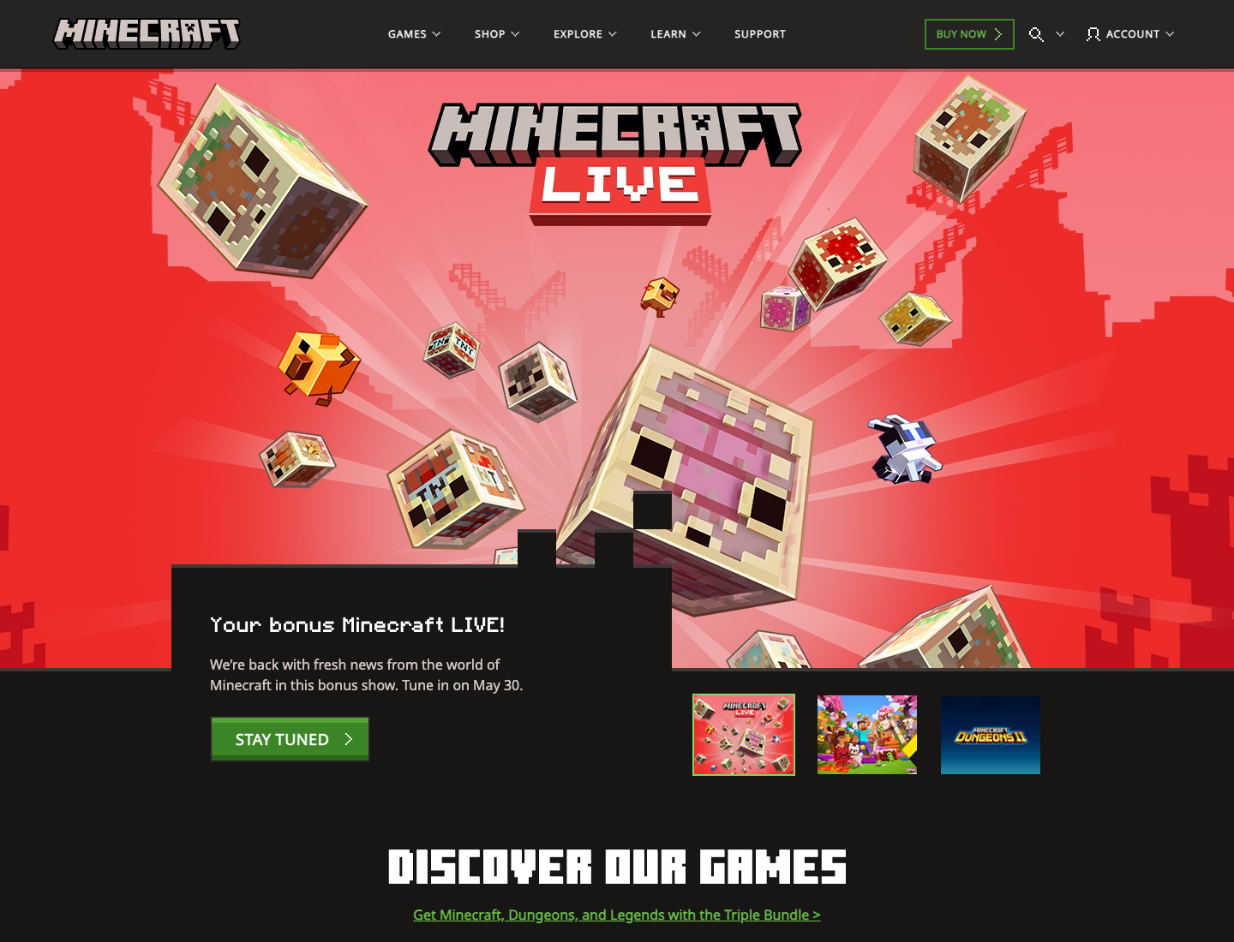
ORIGINAL VS CLONE
The clone follows the same homepage skeleton, while the content system changes to LEGO.
Minecraft original: game homepage with blocky hero, tabs, discovery sections.
LEGO clone: same structure and interaction pattern with new product/story content.
Screenshots captured from minecraft.net/en-us and local clone
03

Slide 4
COMPARISON MAP
Similarity is shown by matching page roles, not copying the exact text.
Area
Minecraft original
LEGO clone
Header
Logo, Games/Shop/Explore/Learn, Buy Now, Search, Account
LEGO logo, Themes/Shop/Explore/Learn, Buy Now, Search, Account
Hero
Large visual hero, text card, CTA, thumbnail tabs
Large LEGO hero video/image, text card, CTA, thumbnail tabs
Discovery
Game cards and category sections
LEGO set cards, marketplace-style product sections
Media
Gameplay trailer tabs and video area
Featured LEGO video tabs and play/pause control
Footer
Social links, columns, legal links
LEGO social links, footer columns, legal strip
INT150 Individual Project | Minecraft homepage clone with LEGO content
04

Slide 5
HTML STRUCTURE
The page is split into semantic regions so the clone is readable and maintainable.
<header class="site-header" data-site-header>
<nav class="navbar" aria-label="Primary navigation">...</nav>
<div class="mega-panel" data-panel="games" hidden>...</div>
<div class="search-overlay" data-search-overlay hidden>...</div>
</header>
<main id="main-content">
<section class="hero-section">...</section>
<section class="discover-section">...</section>
<section class="marketplace-section">...</section>
<section class="trailer-section">...</section>
<section class="news-section">...</section>
</main>
<footer class="mc-footer">...</footer>
Why this matters
Header, main, and footer match the expected homepage anatomy.
Sections are named by purpose, so screenshots and code are easy to explain.
ARIA labels and hidden panels support menu/search interactions.
This supports the rubric’s file/tag organization requirement.
Code source: index.html
05

Slide 6
CSS LAYOUT
Flexbox handles navigation flow; Grid handles multi-column content and mega panels.
.navbar {
position: relative;
min-height: var(--header-height);
display: flex;
align-items: center;
padding: 0 clamp(24px, 4.05vw, 64px);
}
.mega-shell {
display: grid;
grid-template-columns:
254px minmax(620px, 888px) minmax(180px, 255px);
gap: clamp(32px, 3.2vw, 46px);
}
.game-grid,
.news-grid {
display: grid;
grid-template-columns: repeat(4, 1fr);
}
Flexbox
Grid
Navbar, buttons, footer links
Mega menu, cards, forms
Positioning
Tokens
Fixed header, overlays, hero card
Reusable color, size, and duration values
Code source: styles/layout.css
06

Slide 7
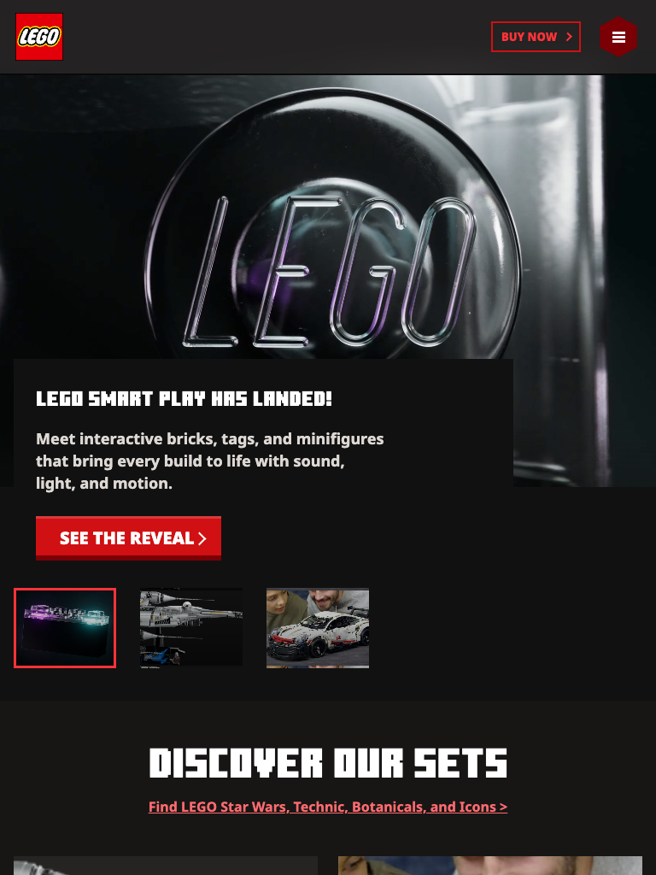
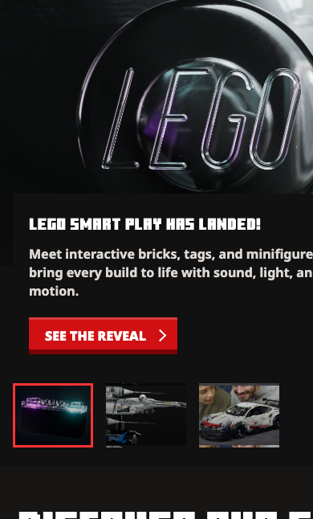
RESPONSIVE PROOF
The clone keeps the same content hierarchy while adapting navigation and grids.
Responsive behavior
Desktop shows full nav and wide hero.
Tablet compresses card grids.
Mobile switches to a menu panel and single-column content.
Desktop
Tablet
Mobile
Screenshots captured from local clone at 1440, 768, and 390px widths
07

Slide 8
JAVASCRIPT INTERACTIONS
JavaScript is not scored directly, but it proves the clone is more than a static layout.
q("[data-menu-toggle]")?.addEventListener("click", (e) => {
const menu = q("[data-nav-menu]");
const on = menu.classList.toggle("is-open");
setOpen(e.currentTarget, on);
document.body.classList.toggle("is-menu-open", on);
if (!on) close();
});
// Same event controller handles:
// mega panels, search overlay, hero tabs,
// trailer tabs, video toggle, carousel scroll,
// and Escape key close behavior.
Interaction list
Mobile menu open and close state
Mega menu tab switching
Search overlay focus behavior
Hero and trailer content switching
Carousel scroll buttons and video pause/play
Code source: scripts/main.js
08

Slide 9
CSS REFERENCES
CSS beyond class is documented with references and explained by use case.
:root {
--lego-red-5: #d01012;
--header-height: 78px;
}
.page-shell {
width: min(calc(100% - 32px), var(--page-max));
margin-inline: auto;
}
.navbar {
backdrop-filter: blur(18px);
padding: 0 clamp(24px, 4.05vw, 64px);
}
@media (prefers-reduced-motion: reduce) {
* { animation-duration: 0.01ms !important; }
}
CSS variables
CSS nesting
Reusable design tokens: colors, fonts, durations
`&:hover`, `&::after`, and state selectors inside components
Responsive math
Media fitting
`calc()`, `min()`, and `clamp()` for fluid sizes
`aspect-ratio` and `object-fit` for stable image cards
Visual effects
Motion access
`backdrop-filter`, `box-shadow`, `filter`, `clip-path`
`prefers-reduced-motion` respects user settings
References: MDN CSS Custom Properties, CSS Nesting, CSS Values, Scroll Snap, prefers-reduced-motion
09

Slide 10
CLOSING
The final story: Minecraft structure, LEGO content, custom code.
This project is a homepage clone focused on structure and behavior: the visual hierarchy, menu system, hero tabs, content rhythm, responsive layout, and footer logic follow the Minecraft original, while the content direction becomes a LEGO showcase.
HTML
CSS
JS
Assets
semantic sections
5 separated stylesheets
menu, tabs, video, scroll
images, SVG, fonts, video
5-minute speaking order
Overview -> Original vs clone -> Layout and files -> CSS and responsive -> JavaScript -> References
Similarity
Organization
CSS
Responsive
Presentation
INT150 Individual Project | Minecraft homepage clone with LEGO content
10

