Slide 1
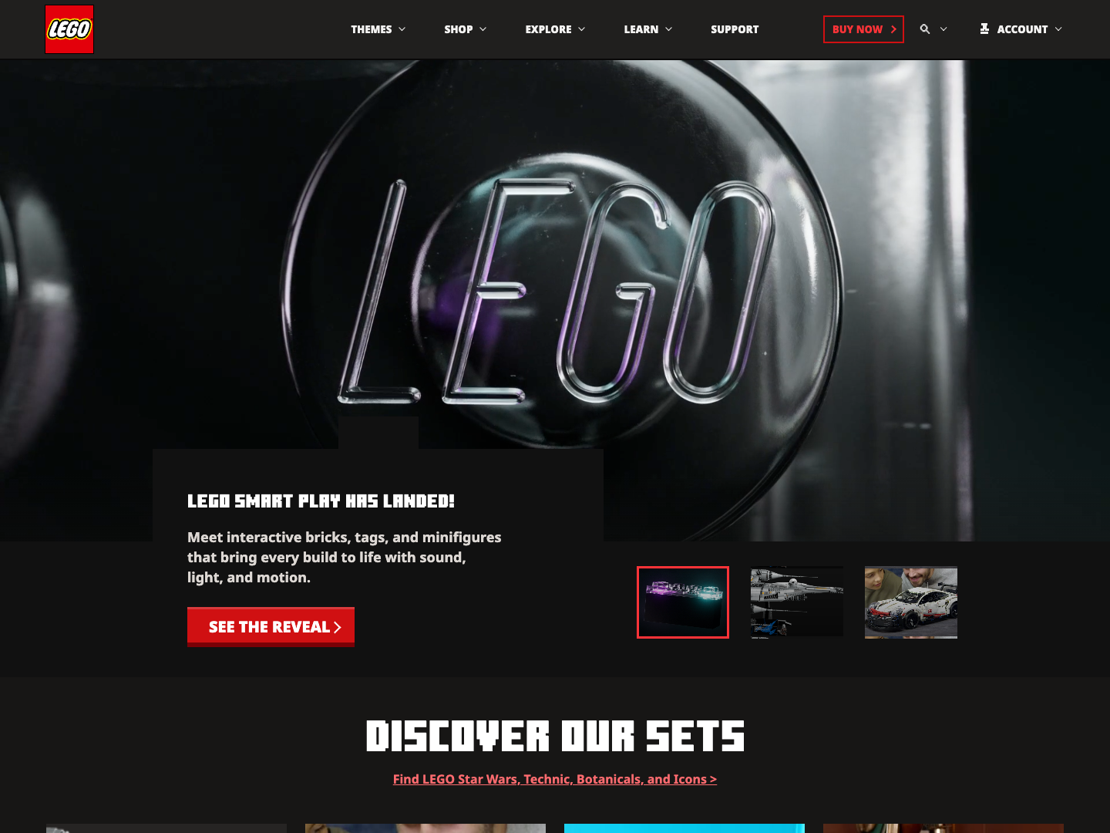
MINECRAFT -> LEGO
Homepage clone
Structure, content, code
01
CLONE
GUIDE
Minecraft homepage structure rebuilt with LEGO-themed content and custom front-end code.
ORIGINAL
minecraft.net/en-us
CLONE
LEGO content direction

Slide 2
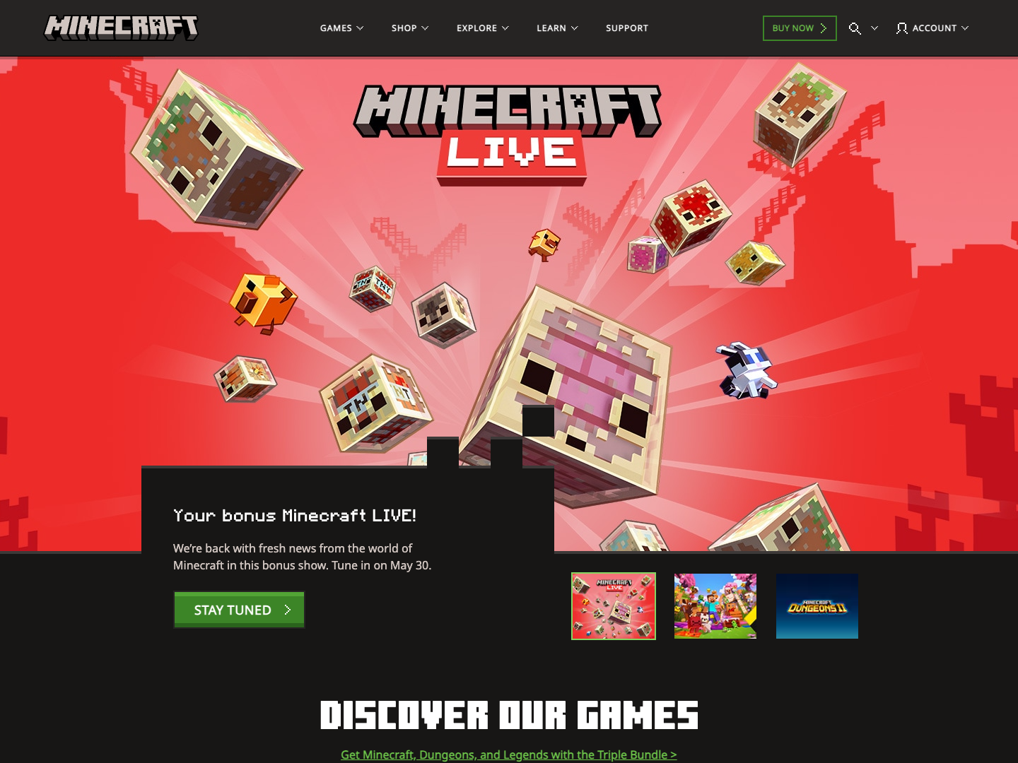
REFERENCE
Original and clone
Visual comparison
02
FROM
MINECRAFT
TO LEGO
The clone preserves the homepage skeleton: fixed navigation, hero card, slide thumbnails, discovery sections, video area, and footer.
Minecraft original
LEGO content clone

Slide 3
CONTENT
Page anatomy
Minecraft roles, LEGO subjects
03
STRUCTURE
Each Minecraft page role is translated into a LEGO content role.
Header
Navigation, search, account, Buy Now
LEGO theme navigation and mega panels
Hero
Campaign visual, card copy, CTA, tabs
SMART Play, Star Wars, Technic, Botanicals
Discovery
Game cards and news rhythm
Sets, stories, marketplace rows
Media
Trailer and video panels
Featured LEGO videos with controls
Footer
Social, links, legal structure
LEGO social and footer columns

Slide 4
COMPARISON
Original vs clone
Screenshots and sections
04
MATCH
->
Original: Minecraft homepage
Clone: LEGO content system
Blocky campaign hero, black card, green CTA, thumbnail tabs.
Same structure and interaction pattern with LEGO imagery, copy, and red CTA.

Slide 5
LAYOUT
HTML and CSS
Structure proof
05
CODE
The layout is organized as reusable page regions and section blocks.
<header class="site-header">
<nav class="navbar">...</nav>
<div class="mega-panel" hidden>...</div>
</header>
<main id="main-content">
<section class="hero-section">...</section>
<section class="discover-section">...</section>
<section class="marketplace-section">...</section>
<section class="trailer-section">...</section>
<section class="news-section">...</section>
</main>
<footer class="mc-footer">...</footer>
.navbar {
display: flex;
align-items: center;
padding: 0 clamp(24px, 4.05vw, 64px);
}
.mega-shell {
display: grid;
grid-template-columns:
254px minmax(620px, 888px)
minmax(180px, 255px);
}
.game-grid,
.news-grid {
display: grid;
}
index.html
styles/layout.css

Slide 6
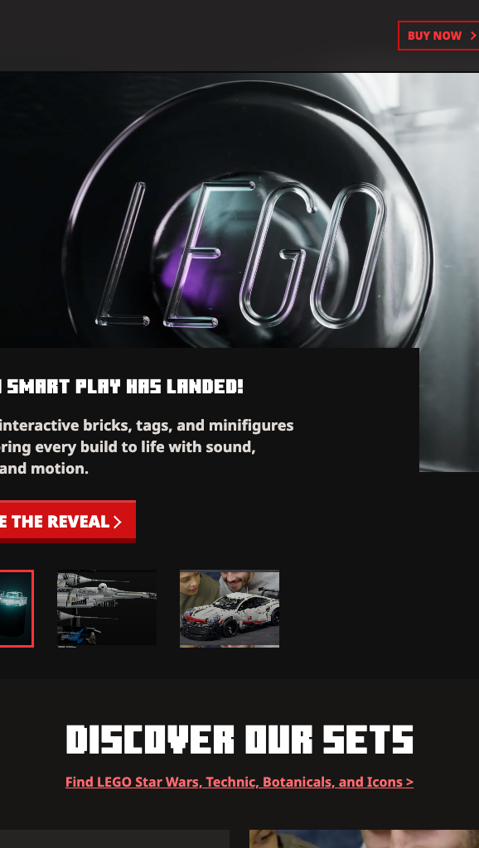
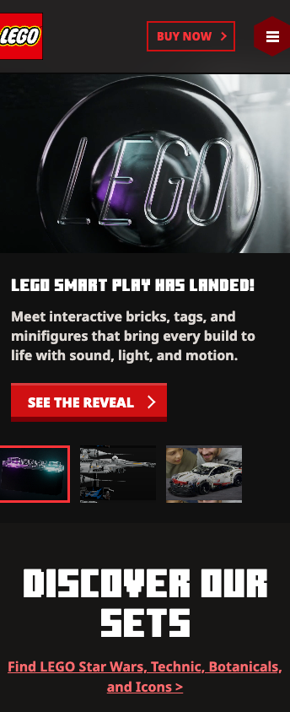
RESPONSIVE
Desktop / tablet / mobile
Same hierarchy, different frame
06
SCREEN
SYSTEM
Desktop
Tablet
Mobile
Full navigation and wide hero composition.
Compressed cards and tighter page rhythm.
Menu panel, stacked content, reduced hero scale.

Slide 7
INTERACTION
JavaScript
Menu, tabs, video
07
STATE
The JavaScript layer changes UI state through data attributes and class names.
q("[data-menu-toggle]")?.addEventListener("click", (e) => {
const menu = q("[data-nav-menu]");
const on = menu.classList.toggle("is-open");
setOpen(e.currentTarget, on);
document.body.classList.toggle("is-menu-open", on);
});
// The same controller also handles:
// mega panels, search overlay, hero tabs,
// trailer tabs, scroll buttons, and Escape close.
data-panel-trigger
opens mega panels
data-search-open
reveals search overlay
hero-tab
switches hero media
data-scroll-track
moves carousels
scripts/main.js

Slide 8
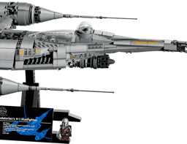
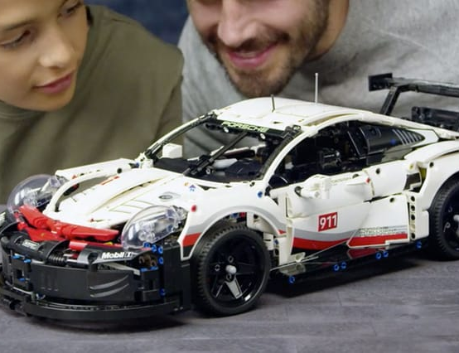

REFERENCES
CSS beyond class
Documented usage
08
CSS
CSS variables: --token and var()
CSS nesting: &:hover, &::after, &[aria-expanded]
REFERENCES
Responsive math: calc(), min(), clamp()
Media fitting: aspect-ratio and object-fit
Effects: backdrop-filter, filter, box-shadow, clip-path
Motion access: prefers-reduced-motion
Reference source: MDN Web Docs

