Slide 1
Intel Galileo (Gen 2) board performance Team: Inside Intel
Presenter: Chinnakkannu Adaikkala Raj
Team Memebers:Aditya Sundararajan, Natarajan Rajkumar, Shehzad Jalaluddin

Slide 2
Objective
Compute Saliency map
Measure performance
Execution time
Power consumption
Optimize the performance

Slide 3
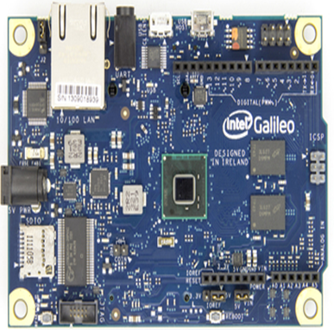
Platform - Intel Galileo
Quark SoCx1000
32 bit processor
Single core, 400Mhz
OS-Linux yockto image
OpenCV v2.8
Connection type
Ethernet Cable
USB cable

Slide 4
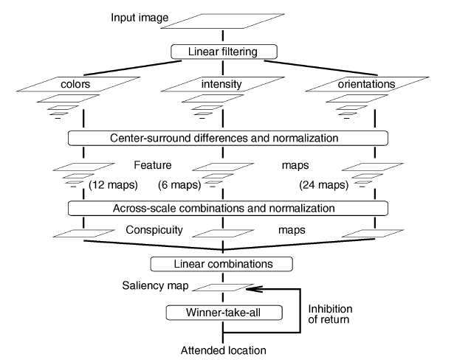
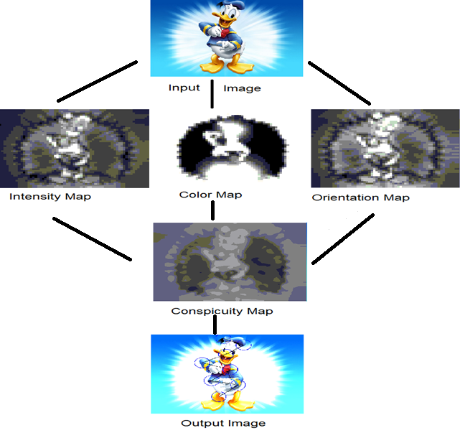
Flow Graph

Slide 5
Test Result On Different Images

Slide 6
Saliency operation

Slide 7
Time Wheel

Slide 8
Saliency result 2

Slide 9
Power Consumption

Slide 10

Source Codes, ppt, pdf of this project can be found in:
www.github.com/1143stuff

Slide 11
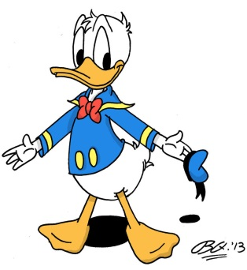
Thank you

