Slide 1
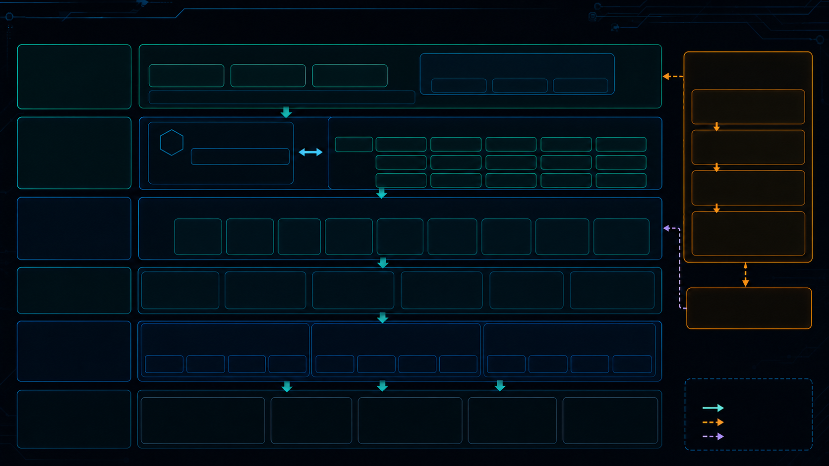
**E
Probe DaemonSet (Rust)
Probe Agent
# Probe Agent
• Probe Agent
HE 6W40E
*#SEA
hostNetwork | hostPID | privileged | iface: ens9f0
mode: af_packet | metrics: 9091
Kafka flE (SASL_SSL)
Ingest Gateway (Go)
32m15
flow.events.v1
session.events.v1
feature.stat.v1
detections.v1
alerts.v1
gRPC 50051
pcap.index.v1
alert.feedback.v1
rule.updates
model-updates
audit.logs
asset.bindings.v1
device.loqs.v1
user.events.v1
dlq.v1
MLOps
Flink 1F ## (Streaming)
:: Session Job
Elf Feature Job
fOr Rule Job
O Behavior Job
CEP Job
Alert Job
Log Job
PCAP Job
23
User Job
rule.updates
THE A TU
PCAP * 5|
model-updates
ClickHouse
PostgreSQL
OpenSearch
NebulaGraph
Redis
MinIO
8#771i65
OLAP SIF
• 17 / 2ia
Flink #E
Web Ul (React / Vite)
MLOps BE S
API 1*5
90549
R*S#
SE BE HE
1190032 BA
Kubernetes v1.29.15
0M52#
8-2tb (10.0.5.8) control-plane
containerd
APISIX NodePort 30180
ConfigMap / Secret
Prometheus / Grafana
zeus-server (10.0.5.9) worker
TLS / Auth / BE E

