Slide 1


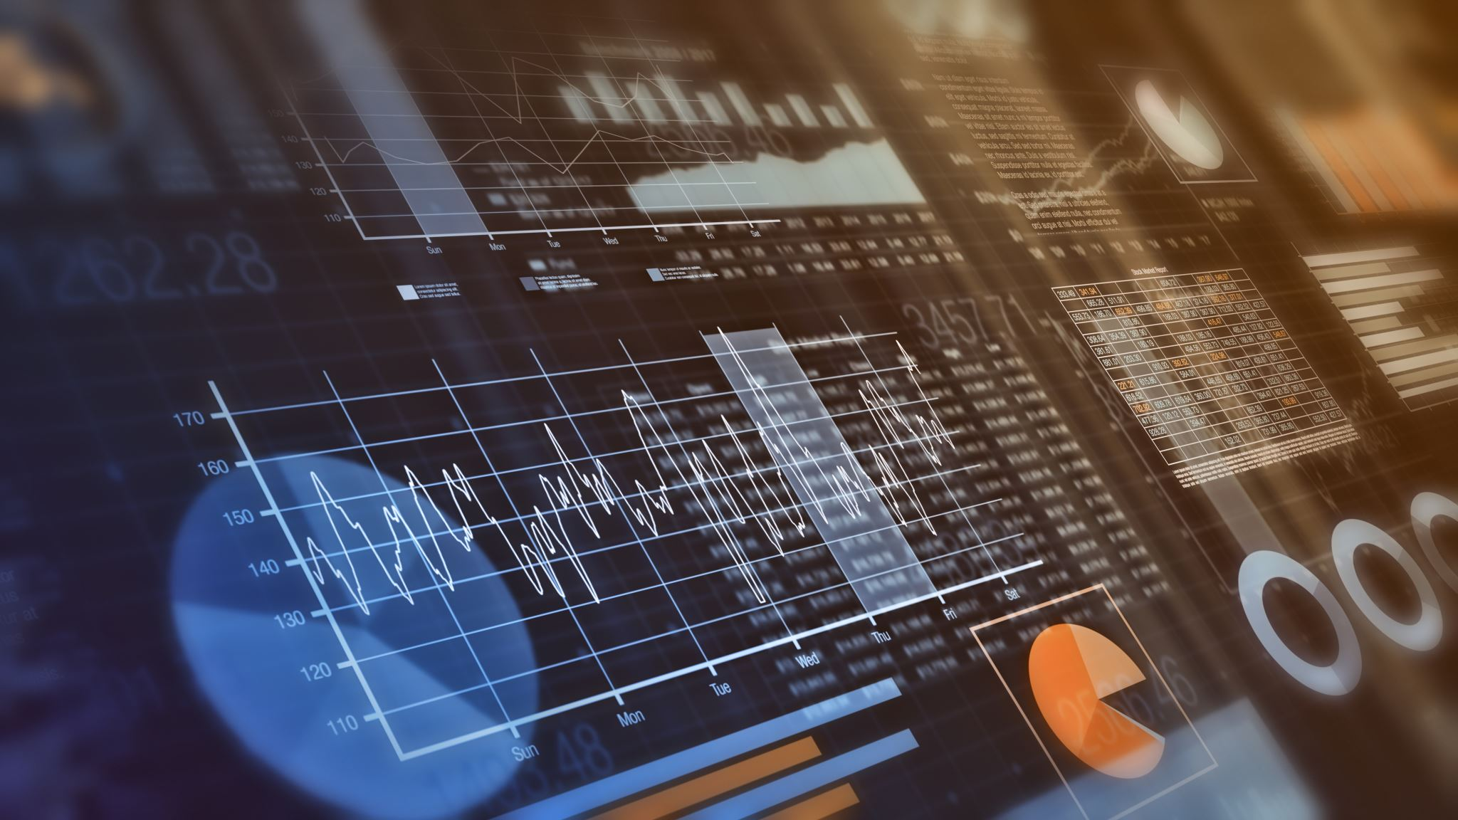
Study On Panel Data Methodologies With Application To Macroeconometrics (Inflation Forecasting)
Submitted By:
Mohamed Abd Al-mgyd
Supervised By:
Dr. Amal Abd Al-Hamid

Slide 3
A Study On Panel Data Methodologies With An Application To Macroeconometrics (Inflation Forecasting)
Submitted By:
Mohamed Abd Al-mgyd
Supervised By:
Dr. Amal Abd Al-Hamid

