Slide 1
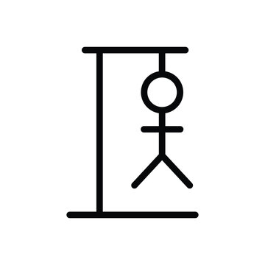
Hangman Game
Designed and Developed by Group-3

Slide 2
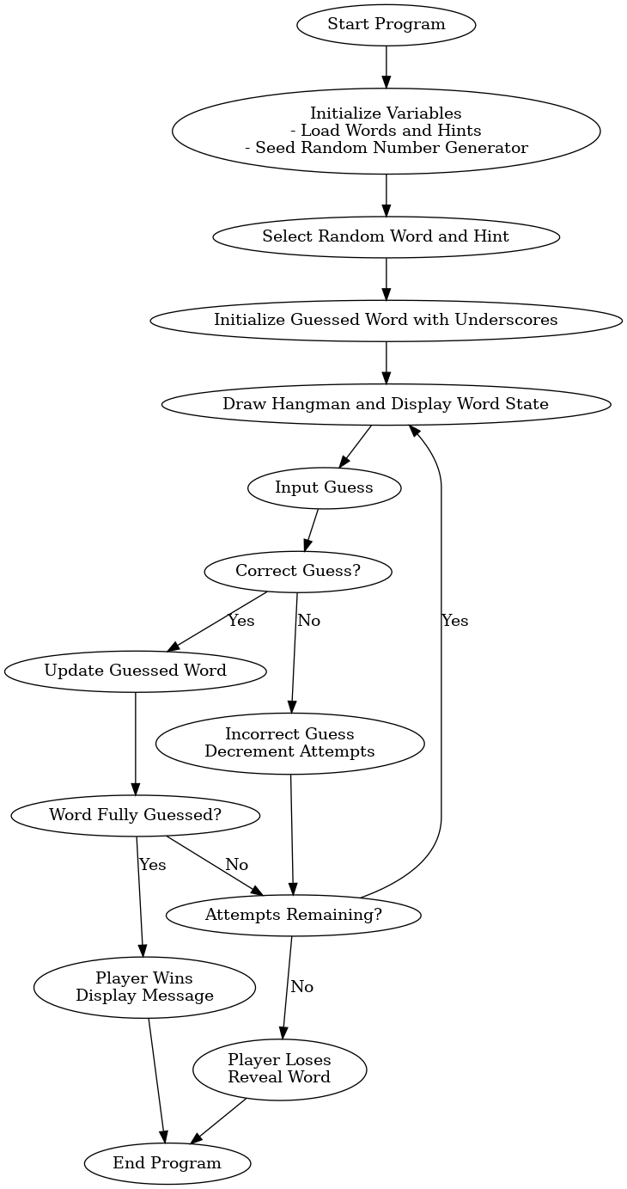
What is the Hangman Game?
Hangman is a classic word guessing game. The player tries to uncover a hidden word by guessing individual letters. There are limited attempts to guess the correct word and a hint is generally provided.

Slide 3
Key Features
Randomized word selection for replayability.
Contextual hints for each word to assist players.
Dynamic visuals to represent the hangman stages.
Input validation and progress tracking.
Clear win/loss states with feedback to players.

Slide 4
Code Highlights
Written in C.
Utilizes:
- rand() for random word selection.
- Arrays for word and hint storage.
- String functions for manipulation.
Libraries and Headers used:
- <stdio.h> for I/O operations.
- <stdlib.h> for memory management and random numbers.
- <string.h> for string manipulation.
- <time.h> for seeding random number generator.
Key Functions:
- drawHangman(attemptsleft): Draws hangman figure based on remaining attempts
- main(): Game loop, user input handling, win/lose logic

Slide 5
Development Challenges
Challenge: Ensuring random word selection.
Solution: Used srand(time(NULL)) to seed randomness.
Challenge: Preventing invalid inputs.
Solution: Implemented input validation and feedback.
Challenge: Enhancing user engagement.
Solution: Added hints and dynamic visuals for progress tracking.

Slide 6
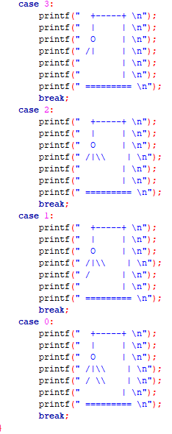
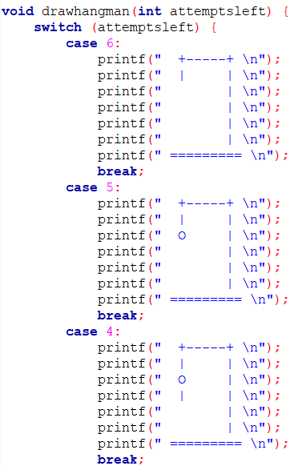
Function to draw the hangman

Slide 7
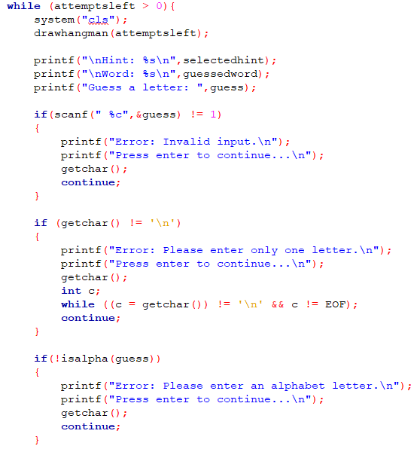
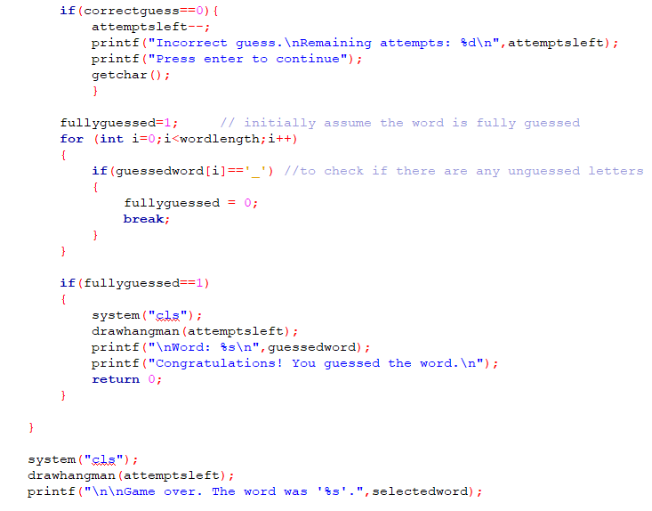
The main game loop
Error handling

Slide 8
User Interface
Game Screen Layout:
- Hangman figure
- Current state of guessed word
- Hints
User Input Handling:
- Players input guesses using scanf
- Feedback after each guess indicating correct/incorrect guesses
Feedback Mechanisms:
- Correct guesses fill in blanks in real-time
- Incorrect guesses update hangman figure and display remaining attempts

Slide 9
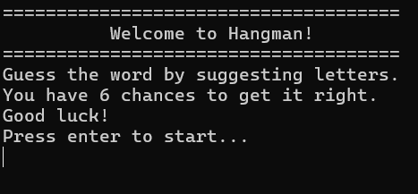
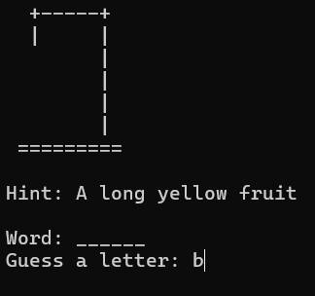
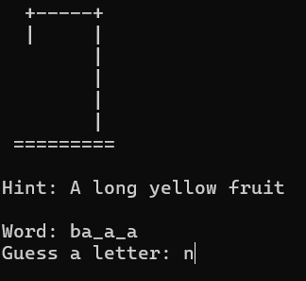
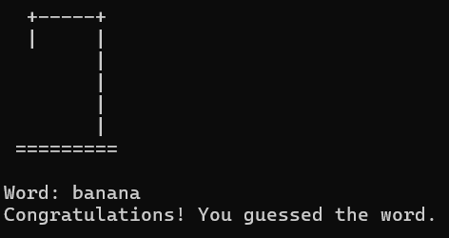
Demonstration
Welcome screen
A successful attempt

Slide 10
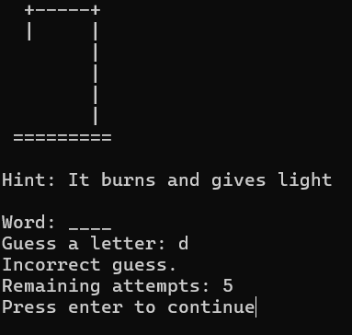
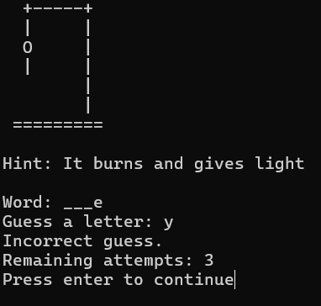
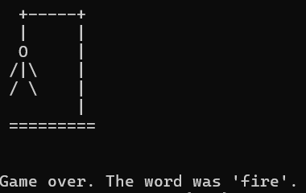
A game over

Slide 11
Conclusion:
Summary:
Random word selection.
Guessing mechanism.
Win/lose conditions.
Possible Future Enhancements:
Add more words.
Improve user interface.
Difficulty settings.

Slide 12
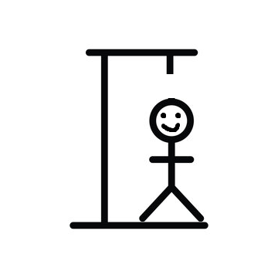
Thank You

