Slide 1
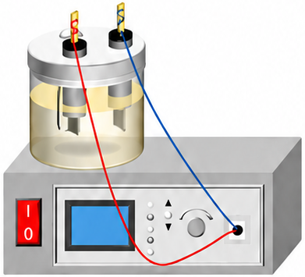
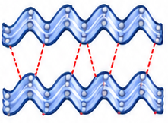
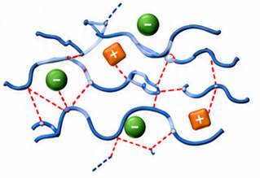
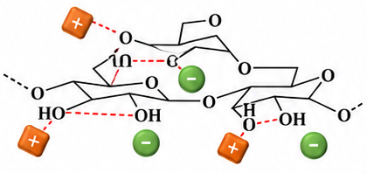
A
Electric current
(Thermal effect)
[Amim]⁺
350
Water bath heating
a
[Oac]⁻
300
MEF
[Bmim]⁺
250
b
200
Cl⁻
[Emim]⁺
Electrical conductivity (mS/cm)
c
150
e
f
d
100
h
g
Q=E²×σ
50
4.8V
50Hz
0
[Bmim]Cl
[Bmim]OAc
[Amim]Cl
[Emim]Cl
Length of line represents velocity
Length of line represents velocity
Electrical conductivity
B
Starch structure disruption
Native starch structure
(ordered)
Disrupted starch structure
(disordered)
−
+
+
+
−
Electric field
+
IL interactions
+
−
−
+
+
−
+
−
+
−
•
Intact granule
•
Granule fragmentation
•
Ordered double helices
•
Weakened hydrogen bonding
•
Strong hydrogen bonding
•
Chain disorder and loosened packing
B
Electric field mass transfer
Different anions polar:
Cl⁻
>
[Oac]⁻
−
+
Cl
O
+
−
C
−
+
CH₃
O⁻
+
−
−
Different alkyl chain lengths:
+
+
−
[Bmim]⁺>[Amim]⁺>[Emim]⁺
+
−
+
−
N
N⁺
N
N⁺
N
N⁺
Anion migration (to − electrode)
Weaker disruption
Moderate disruption
Stronger disruption
Cation migration (to + electrode)
Starch disruption
Starch granule
+
Cation (IL⁺)
−
Anion (IL⁻)
Notes:
按用户给出的新版竖版示意图重建。标题、说明、离子/化学标签、公式、箭头、柱形/误差线/字母、淀粉颗粒及下方Lewis/阳离子骨架示意均为原生可编辑对象。MEF装置、左侧氢键化学放大图、有序双螺旋及无序链示意由AI按参考图复刻，为四张可替换图片，并非原图像素。柱形高度和误差线按截图外观位置描摹，未恢复或编造原始数值数据集。化学结构为参考图外观重绘，不是可解析化学结构文件。第三面板仍标B，Different anions polar、上下图例的用词及离子顺序均按原图保留，未做科学或语法修订。

