Slide 1
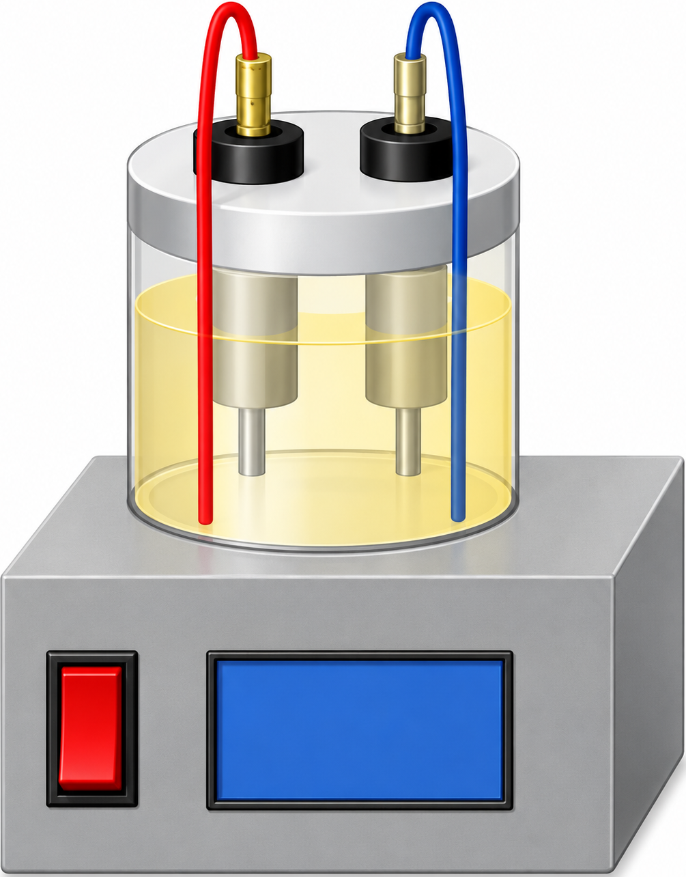
A
Electric current (Thermal effect)
350
a
[Bmim]⁺
300
Water bath heating
[OAc]⁻
MEF
[Amim]⁺
250
b
200
Cl⁻
[Emim]⁺
Electrical conductivity (mS/cm)
c
150
e
f
d
100
h
g
I
MEF
Q = E² × σ
50
0
4.8 V
50 Hz
0
Cation migration (to − electrode)
[Bmim]Cl
[Bmim]OAc
[Amim]Cl
[Emim]Cl
Anion migration (to + electrode)
Electrical conductivity
B
Starch structure disruption
+
−
+
−
+
Electric field
→
+
−
−
+
+
−
Disrupt starch
structure
+
−
+
−
Ordered structure
Disordered structure
(intact starch)
(disrupted starch)
C
Electric field-assisted mass transfer
Anion effect
Cl⁻
>
[OAc]⁻
+
−
+
−
Cation structure
+
[Bmim]⁺, [Amim]⁺, [Emim]⁺
+
−
−
[Bmim]⁺
[Amim]⁺
[Emim]⁺
+
−
+
−
+
−
Weaker
disruption
Moderate
disruption
Stronger
disruption
Starch disruption
Starch granule
+
Cation (IL⁺)
−
Anion (IL⁻)
Notes:
按用户给出的竖版示意图重建。A/B/C标题、公式、图表坐标及图例、柱形/误差线/显著性字母、离子、迁移箭头、电极、淀粉颗粒、分子链及说明均为原生可编辑PowerPoint对象。MEF装置由图像工具按参考图复刻，为唯一的可替换图片，并非原图像素。淀粉裂纹及分子链为参考外观的原生矢量示意。柱形高度和误差线按截图视觉位置描摹；参考图没有精确柱值标签，因此未创建或声称恢复原始数值数据集。4.8 V、50 Hz及图中各物种/公式按参考图录入，未做外部科学核验。

