Slide 1
Mathematical Analysis and Numerical Simulation for Bose-Einstein Condensates
Weizhu Bao
Department of Mathematics
& Center of Computational Science and Engineering
National University of Singapore
Email: bao@math.nus.edu.sg
URL: http://www.math.nus.edu.sg/~bao

Slide 2
Outline
Motivation & theoretical predication
Gross-Pitaevskii equation (GPE)
Stationary, ground & central vortex states
Methods & results for ground states
Methods & results for dynamics
Extension to rotation frame & multi-component
Conclusions & Future challenges

Slide 3
Motivation
Bose-Einstein condensation:
  Bosons at nano-Kevin temperature
  many atoms occupy in one obit (at quantum mechanical ground state)
  `super-atom’
  new matter of wave. i.e., the fifth matter of state
Theoretical predication: Bose & Einstein
  Bose, Z. Phys., 26 (1924) 82
  Einstein, Sitz. Ber. Kgl. Preuss. Adad., Wiss. 22 (1924) 261
Experimental realization: JILA 1995
  Anderson et al., Science, 269 (1995), 198: JILA Group; Rb
  Davis et al., Phys. Rev. Lett., 75 (1995), 3969: MIT Group; Rb
  Bradly et al., Phys. Rev. Lett., 75 (1995), 1687, Rice Group; Li

Slide 4
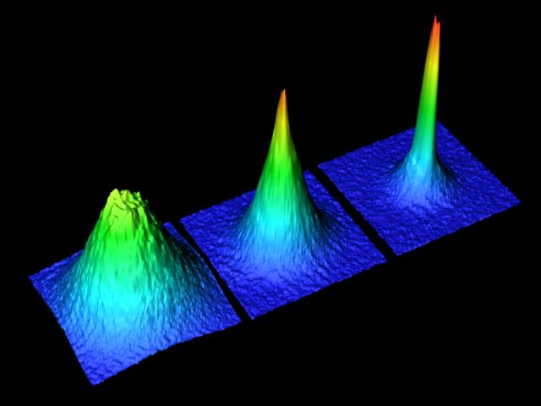
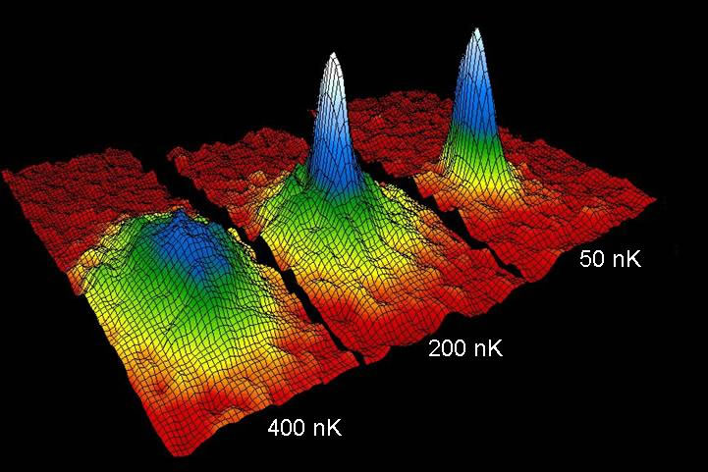
Experimental Results
JILA (95’,Rb,5,000)
ETH (02’,Rb, 300,000)

Slide 5
Motivation
2001 Nobel prize in physics:
  C. Wiemann: U. Colorado; E. Cornell: NIST & W. Ketterle: MIT
Mathematical models:
  Gross-Pitaevskii equation (mean field theory)
  Quantum Boltzmann master equation (kinetic)
Mathematical analysis
  Existence, dynamical laws, soliton-like solution, damping effect, etc.
Numerical Simulations
  Numerical methods
  Guiding and predicting outcome of new experiments

Slide 6




Possible applications
Quantized vortex for studying superfluidity
Test quantum mechanics theory
Bright atom laser: multi-component
Quantum computing
Atom tunneling in optical lattice trapping, …..
Square Vortex lattices in spinor BECs
Vortex lattice
dynamics
Giant vortices

Slide 7
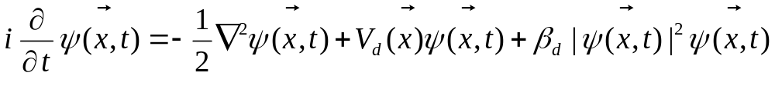
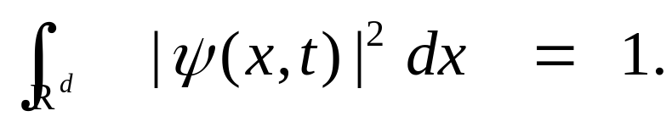

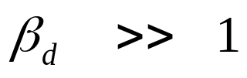
Gross-Pitaevskii equation
Gross-Pitaevskii Equation (GPE)
Normalization condition
Two extreme regimes:
  Weakly interacting condensation
  Strongly repulsive interacting condensation

Slide 8
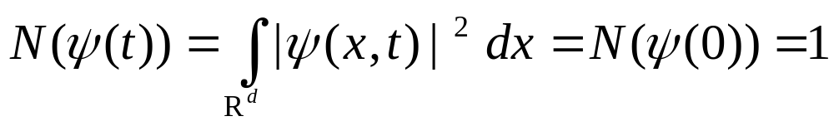
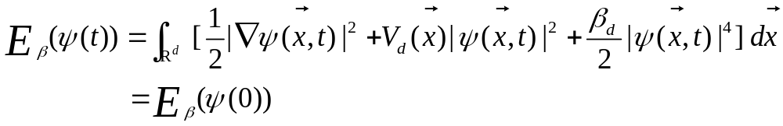
Gross-Pitaevskii equation
Conserved quantities
  Normalization of the wave function
  Energy
Chemical potential

Slide 9

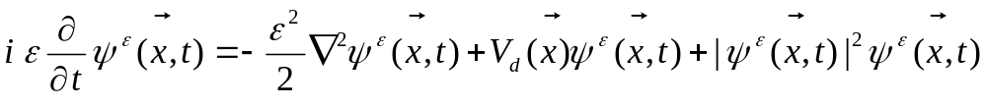
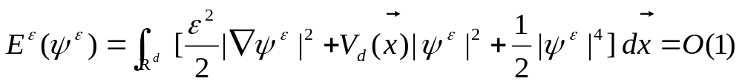
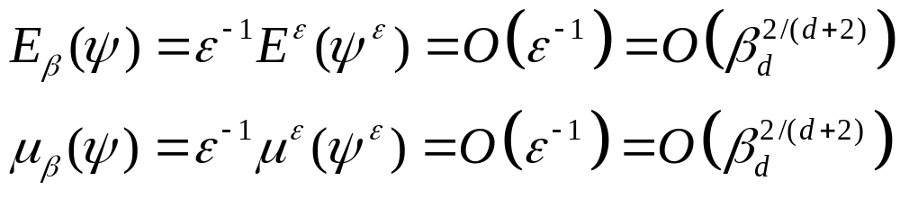
Semiclassical scaling
When , re-scaling
With
Leading asymptotics (Bao & Y. Zhang, Math. Mod. Meth. Appl. Sci., 05’)

Slide 10
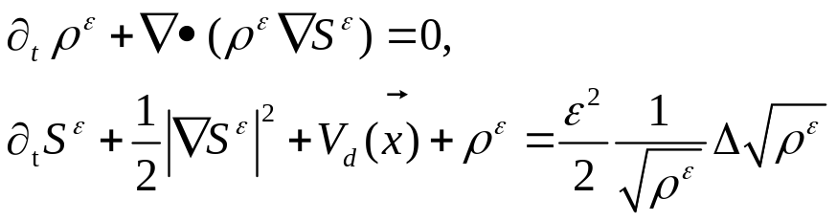
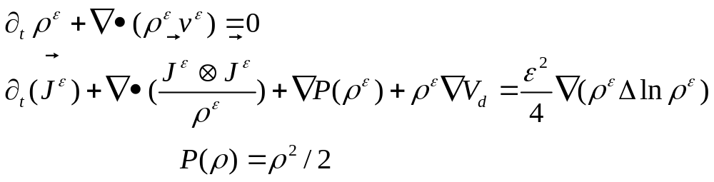
Quantum Hydrodynamics
Set
Geometrical Optics: (Transport + Hamilton-Jacobi)
Quantum Hydrodynamics (QHD): (Euler +3rd dispersion)

Slide 11
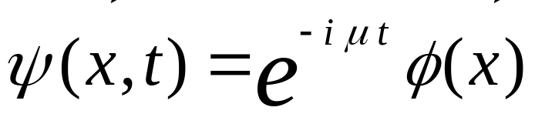
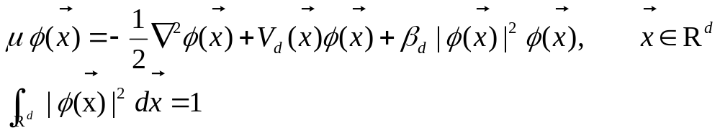
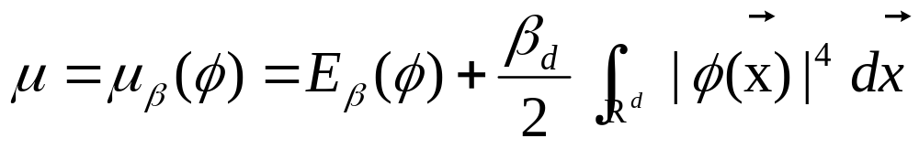
Stationary states
Stationary solutions of GPE
Nonlinear eigenvalue problem with a constraint
Relation between eigenvalue and eigenfunction

Slide 12

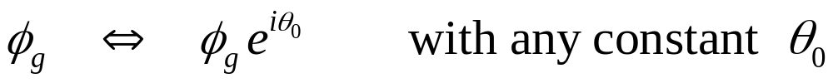
Ground state
Ground state:
Existence and uniqueness of positive solution :
  Lieb et. al., Phys. Rev. A, 00’
Uniqueness up to a unit factor
Boundary layer width & matched asymptotic expansion
  Bao, F. Lim & Y. Zhang, Trans. Theory Stat. Phys., 06’

Slide 13

Numerical methods for ground states
Runge-Kutta method: (M. Edwards and K. Burnett, Phys. Rev. A, 95’)
Analytical expansion: (R. Dodd, J. Res. Natl. Inst. Stan., 96’)
Explicit imaginary time method: (S. Succi, M.P. Tosi et. al., PRE, 00’)
Minimizing by FEM: (Bao & W. Tang, JCP, 02’)
Normalized gradient flow: (Bao & Q. Du, SIAM Sci. Comput., 03’)
  Backward-Euler + finite difference (BEFD)
  Time-splitting spectral method (TSSP)
Gauss-Seidel iteration method: (W.W. Lin et al., JCP, 05’)
Spectral method + stabilization: (Bao, I. Chern & F. Lim, JCP, 06’)

Slide 14
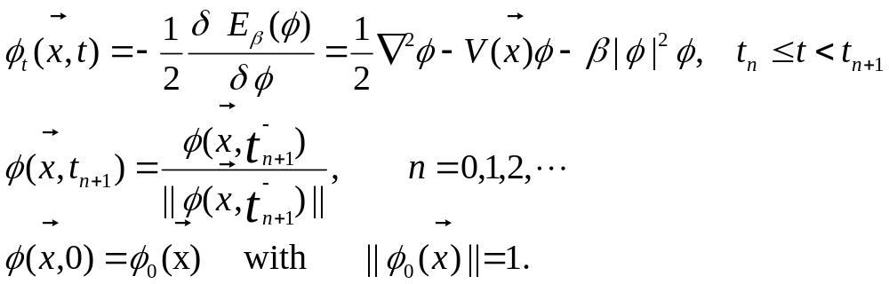

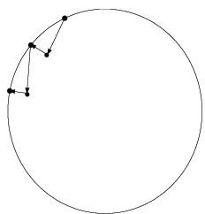


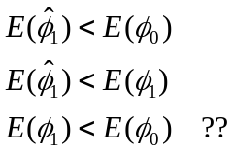

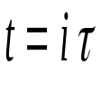
Imaginary time method
Idea: Steepest decent method + Projection
  The first equation can be viewed as choosing in GPE
  For linear case: (Bao & Q. Du, SIAM Sci. Comput., 03’)
  For nonlinear case with small time step, CNGF

Slide 15
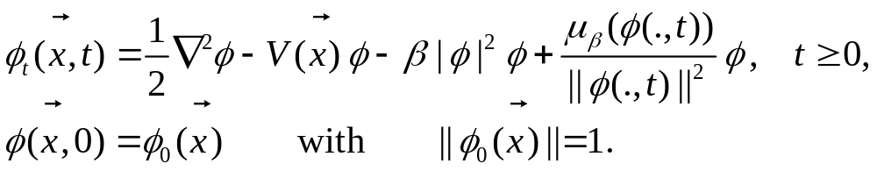
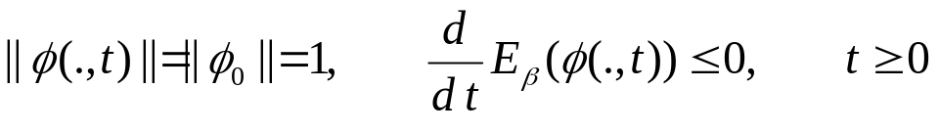
Normalized gradient glow
Idea: letting time step go to 0 (Bao & Q. Du, SIAM Sci. Comput., 03’)
  Energy diminishing
  Numerical Discretizations
    BEFD: Energy diminishing & monotone (Bao & Q. Du, SIAM Sci. Comput., 03’)
    TSSP: Spectral accurate with splitting error (Bao & Q. Du, SIAM Sci. Comput., 03’)
    BESP: Spectral accuracy in space & stable (Bao, I. Chern & F. Lim, JCP, 06’)

Slide 16

Ground states
Numerical results (Bao&W. Tang, JCP, 03’; Bao, F. Lim & Y. Zhang, TTSP, 06’)
  In 1d
    Box potential:
    Harmonic oscillator potential:
  In 2d
    In a rotational frame
    With a fast rotation
  In 3d
    With a fast rotation
next

Slide 17
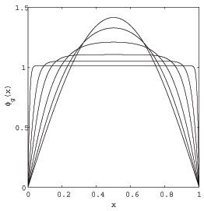
back

Slide 18
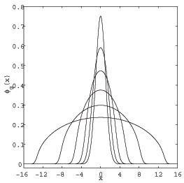
back

Slide 19
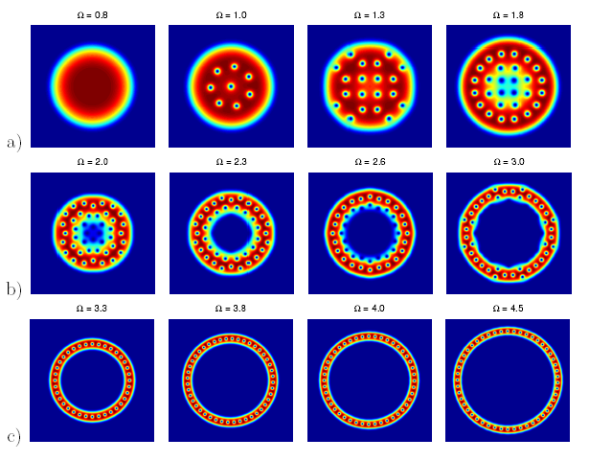
back

Slide 20
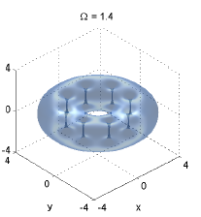
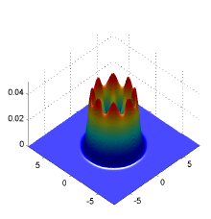
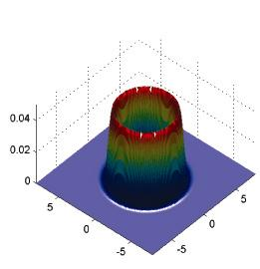
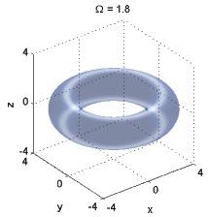
back

Slide 21
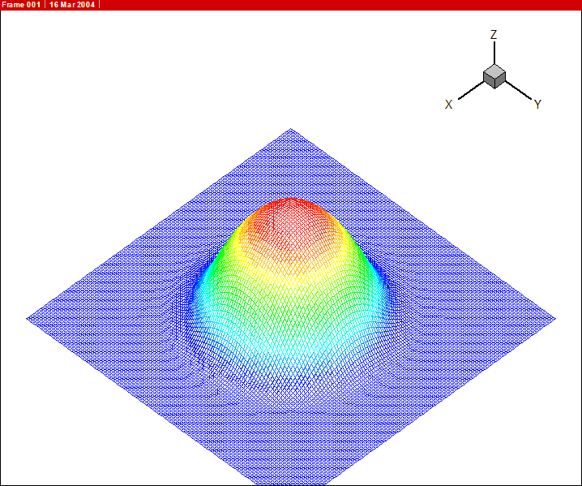
back

Slide 22
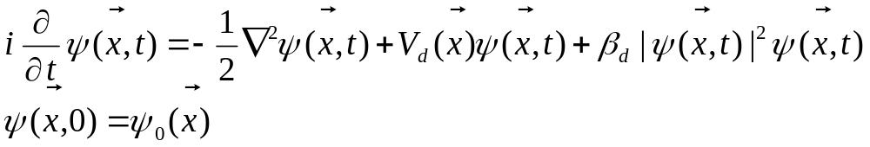
Dynamics of BEC
Time-dependent Gross-Pitaevskii equation
Dynamical laws
  Time reversible & time transverse invariant
  Mass & energy conservation
  Angular momentum expectation
  Condensate width
  Dynamics of a stationary state with its center shifted

Slide 23
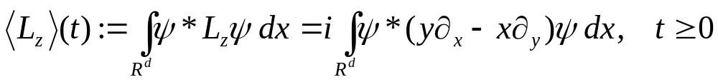
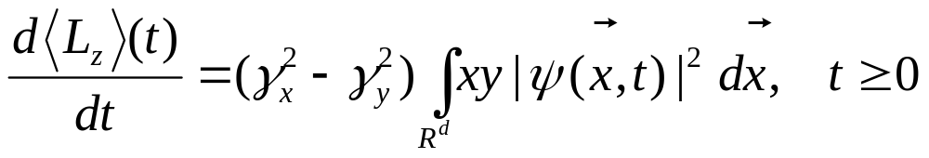

Angular momentum expectation
Definition:
Lemma Dynamical laws (Bao & Y. Zhang, Math. Mod. Meth. Appl. Sci, 05’)
For any initial data, with symmetric trap, i.e. , we have
Numerical test next

Slide 24
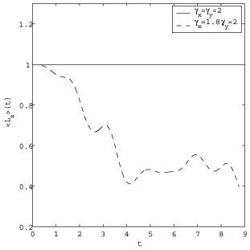
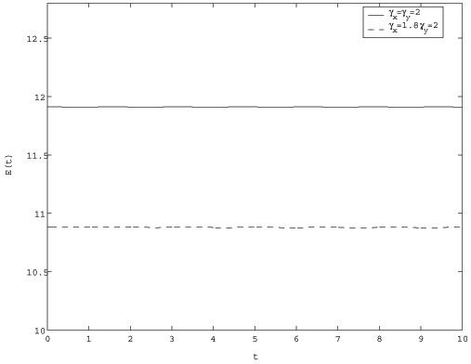
Angular momentum expectation
Energy
back

Slide 25
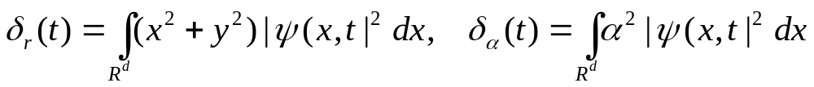

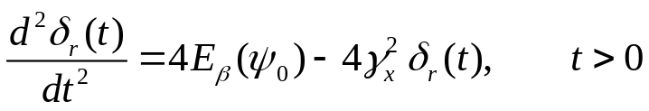

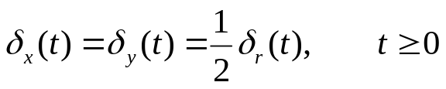
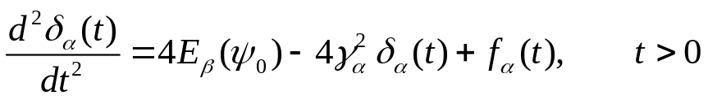
Dynamics of condensate width
Definition:
Dynamic laws (Bao & Y. Zhang, Math. Mod. Meth. Appl. Sci, 05’)
  When for any initial data:
  When with initial data
  Numerical Test
  For any other cases:
next

Slide 26
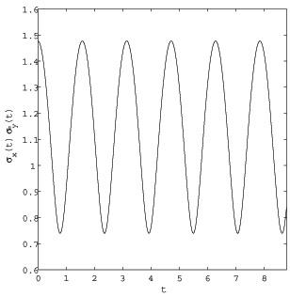
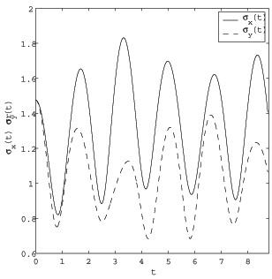
Symmetric trap
Anisotropic trap
back

Slide 27

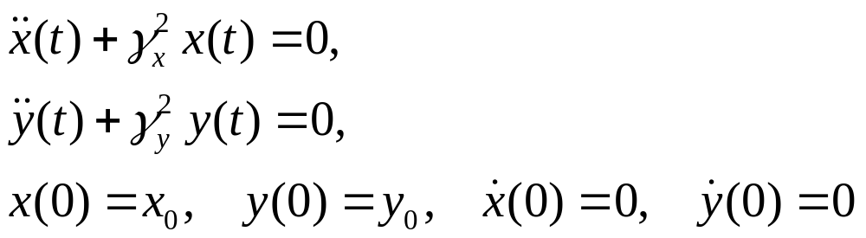
Dynamics of Stationary state with a shift
Choose initial data as:
The analytical solutions is: (Garcia-Ripoll el al., Phys. Rev. E, 01’)
  In 2D:
  In 3D, another ODE is added
example
next

Slide 28
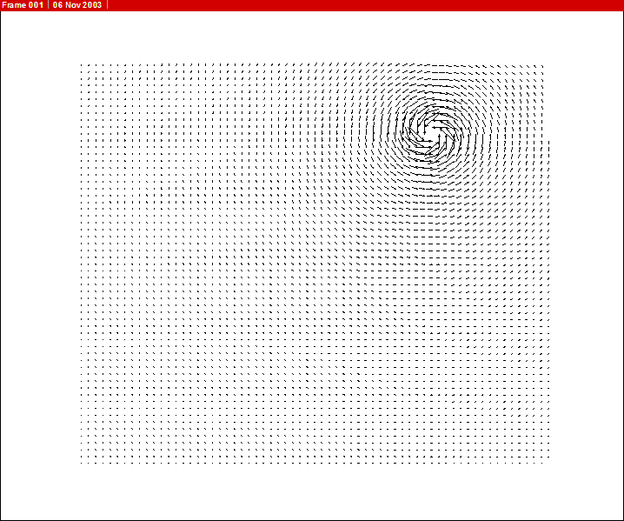
back

Slide 29
Numerical methods for dynamics
Lattice Boltzmann Method (Succi, Phys. Rev. E, 96’; Int. J. Mod. Phys., 98’)
Explicit FDM (Edwards & Burnett et al., Phys. Rev. Lett., 96’)
Particle-inspired scheme (Succi et al., Comput. Phys. Comm., 00’)
Leap-frog FDM (Succi & Tosi et al., Phys. Rev. E, 00’)
Crank-Nicolson FDM (Adhikari, Phys. Rev. E 00’)
Time-splitting spectral method (Bao, Jaksch&Markowich, JCP, 03’)
Runge-Kutta spectral method (Adhikari et al., J. Phys. B, 03’)
Symplectic FDM (M. Qin et al., Comput. Phys. Comm., 04’)

Slide 30
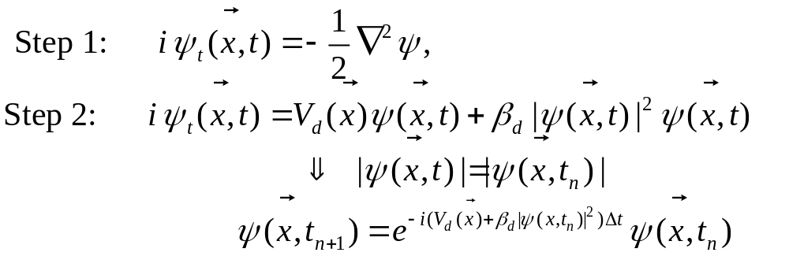
Time-splitting spectral method (TSSP)
Time-splitting:
For non-rotating BEC
  Trigonometric functions (Bao, D. Jaksck & P. Markowich, J. Comput. Phys., 03’)
  Laguerre-Hermite functions (Bao & J. Shen, SIAM Sci. Comp., 05’)

Slide 31
Properties of TSSP
  Explicit, time reversible & unconditionally stable
  Easy to extend to 2d & 3d from 1d; efficient due to FFT
  Conserves the normalization
  Spectral order of accuracy in space
  2nd, 4th or higher order accuracy in time
  Time transverse invariant
  ‘Optimal’ resolution in semicalssical regime

Slide 32



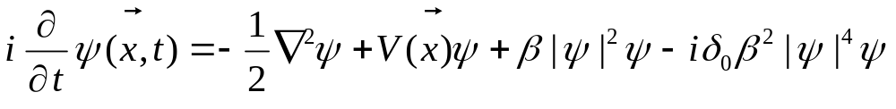
Dynamics of Ground states
1d dynamics:
2d dynamics of BEC (Bao, D. Jaksch & P. Markowich, J. Comput. Phys., 03’)
  Defocusing:
  Focusing (blowup):
3d collapse and explosion of BEC (Bao, Jaksch & Markowich,J. Phys B, 04’)
  Experiment setup leads to three body recombination loss
  Numerical results:
    Number of atoms , central density & Movie
next

Slide 33

back

Slide 34
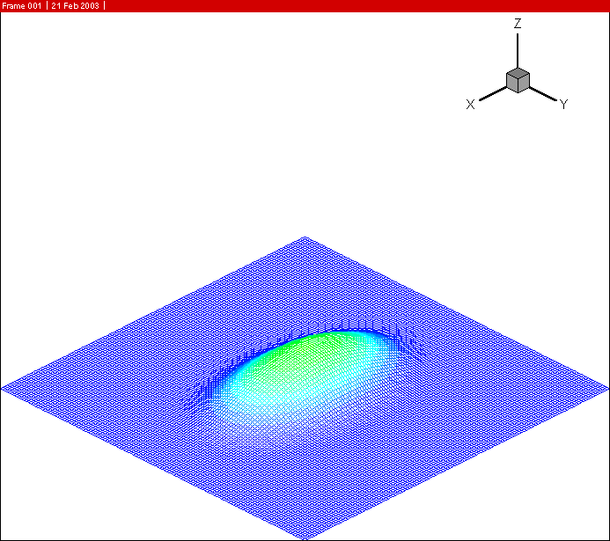
back

Slide 35
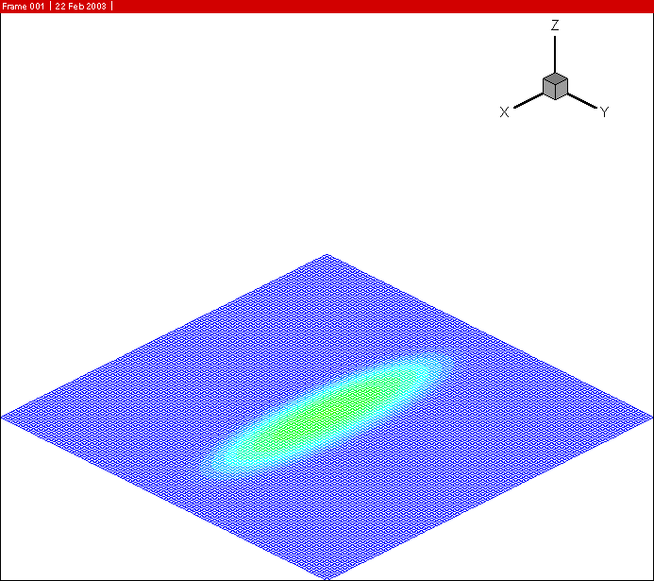
back

Slide 36
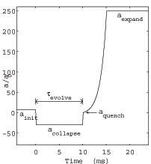
Collapse and Explosion of BEC
back

Slide 37
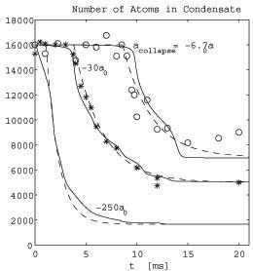
Number of atoms in condensate
back

Slide 38
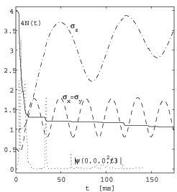
Central density
back

Slide 39

back

Slide 40


Extension
GPE with damping term (Bao & D. Jaksch, SIAM J. Numer. Anal., 04’)
Two-component BEC
  Methods for ground state & dynamics (Bao, Multiscale Mod. Sim., 04’)
  Dynamics laws (Bao & Y. Zhang, 06’)

Slide 41

Extension
GPE in a rotational frame
  For ground state (Bao, H. Wang & P. Markowich, Commun. Math. Sci., 04’)
  Dynamical laws (Bao,Du&Zhang, SIAM Appl. Math., 06’;Appl. Numer. Math. 06’)
  Numerical methods
    Time-splitting +polar coordinate (Bao,Du&Zhang, SIAM Appl. Math., 06’)
    Time-splitting + ADI in space (Bao & H. Wang, J. Comput. Phys., 06’)

Slide 42
Conclusions & Future Challenges
Conclusions:
  Mathematical results for ground & excited states
  Dynamical laws in BEC
  Efficient methods for ground state & dynamics
  Comparison with experimental resutls
  Vortex stability & interaction in 2D
Future Challenges
  Multi-component BEC
  Quantized vortex states & dynamics in 3D
  Coupling GPE & QBE

Slide 43
Collaborators
External
  P.A. Markowich, Institute of Mathematics, University of Vienna, Austria
  D. Jaksch, Department of Physics, Oxford University, UK
  Q. Du, Department of Mathematics, Penn State University, USA
  J. Shen, Department of Mathematics, Purdue University, USA
  L. Pareschi, Department of Mathematics, University of Ferarra, Italy
  W. Tang & L. Fu, IAPCM, Beijing, China
  I-Liang Chern, Department of Mathematics, National Taiwan University, Taiwan
External
  Yanzhi Zhang, Hanquan Wang, Fong Ying Lim, Ming Huang Chai
  Yunyi Ge, Fangfang Sun, etc.

