Slide 1
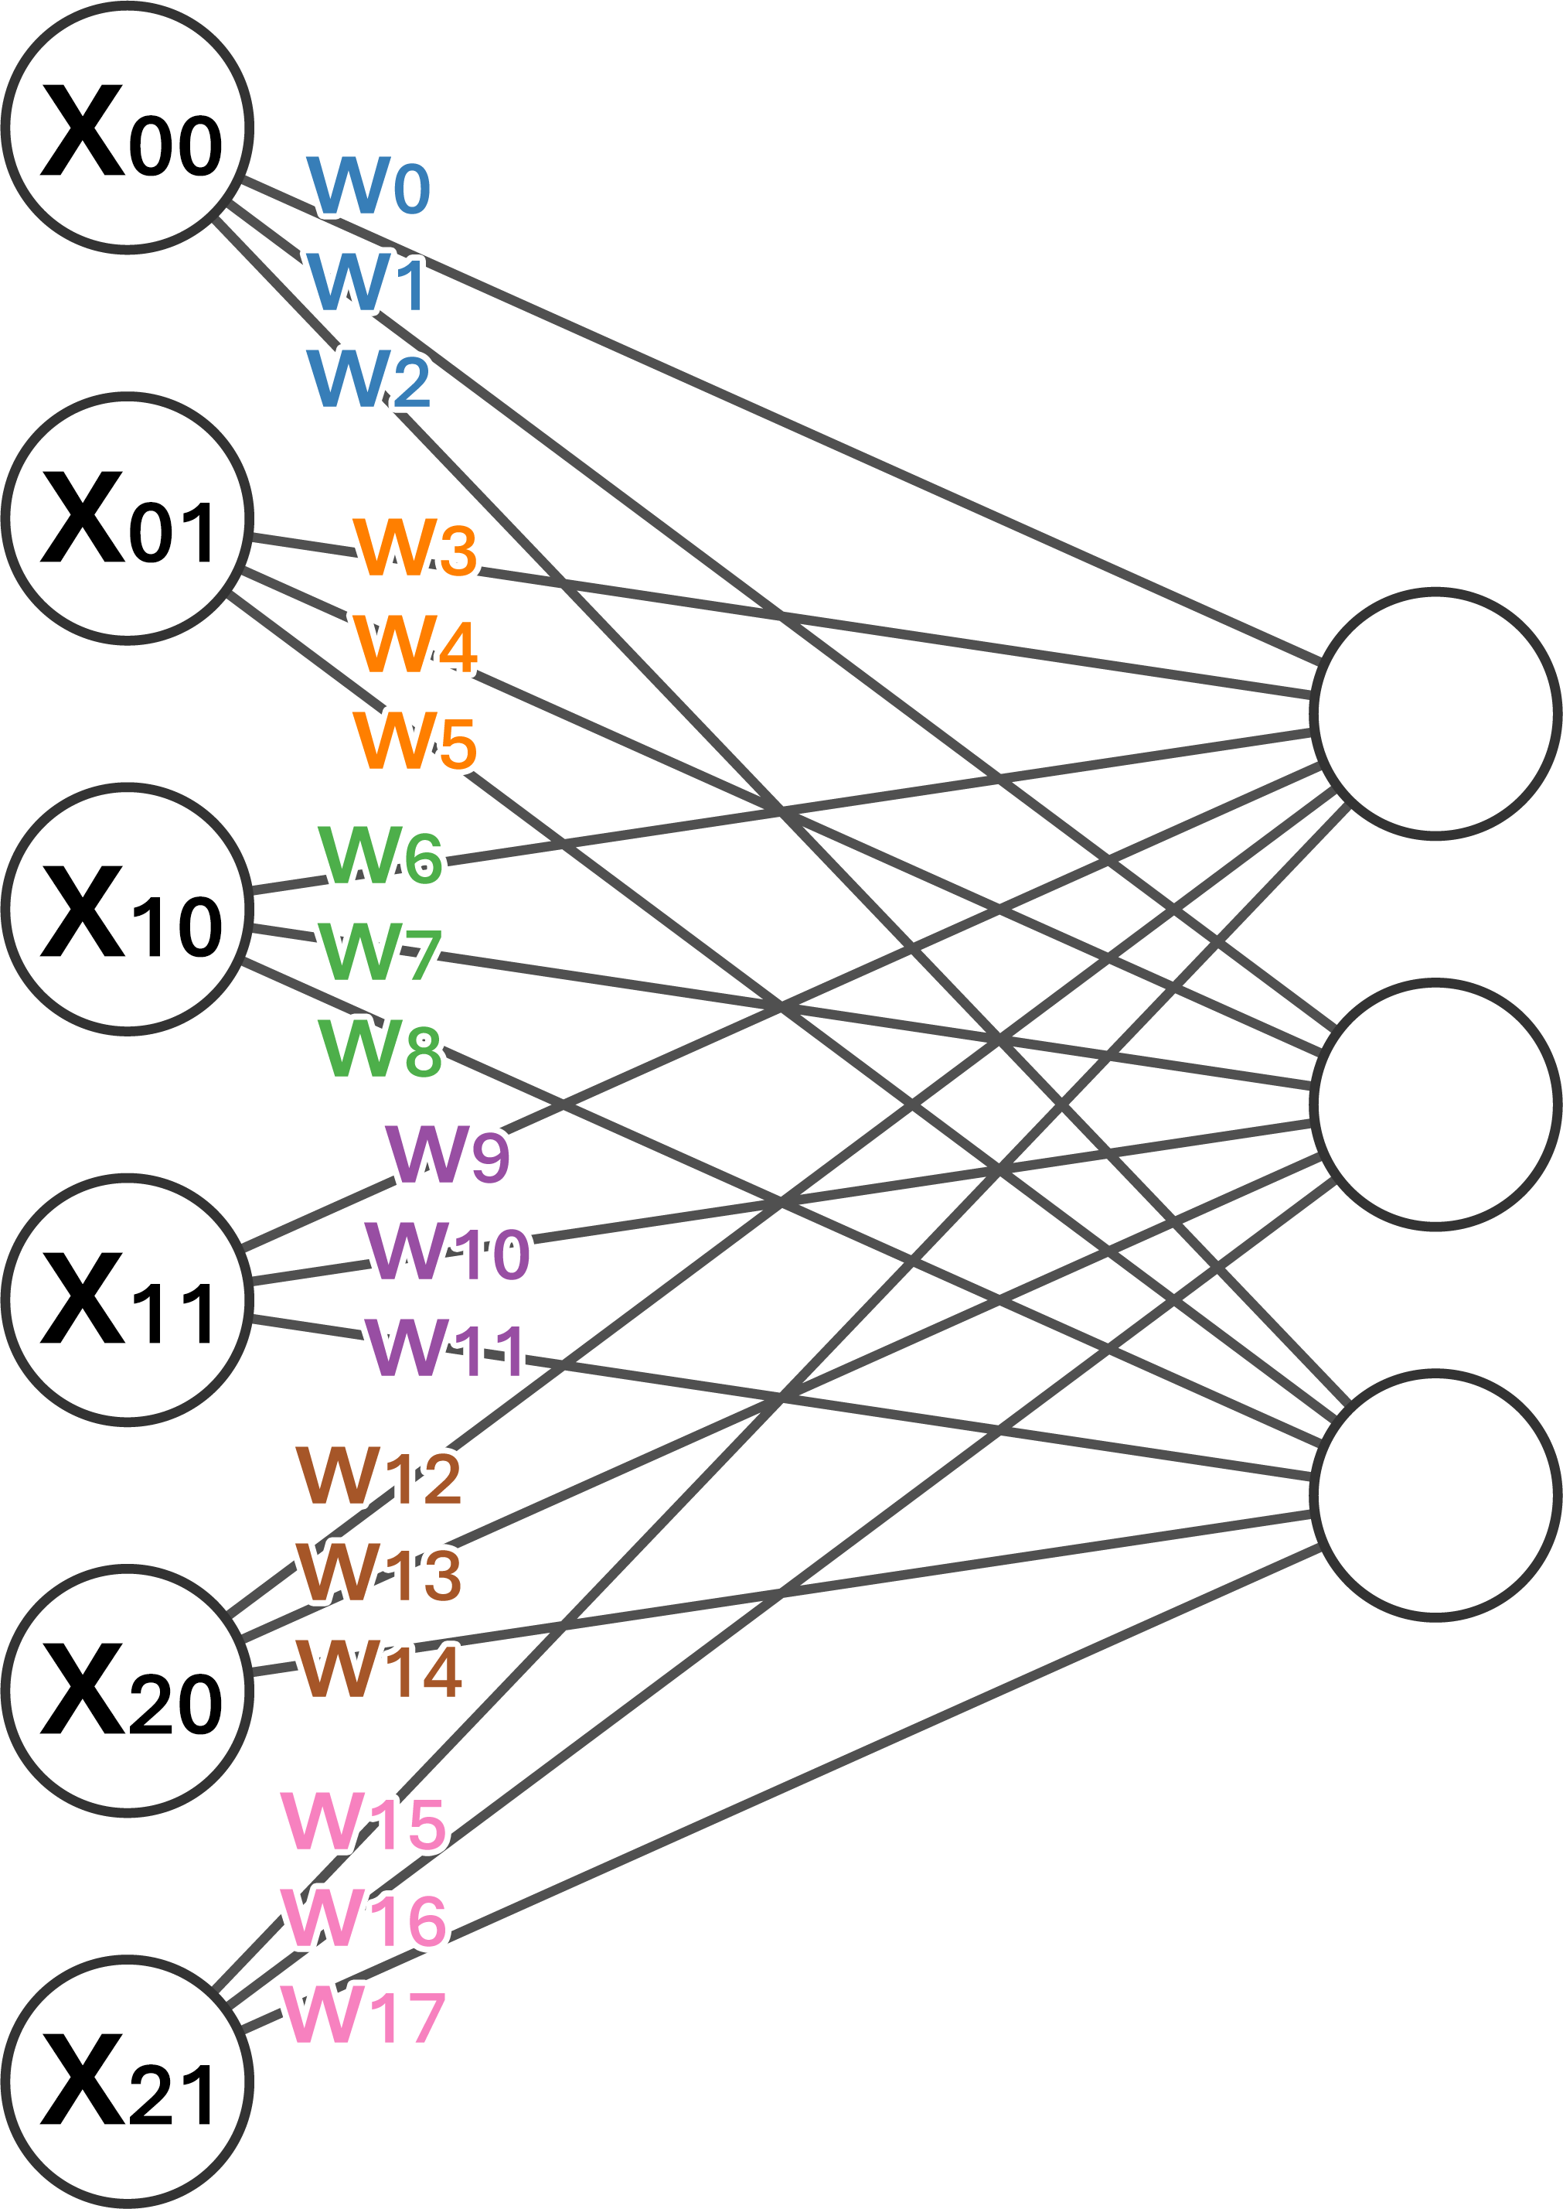
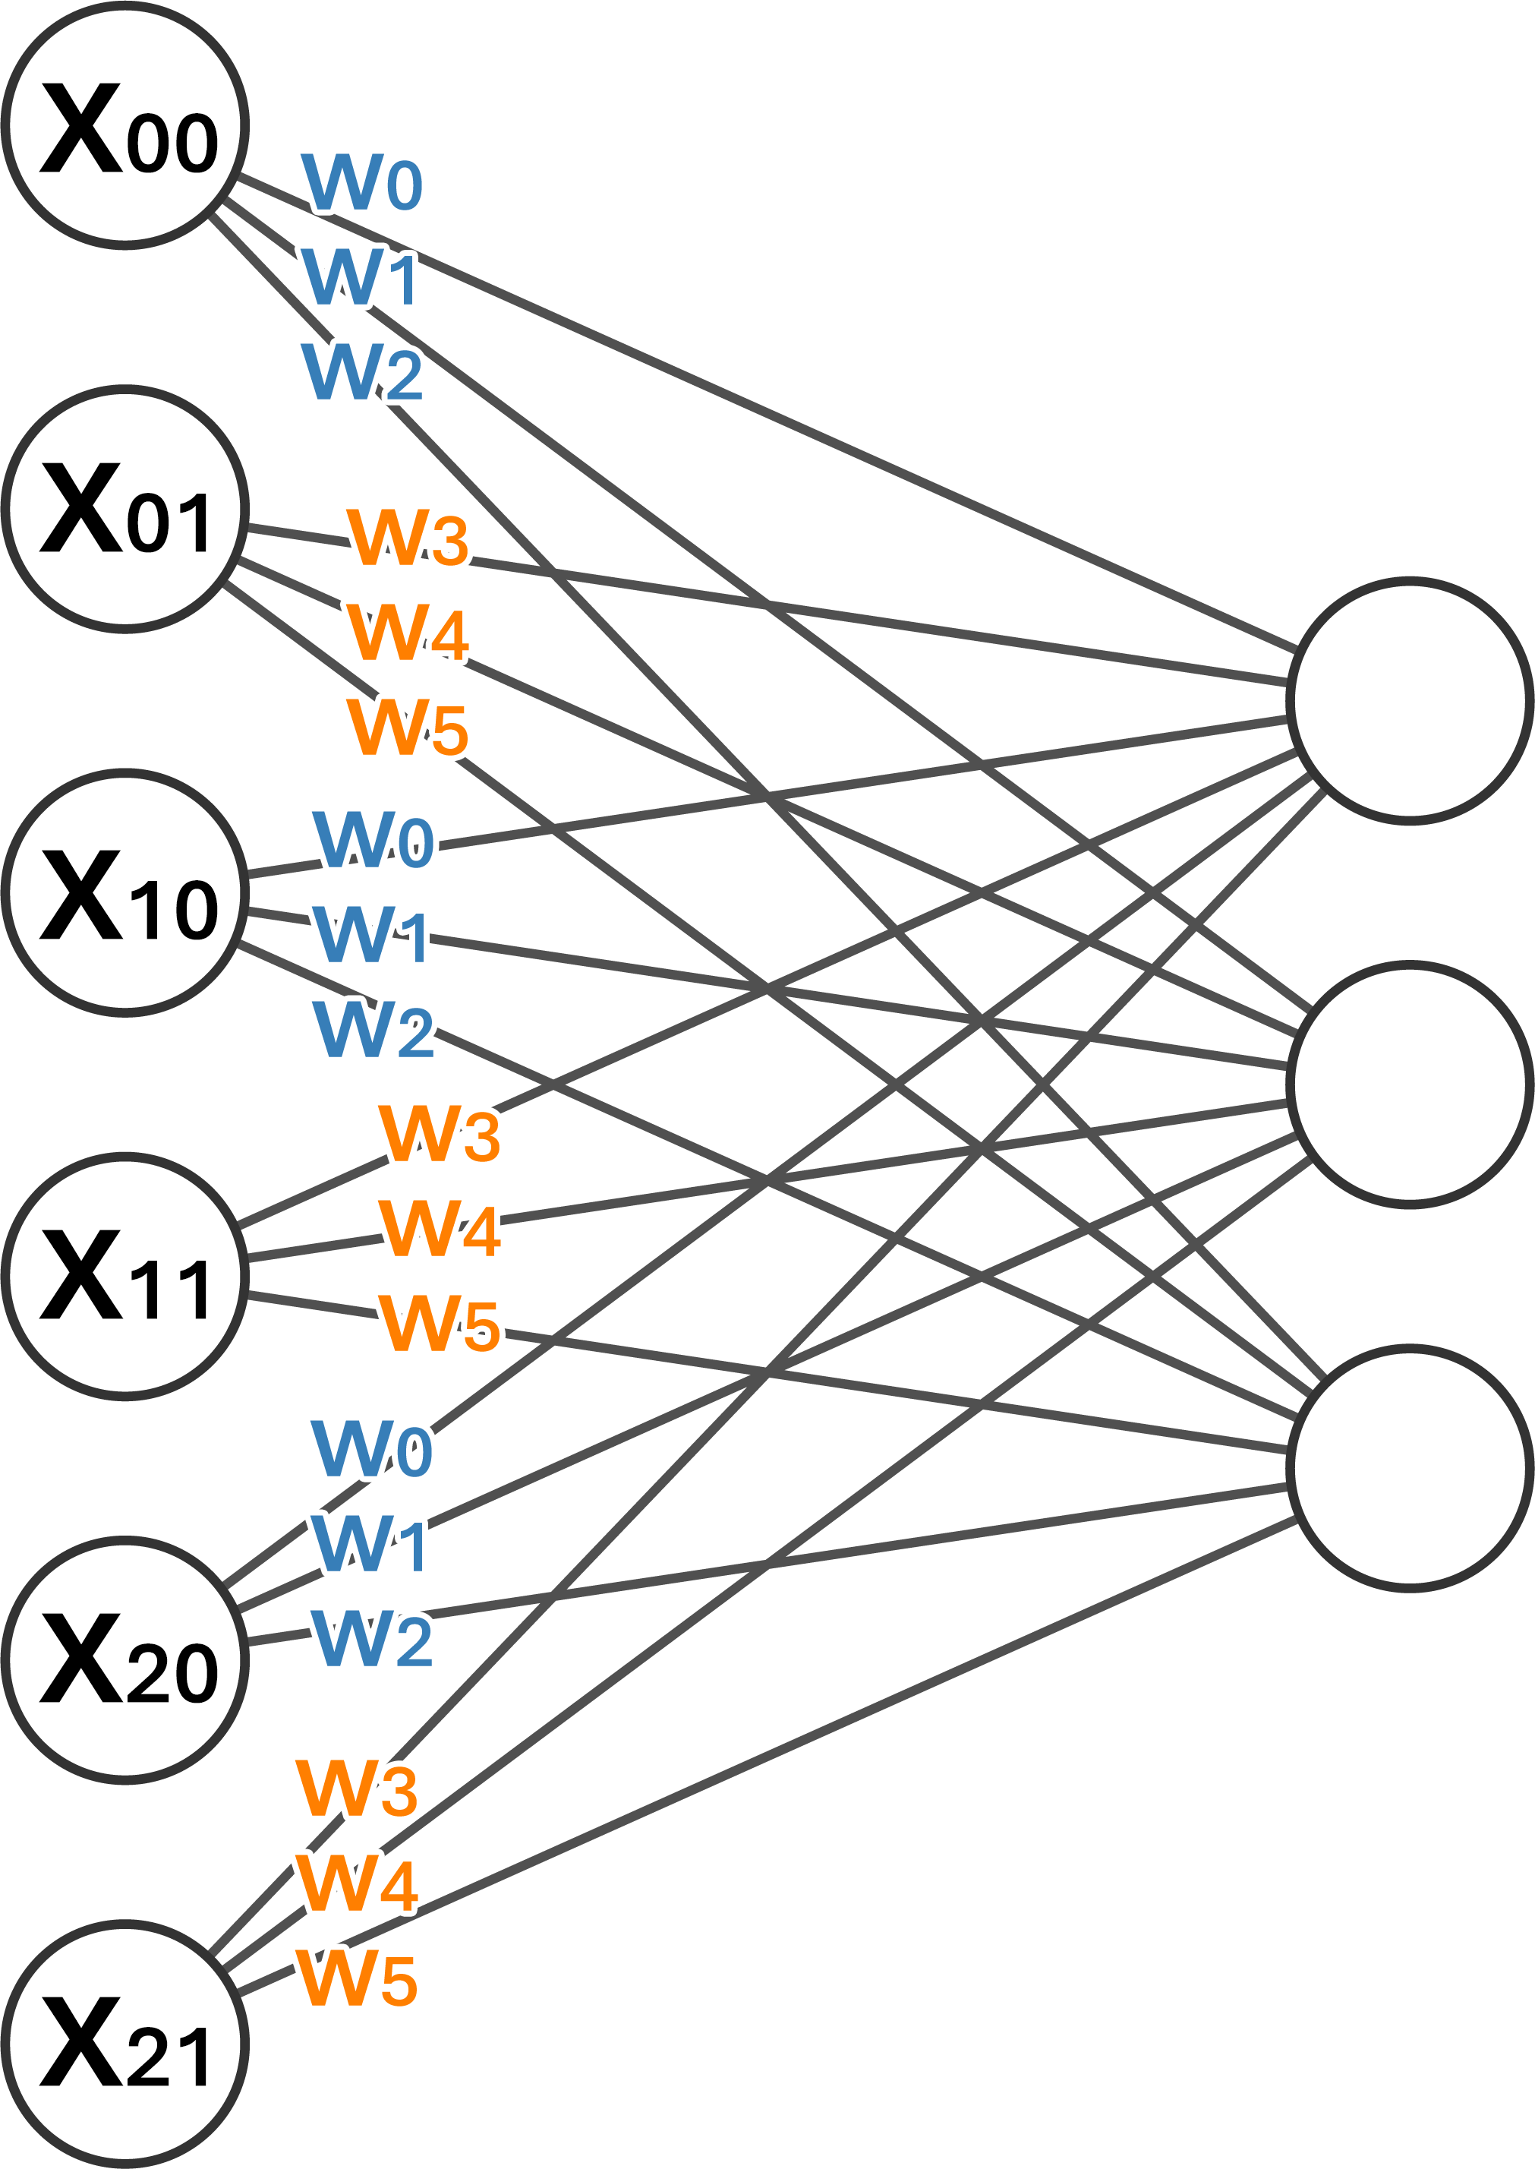
Row 0
Row 0
Row 1
Row 1
Row 2
Row 2
MLP
Shared MLP

