Slide 1
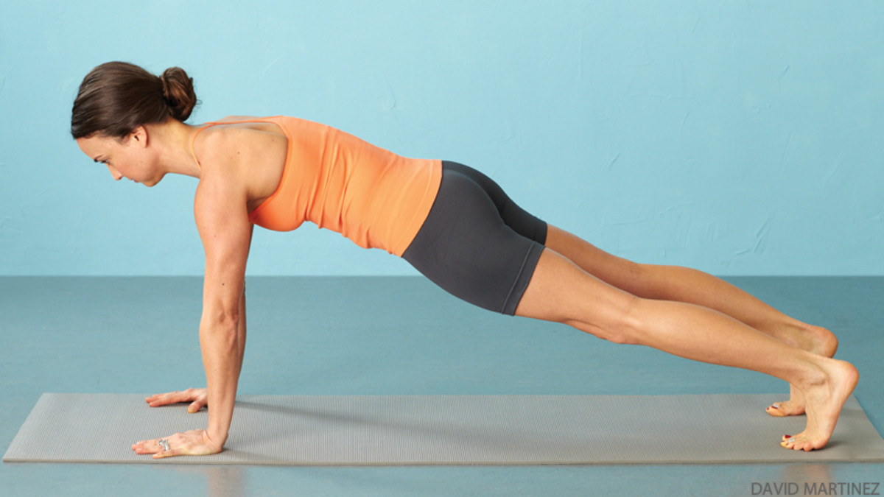
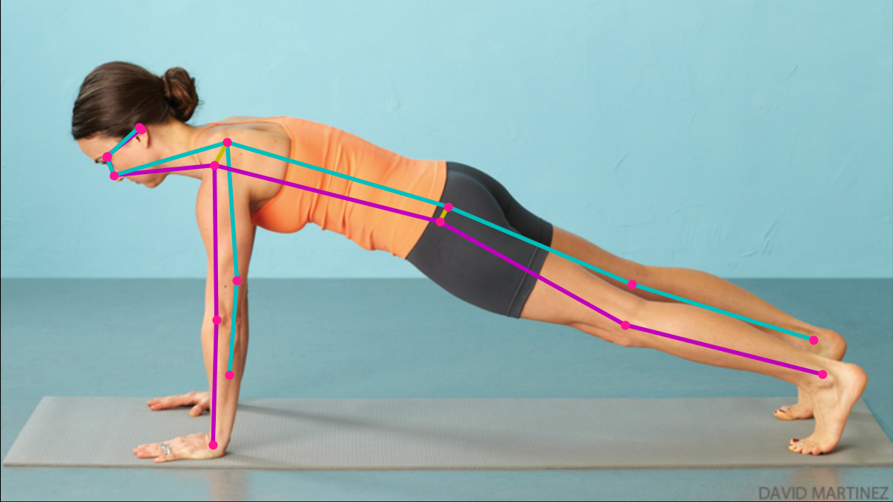
MoveNet or a similar model to extract the user's skeleton
A classification model (e.g., MLP, SVM, CNN)
[Output]
<current posture>
<corrective prompt for improper posture>

Slide 2
Pre-trained human pose detection model
Self-trained deep learning classification model
Output
<posture type>
<posture correctness / mistake category>
Stage 1
Stage 2
Raw input (image frame)
User’s body keypoints extracted

